Slide 1

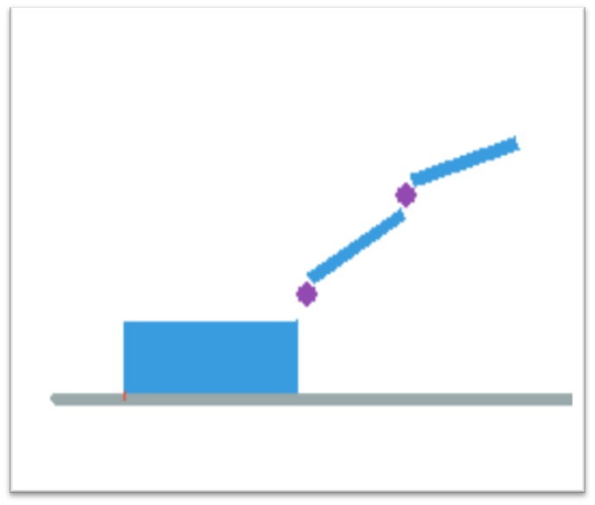
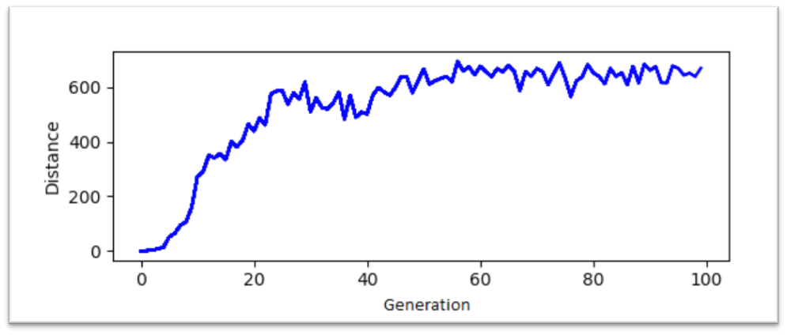
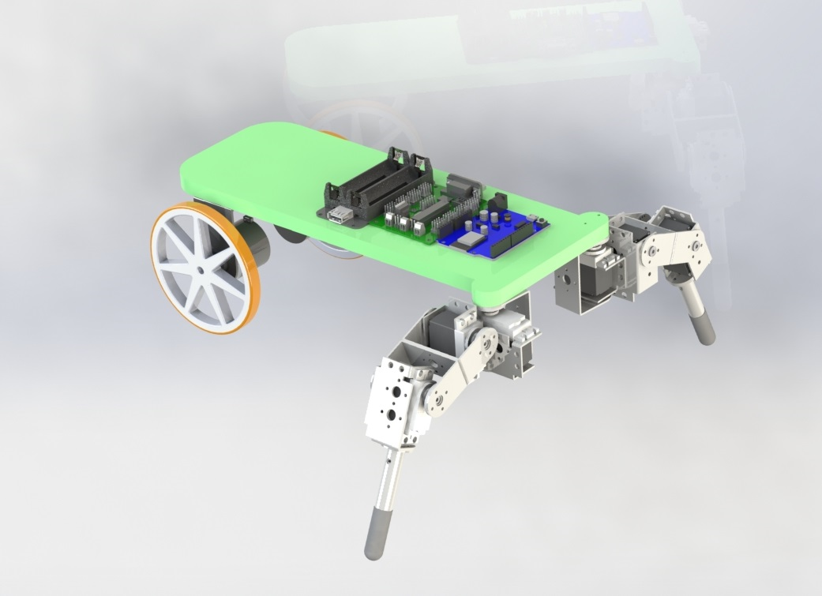
Artificial Intelligence for Walking Robot
Josh Davy | Mechatronics and Robotics BEng
Abstract
Traditionally the gait of legged robots are derived by an engineer based on what is seen in nature and on assumptions of what properties the optimum gait would have. This involves kinematic and dynamic analysis of the robot which becomes increasingly difficult with robots with greater degrees of freedom. Further, real actuators and joints are not ideal and are also difficult to mathematically model accurately. In this project the aim is to use machine learning techniques to allow a robot to develop its own gait free from human bias of what the optimum gait would look like. This technique means no kinematic or dynamic analysis of a robot is necessary, as the robot will attempt to learn a policy of moving its joints to optimise its gait.
sOMETHing about machine learning
Simulation
A very simple 2D simulation of a robot with a singular leg (A ”crawler” robot) was created to apply the hill climbing algorithm[reference] in order to test the theory and experiment with simulation software. The code is written in Python and makes use of Pymunk [11] a python wrapper for the Chipmunk physics simulation software. The gait was parametrised as 5 sets of pairs of joint angles (For each of the two joints in the leg). The gait is then formed by cycling through the pairs of joint angles. The policy is then evaluated by running the policy on the simulated robot five times and the fitness is the distance travelled. Variations of the policy are formed by varying each parameter with a Gaussian distribution (µ = θi , σ2 = 10) where θi is the current parameter value.
The 2D model robot used in the simulation.
Reference
Pic of experimental setup
Results
The robotic platform used for optimisation.
Robotic Platform
The physical robot needs to be specifically designed in order to suit the gait training process. Mainly there needs to be a way of accurately measuring velocity feedback from the robot legs. The design has two legs each with three degrees of freedom and at the rear and two wheels with mounted encoders. Several approaches to velocity feedback were considered such as a external tracker or ultrasonic sensor but the wheeled encoders allow the robot to train freely without any external requirements.
Supervised By Dr Craig A. Evans | School of Electronic & Electrical Engineering 2020

