Slide 1
National Youth Drug Use Survey
Josh Wilkes

Slide 2
Goals
Better understand the predictors that would increase risk of drug use at an early age
Looking specifically at cigarette use started at a young age leading to increased risks in cancers and cardiovascular disease

Slide 3
Methodology
4 primary methods were used during analysis
Decision tree
Splits data recursively based on predictor values to minimize variance
Each node represents a split where a value or class will determine if one outcome is more likely
Tuning is achieved by changing the complexity parameter which puts a threshold of how much error is reduced to keep the model
These are simpler to interpret but can be prone to overfitting
Random Forest/Bagging
Builds many trees where the values are added together to create shared decision tree
This leads to higher data that is less prone to overfitting but is also less interpretable
Performance is assessed with out of bag error
Tuning can be done by changing the number of trees generated and the amount of predictors that are used (Bagging uses all of the predictors)
Random Forest can be interpreted with feature importance
Boosting
Builds many trees similar to random forest but allows better performing trees to have a larger impact on prediction
Performance is assessed by tracking test and training errors over several iterations
Tuning is performed by changing the number of trees and and shrinkage which controls the amount of time to train
Can be interpretated with feature importance and partial dependence plots.

Slide 4
Demographic Predictors Used for Each Model
Binary sex (male, female)
race (7 categories)
overall health (4 categories)
Enrolled in school (yes, no)
Current Grade in School (11 categories, blank/skip)
Number of days skipped school in past month (1-30, blank/skip) (Any value above 30 was set to NA
Is a mother present in the house (yes, no, don't know, over 18) Over 18 was set to NA
Is a father present in the house (yes, no, don't know, over 18) Over 18 was set to NA
Total family income (4 categories)
Gov assistance (yes, no)
poverty level (4 categories)
Population density (>1M people, <1M people, can't be determined) Cant be determined set to NA
Metro size status (large metro, small metro, nonmetro)

Slide 5
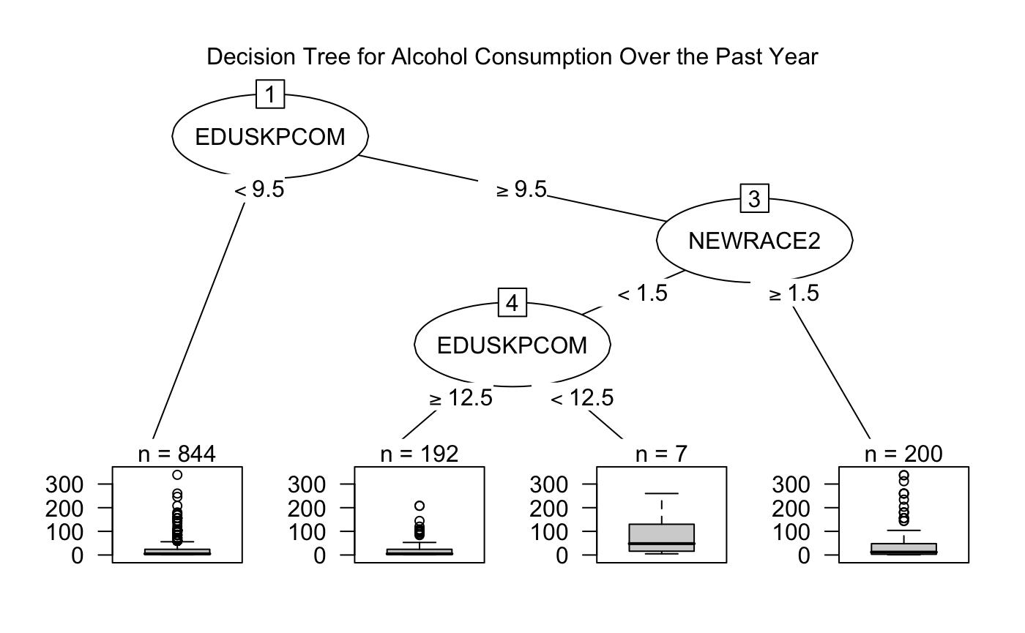
Evaluating Alcohol consumption in days per month

Slide 6
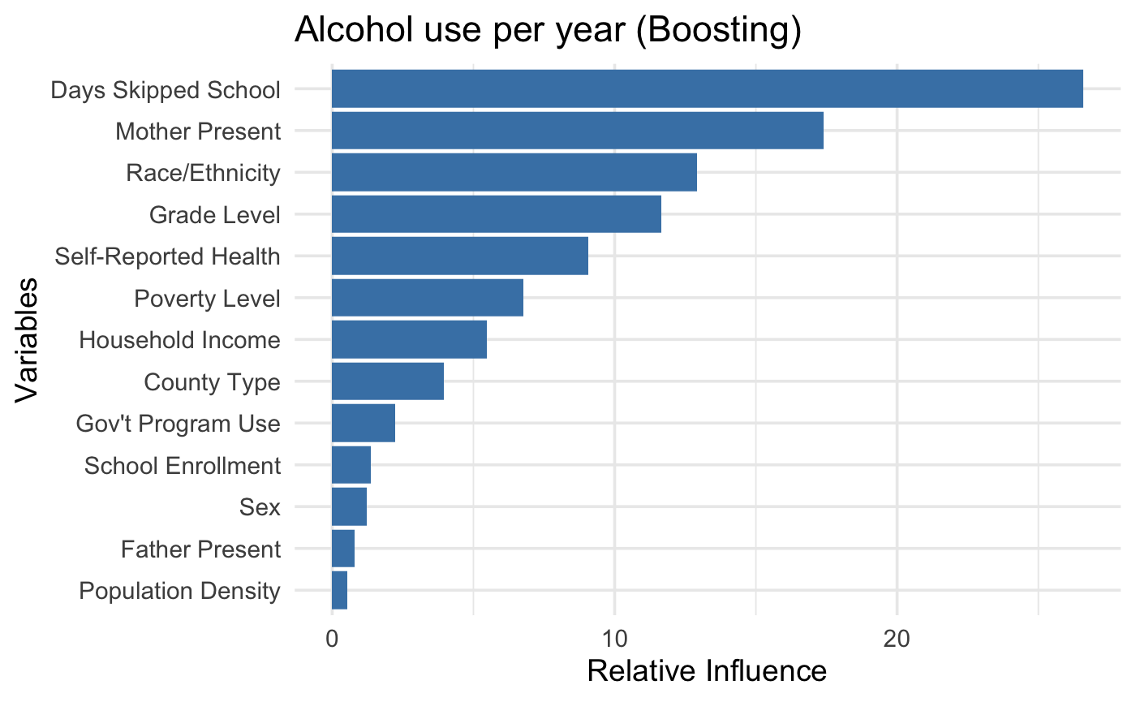
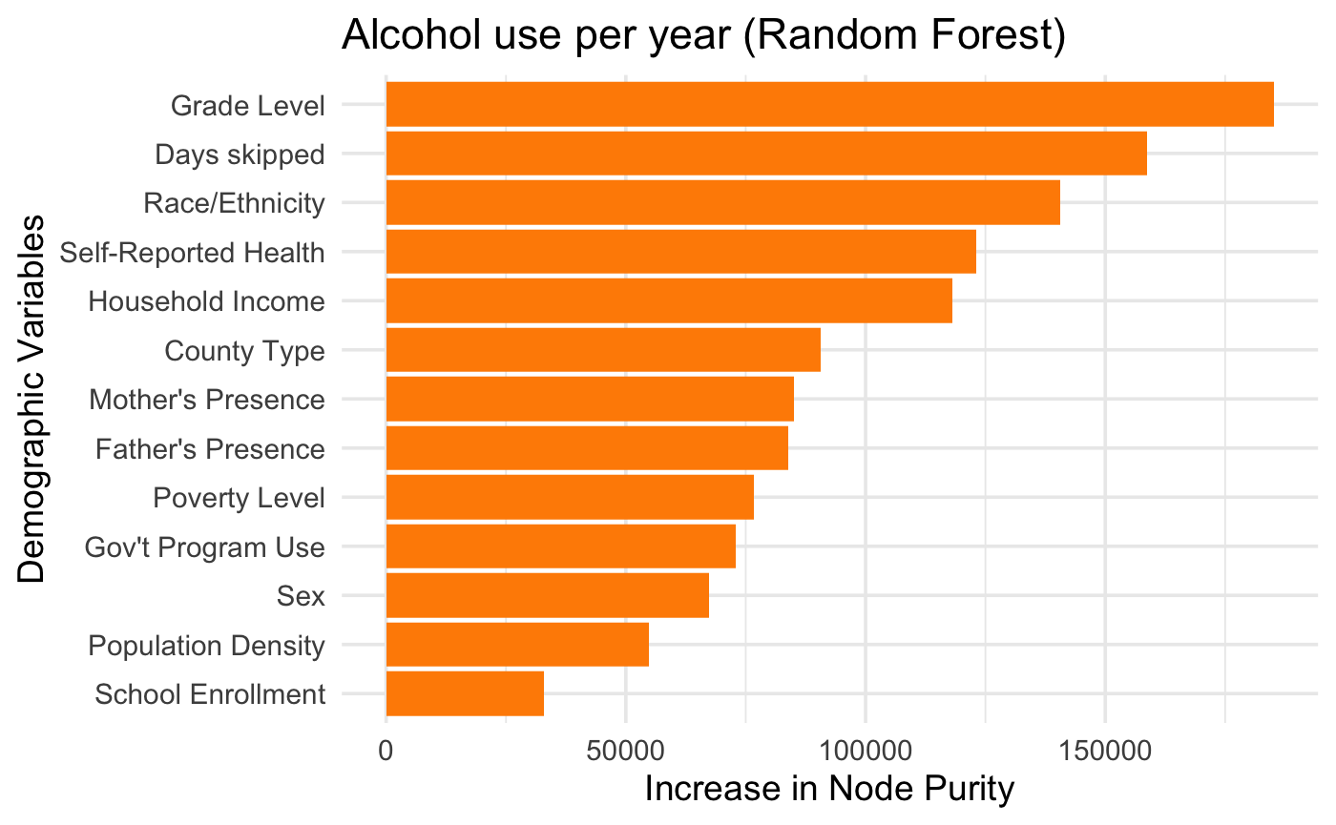
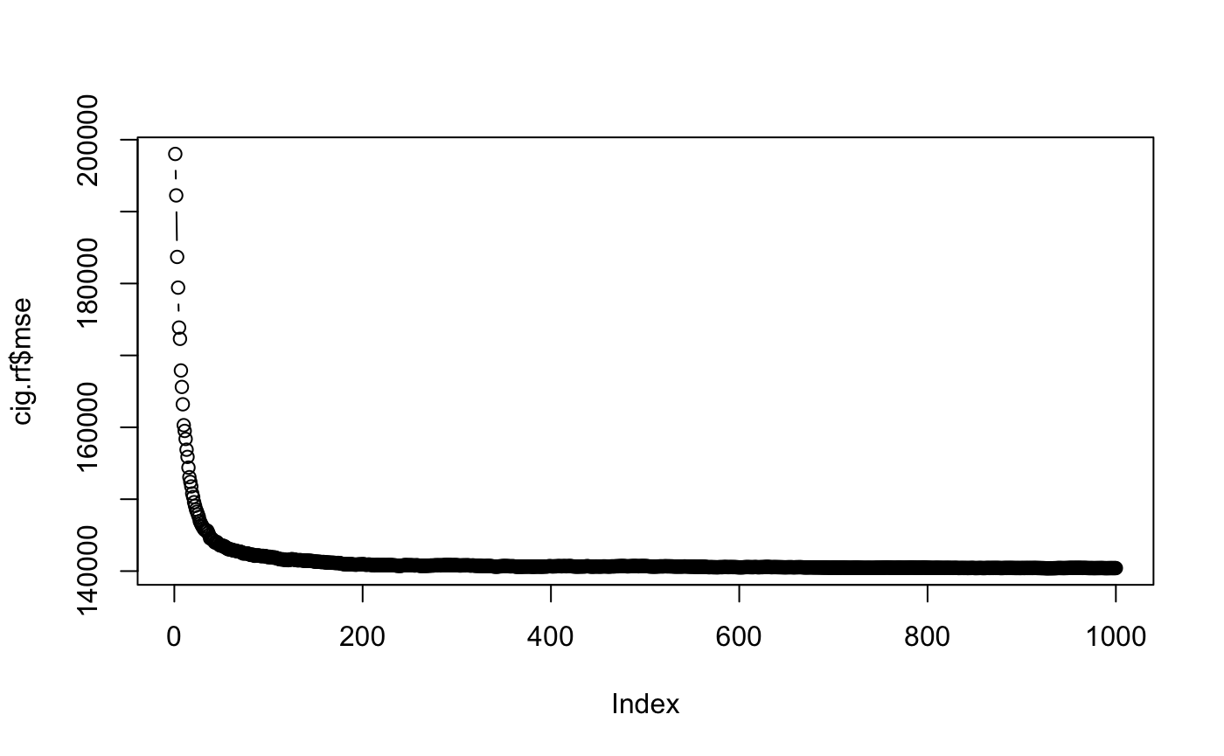
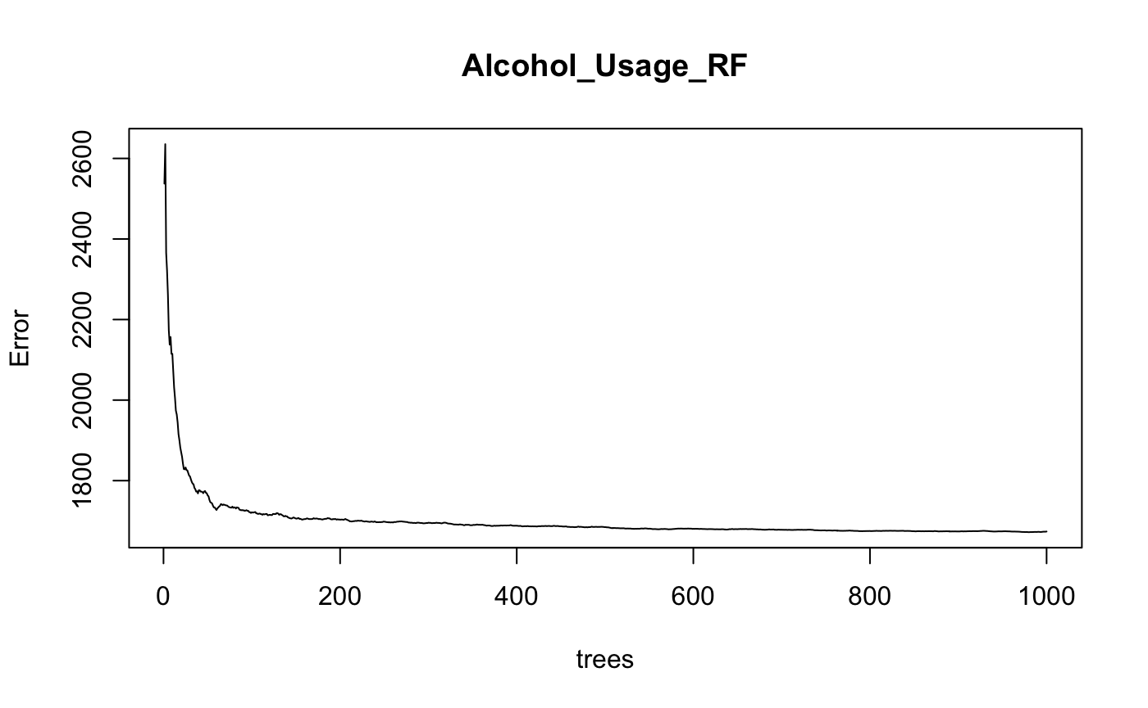
Using Random Forest and boosting for evaluating Alcohol consumption
"Boosting RMSE: 40.49"
Number of trees used: 300
"Random Forest RMSE: 41.65"
Number of trees used: 500

Slide 7
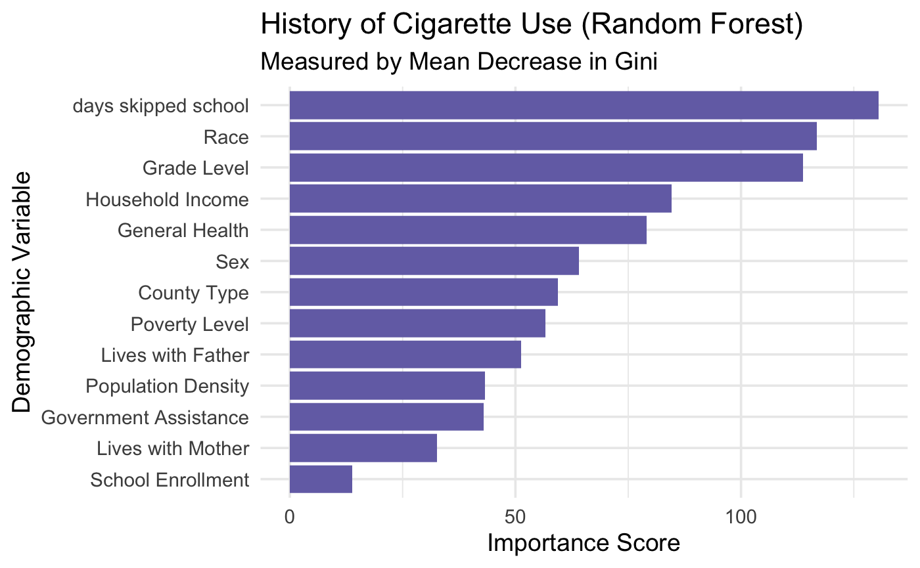

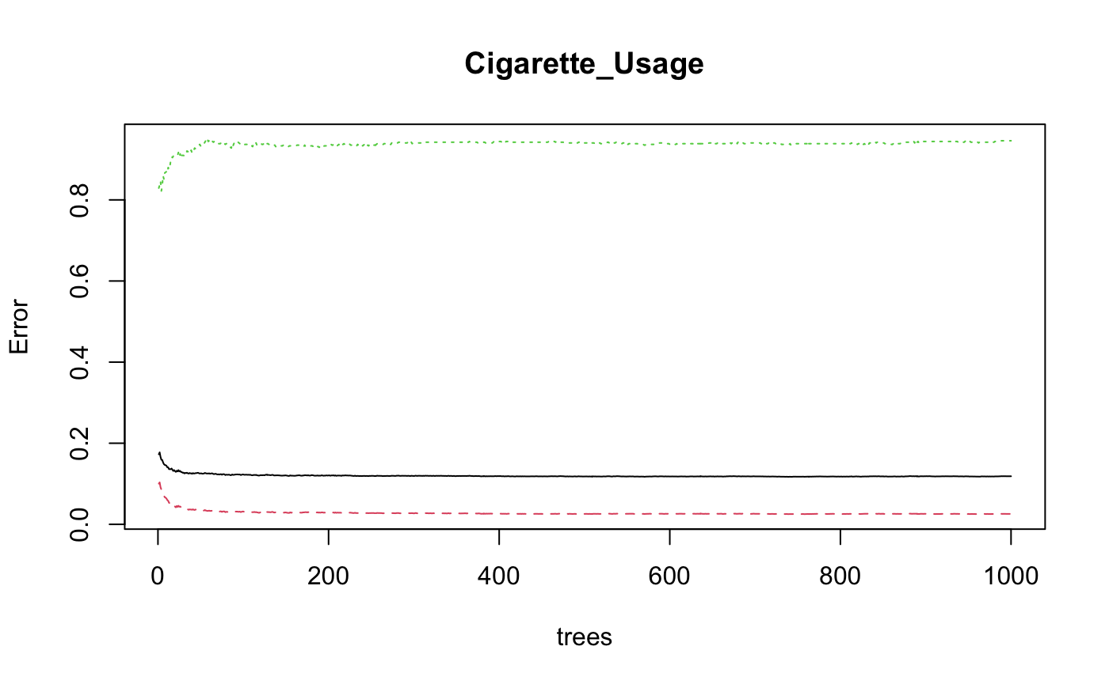
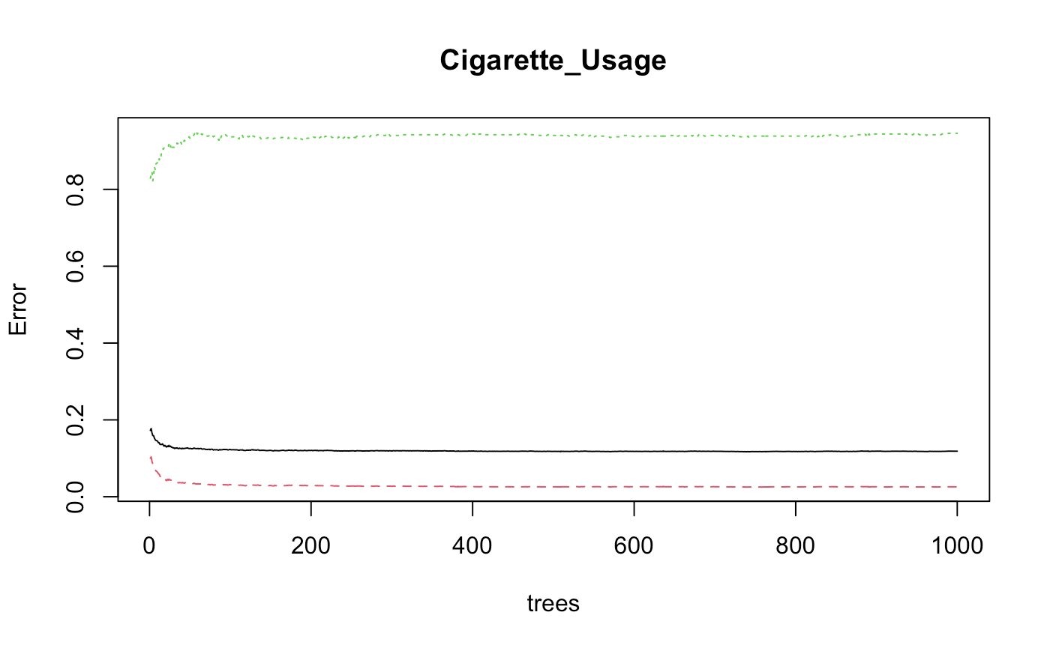
Comparing random forest with Bagging for History of Cigarette use
Number of trees used Bagging (left): 100
RMSE: 10.2%
Number of trees used Bagging (left): 100
RMSE: 8.2%

Slide 8
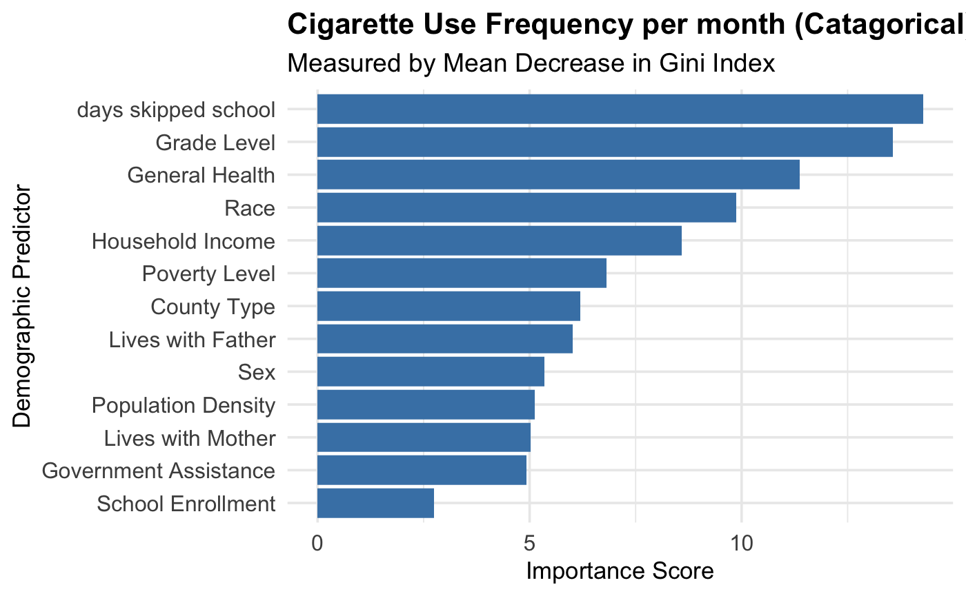
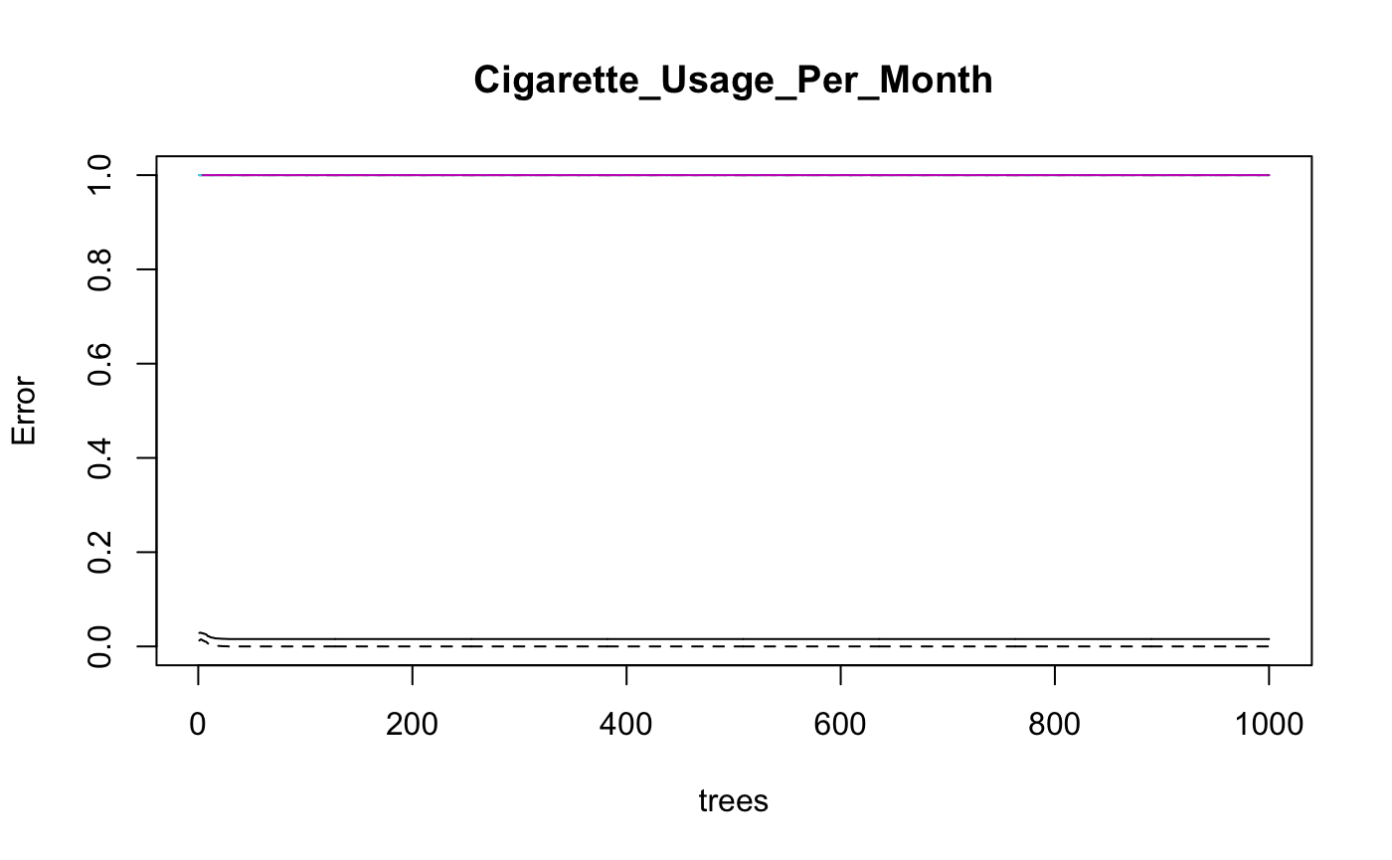
Looking at categorical Frequency of cigarettes per month
Number of trees used Bagging (left): 100
RMSE: 1.24%

Slide 9
Discussion
We can see a large clustering of predictors that are Race, days skipped school, grade level, and Health
Mother present was shown to have importance in once model although did not show up again.
Health may be linked closer to the long-lasting effects of using these drugs (especially in the instance of smoking cigarettes) This might not be a good predictive factor
Income was associated with the presence of smoking which might suggest at a link between SES and the habit so smoking

