Slide 1
Keccak/Sha3 Cryptographic hashing
Josh Wretlind
MATH 440 – Parallel Scientific Computing
11/21/2013

Slide 2
Overview
What cryptographic hashing is
Performance vs Security tradeoff
What hash functions are there, why SHA3/Keccak?

Slide 3
Overall SHA3
Main driver is output width and lane size
SHA3-X represents SHA3 with output length of X
Typically 256 or 512
Lane width = 2^(lane size)
SHA3 specifies a state array of 5*5*lane width
Capacity is double the output width
The rate at which bits are taken into the state is 5*5*lane width – capacity

Slide 4
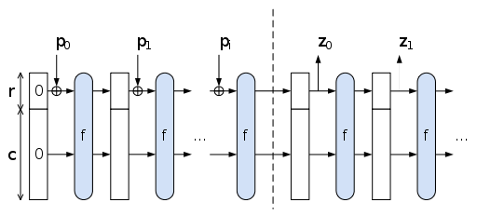
How does SHA3 work?

Slide 5
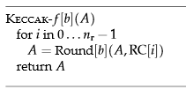
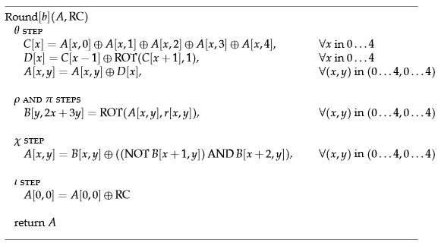
How SHA3 works pt 2

Slide 6
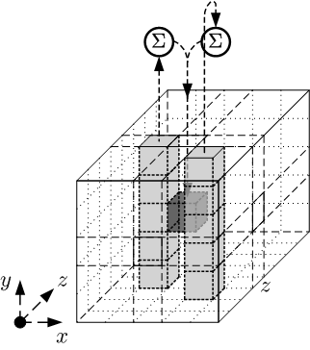
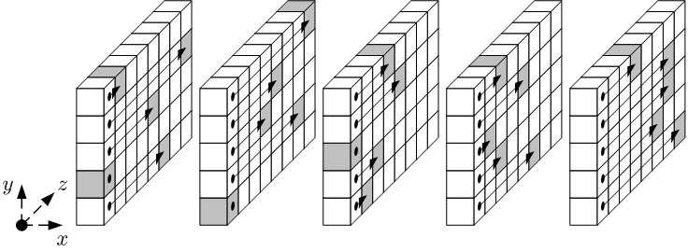
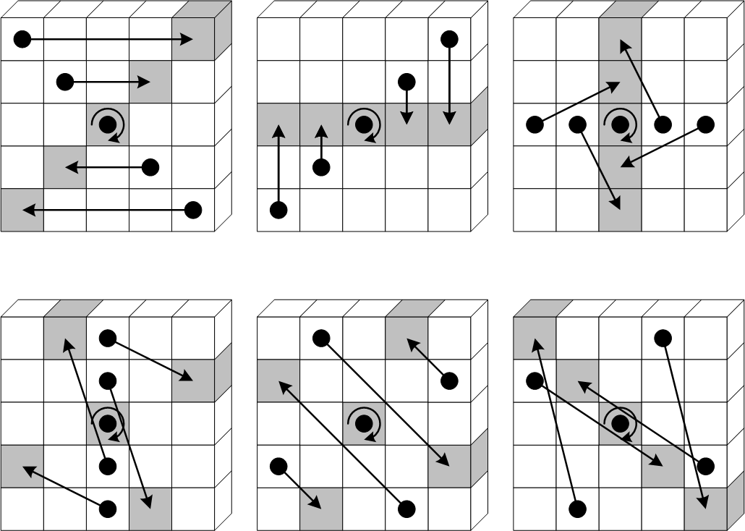
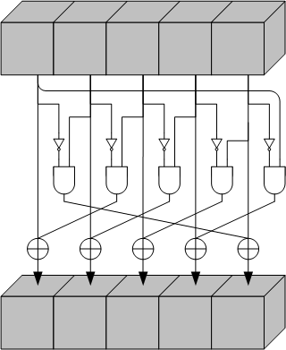
SHA3 round steps

Slide 7
Performance Results
Speedup using SHA256 and 1MB of input:

