Slide 1
Wind Turbine Failure Analysis - Project
EDA Insights Summary

Slide 2
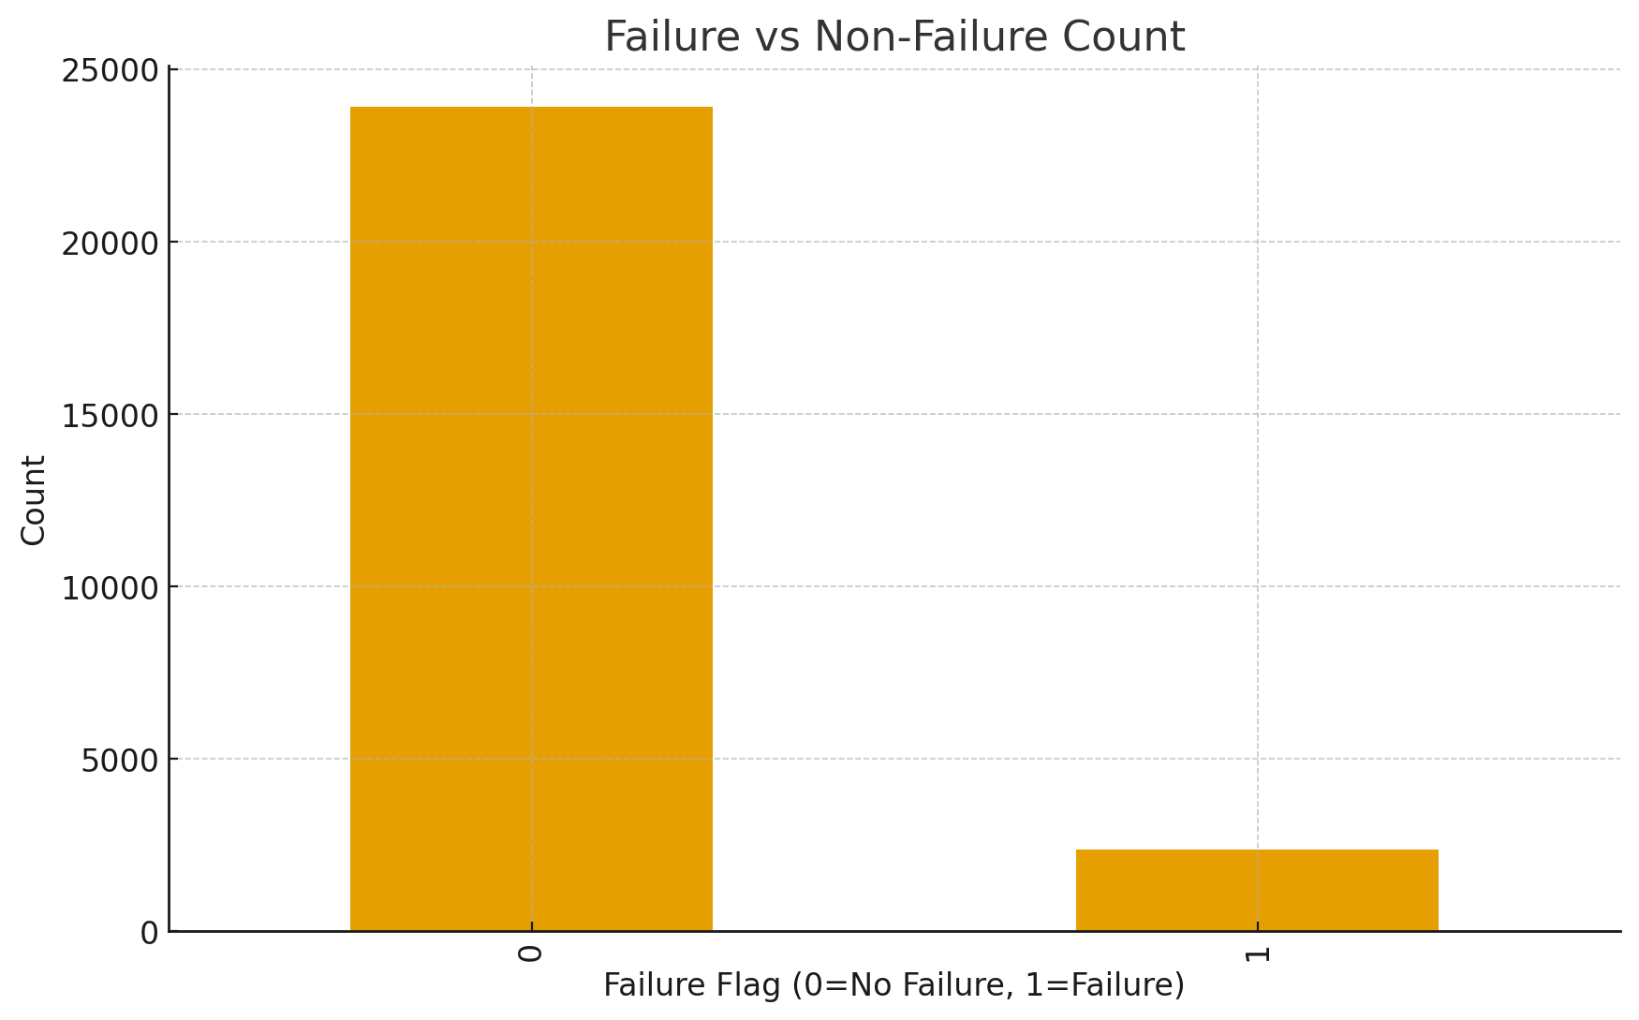
Failure vs Non-Failure Distribution
#1 — Failures are rare
Most of the records are normal (non-failure).
- So failure is a rare event (imbalanced dataset)

Slide 3
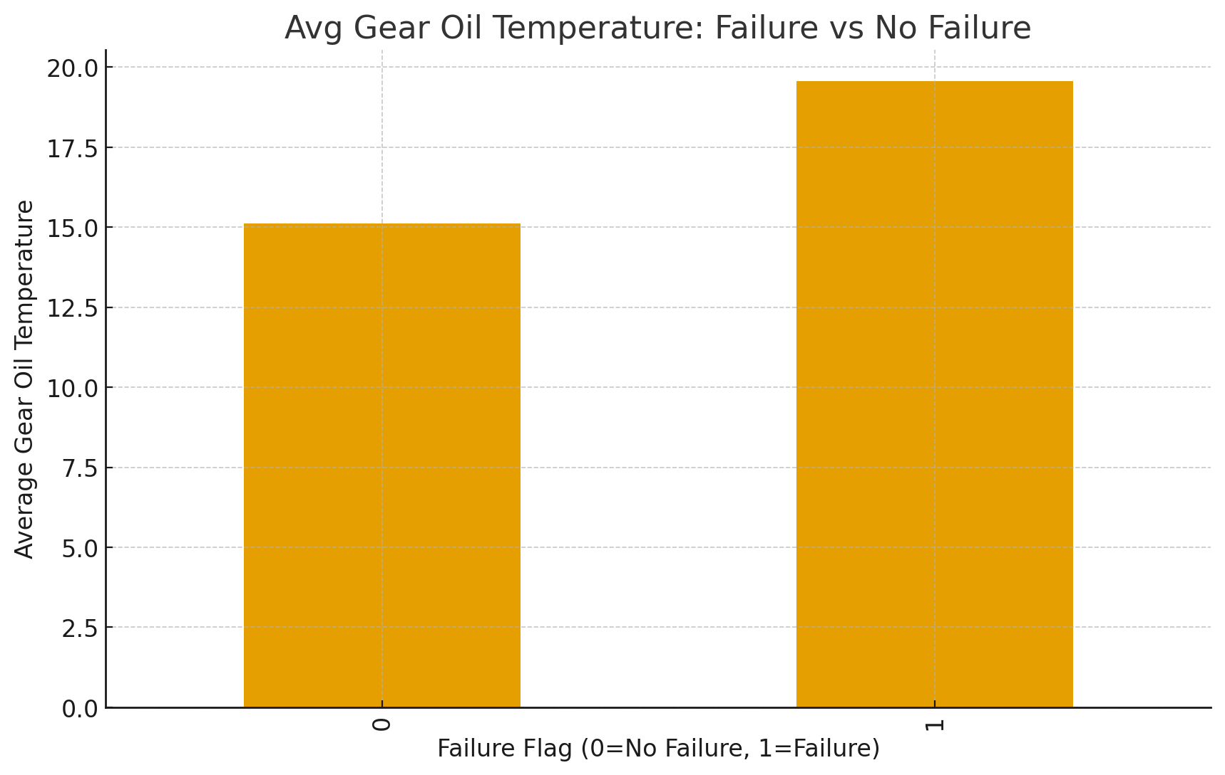
Gear Oil Temperature vs Failure
Average Gear Oil Temperature :
Condition | Gear Oil Temp
No Failure | ~15°C
Failure | ~19.6°C
→ Big temperature spike before failure
→ Gearbox lubrication breaking down → mechanical friction increasing

Slide 4
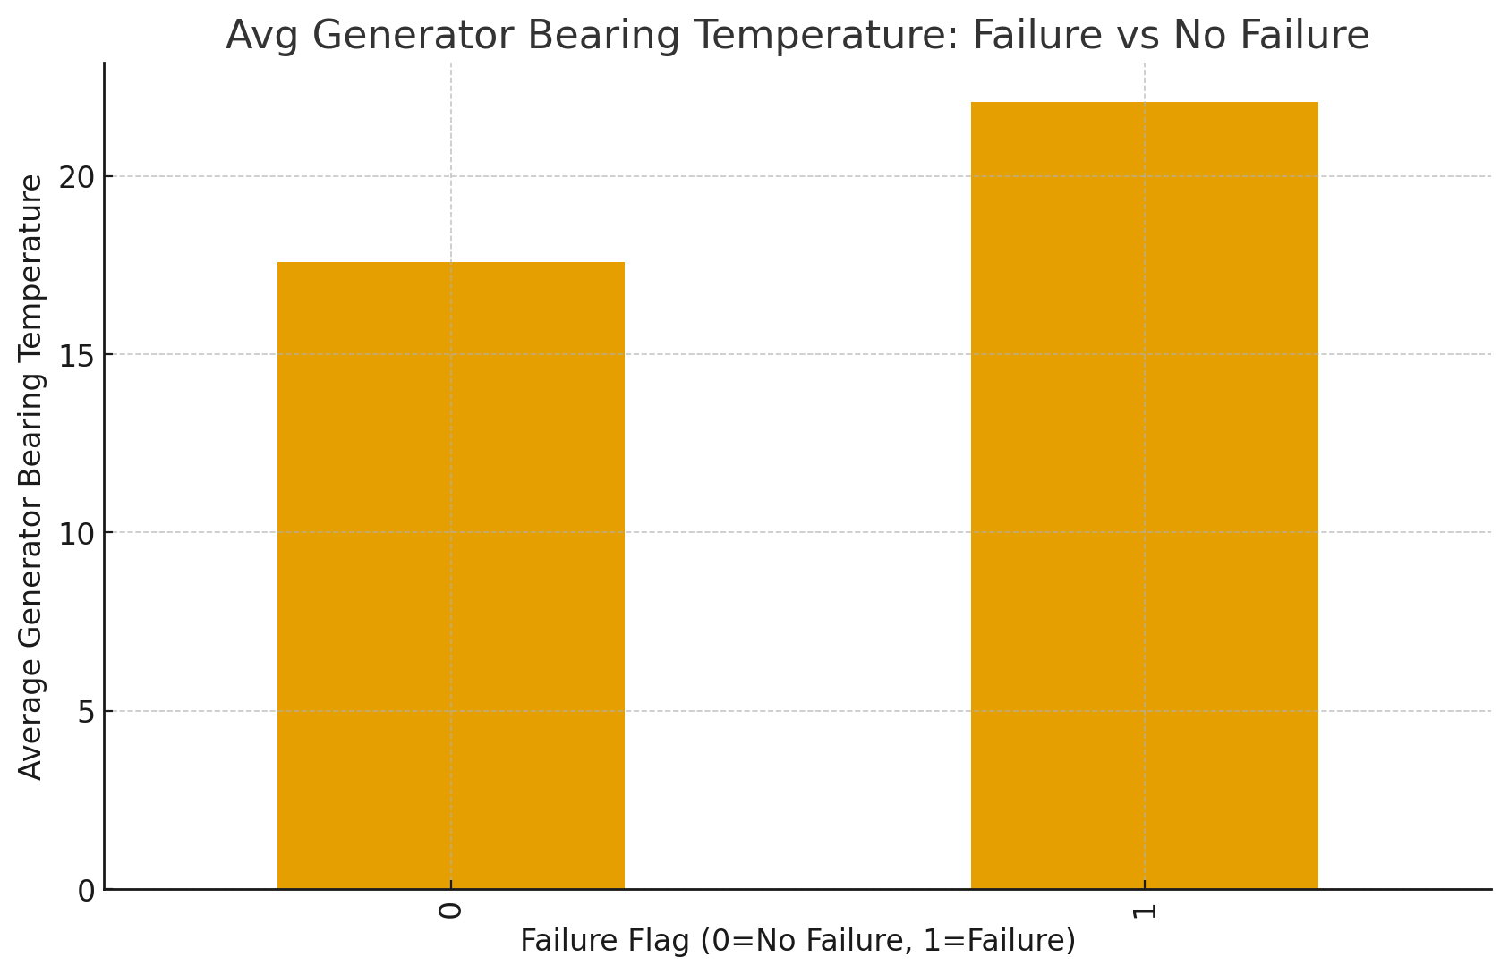
Generator Bearing Temperature vs Failure
Average Bearing Temp:
→ Bearings overheating → internal mechanical stress
This confirms a consistent thermal pattern.
Condition | Bearing Temp
No Failure | ~17.6°C
Failure | ~22.2°C

Slide 5
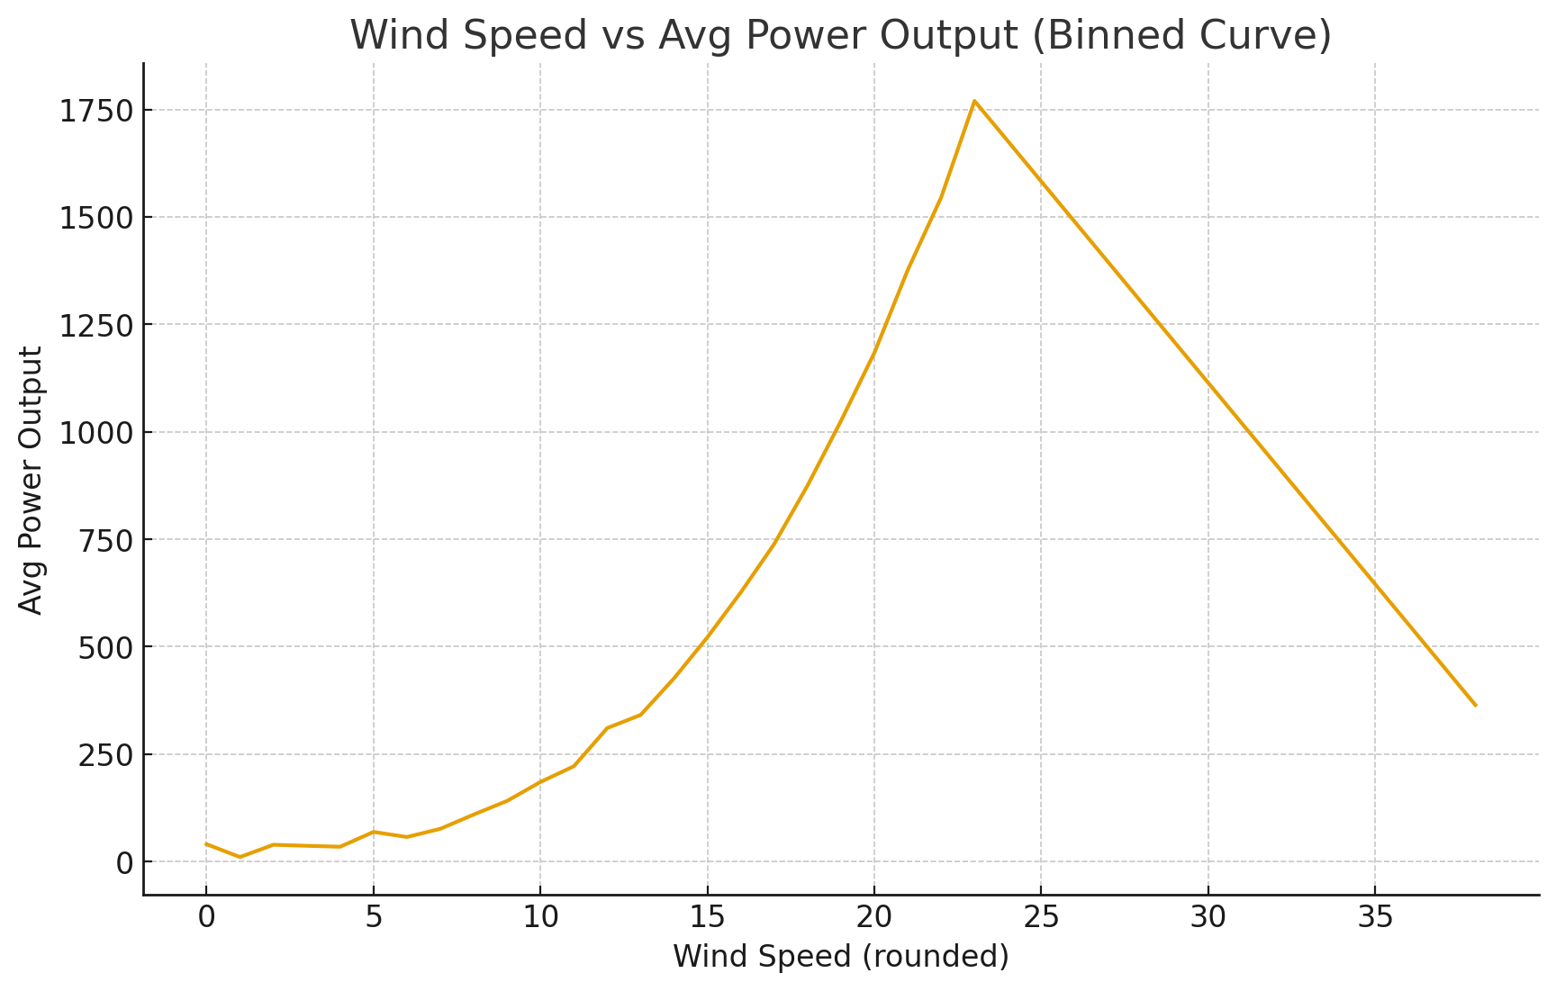
Wind Speed vs Power Output
As wind speed rises:
0 – 8 m/s → low power
8 – 20 m/s → power increases sharply
~23 m/s → TURBINE PEAK POWER
25 m/s → power drops again (safety cut-out)
→ This proves the dataset is realistic (this is how real turbines behave)

Slide 6
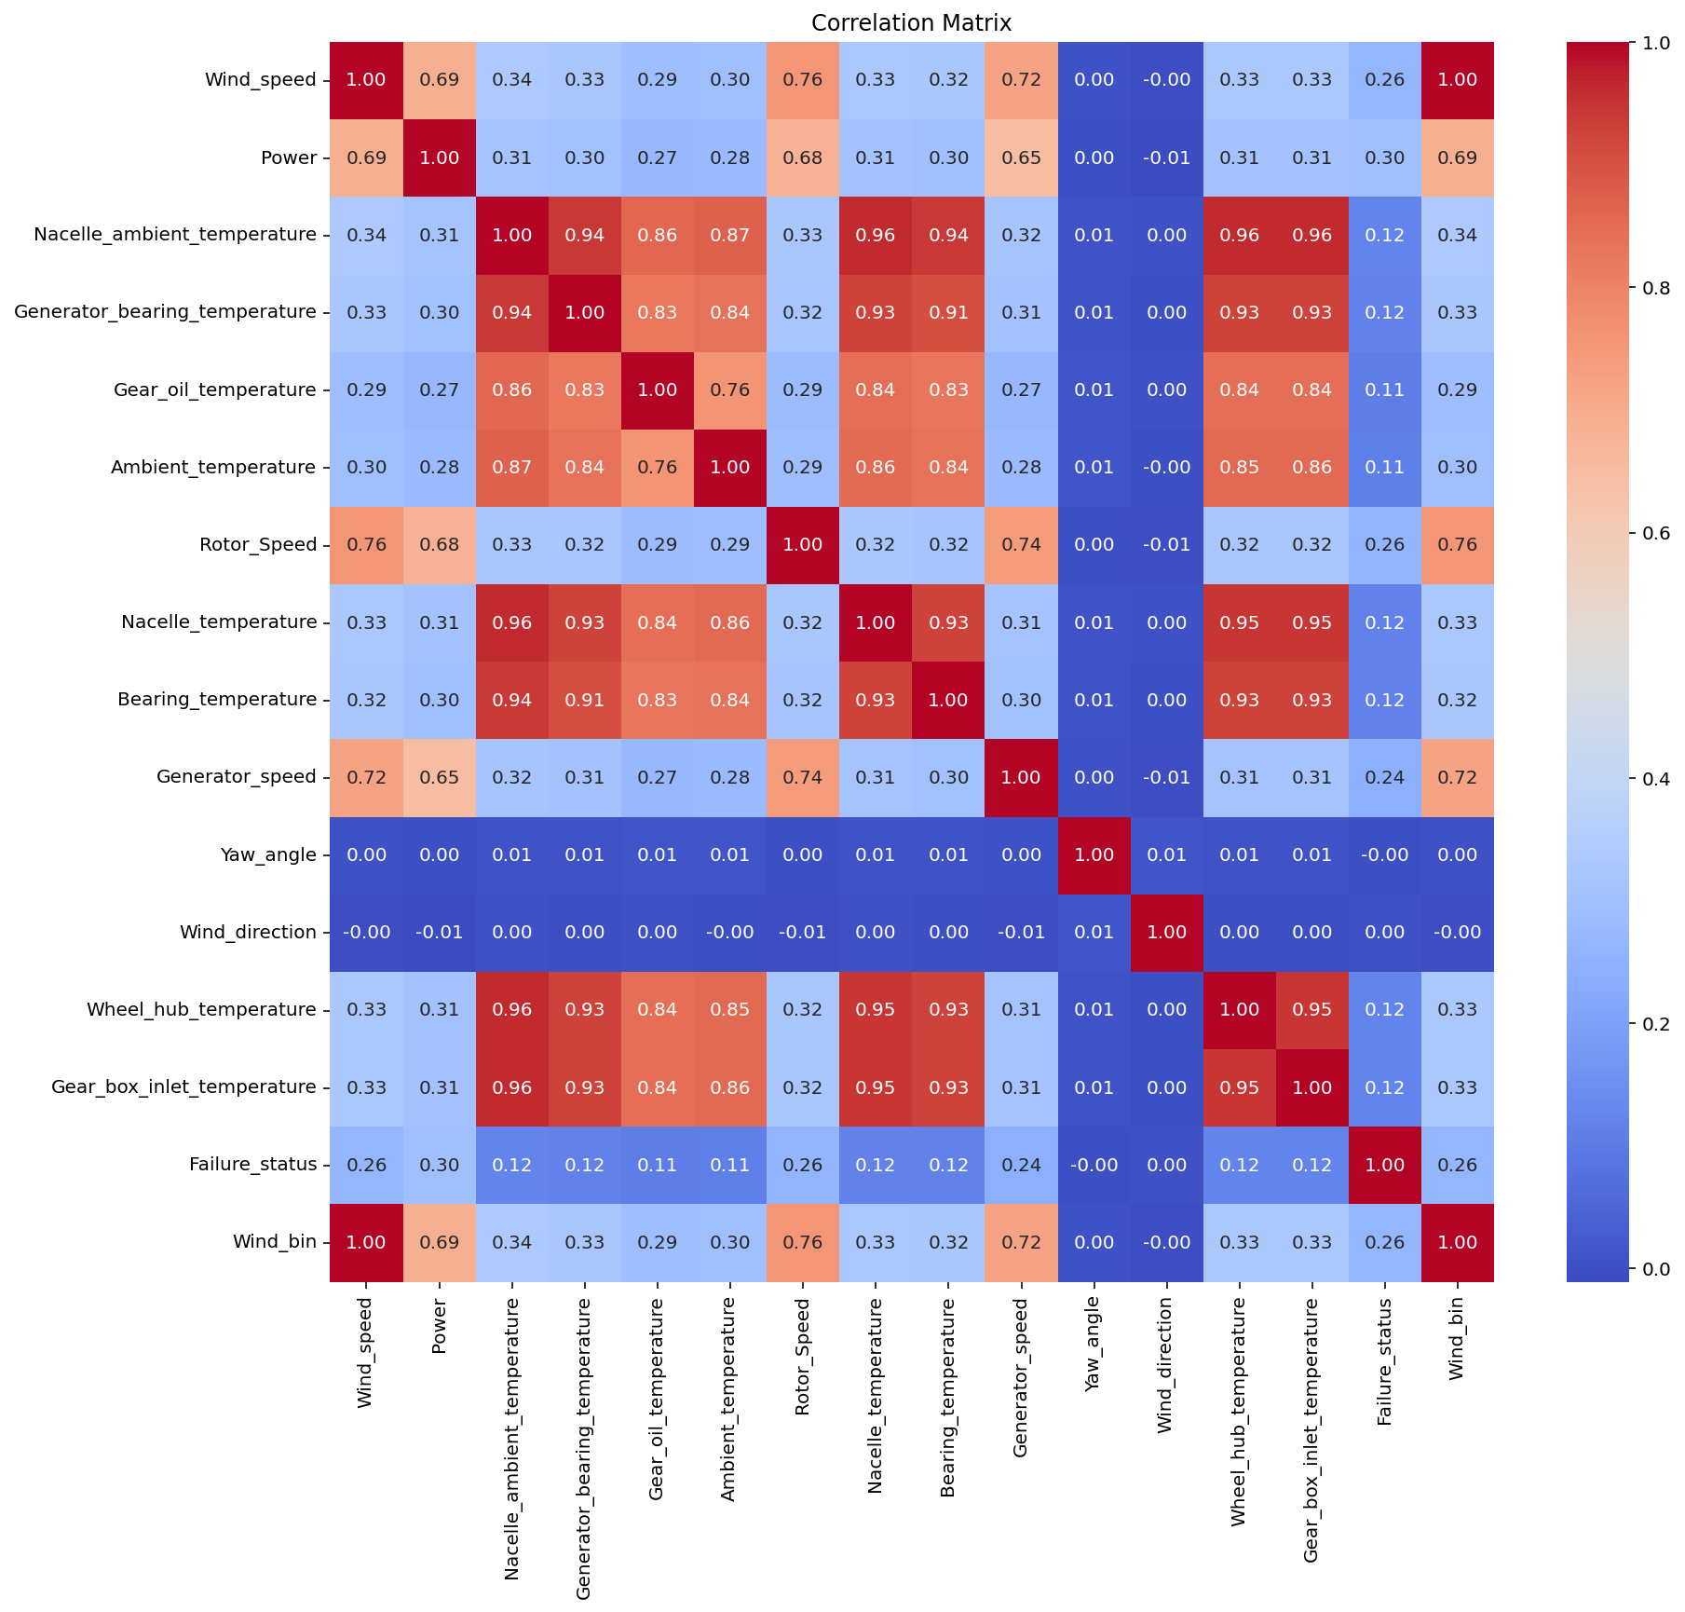
Correlation and Feature Insights

Slide 7
Thermal sensors have the strongest relationship with failure
Correlation heatmap showed:
Sensor | Correlation with Failure
Gear Oil Temp | High
Bearing Temp | High
Wheel Hub Temp | High
Nacelle Temp | Medium
→ Temperature is the best failure predictor
Wind speed / yaw / direction → weak failure link

Slide 8
Key Insights
Failures are rare in dataset.
Turbine components(Gear Oil & Bearing Temps ) heat up before failing.
Wind vs Power curve realistic: peaks ~23 m/s .
Thermal sensors = strong predictors of failure.

