Slide 1
STANZOE3 E - Store
Modern online shopping for bags, shoes & more
Product Variants
Simple Payment
WhatsApp Contact
Multiple colors and sizes for each product
Bank transfer with account details popup
Direct chat to confirm payment & delivery
Let's build your perfect online store →
Proposal for [Stanzo3] | January 2025

Slide 2

Product Showcase with Variants
✨ Flexible Product System
Multiple Color Options
Each product can have unlimited color variants with visual color swatches
Size Variations
Classic Leather Bag
Flexible sizing system for bags (S/M/L) and shoes (EU/US sizes)
Premium quality, handcrafted design
Easy to Expand
Available Colors:
Add new product categories anytime - accessories, clothing, or anything else
Inventory Management
Track stock for each color-size combination independently
Available Sizes:
Small
Medium
Large
Products can have any combination of colors and sizes

Slide 3


Simple Shopping Flow
→
→
🛍️
🛒
💳
Browse & Select
Add to Cart
Checkout
Customer browses products and chooses color & size
Items added to shopping cart with selected variants
Review order and proceed to payment
💳 Payment Instructions
💬 Confirm Payment
Bank Transfer Details
✓
Payment Made?
Click the button below to notify us via WhatsApp
Transfer this amount and click the button below after payment
Payment popup appears after checkout | WhatsApp link pre-filled with order details
We'll confirm your payment and arrange delivery

Slide 4


Recommended Technology Stack
Other Options (Not Recommended)
React (vite) + Node.js
WordPress + WooCommerce
Pros: Quick setup, many plugins
Cons: Hard to customize payment popup, less flexible
Why This Stack?
Full Control & Flexibility
Custom payment flow and WhatsApp integration exactly as you want it
C# ASP.NET MVC
Modern & Fast
Pros: Enterprise-grade, powerful
Lightning-fast page loads and smooth user experience
Cons: Too complex for this project, slower development
Easy to Scale
Add new features, product categories, and payment methods anytime
Mobile-Friendly
Plain HTML + JavaScript
Perfect on phones, tablets, and desktops
Pros: Simple, lightweight
Your Developer Knows It
Cons: Hard to maintain as site grows, no modern features
Faster development with familiar technology
Tech Stack Details:
React, TypeScript, Node.js, Tailwind CSS
Database: PostgreSQL or MongoDB
Based on your requirements and developer expertise

Slide 5

Project Timeline & Next Steps
Development Timeline
Ready to Start?
Let's build your online store!
Week 1-2
Design & Planning
Mockups, database design, project setup
What You'll Get:
✓ Product catalog with variants
✓ Shopping cart & checkout
✓ Payment popup system
Week 3-4
✓ WhatsApp integration
Core Development
✓ Mobile-responsive design
Product catalog, cart, payment system
✓ Admin panel
Week 5-6
Next Steps:
1. Approve proposal
Testing & Launch
2. Provide product images
WhatsApp integration, testing, go live
3. Share bank details
4. We start development!
Timeline may vary based on feedback | Questions? Let's discuss!

Slide 6
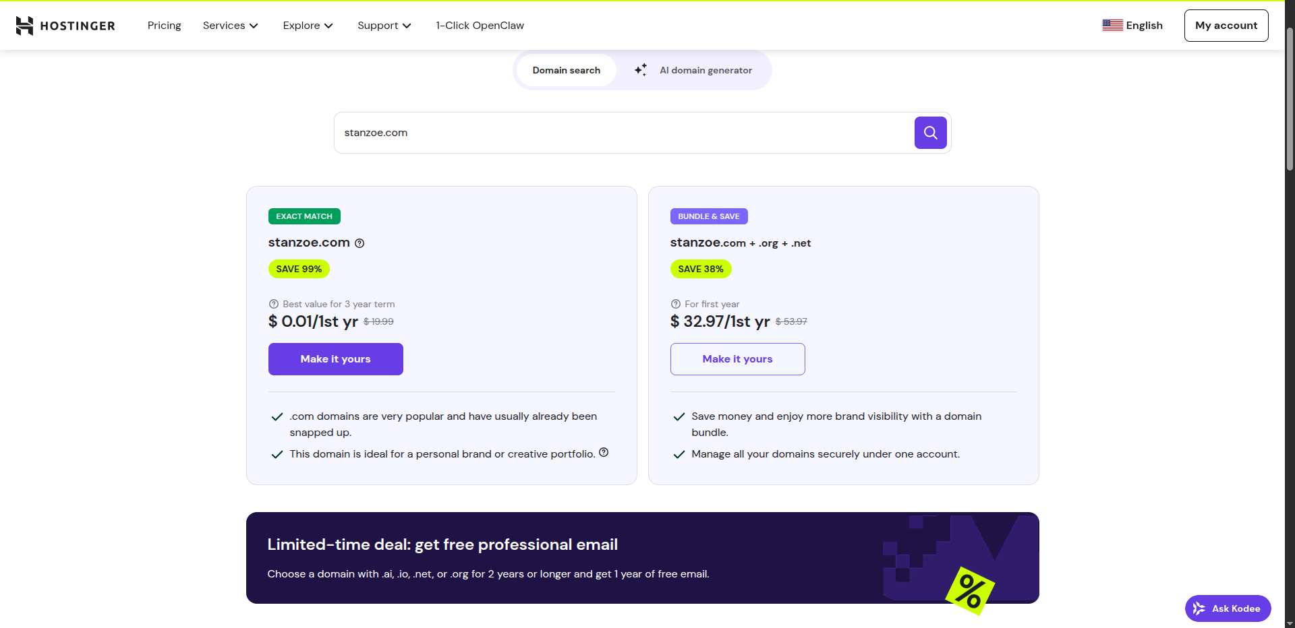
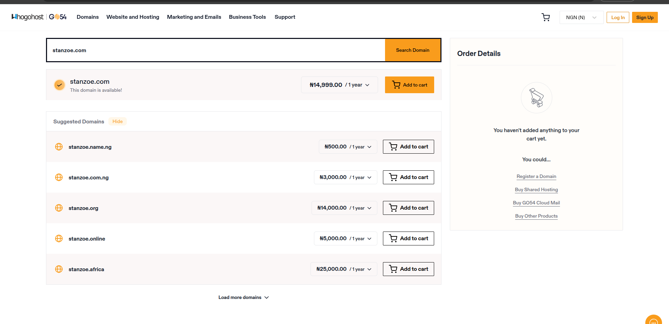
Dependencies
Ready to Start?
Domain Name Registration
stanzoe.com ( Name cheap / Whogohost)
Hosting Name cheap / Whogohost
Development
Deployment
Week 3-4
Week 5-6
Timeline may vary based on feedback | Questions? Let's discuss!

Slide 7
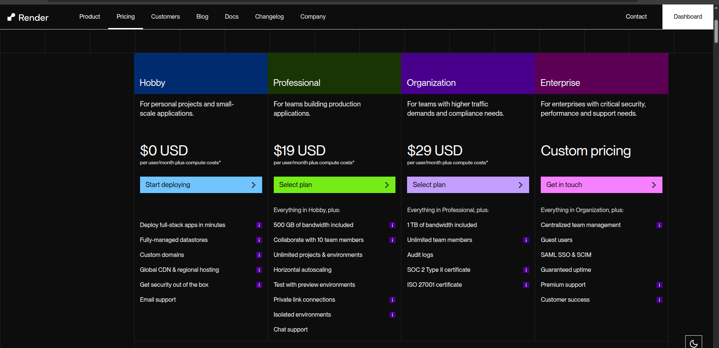
Dependencies
Ready to Start?
Domain Name Registration
stanzoe.com ( Name cheap / Whogohost)
Hosting Render
Development
Week 3-4
Week 5-6
Timeline may vary based on feedback | Questions? Let's discuss!

