Slide 1
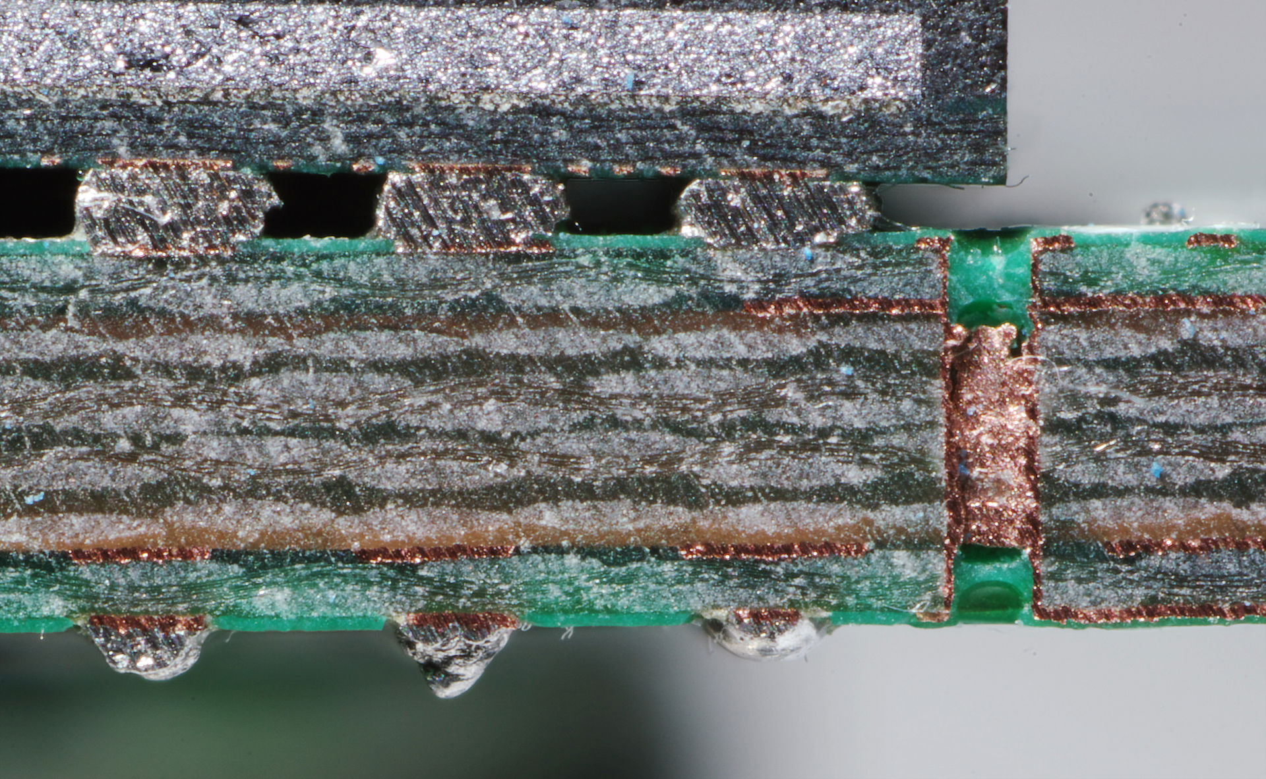
Silkscreen
(white)
Glass Fibre
(FR4)
Internal
Copper
External
Copper
Plated Through
Hole (via)
Solder Mask
(green)

