Slide 1
Project 4
Implementing Feedback, Final Model Iterations, Testing Pretrained Models, and Migrating to PyTorch
Group 3: Joshua Peterson, Michael Gray and Mangala Desai

Slide 2
Overview
Introduction & Motivation for Project
Background Research
Data Description
Methods
Data Cleaning & Preparation
Model Building
Evaluation
Results
Analysis of Models
Selected Models
Discussion & Conclusions
Notes:
Our main goals in this final project were:
Perform some final systematic iterations of our model based on professor’s feedback.
Test some popular pre-trained models.
Try out PyTorch.

Slide 3
Introduction & Motivation for Project
The need to develop methods for accurately and quickly identifying viral pneumonias related to COVID-19 is a current and urgent need.
Deep learning models are being deployed currently to detect the effects of COVID-19 within radiology images; however, it is still a developing field.
These models can help improve accuracy of radiologists and even replace one in the event of a shortage.
We aim to create a deep learning model that accurately detects COVID-19 and other types of pneumonia that is not biased by common artifacts such as feeding tubes and image quality differences. Many of the existing models are trained on x-ray images of lungs AND surrounding areas.
Notes:
Mangala

Slide 4
Background Research
The utilization of deep learning techniques to detect COVID-19 is a developing field
Various deep learning architectures have been suggested by other researchers to detect COVID-19 in radiological images, such as VGG19, ResNet50, Xception and InceptionV3.
Lack of consensus in the field
There have been issues with models being able to generalize when deployed
To be able to use such models practically, they would need to be able to generalize to new data well.
Researchers trained a 121-layer convolutional neural network on a dataset of 100,000 lung x-ray images that were labeled for 14 different diseases. Unsure how transferable this network is when detecting COVID-19.
Notes:
Joshua

Slide 5
Data Description
The dataset contains 6,504 JPEG and PNG images. There are corresponding JSON files for each image that contain the annotations and metadata for the images.
The classes of interest among the images are the following: viral pneumonia (non-COVID), bacterial pneumonia, no pneumonia (healthy) and COVID-19.
All cases of COVID-19 also contain viral pneumonia.
Fungal and Lipoid Pneumonia labels comprise a small percentage. 74 were not otherwise label.
These low N classes will be excluded.
Notes:
Michael

Slide 6
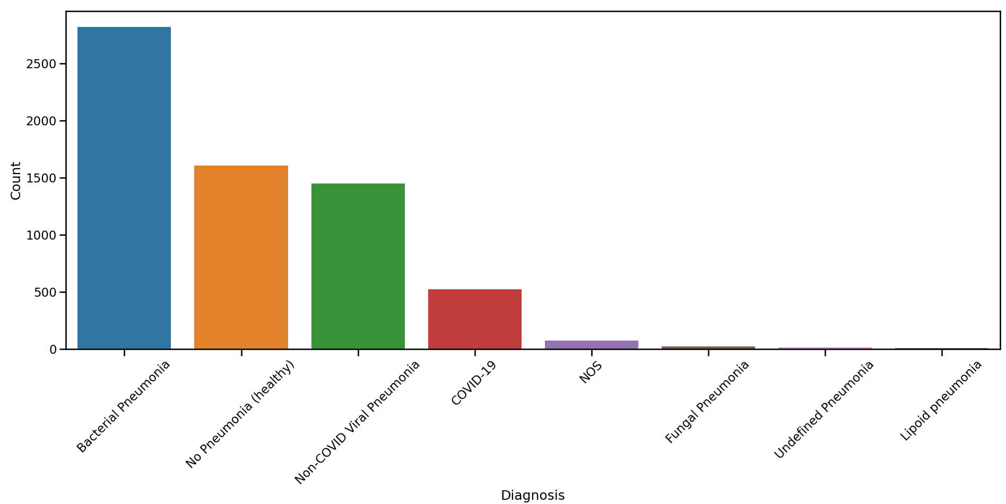
Data Description
Pretty big class imbalance. Will impact model performance.
EXCLUDED
EXCLUDED
EXCLUDED
EXCLUDED

Slide 7
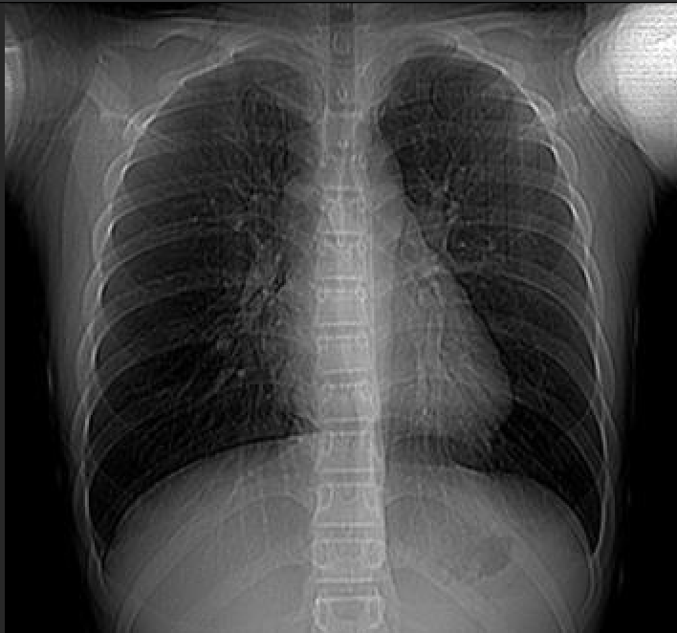
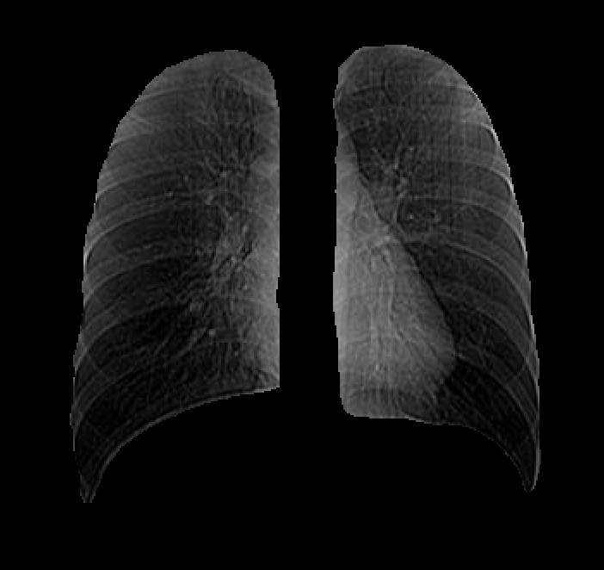
Methods - Data Cleaning & Preparation
Segmentation coordinates applied to raw images. Masking should help generalizability by reducing external cues that bias the model.

Slide 8
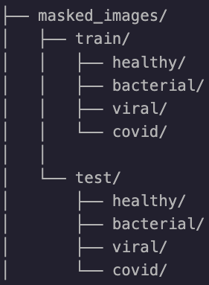
Methods - Data Cleaning & Preparation
Folder Structure
70/30 train/test split.
Train split 75/25 for validation data
(same structure also for raw_images)

Slide 9
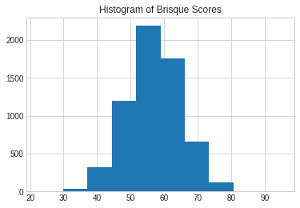
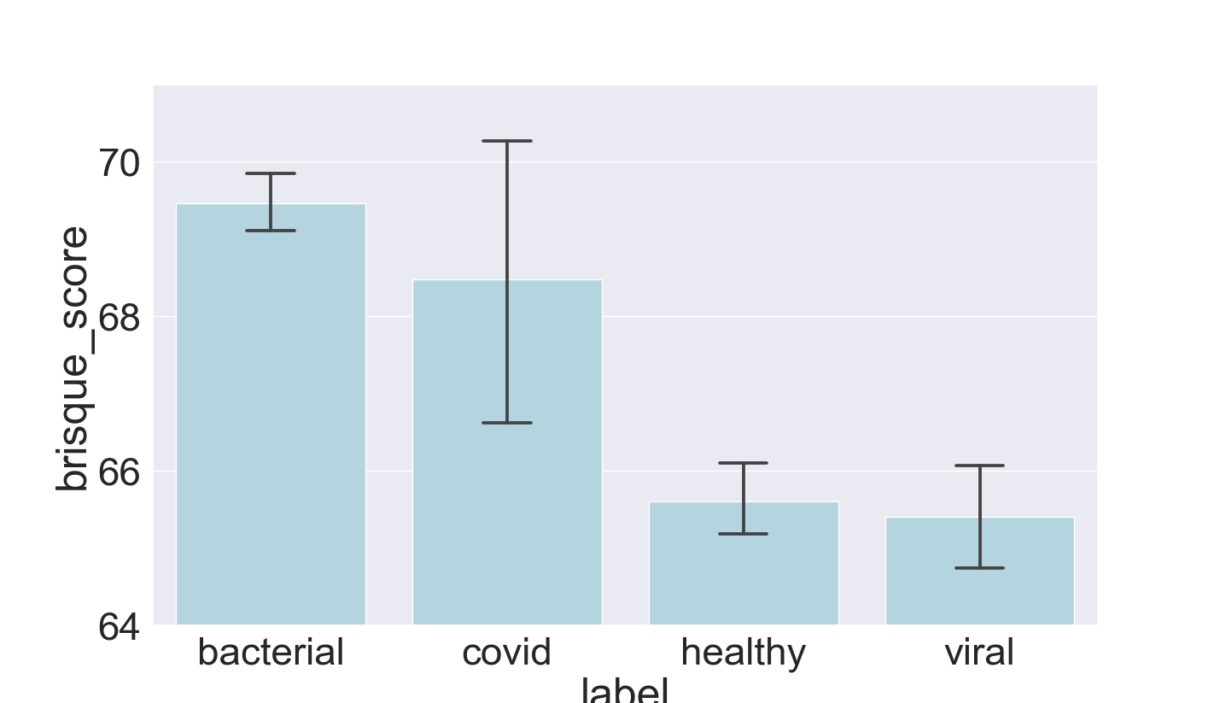
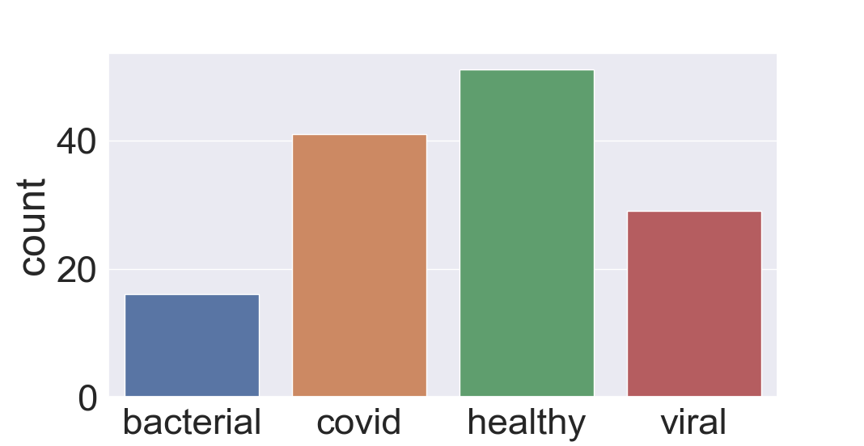
Methods - Data Cleaning & Preparation
Determining the Quality of Our Images
We calculated a BRISQUE score for each of our images to assess the quality of the images.
Overall:
Score vs class:
1.5*IQR Outliers:
Significantly worse image quality for covid and bacterial compared to healthy (p<0.05)
Later we will compare removing outliers vs. not to see if it influences model accuracy.

Slide 10
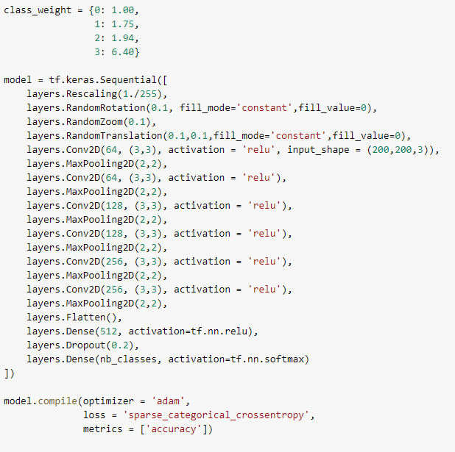
Methods - Initial Modeling
Initially developed CNN from scratch
Used as a starting point from which to further develop and refine a model for this image classification task.
Initial 16 Layer CNN Model

Slide 11
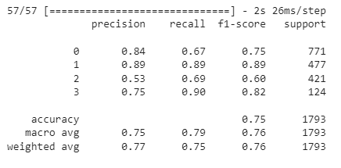
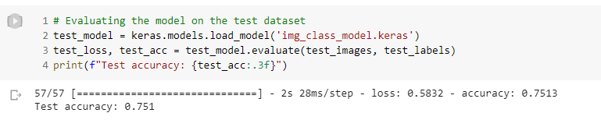
Methods - Results of Initial Modeling
Making Predictions with this Initial Model
Able to achieve a test accuracy of 75%
The classification matrix shows how well the model performs with regard to each class
Best at identifying healthy lungs
Struggles with identifying viral pneumonia the most.
Still does not get close to state-of-the-art models in the field.

Slide 12
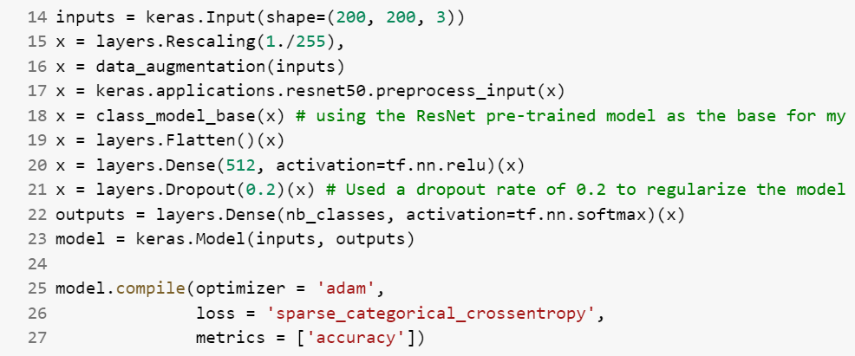
Methods - Testing Pretrained Models
These pre-trained model were run without class weighting.
The following pre-trained models were tested:
VGG16
VGG19
ResNet50
Xception
InceptionV3
These models were selected to be tested based on what we’ve seen used in other research in the field.

Slide 13
Results - Testing Pretrained Models
 | VGG16 | VGG19 | ResNet50 | Xception | InceptionV3
Test Accuracy | 0.816 | 0.799 | 0.833 | 0.785 | 0.76
Macro Avg. Precision | 0.82 | 0.8 | 0.84 | 0.76 | 0.75
Macro Avg. Recall | 0.84 | 0.82 | 0.84 | 0.82 | 0.78
Bacterial F1 Score | 0.83 | 0.8 | 0.84 | 0.8 | 0.79
Healthy F1 Score | 0.91 | 0.92 | 0.92 | 0.89 | 0.87
Viral F1 Score | 0.66 | 0.64 | 0.69 | 0.62 | 0.51
COVID-19 F1 Score | 0.91 | 0.88 | 0.91 | 0.84 | 0.84
The ResNet50 pre-trained model performed the best with a test accuracy of 83.3%

Slide 14
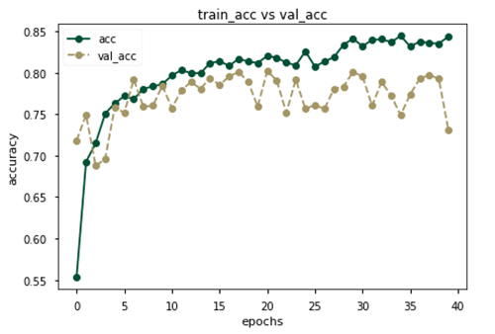
Results - Testing Pretrained Models
Because ResNet50 performed the best, additional fine tuning was conducted.
Unfroze the last 32 layers of the ResNet50 model. The entirety of the “conv5” block.
Brought the accuracy of the model up to 85.7%.
 | ResNet50 | Xception
Test Accuracy | 0.857 | 0.831
Macro Avg. Precision | 0.87 | 0.82
Macro Avg. Recall | 0.87 | 0.83
Bacterial F1 Score | 0.86 | 0.84
Healthy F1 Score | 0.95 | 0.92
Viral F1 Score | 0.73 | 0.7
COVID-19 F1 Score | 0.95 | 0.83

Slide 15
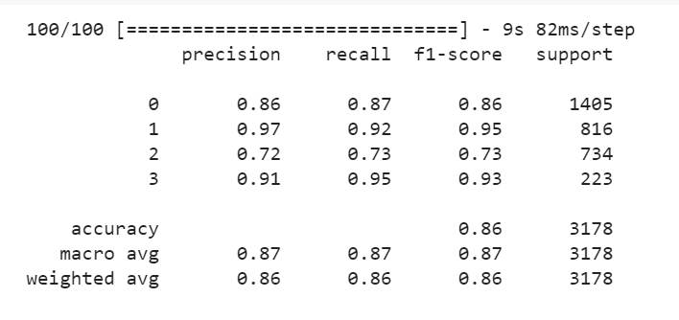
Results - Testing Pretrained Models
Chose to use the fine-tuned ResNet50 pre-trained model.
We were able to increase our test accuracy by 10% by using this model.
Achieved a final accuracy of 86% with this model.
However, we still wanted to explore PyTorch implementation of our CNN model

Slide 16





Methods - Migrating to PyTorch
Why?
More model control
More room for optimization
Better Apple M1 chip support (for GPU acceleration)
Faster than Keras
How?
Use conda to create a virtual environment with python 3.9.
conda install pytorch torchvision torchaudio -c pytorch
In the model script:
Then, ask ChatGPT how to convert your Keras model to PyTorch! Just kidding … Sort of …

Slide 17
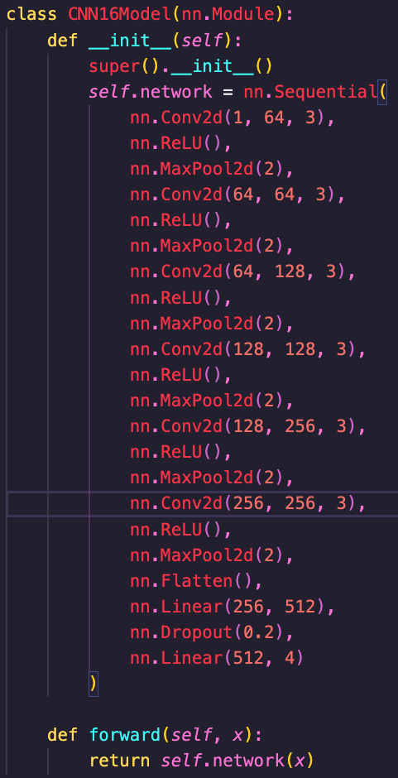
Methods - Migrating to PyTorch
CNN Architecture:
6 Conv2d layers
1 input channel in 1st layer (grayscale images)
3x3 filter kernel
2x2 MaxPool2d
ReLU activations
2 fully connected layers
Training was noticeably faster after enabling M1 GPU, compared to both CPU and free-tier Colab.

Slide 18
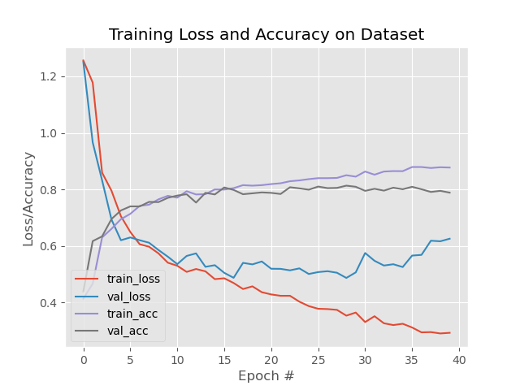
Results - Model Iterations Phase Two
First, plotting the loss and accuracy metrics for the train and validation datasets to find the optimal epoch #
Chose 15 epochs for all final iterations.

Slide 19
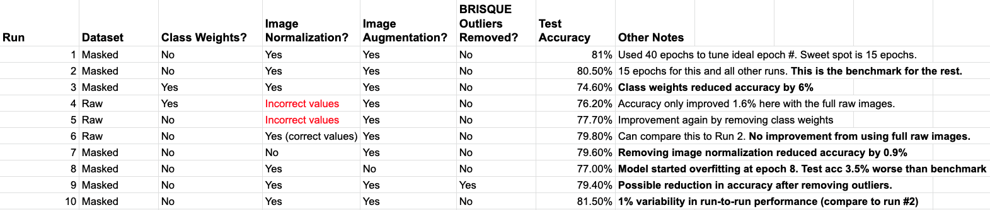
Results - Model Iterations Phase Two
Systematically testing the contribution of:
class weights, image normalization, image augmentation, BRISQUE outliers, masked vs raw images.
Surprise: Class weights reduced accuracy by 6%
Not surprise: Removing image augmentation caused early overfitting and reduced accuracy.
Not ideal: ~1% variability in test-retest accuracy.

Slide 20
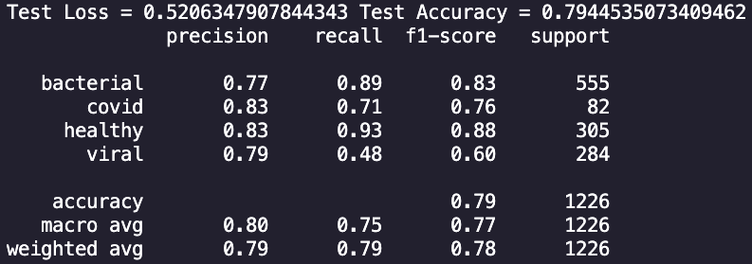
Results - Improving Performance of CNN Model
Previously….
In Keras, we used the same CNN architecture and obtained 75% accuracy.
Now:
With our best CNN model, we obtained 81.5% accuracy.
Did not use class weights in loss function
Had image normalization (by mean and sd)
Had image augmentation (small random rotations and translations)
Used masked images
Our previous best in Keras did not use image normalization.

Slide 21
Discussion & Conclusions
Discussion
We tried to reach the 95% accuracy of a reference paper using the same base architecture as them.
We speculate that we were disadvantaged by class imbalance.
They had n = 2600 for each of 3 classes.
We also had 4 classes.
There’s probably additional image augmentations and preprocessing we could explore to improve the results of our modeling.
A future study quantifying the effect of class imbalance would be helpful.
Conclusions
Our model is not sufficient to be useful in a production environment, but we have laid a good foundation for future improvements and efforts.
Were able to achieve a test accuracy of 85.7% using a fine tuned ResNet50 pre-trained model
Developed a PyTorch implementation to improve accuracy of CNN model to 81.5%

Slide 22
References
Fauci AS, Lane HC, Redfield RR. Covid-19 - Navigating the Uncharted. The New England Journal of Medicine [Internet]. 2020 Mar 26 [cited 2022 Sep 13]. Available from: https://www.nejm.org/doi/full/10.1056/nejme2002387
Coronavirus World Map: Tracking the Global Outbreak. New York Times. 2022 [cited 2022 Sep 12]. Available from: https://www.nytimes.com/interactive/2021/world/covid-cases.html
Del Rio C, Collins LF, Malani P. Long-term Health Consequences of COVID-19. JAMA [Internet]. 2020 Oct 5 [cited 2022 Sep 13]. Available from: https://jamanetwork.com/journals/jama/article-abstract/2771581
Sharma O, Sultan AA., Ding H, Triggle CR. A Review of the Progress and Challenges of Developing a Vaccine for COVID-19. Frontiers in Immunology [Internet]. 2020 [cited 2022 Sep 15]; 11. Available from: https://www.frontiersin.org/articles/10.3389/fimmu.2020.585354/full
Khan AI, Shah JL, Bhat MM. CoroNet: A deep neural network for detection and diagnosis of COVID-19 from chest x-ray images. Computer Methods and Programs in Biomedicine [Internet]. Available from: https://www.sciencedirect.com/science/article/pii/S0169260720314140?casa_token=YR3Bry_IGi8AAAAA:yzWkADLKpzyF0-R-lCckM7rjKT0rL2i5oibgOImOqGyq7dTf9JnYT-whcjsv6K4fQ920pmfW16c
Narin, A., Kaya, C. & Pamuk, Z. Automatic detection of coronavirus disease (COVID-19) using X-ray images and deep convolutional neural networks. Pattern Anal Applic 24, 1207–1220 (2021). 2021 May 9 [cited 2022 Sep 13]. Available from: https://doi.org/10.1007/s10044-021-00984-y
Arbib MA. The Handbook of Brain Theory and Neural Networks. MIT Press. 2002 [cited 2022 Sep 15]. Available from: https://dl.acm.org/doi/abs/10.5555/572531
Hebb DO. The Organization of Behavior: A Neuropsychological Theory. 99th ed. The United States of America: John Wiley & Sons; 1949 [cited 2022 Sep 15]. Available from: https://pure.mpg.de/rest/items/item_2346268/component/file_2346267/content
LeCun Y, Bengio Y, Hinton G. Deep Learning. Nature. 521. 436-44. 10.1038/nature14539. 2015 [cited 2022 Sep 15]. Available from: https://www.researchgate.net/publication/277411157_Deep_Learning
Wang M, Deng W. Deep Face Recognition: A Survey. Neurocomputing [Internet]. 2021 Mar [cited 2022 Sep 15]. 429; 215-244. Available from: https://arxiv.org/abs/1804.06655
Tesla.com: Artificial Intelligence & Autopilot. c2022 [cited 2022 Sep 15]. Available from: https://www.tesla.com/AI
Ramesh A, Pavlov M, Goh G, Gray S, Voss C, Radford A, Chen M, Sutskever I.. Zero-shot text-to-image generation [Internet]. arXiv [cs.CV]. 2021 [cited 2022 Sep 15]. Available from: https://arxiv.org/pdf/2102.12092.pdf
Rajpurkar P, Irvin J, Zhu K, Yang B, Mehta H, Duan T, et al. CheXNet: Radiologist-level pneumonia detection on chest X-rays with deep learning [Internet]. arXiv [cs.CV]. 2017 [cited 2022 Sep 15].. Available from: https://arxiv.org/abs/1711.05225
Cohen JP, Hashir M, Brooks R, Bertrand H. On the limits of cross-domain generalization in automated X-ray prediction. Proceedings of Machine Learning Research 1-13, 2020. 2020 [cited 2022 Sep 13]. Available from: https://arxiv.org/pdf/2002.02497.pdf
Khan A, Khan SH, Saif M, Batool A, Sohail A, Khan MW. A Survey of Deep Learning Techniques for the Analysis of COVID-19 and their usability for Detecting Omicron. 2022 [cited 2022 Sep 15]. Available from: https://arxiv.org/ftp/arxiv/papers/2202/2202.06372.pdf
Fusco R, Grassi R, Granata V, Setola SV, Grassi F, Cozzi D, Pecori B, Izzo F, Petrillo A. Artificial Intelligence and COVID-19 Using Chest CT Scan and Chest X-ray Images: Machine Learning and Deep Learning Approaches for Diagnosis and Treatment. J Pers Med. 2021 Sep 30 [cited 2022 Sep 15];11(10):993. doi: 10.3390/jpm11100993. PMID: 34683133; PMCID: PMC8540782. Available from: https://www.ncbi.nlm.nih.gov/pmc/articles/PMC8540782/
Diaz-Escobar J, Ordóñez-Guillén NE, Villarreal-Reyes S, Galaviz-Mosqueda A, Kober V, Rivera-Rodriguez R, et al. (2021) Deep-learning based detection of COVID-19 using lung ultrasound imagery. PLoS ONE 16(8): e0255886. 2021 Aug 13 [cited 2022 Sep 16]. Available from: https://doi.org/10.1371/journal.pone.0255886
Giełczyk A, Marciniak A, Tarczewska M, Lutowski Z. Pre-processing methods in chest X-ray image classification. PLoS One [Internet]. 2022;17(4):e0265949. Available from: http://dx.doi.org/10.1371/journal.pone.0265949
Radiologyinfo.org. Pneumonia [Internet]. [cited 2022 Oct 10]. Available from: https://www.radiologyinfo.org/en/info/pneumonia
Bell D, Jones J. Pneumonia (summary). In: Radiopaedia.org. Radiopaedia.org; 2015 [cited 2022 Oct 10]. Available from: https://radiopaedia.org/articles/pneumonia-summary?lang=us
Koo HJ, Lim S, Choe J, Choi S-H, Sung H, Do K-H. Radiographic and CT features of viral pneumonia. Radiographics [Internet]. 2018;38(3):719–39. [cited 2022 Oct 10]. Available from: http://dx.doi.org/10.1148/rg.2018170048
Kafritsas N. Installing PyTorch on apple M1 chip with GPU acceleration [Internet]. Towards Data Science. 2022 [cited 2022 Dec 12]. Available from: https://towardsdatascience.com/installing-pytorch-on-apple-m1-chip-with-gpu-acceleration-3351dc44d67c

Slide 23
Questions?

Slide 24
Thank You!

