Slide 1

Excel Basics Workshop

Slide 2
Agenda
Entering and Storing Data
Working with and Manipulating Data
Introduction of Formulas and Functions
Helpful Tools and Resources

Slide 3
Part 1 – Entering and Storing Data
ENTERING DATA
Tabular Structure
Heading 1 | Heading 2 | Heading 3
Data | Data | Data
Data | Data | Data
Data | Data | Data
Record 1
Record 2
Record 3
Attribute 1
Attribute 2
Attribute 3
Good Practices
Try to always provide a “Notes” or “Data Dictionary” sheet if it would be helpful
If possible, put record identifiers in the left most columns

Slide 4
Part 1 – Entering and Storing Data
STORING DATA
Maintain Structure
Heading 1 | X | Heading 3
Data | X | Data
X | X | X
Data | X | Data
Good Practices
Maintain tabular structure across edits
Make sure like and same data is formatted consistently across sheets and workbooks
When removing data, remove the whole column or row containing the data rather than just data
Inspect workbook for accessibility and compatibility issues

Slide 5
Part 1 – Exercise
Instructions:
Make a new sheet and name it “Part 1 – Answer”
Take the raw data on the “Part 1 - Exercise” sheet and put it into the proper tabular format on your newly created “Part 1 – Answer” sheet
Insert a row above your formatted data table
Provide a header for each column
Delete the column that contains the employee salaries
Countdown
1
Fin
3
2
5
4

Slide 6
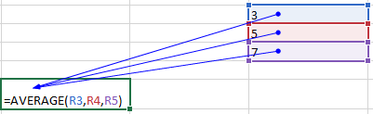
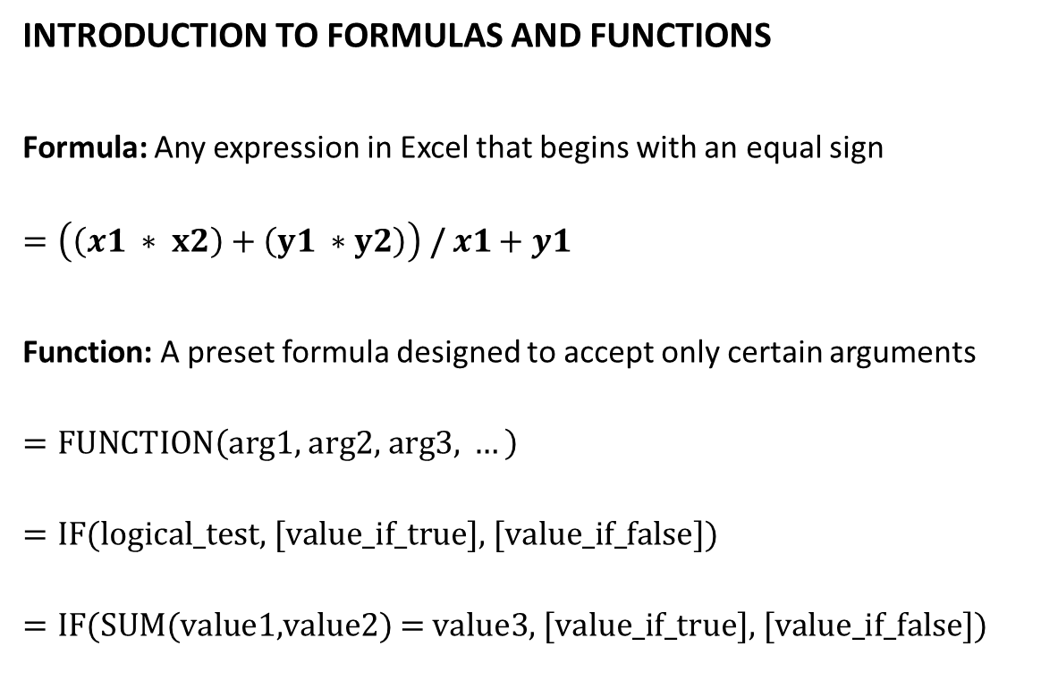
Part 2 – Introduction to Formulas and Functions
INTRODUCTION TO FORMULAS AND FUNCTIONS
Formula: Any expression in Excel that begins with an equal sign
$$=\left(\left(x1 ∗ x2\right)+\left(y1 ∗y2\right)\right) \text{/ }x1+y1$$
Function: A preset formula designed to accept only certain arguments
$$=\text{FUNCTION}\left(\text{arg}\text{1, }\text{arg}\text{2, }\text{arg}\text{3, }…\right)$$
$$=\text{IF}\text{(}\text{logical}\text{_}\text{test}\text{, [}\text{value}\text{_}\text{if}\text{_}\text{true}\text{], [}\text{value}\text{_}\text{if}\text{_}\text{false}\text{])}$$
$$=\text{IF}\text{(}\text{SUM}\text{(}\text{value}\text{1,}\text{value}\text{2) = }\text{value}\text{3, [}\text{value}\text{_}\text{if}\text{_}\text{true}\text{], [}\text{value}\text{_}\text{if}\text{_}\text{false}\text{])}$$
ExcelJet, Excel formulas and functions: https://exceljet.net/excel-formulas-and-functions

Slide 7
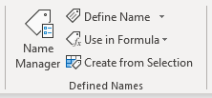

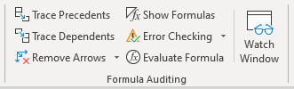
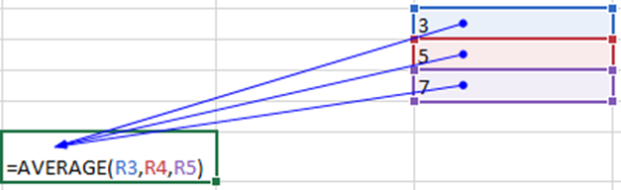
Part 2 – Introduction to Formulas and Functions
WORKING WITH FORMULAS AND FUNCTIONS
Defined Names
Makes formulas easier to understand
Allows for easier referencing
Organizes data/information
Allows for easy managing and editing
Formula Auditing
Investigate your formula errors
Understand your formula precedents and dependents

Slide 8
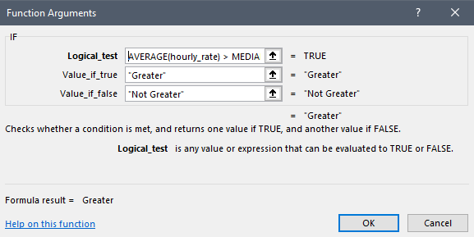
Part 2 – Introduction to Formulas and Functions
FINDING HELP
Use the “Insert Function” tool to find additional information
For additional help, a guide for all formulas and functions can be found here and here and here
Google… Google for everything else

Slide 9
Part 2 – Exercise
Instructions:
Using a formula, calculate the number of hours worked in a year in the “Hours_Worked” column (Hint: Annual_Rt / Hrly_Rate)
Using “Trace Precedents”, identify the precedents of your hours worked in a year formula
Remove the arrows after you have identified the precedents
Using the “Insert Function” tool, find out how to properly use the CONCATENATE function then insert the function into cell K2
Use the CONCATENATE function to join the “Unit” and “Dept” text into one column (Hint: all text needs to be surrounded by “x”)
Using “Define Name”, name all rates in the “Annual_Rt” column as “annual_rate” and “Hrly_Rate” column as “hourly_rate”
Use an IF function to determine if someone makes a higher than average “Hrly_Rate”. If TRUE, return “Yes” and if FALSE, return “No”
Use “Evaluate Formula” to run through your IF function step by step
Answer the question “What does the LEFT function do?” using the link provided on the “Part 2 – Exercise” sheet
Countdown
1
Fin
3
2
7
6
5
4

Slide 10
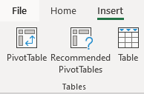
Part 3 – Working with and Manipulating Data
WORKING WITH DATA
Tabular Structure
Using Tables
Organizes and makes it easy to analyze related data
Makes it easy to sort, format and filter related data
Heading 1 | Heading 2 | Heading 3
Data | Data | Data
Data | Data | Data
Data | Data | Data
Record 1
Record 2
Record 3
Attribute 1
Attribute 2
Attribute 3

Slide 11
Part 3 – Working with and Manipulating Data
VIEWS
Freezing Panes
New Window
Arrange All
Freezing Panes
Split
Sorting & Filtering
GCFGlobal, Excel – Basic Tips for Working with Data: https://edu.gcfglobal.org/en/excel/basic-tips-for-working-with-data/1/

Slide 12
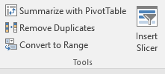
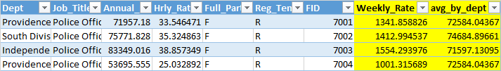
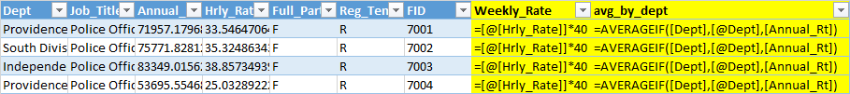
Part 3 – Working with and Manipulating Data
MODIFYING TABLES
Removing Duplicates
Adding Calculations using Formulas and Functions

Slide 13
Part 3 – Exercise
Instructions:
Convert the dataset into a Table
Name the Table “EmployeeSalaries”
Freeze row 1 and column A
Remove all duplicate records based on “FID” and “Name”
Sort the Table by “Annual_Rt” in descending order (largest to smallest)
Filter the Table by the “Annual_Rt” column, keep only those records with an annual salary greater than $70,000
Insert a column to the right of the Table called ”weekly_rt”
In the newly created column, use a formula to calculate the weekly earnings of each individual (Hint: assume a 40 hour work week)
Insert another column to the right of “weekly_rt” and call it “avg_by_dept”
Average the weekly earnings of individuals by each “Dept” (Hint: use the AVERAGEIF function)
Filter the “Dept” column so you can only see records related to “Steele Creek Division”
What is the average weekly earnings of individuals in the “Steele Creek Division”?
Countdown
1
Fin
3
2
7
6
5
4

Slide 14
Part 4 – Helpful Tools and Resources
Beginner Tutorials
Office – Excel for Windows Training
Excel Help Center
Microsoft Excel Beginners Video Tutorial – Level 1 & Level 2
Community Resources
Excel Jet
Excel Jet – List of Shortcuts
Ask Google!

Slide 15
Questions?

