Slide 1

Excel Workshop
~
Excel Basics – Part 1

Slide 2
Agenda
Working with Sheets and Cells
Entering and Storing Data
Helpful Tools and Resources

Slide 3
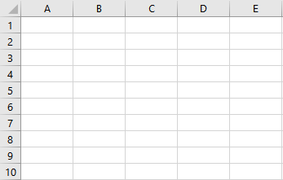
Part 1 – Working with Sheets and Cells
INTRODUCTION TO EXCEL
Tabular – Definition: of, relating to, or arranged in a table
specifically: set up in rows and columns
Sheets: A tabular collection of cells
Cells: The intersection of a row and column where data can be stored

Slide 4

Part 1 – Working with Sheets and Cells
SHEETS
Adding
Editing
Rename
Move and Copy
Tab Color
Grouping
Deleting
Table 1
Table 2
Table 3
Sheet 1
Sheet 2
Sheet 3
Workbook
GCFGlobal, Excel 2016 – Working with Multiple Worksheets: https://edu.gcfglobal.org/en/excel2016/working-with-multiple-worksheets/1/
Excel Easy, Worksheets: https://www.excel-easy.com/basics/worksheets.html

Slide 5


Part 1 – Working with Sheets and Cells
CELLS
Formatting Cells
Home tab
Tool groups
Insert, Delete, Format and Modify Cells
Merge & Center
Wrap Text
Group 1
Group 2
Group 3
GCFGlobal, Excel 2016 – Formatting Cells: https://edu.gcfglobal.org/en/excel2016/formatting-cells/1/
GCFGlobal, Excel 2016 – Modifying Columns, Rows, and Cells: https://edu.gcfglobal.org/en/excel2016/modifying-columns-rows-and-cells/1/
Excel Easy, Format Cells: https://www.excel-easy.com/basics/format-cells.html

Slide 6
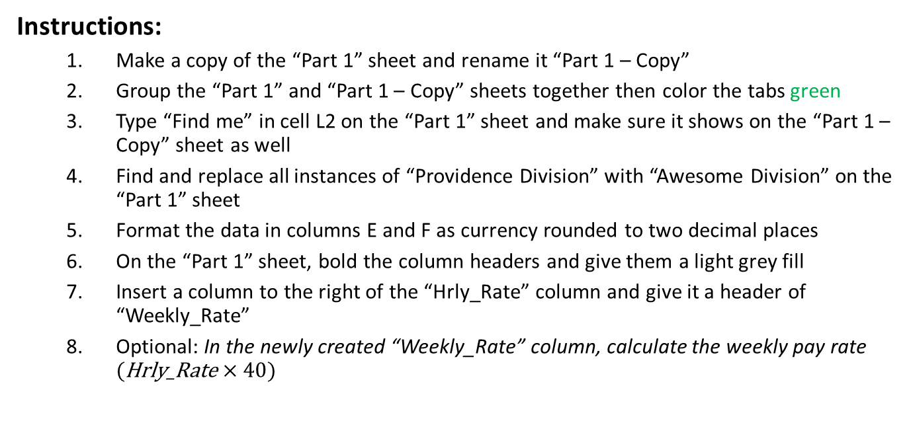
Part 1 – Exercise
Instructions:
Make a copy of the “Part 1” sheet and rename it “Part 1 – Copy”
Group the “Part 1” and “Part 1 – Copy” sheets together then color the tabs green
Type “Find me” in cell L2 on the “Part 1” sheet and make sure it shows on the “Part 1 – Copy” sheet as well
Find and replace all instances of “Providence Division” with “Awesome Division” on the “Part 1” sheet
Format the data in columns E and F as currency rounded to two decimal places
On the “Part 1” sheet, bold the column headers and give them a light grey fill
Insert a column to the right of the “Hrly_Rate” column and give it a header of “Weekly_Rate”
Optional: In the newly created “Weekly_Rate” column, calculate the weekly pay rate $(\text{Hrly}\text{_}\text{Rate}×40)$
Countdown
1
Fin
3
2
7
6
5
4
Answers:
Please refer to your handbook for the answer this exercise

Slide 7
Part 2 – Entering and Storing Data
ENTERING DATA
Tabular Structure
Heading 1 | Heading 2 | Heading 3
Data | Data | Data
Data | Data | Data
Data | Data | Data
Record 1
Record 2
Record 3
Attribute 1
Attribute 2
Attribute 3
Good Practices
Try to always provide a “Notes” or “Data Dictionary” sheet if it would be helpful
If possible, put record identifiers in the left most columns

Slide 8
Part 2 – Entering and Storing Data
STORING DATA
Maintain Structure
Heading 1 | X | Heading 3
Data | X | Data
X | X | X
Data | X | Data
Good Practices
Maintain tabular structure across edits
Make sure like and same data is formatted consistently across sheets and workbooks
When removing data, remove the whole column or row containing the data rather than just data
Inspect workbook for accessibility and compatibility issues

Slide 9
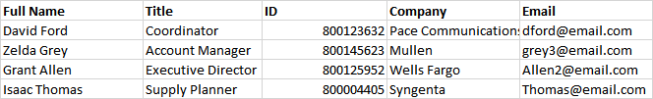
Part 2 – Exercise
Instructions:
Make a new sheet from the “Part 2” sheet and name it “Part 2 – Answer”
Take the raw data on the “Part 2” sheet and put it into the proper tabular format on your newly created “Part 2 – Answer” sheet
Insert a row above your newly created table
Provide a header for each column
Delete the column that contains the employee salaries
Countdown
1
Fin
3
2
5
4
Sample Output:

Slide 10
Part 3 – Helpful Tools and Resources
Beginner Tutorials
Excel Easy
Excel Easy – Keyboard Shortcuts
GCF Global – Excel 2016
Office – Excel for Windows Training
Excel Help Center
Microsoft Excel Beginners Video Tutorial – Level 1 & Level 2
Community Resources
Excel Jet
Excel Jet – List of Shortcuts
Microsoft Excel Community
Microsoft Answers Community
Ask Google!

Slide 11
Part 2 – Exercise
Instructions:
Answer the questions provided on the “Part 3” sheet utilizing the resource links provided
Countdown
1
Fin
3
2
5
4
Answers:
Please refer to your handbook for the answers to this exercise

Slide 12
Questions?

Slide 13
Extra Exercise
Instructions:
Make a copy of the “Part 1” sheet into a new workbook
Delete “Sheet1” which was automatically provided when starting a new workbook
Color the “Part 1” sheet tab blue
Hide columns G and H (Hint: try using Google if you don’t know how to hide columns and rows)
Change the color of the text in column B to red
Delete a column and row from the data set, while maintaining its table format
Find a keyboard shortcut that will allow you to select the entire header row of the table
Find a keyboard shortcut that will allow you to toggle the bolding of the text
Delete all the data in the table then type “I’m done” in cell A1

