Slide 1
Linear Regression and Linear SVR in Predicting Effects of Alcohol on Student Grades
Authors:
Joshua Dhikusooka
Presented by -
Joshua Dhikusooka
Affiliation:
Makerere University

Slide 2
Introduction
Education is an integral part of the community, in a country and the whole world at large, most concerns in one country are faced by many other countries too. Alcohol use can also negatively impact a student's ability to study effectively, retain information, and perform well on exams.
Additionally, alcohol consumption can lead to a number of negative consequences such as health problems, legal problems, and social problems, which can all have a negative impact on academic performance

Slide 3
Problem Statements
There has been an increased usage of alcohol which has manifested in schools.
The development of machine learning model provides a solution to predict and make profound decisions to improve education.
Machine Learning technologies are used to predict outcomes of occurrences, by using of supervised learning approach which looks into output data and input data being specified, the algorithm learns and produces more accurate results.

Slide 4
Related Works
Many studies have been done on alcohol consumption and student grades in different contexts.
“Linear discrimination analysis (LDA) was used to predict weaknesses in process of learning in order to create better learning environment for students.”

Slide 5
Research gaps
Linear discrimination analysis is used to reduce 2D graph to 1D graph in order to maximize the separability between classes but it fails when the mean of distribution are shared, it becomes impossible to find new axis. This makes both classes linearly non separable.
LDA is used to reduce feature number before processing in order to maximize the separability of classes”
LDA is a powerful technique, it is simple to implement. However, LDA can be sensitive to outliers and it may not perform well when the classes are not well-separated or when the sample size is small.

Slide 6
contributions
Linear Support Vector Regression (SVR) is a variant of SVR that uses a linear kernel, which means that it only considers linear relationships between the input and output variables. What makes Linear SVR ideal is that it focuses on linear relationships thus giving the best results for regression model.
Linear Support Vector Regression (SVR) is a variant of SVR that uses a linear kernel, which means that it only considers linear relationships between the input and output variables. What makes Linear SVR ideal is that it focuses on linear relationships thus giving the best results for regression model.

Slide 7
contributions
It's worth noting that the Linear SVR algorithm not only finds a boundary but also assigns a weight to each point, which are the support vectors.
Points that are farther from the boundary have a lower weight, which means that they do not contribute to the decision boundary as much as the support vectors.

Slide 8
Methodology
In this research we aim at predicting effects of alcohol on student grades,
we use techniques like Linear regression[6], Linear SVR.
Other techniques used to bring in a different variation are K near regression (KNR) [1], Random Forest Regression(RFR),
There are multiple forms of regression. This form of predictive modeling takes into consideration of dependent variable and independent variables, using independent variable to predict dependent variables (outcome).

Slide 9
Methodology
The relationship between dependent and one or more independent variables is determined by line of best fit
y = c+ bx.
And y is the dependent score, c is the constant, b is the regression coefficient, while x is a score on independent variable.

Slide 10
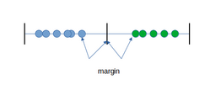
Methodology
Support Vector Machine (SVM) Regression model which is referred to as SVR or support vector Regression fall under supervised machine learning. This algorithm tries to fit data by finding hyper-plane that separates two classes with highest possible margin. Its good with outliers and its decision model can be easily updated

Slide 11
Data set Description
The data set of two csv files consisting 395 data point and other 649 data points. Of the 33 attributes/features 17 are categorical and the rest are numerical. The data set is then divided into two, 25 percent as testing and 75 percent as training set.
Name | Description
health | Current health status
sex | Student’s sex
age | Student’s age
Medu | Mother education
Fedu | Father education
Mjob | Mother job
Fjob | Father job
studytime | Weekly study time
guardian | Student’s guardian

Slide 12
Data Preparation and Exploratory Data
The preparation steps include processing it by cleaning, finding outliers, through use of box plots, data describing to showing mean and standard deviation was used to detect outliers. Correlating features to make best selection of features.

Slide 13
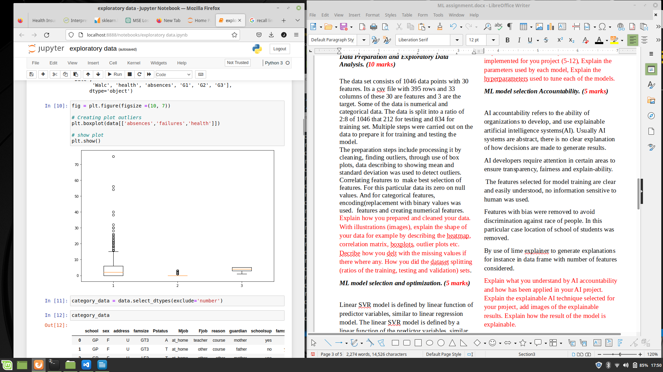
Data Preparation and Exploratory Data
we see that feature absences has gotten outliers and feature health is free from outliers.

Slide 14
ML model selection Accountability.
AI accountability refers to the ability of organizations to develop, and use explainable artificial intelligence systems(AI). Usually AI systems are abstract, there is no clear explanation of how decisions are made to generate results.
AI developers require attention in certain areas to ensure transparency, fairness and explain-ability.
The features selected for model training are clear and easily understood, no information sensitive to human was used.

Slide 15
Results and Discussion
Usually AI results can take any form depending on the type of problem and the technique used to solve it. Here machine learning helps predict effects of alcohol on student grades and predict grades of student based on there past behavior or environment they have lived and Regression models were evaluated using several metrics that measure the model’s ability to accurately predict the target variable.
Based on the following metrics:
R-squared : R2_score this metric measures proportion of the variance in the target variable that is explained by the model.
R2 = 1 - (Sum of squared residuals / Total sum of squares)

Slide 16
Results and Discussion
Regression model | R2_score | Accuracy (%)
Linear Regression | 0.85 | 85
Random Forest Regression | 0.742 | 74
Linear-SVR | 0.809 | 81
SVR | 0.790 | 79
K-N Regression | 0.771 | 77
SDG Regression | 0.799 | 79
Based on the results, the discussed models were evaluated using R2-score. And it clearly shows Linear Regression and Linear-SVR attained the best accuracy of 85 and 81 respectively.

Slide 17
Conclusions
In conclusion, Linear Support Vector Regression (Linear SVR) is a variant of Support Vector Regression (SVR) that uses a linear kernel.
This means that it only considers linear relationships between the input and output variables.
Linear SVR is a powerful tool for performing regression tasks when the relationship between the input and output variables is linear. It is computationally efficient, and can handle large and sparse data sets.
However, it may not be the best choice when the relationship between the input and output variables is non-linear. In such cases, SVR with a non-linear kernel or other non-linear regression methods should be considered.

Slide 18
References
1. S. Ismail, N. I. A. N. Azlan and A. Mustapha, "Prediction of alcohol consumption among Portuguese secondary school students: A data mining approach," 2018 IEEE Symposium on Computer Applications & Industrial Electronics (ISCAIE), 2018, pp. 383-387, doi: 10.1109/ISCAIE.2018.8405503.
2. B. Sravani and M. M. Bala, "Prediction of Student Performance Using Linear Regression," 2020 International Conference for Emerging Technology (INCET), 2020, pp. 1-5, doi: 10.1109/INCET49848.2020.9154067.
3. V. Gazivoda, L. Filipović and M. Daković, "Comparative Analysis of Regression and Neural Network Models on Students' Grades," 2021 10th Mediterranean Conference on Embedded Computing (MECO), 2021, pp. 1-4, doi: 10.1109/MECO52532.2021.9460261.
4. H. Gull, M. Saqib, S. Z. Iqbal and S. Saeed, "Improving Learning Experience of Students by Early Prediction of Student Performance using Machine Learning," 2020 IEEE International Conference for Innovation in Technology (INOCON), 2020, pp. 1-4, doi: 10.1109/INOCON50539.2020.9298266.

Slide 19
Thanks For Listening

