Slide 1

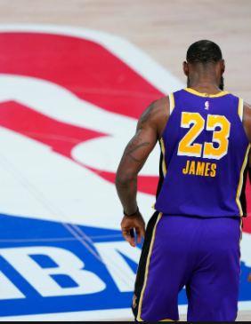
NBA PLAYER ANALYSIS
Ali Akbar
Pierre-Olivier
Karanpreet
Josh Bissessarsingh

Slide 2
Project Outline
Database Integration: SQLite & SQLAlchemy
Data Visualization
& Time Series Model
Project Overview & Purpose
Data Collection & ETL Process
Machine Learning : Data Clustering & Principal Component Analysis

Slide 3
Project Overview
Analyzing trends in NBA player performance
Determine the new player archetype in the modern-day position list
Determine if adjusting the athlete's playstyle can improve or prolong performance

Slide 4
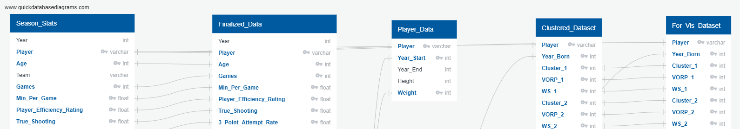
Extract Transform Load
Kaggle Dataset :
NBA Players stats since 1950
(Season Stats, Player Data)
Data Preprocessing :
Remove unwanted columns (e.g., Teams and Games Started)
Filter data to appropriate time period (2003-2017)
Merge datasets & filter out the duplicates

Slide 5

Database Integration
Database using SQLite and SQLAlchemy
Finalized Data
Clustered Data
Data for visualizations

Slide 6

Unsupervised Machine Learning
Principal Component Analysis
Calculated variances to determine the optimal number of components (10)
Clustering based on Player archetype
Used K-Means to find optimal number of clusters based on the PCA (9)
Determined cluster type to interpret the playstyles
Notes:
References - Model 1: https://github.com/micahmelling/player_decline Article: https://www.baseballdatascience.com/machine-learning-to-predict-player-decline/
Model 2: https://towardsdatascience.com/redefining-nba-player-classifications-using-clustering-36a348fa54a8

Slide 7
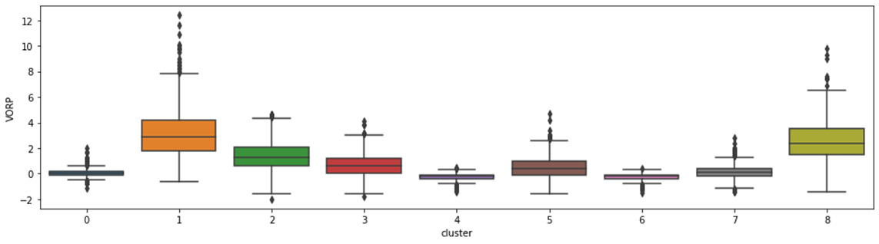
Visualizing Clusters based on VORP
(Value Over Replacement Player)

Slide 8
Results for Cluster Components
PCA Playing Styles
Cluster Player Types

Slide 9
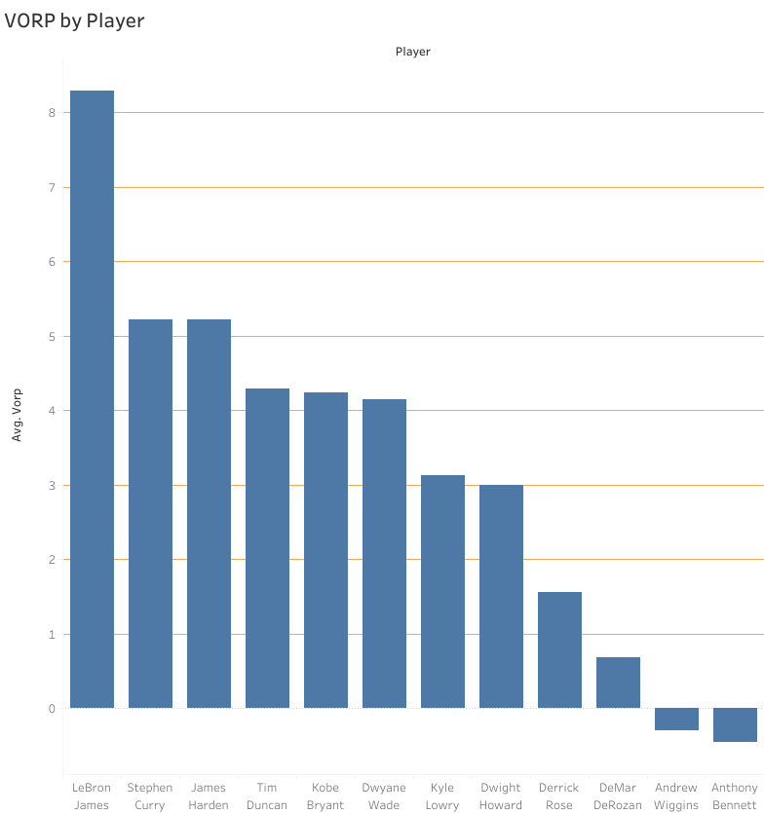
Data Visualization
VORP By Player
VOPR By Age
VORP By Status
https://public.tableau.com/app/profile/syed.ali.akbar/viz/NBAAnalysis_16232021658490/VORPbyPlayersandAge

Slide 10

Time Series
Analyzed VORP and Cluster for every two-year period
Determined if the VORP was improving or regressing
Based on Improvement or Regression we determine if the player changed their playstyle (Cluster)

Slide 11
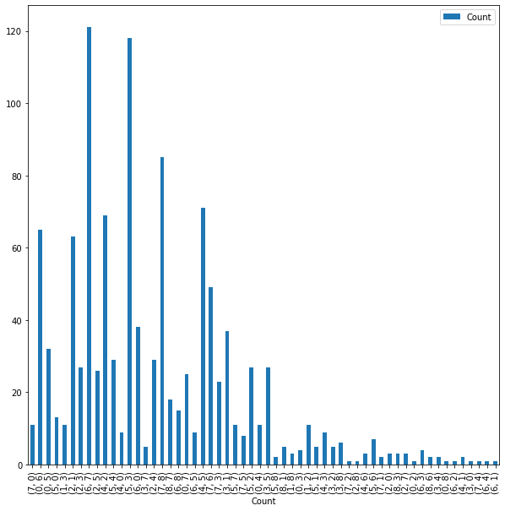
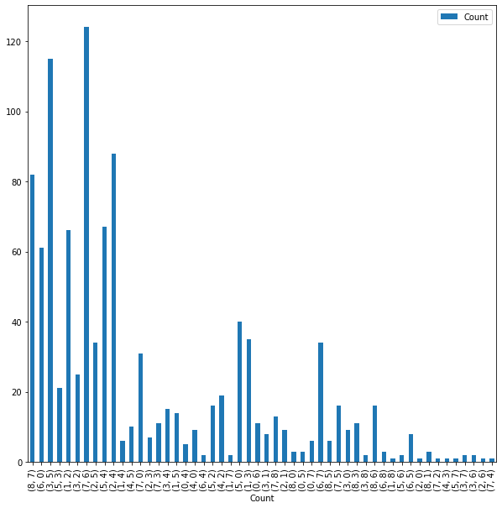
Improvements
Regression

Slide 12
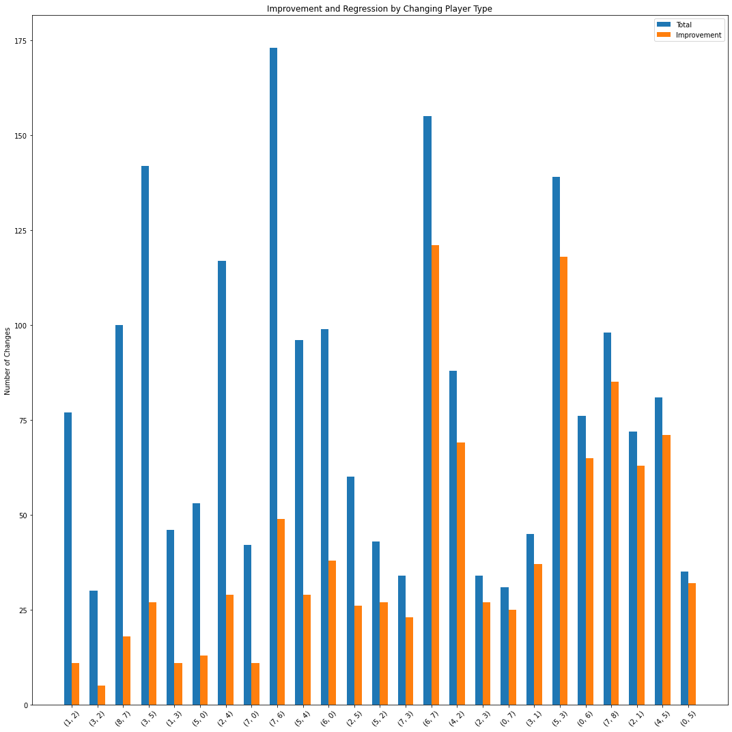
Improvement Vs Total Changes
Comparing the number of improvements to the total number of changes (Improvements + Regression)

