Slide 1
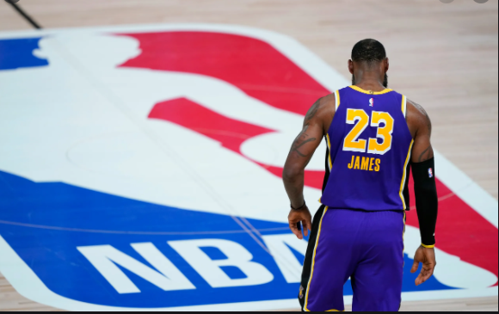
NBA PLAYER ANALYSIS
Submitted By-
Ali
Josh
Pierre
Karan

Slide 2
PROJECT OVERVIEW
Using machine learning to analyze player preformance in the NBA. This analysis will aim to provide insight on the following questions:
Determining the new player archytpe in the modern day position list.
Will adjusting the athletes playstyle help improve performance.

Slide 3
STORYBOARD
Project overview and setting the hypothesis
Data Integration using PostgreSQL and ERD Diagram
Data Visualization
And Time Series Model
Data Collection and cleaning the data files
Machine Learning Model - Clustering the data using PCA model

Slide 4
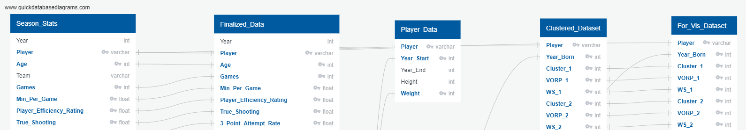
ETL
From Kaggle data set (Season Stats, Player Data)
Removed unwanted columns (e.g. Teams and Games Started)
Filtered data to the appropriate time period (2003-2017)
Merged datasets together and filtered out the duplicates

Slide 5

Database Integration
Created Database using SQLite and SQLAlchemy
Imported 3 tables into the database
Finialized Data
Clustered Data
For Vis Data

Slide 6
MACHINE LEARNING
Primary Objective
Using unsupevised machine learning to create the PCA model and cluster player based on archetype
By claculating the variances we determined that opitimal components for the PCA was 10
Using K-Means we concluded to using 9 clusters based on the PCA
After clustering the dataset, we found cluster type to determin play styles
Notes:
References - Model 1: https://github.com/micahmelling/player_decline Article: https://www.baseballdatascience.com/machine-learning-to-predict-player-decline/
Model 2: https://towardsdatascience.com/redefining-nba-player-classifications-using-clustering-36a348fa54a8

Slide 7
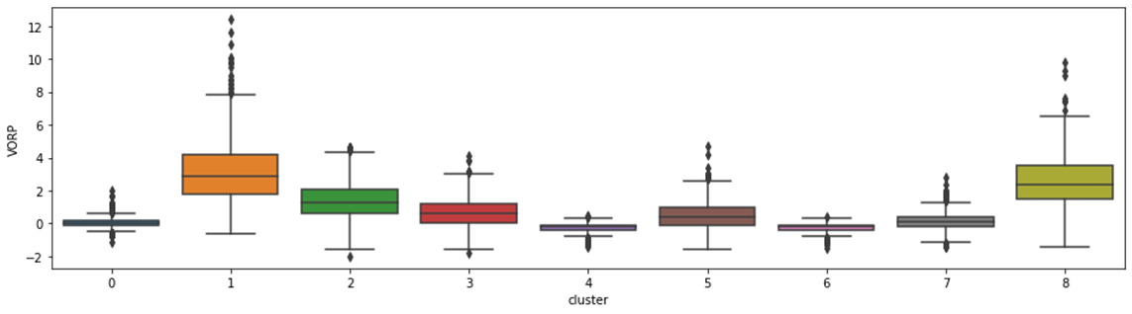
Visualize clusters Based on VORP

Slide 8
Final Results for Cluster Components
PCA Playing Styles
Cluster Player Types

Slide 9
DATA VISUALIZATION
Tableau will be used for data visualization -
https://public.tableau.com/app/profile/syed.ali.akbar/viz/NBAAnalysis_16232021658490/VORPbyAgebyPlayers
The Charts are
VORP By Year
VOPR By Player
VORP By Age

Slide 10
Time Series
Looked at the VORP and Cluster for every two year period,
Noted if there was an improvement or regression in VORP
If there was Improvement or Regression we noted down if the play changed his Play type (Cluster)
ADD TIME SERIES IMAGE

Slide 11
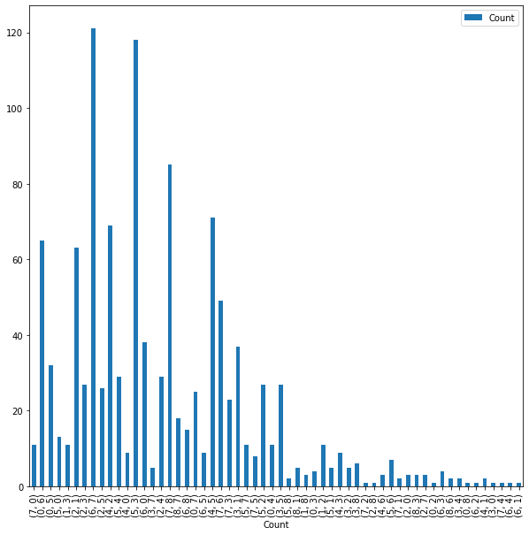
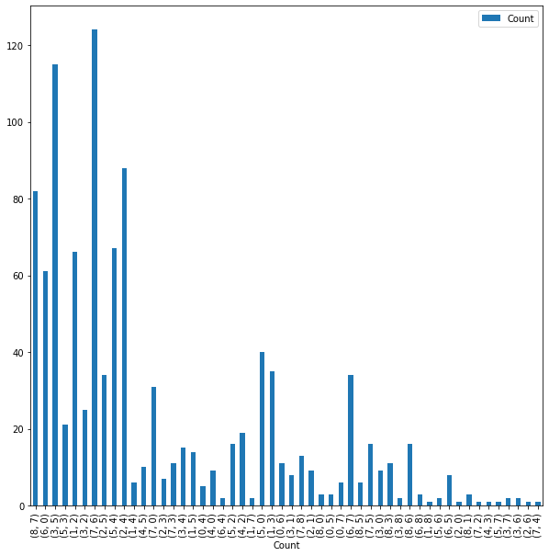
Improvements
Regression

Slide 12
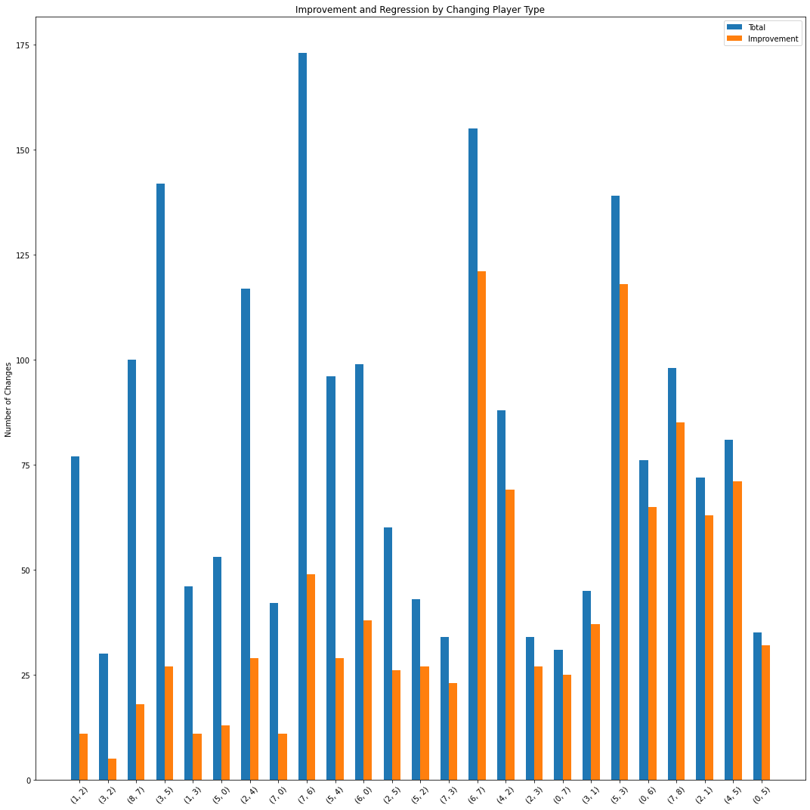
Improvement Vs Total Changes
Comparing the number of improvements to the total number of changes (Improvements + Regression)

