Slide 1
Need Based Sprinkler System
MSCS CE CSULB Spring 2015
Joshua Baird
Advisor: John Tramel

Slide 2
Agenda
Project Overview
Design
Implementation
Achievements
Future of the project
References
Demo
Questions

Slide 3
Project Overview
A sprinkler-watering system with more control than just time.
Based on the need of the soil.
Expandable to different sensor types.
Expandable to different control outputs.
Reduce the use of unnecessarily watering.
Easy to use. Setup and forget it.
Setup and monitoring from anywhere.
Cheaper alternative to other solutions.

Slide 4
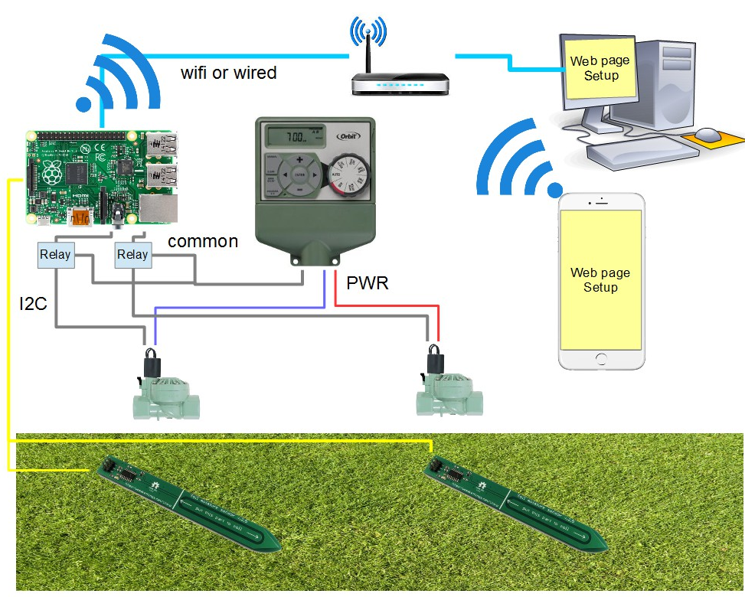
Design
Hardware

Slide 5
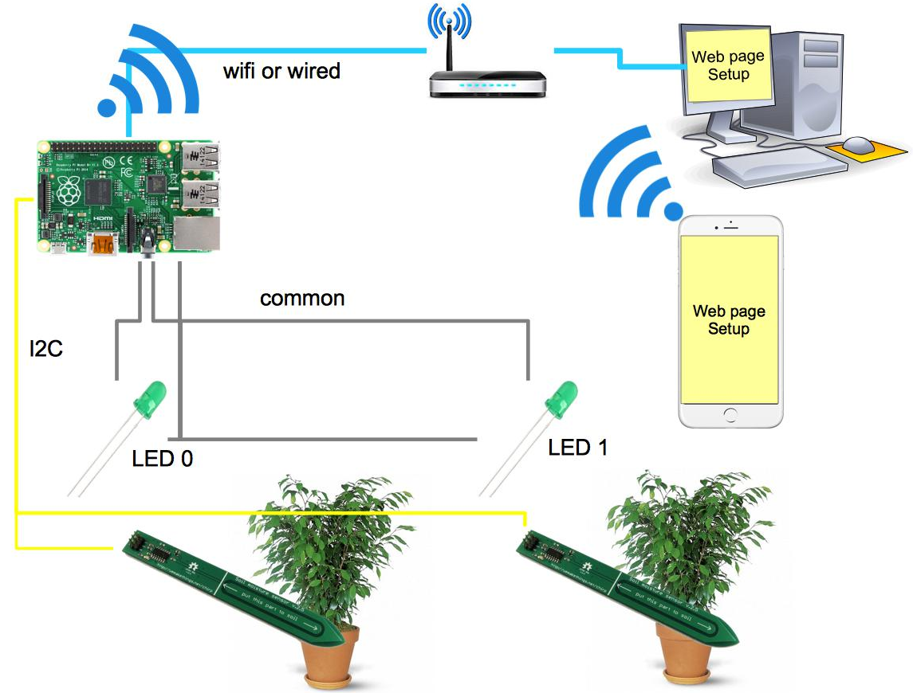
Design
Hardware

Slide 6
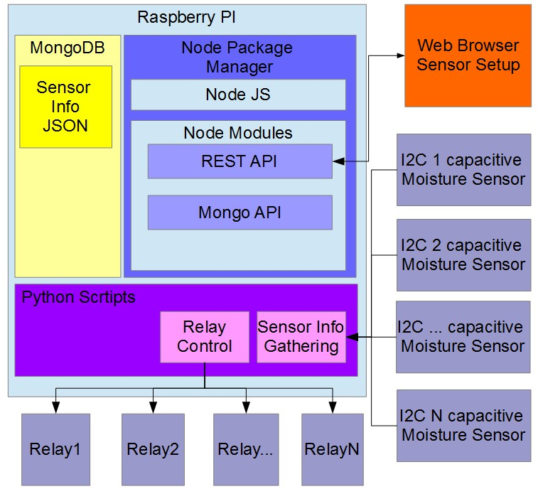
Design
Software

Slide 7
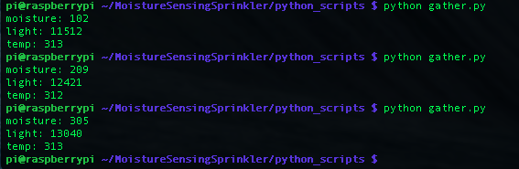
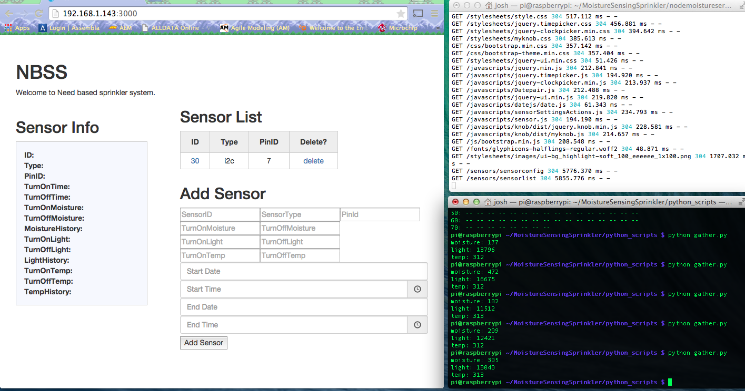
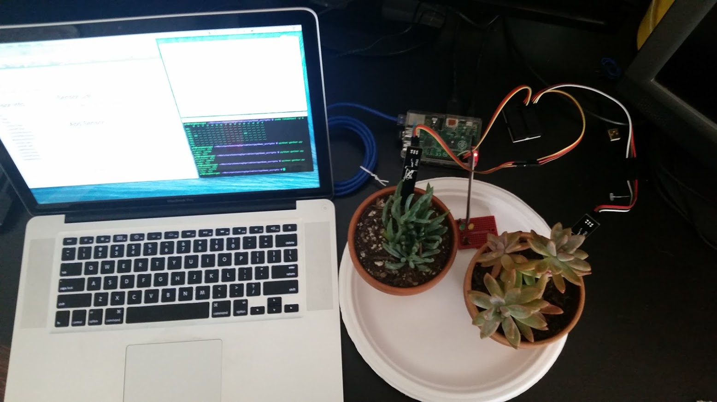
Implementation
Hardware

Slide 8
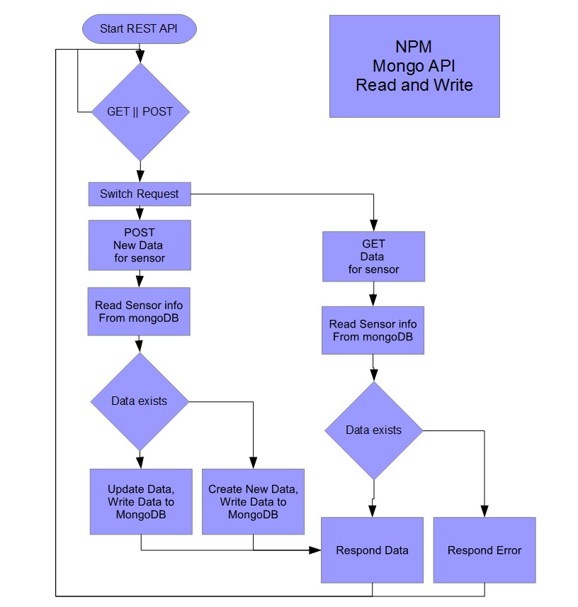
Implementation
RESTFUL API

Slide 9
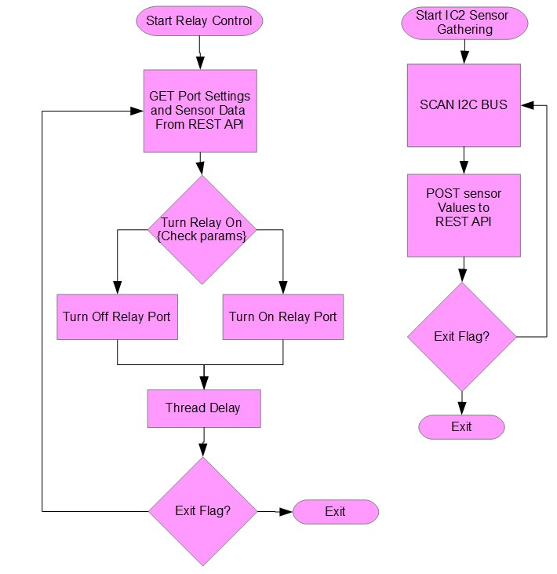
Implementation
Scripts

Slide 10
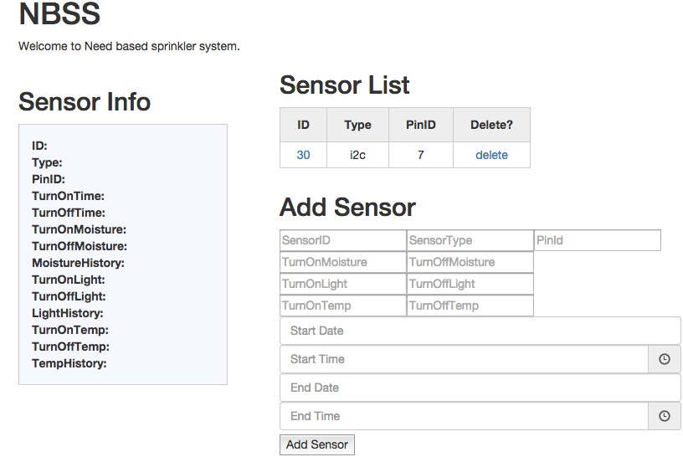
Implementation
UI

Slide 11
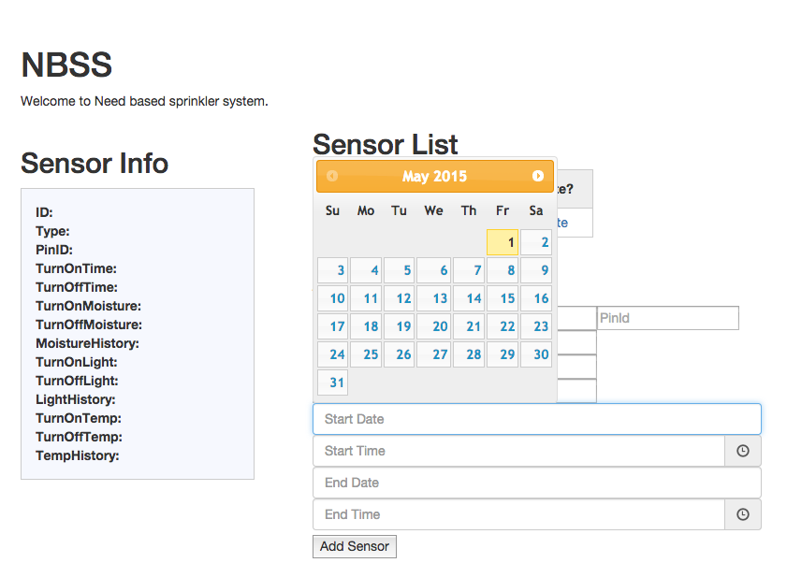
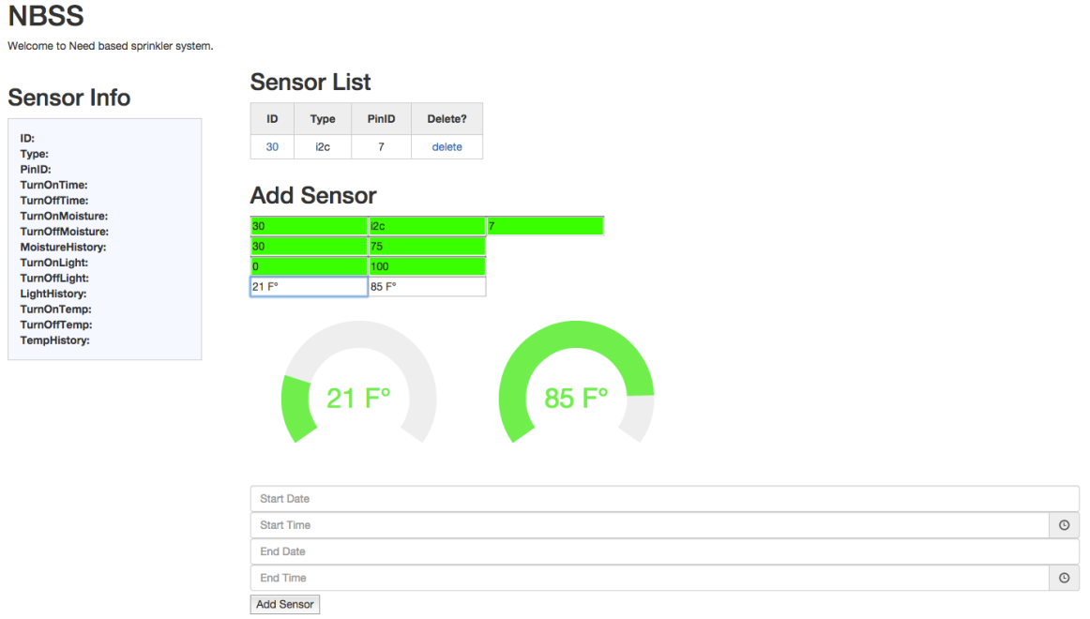
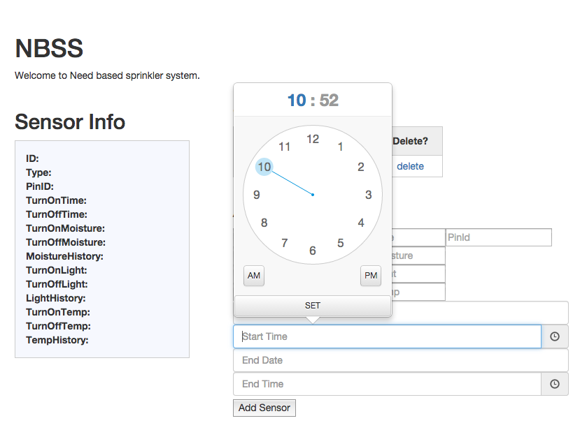
Implementation
UI -Helpers

Slide 12
Goals and Achievements
Produce a working software platform that is a web server:
SUCCESS!
Produce Scripts to read sensors and control outputs:
SUCCESS!
Produce a working hardware proof of concept:
SUCCESS!
Produce a working sprinkler system:
Proof of concept but no actual working model in field.
Cost and Time factors
Produce a working watering system:
SUCCESS!

Slide 13
Future of the project
Adding a wireless sensor.
Either find a sensor that works over rf or design my own.
Thinking a mesh of wireless sensors is really the way to go.
Adding multiple output drivers.
The RESTFUL api allows us to use more than just one device to control outputs. As long as they can connect to the network they can talk directly to the api.
Adding new scripts for reading different kinds of sensors
Adding more “helpers” to the setup screen similar to the temperature and date time pickers.
Adding more scripts and script examples in other programming languages.
Create a setup script that will do all the steps for the user by hand.
Stress test the scalability of the system to get a better idea of its expandability.
Upgrade the Pi to a Raspberry PI 2.
This will allow for more features. As it is now the loading of some of the modules takes quite a bit of time.
I would love to install this system in a real world test environment.
For all kinds of sensor types and situations.
Add a cleaner look and feel to the setup and configuration pages
Simplify the setup and configuration.
Possibly automate all the steps.

Slide 14
References
Github, where all code is stored.
https://github.com/joshbaird/MoistureSensingSprinkler
Guide to setup MongoDB on a raspberry pi
https://emersonveenstra.net/mongodb-raspberry-pi/
Guide to Express and Restful api.
http://cwbuecheler.com/web/tutorials/2013/node-express-mongo/
http://cwbuecheler.com/web/tutorials/2014/restful-web-app-node-express-mongodb/
Source code for accessing the moisture sensor in python
https://github.com/JasperWallace/chirp-graphite
Source code for the moisture sensor
https://github.com/Miceuz/PlantWateringAlarm/tree/release/sensor
Smart Irrigation Controllers: How Do Soil Moisture Sensor (SMS) Irrigation Controllers Work?
http://edis.ifas.ufl.edu/ae437

Slide 15
Demo
YAY!

Slide 16
Questions?

