Slide 1
4
Medical/Legal and
Ethical Issues

Slide 2
Multimedia Directory
Slide 7 Legal Issues in Healthcare Video
Notes:
This video appears later in the presentation; you may want to preview it prior to class to ensure it loads and plays properly. Click on the link above in slideshow view to go directly to the slide.

Slide 3
Topics
Scope of Practice
Patient Consent and Refusal
Other Legal Issues
Notes:
Planning Your Time: Plan 60 minutes for this chapter.
Scope of Practice (20 minutes)
Patient Consent and Refusal (20 minutes)
Other Legal Issues (20 minutes)
Note: The total teaching time recommended is only a guideline.
Core Concepts:
The scope of practice of an EMT
How a patient may consent to or refuse emergency care
The legal concepts of torts, negligence, and abandonment
What it means to have a duty to act
The responsibilities of an EMT at a crime scene

Slide 4
Scope of Practice
Notes:
Teaching Time: 20 minutes
Teaching Tips: Discuss how the scope of practice for an EMT is defined in your state. Describe the actual scope of practice. Demonstrate where an EMT might reference his own scope of practice. Where is it written down? What laws, rules, and/or protocols apply? Use actual examples to illustrate standard of care and deviation from the standard of care.

Slide 5
Scope of Practice
Regulations and ethical considerations that defines the scope, or extent and limits of an EMT's job
May include skills and procedures
Determined by national, state, local laws, statutes, and protocols
Notes:
Covers Objective: 4.2
Point to Emphasize: Scope of practice defines the extent and limits of an EMT's job.
Discussion Topic: Define scope of practice. How is the scope of practice for an EMT different from what it is for a paramedic?
Critical Thinking: In Chapter 2 we discussed pandemic flu. Consider this situation and think about how the scope of practice of an EMT might change under certain circumstances. How might it change in the event of a devastating pandemic disease?
Knowledge Application: Have students research the scope of practice for EMTs in your area. How might that scope differ from what is used in another state?

Slide 6
Standard of Care
Care that would be expected from an EMT with similar training when caring for a patient in a similar situation
Meeting standard of care reduces risk of legal action
Scope of practice
  What you can do
Standard of care
  How you should do it
Notes:
Covers Objective: 4.3
Point to Emphasize: Standard of care defines the care that one would expect another EMT with similar training to provide when caring for a patient in a similar situation.
Discussion Topic: How is the standard of care created in your state? How might the actions that you take be judged against a particular standard of care?
Knowledge Application: Present examples of patient care. Have the class become the expert witness for the prosecution. Ask students to judge whether the care that you describe meets their standard of care.

Slide 7
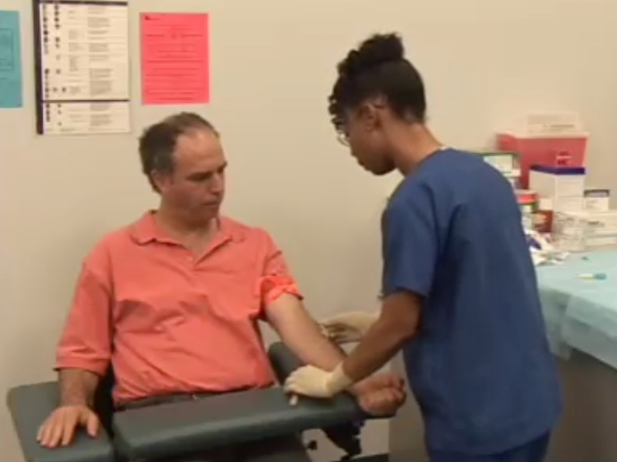
Legal Issues in Health Care Video
Click on the screenshot to view a video on the topic of legal issues in health care.
Back to Directory
Notes:
Covers Objective: 4.4
Video Clip
Legal Issues in Health Care
Why should an EMT have a basic understanding of legal issues related to health care?
What is meant by negligence?
Why is it important to maintain the standard of care?
Discuss the different types of communication that HIPAA protects.
Explain the importance of obtaining informed consent from a patient prior to rendering emergency care.
What is meant by respondeat superior?

Slide 8
Patient Consent and Refusal
Notes:
Teaching Time: 20 minutes
Teaching Tips: Use role-playing and simulated patients to present reality-based scenarios pertaining to consent and refusal of care. This lesson lends itself well to real-world examples. Use actual EMS-related case law to describe legal and ethical dilemmas facing EMTs. Invite a local attorney to discuss laws pertaining to EMS.

Slide 9
Consent
Permission from patient to assess, treat, and transport
Expressed consent
  Must be informed
Implied consent
  Assumed consent
  Follow local laws and protocols.
continued on next slide
Notes:
Covers Objective: 4.4
Point to Emphasize: A patient must give consent to treat to the EMT. This consent may be expressed or implied.
Discussion Topic: How is expressed consent different from implied consent? Discuss specific examples of each.

Slide 10
Consent
Children and mentally incompetent adults
  Minors not legally permitted to provide consent or refusal for treatment
  Obtain from parent or legal guardian
  Possible exceptions (check local law)
    In loco parentis
    Emancipated minors
continued on next slide
Notes:
Covers Objective: 4.4

Slide 11
Consent
Children and mentally incompetent adults
  Possible exceptions (check local law)
    Life-threatening illness or injury
    Minors who have children
    Minors serving in armed forces
continued on next slide
Notes:
Covers Objective: 4.4

Slide 12
Consent
Children and mentally incompetent adults
  Adult patients incapable of informed decisions about care
    State and local laws and protocols permit transport of such patients under implied consent
continued on next slide
Notes:
Covers Objective: 4.4

Slide 13
Consent
Involuntary transportation
  Patient considered threat to himself or others
  Court order
  Usually requires decision by mental health professional or police officer
  If patient restrained, must not risk legal liability
Notes:
Covers Objective: 4.4 and 4.5
Point to Emphasize: Involuntary transport and patient refusal are closely linked. In such situations, EMTs have an even greater responsibility to monitor the patient's condition during transport.
Discussion Topic: Discuss situations in which involuntary transport would be allowed in your state. When are patients not allowed to refuse transport?

Slide 14
When a Patient Refuses Care
Patient may refuse care or transport under the following circumstances:
  Patient must be legally able to consent.
  Patient must be awake and oriented.
  Patient must be fully informed.
  Patient will be asked to sign a "release" form.
Despite all precautions, EMT may still be held liable.
continued on next slide
Notes:
Covers Objective: 4.6
Point to Emphasize: Patient refusal accounts for a huge percentage of EMS-related lawsuits. EMTs are responsible to attempt to persuade such patients but usually do not have the right to force the issue.
Discussion Topic: Describe the conditions necessary to allow a patient to refuse care. What documentation would also be necessary?

Slide 15
When a Patient Refuses Care
Take all possible actions to persuade the patient to accept care and transport.
  Spend time speaking with the patient.
  Listen carefully to try to determine why the patient is refusing care.
  Inform the patient of the consequences of not going to the hospital.
continued on next slide
Notes:
Covers Objective: 4.6
Knowledge Application: Have students research local EMS laws for regulations regarding patient refusal and do not resuscitate (DNR) orders. What rules apply specifically to your EMS system?

Slide 16
When a Patient Refuses Care
Take all possible actions to persuade the patient to accept care and transport.
  Consult medical direction.
  Ask the patient if it is all right if you call a family member—or advise the patient that you would like to call a family member.
continued on next slide
Notes:
Covers Objective: 4.6
Knowledge Application: Have students research local EMS laws for regulations regarding patient refusal and do not resuscitate (DNR) orders. What rules apply specifically to your EMS system?

Slide 17
When a Patient Refuses Care
Take all possible actions to persuade the patient to accept care and transport.
  Call law enforcement personnel if necessary.
Notes:
Covers Objective: 4.6
Knowledge Application: Have students research local EMS laws for regulations regarding patient refusal and do not resuscitate (DNR) orders. What rules apply specifically to your EMS system?

Slide 18
Think About It
What are the risks of beginning treatment and/or transport without getting consent from the patient?
What if the patient refuses to sign the refusal of care form?
Notes:
Covers Objective: 4.6
Talking Points: Subjecting the patient to unwanted care and transport has actually been viewed in court as assault (placing a person in fear of bodily harm) or battery (causing said harm or restraining). Document that the patient refused to sign the form, and have a witness to the refusal sign the document if possible.

Slide 19
When a Patient Refuses Care
Subjecting the patient to unwanted care and transport has actually been viewed in court as assault or battery.
Have witnesses to refusal.
Inform patient that if they change their mind, they can call back.
continued on next slide
Notes:
Covers Objective: 4.6
Knowledge Application: Work in small groups with a programmed patient. Present each group with a patient refusal scenario and discuss strategies and outcomes.

Slide 20
When a Patient Refuses Care
If possible, have friend or relative remain with patient.
Document attempts thoroughly.
Notes:
Covers Objective: 4.6
Knowledge Application: Work in small groups with a programmed patient. Present each group with a patient refusal scenario and discuss strategies and outcomes.

Slide 21
Do Not Resuscitate Orders and Physician Orders for Life-Sustaining Treatment
Legal document expressing patient's wishes if patient unable to speak for self
Do not resuscitate order (DNR)
  May be part of an advance directive
  May be part of a Physician Order for Life-Sustaining Treatment (POLST)
Should also be familiar with living wills and health care proxies
Notes:
Covers Objective: 4.7
Critical Thinking: You respond to a nursing home for a patient in cardiac arrest. Staff at the facility presents you with a valid DNR order, but family members ask you to "please do everything you can." They are very upset and agitated. What should you do?

Slide 22
Other Legal Issues
Notes:
Teaching Time: 20 minutes
Teaching Tip: Link duty to act to critical decision making. Teach that these choices are often not clear and sometimes are difficult. Discuss the idea that there may not always be a correct answer. Discuss the term negligence. Before officially defining it, ask students to define it. Discuss how their answers relate to the actual definition. Demonstrate confidentiality practices in the classroom. Discuss your classroom/educational institution requirements for confidentiality. How do they relate to confidentiality in EMS? Law enforcement officers are often eager to discuss crime scene preservation. Enlist their help in the classroom.

Slide 23
Negligence
Something that should have been done was not done, or was done incorrectly
Must prove:
  EMT had duty to act
  Breach of duty
    EMT failed to provide standard of care expected or failed to act
continued on next slide
Notes:
Covers Objective: 4.8
Point to Emphasize: Negligence, in EMS, implies that there was a duty to act but that there was a breach of duty or a breach of the standard of care. It also implies that damages occurred as a result.
Critical Thinking: How does our previous discussion about the standard of care relate to negligence?

Slide 24
Negligence
Must prove:
  Proximate causation
    Patient suffered harm because of EMT action or inaction
Negligent EMTs may be required to pay damages.
continued on next slide
Notes:
Covers Objective: 4.8
Discussion Topic: Discuss the requirements for proving negligence. Use specific examples of each.
Class Activity: Have a mock trial. Consider using local attorneys to add realism. Create a mock lawsuit and have a student defend himself against charges of negligence.

Slide 25
Negligence
Res ipsa loquitur (the thing speaks for itself)
  Legal concept important in negligence cases
Notes:
Covers Objective: 4.8
Discussion Topic: Discuss the requirements for proving negligence. Use specific examples of each.
Class Activity: Have a mock trial. Consider using local attorneys to add realism. Create a mock lawsuit and have a student defend himself against charges of negligence.

Slide 26
Duty to Act
Obligation to provide care to a patient
Duty to act is not always clear.
  Off duty
  On duty but out of jurisdiction
Follow local laws and protocols.
Follow own conscience.
continued on next slide
Notes:
Covers Objective: 4.8
Point to Emphasize: Duty to act is the obligation that requires patient care on the part of the EMT. Good Samaritan laws protect well-intended providers when no duty to act exists.
Knowledge Application: Choose three types of EMS responders: the off-duty EMT, the volunteer EMT, and the on-duty paid EMT. Discuss how the duty to act is defined for each group.

Slide 27
Duty to Act
Abandonment
  Once care is initiated, it may not be discontinued until transferred to medical personnel of equal or greater training.
  Failure to do so may constitute abandonment.
Notes:
Covers Objective: 4.8

Slide 28
Good Samaritan Laws
Grant immunity from liability if rescuer acts in good faith within level of training
Rarely apply to on-duty personnel
May not cover EMTs in some situations
Do not protect persons from gross negligence or violations of law
Notes:
Covers Objective: 4.9
Discussion Topic: Discuss the Good Samaritan laws. What protections do they afford EMS workers?

Slide 29
Think About It
You arrive on the scene of a patient in cardiac arrest. The family says she has a DNR, but don't know where it is. How should you handle this?
You are off duty and arrive on the scene of a vehicle crash. Police and EMS have not yet arrived. Are you legally obligated to stop and render aid?
Notes:
Covers Objective: 4.16
Talking Points: If there is no documentation indicating the patient's wishes not to be resuscitated, most department policies state that the EMT should begin resuscitation. If the document is later produced, efforts may be terminated (usually after consulting with medical control). Remember, you can always stop later after you start, but you can't start later and have much chance of success.
Laws will vary by state, but in most areas you are not legally obligated to stop. However, one may feel a moral obligation even when a legal one does not exist. It is possible, though, that if you render aid and then leave before police or EMS arrive you may be accused of abandonment. In most cases, the Good Samaritan laws will cover your actions while off duty.

Slide 30
Confidentiality
Information on patient's history, condition, treatment considered confidential
continued on next slide
Notes:
Covers Objective: 4.10
Point to Emphasize: Confidentiality presents both legal and ethical pitfalls to health care workers.
Discussion Topic: Describe the confidentiality laws associated with HIPAA. How might they apply to an EMS service?
Knowledge Application: Present local confidentiality policies (for example, from a local clinical site). Discuss how these policies might apply to local EMS services.

Slide 31
Confidentiality
Privacy Rule of the Health Insurance Portability and Accountability Act (HIPAA)
  Information shared with other health care personnel as part of patient's continuing care
  Otherwise must be obtained through subpoena
Notes:
Covers Objective: 4.10
Point to Emphasize: Confidentiality presents both legal and ethical pitfalls to health care workers.
Discussion Topic: Describe the confidentiality laws associated with HIPAA. How might they apply to an EMS service?
Knowledge Application: Present local confidentiality policies (for example, from a local clinical site). Discuss how these policies might apply to local EMS services.

Slide 32
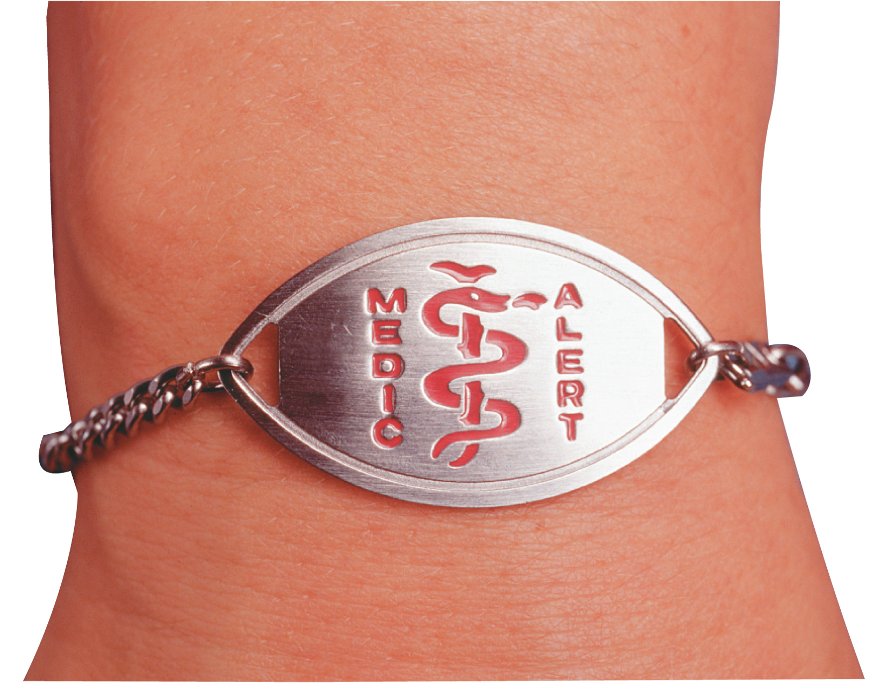
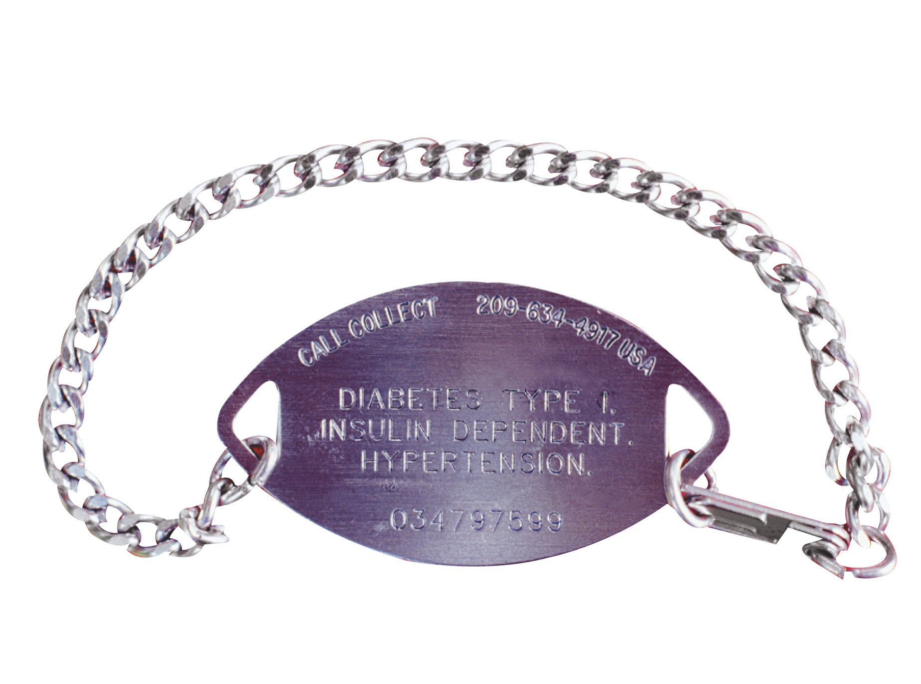
Medical Identification Devices
Example of a medical identification device (front and back).
Notes:
Covers Objective: 4.12

Slide 33
Special Situations
Medical identification devices
  For particular medical conditions
  Necklace, bracelet, or card
  Conditions include:
    Heart conditions
    Allergies
    Diabetes
    Epilepsy
continued on next slide

Slide 34
Special Situations
Organ donors
  Completed legal document allowing donation of organs and tissues in event of death
  May be identified by family members, donor card, driver's license
  Receiving hospital and/or medical direction should be advised per protocol
Notes:
Covers Objective: 4.12

Slide 35
Special Situations
Safe haven laws
  Allow person to drop off an infant or child at any fire, police, or EMS station
  States have different guidelines for ages of children included
  Protect children who may otherwise be abandoned or harmed by parents unwilling or unable to care for them

Slide 36
Crime Scenes
Location where crime was committed or anywhere evidence may be found
Once police have made scene safe, EMT's priority is patient care.
Know what evidence is.
Take steps to preserve evidence.
Notes:
Covers Objective: 4.13
Point to Emphasize: Crime scenes present a special challenge to EMTs. The patient must be cared for, but steps also must be taken to preserve evidence.
Knowledge Application: Use programmed patients to present simulations of crime scenes and the mandated reporting of crimes. Practice crime scene strategies.

Slide 37
Crime Scenes
Examples of evidence
  Condition of the scene
  The patient
  Fingerprints and footprints
  Microscopic evidence
Notes:
Covers Objective: 4.14

Slide 38
Crime Scenes
Preservation of evidence
  Remember what you touch
  Minimize your impact on the scene
  Work with the police
Notes:
Covers Objective: 4.14

Slide 39
Special Reporting Requirements
Child, elderly, or domestic abuse
Violence (gunshot wounds or stabbings)
Sexual assault
Situations where restraint may be necessary
continued on next slide
Notes:
Covers Objective: 4.15
Discussion Topic: Discuss the situations in your state in which EMS workers are mandated to report specific crimes.
Class Activity: Have a mock trial. Consider using local attorneys to add realism. Create a mock lawsuit and have a student defend himself against charges of negligence.

Slide 40
Special Reporting Requirements
Intoxicated person with injuries
Mentally incompetent people with injuries
Check local laws and protocols.
Notes:
Covers Objective: 4.15
Discussion Topic: Discuss the situations in your state in which EMS workers are mandated to report specific crimes.
Class Activity: Have a mock trial. Consider using local attorneys to add realism. Create a mock lawsuit and have a student defend himself against charges of negligence.

Slide 41
Chapter Review

Slide 42
Chapter Review
Medical, legal, and ethical issues are a part of every EMS call.
continued on next slide

Slide 43
Chapter Review
Consent may be expressed or implied. If a patient who is awake and oriented and has the capacity to fully understand his situation refuses care or transport, you should make every effort to persuade him, but you cannot force him to accept care or go to the hospital.
continued on next slide

Slide 44
Chapter Review
Negligence is failing to act properly when you have a duty to act. As an EMT, you have a duty to act whenever you are dispatched on a call. You may have a legal or moral duty to act even when off duty or outside your jurisdiction.
continued on next slide

Slide 45
Chapter Review
Abandonment is leaving a patient after you have initiated care and before you have transferred the patient to a person with equal or higher training.
continued on next slide

Slide 46
Chapter Review
Confidentiality is the obligation not to reveal personal information you obtain about a patient except to other health care professionals involved in the patient's care, under court order, or when the patient signs a release.
continued on next slide

Slide 47
Chapter Review
As an EMT, you may be sued or held legally liable on any of these issues. However, EMTs are rarely held liable when they have acted within their scope of practice and according to the standard of care and have carefully documented the details of the call.
continued on next slide

Slide 48
Chapter Review
At a crime scene, care of the patient takes precedence over preservation of evidence; however, you should make every effort not to disturb the scene unnecessarily and to report your actions and observations to the police.
continued on next slide

Slide 49
Remember
EMTs must use good judgment and decision-making skills when dealing with patient consent and refusal.
Avoiding negligence implies using good judgment; critical thinking is an essential component for avoiding liability.
continued on next slide

Slide 50
Remember
EMTs hold responsibility for patients' protected health information; exercising care when dealing with this information is a legal and ethical obligation.

Slide 51
Questions to Consider
Define scope of practice, negligence, duty to act, abandonment, and confidentiality.
What steps must you take when a patient refuses care or transportation?
What types of evidence may be found at a crime scene? How should you act to preserve evidence?
Notes:
Talking Points: Scope of practice is the medical, legal, and ethical guidelines that guide EMTs in their work. Negligence occurs when you fail to act when you have a duty to act. EMTs have a duty to act whenever they go on a call; they may also be morally obligated to act even when off duty. Abandonment is leaving a patient after you have initiated care before the patient has been handed off to a person with equal or higher training. Confidentiality is the obligation not to reveal personal information obtained about a patient except in certain circumstances.
When a patient refuses care or transportation, make sure that all aspects of the refusal are documented, including all of the steps taken to persuade the patient to be treated and transported. Tell patient that he can call again if the condition worsens. Suggest that someone stay with the patient.
Evidence includes condition of the scene, the patient, fingerprints and footprints, and microscopic evidence. EMTs should carefully observe the scene at all times, disturb the scene as little as possible, and document the call.

Slide 52
Critical Thinking
You respond to a motor vehicle crash and find a seriously injured patient. He has no pulse and you are about to begin CPR when someone says, "Don't do that! He's got cancer and a DNR!" No one has the DNR at the scene. Do you start CPR and transport the patient?
Notes:
Talking Points: You cannot honor a DNR unless it is present and valid. Full care, including CPR and transport, must be initiated as you would on any other call.

