Slide 1
Chapter 5
Unsupervised learning

Slide 2
Introduction
Unsupervised learning
  Training samples contain only input patterns
    No desired output is given (teacher-less)
  Learn to form classes/clusters of sample patterns according to similarities among them
    Patterns in a cluster would have similar features
    No prior knowledge as what features are important for classification, and how many classes are there.

Slide 3
Introduction
NN models to be covered
  Competitive networks and competitive learning
    Winner-takes-all (WTA)
    Maxnet
    Hemming net
  Counterpropagation nets
  Adaptive Resonance Theory
  Self-organizing map (SOM)
Applications
  Clustering
  Vector quantization
  Feature extraction
  Dimensionality reduction
  optimization

Slide 4
NN Based on Competition
Competition is important for NN
  Competition between neurons has been observed in biological nerve systems
  Competition is important in solving many problems
To classify an input pattern into one of the m classes
  idea case: one class node has output 1, all other 0 ;
  often more than one class nodes have non-zero output
x_1
C_1
x_n
C_m
INPUT
CLASSIFICATION
  If these class nodes compete with each other, maybe only one will win eventually and all others lose (winner-takes-all). The winner represents the computed classification of the input

Slide 5
Winner-takes-all (WTA):
  Among all competing nodes, only one will win and all others will lose
  We mainly deal with single winner WTA, but multiple winners WTA are possible (and useful in some applications)
  Easiest way to realize WTA: have an external, central arbitrator (a program) to decide the winner by comparing the current outputs of the competitors (break the tie arbitrarily)
  This is biologically unsound (no such external arbitrator exists in biological nerve system).

Slide 6





Ways to realize competition in NN
  Lateral inhibition (Maxnet, Mexican hat)
  output of each node feeds
  to others through inhibitory
  connections (with negative weights)
  Resource competition
    output of node k is distributed to
    node i and j proportional to w_{ik}
    and w_{jk} , as well as x_{i} and x_{j}
    self decay
    biologically sound
x_{i}
x_{j}
x_{i}
x_{j}
x_{k}

Slide 7
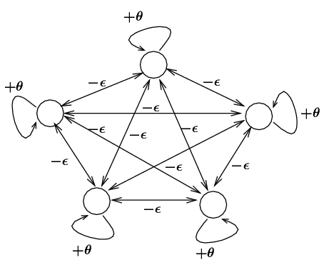
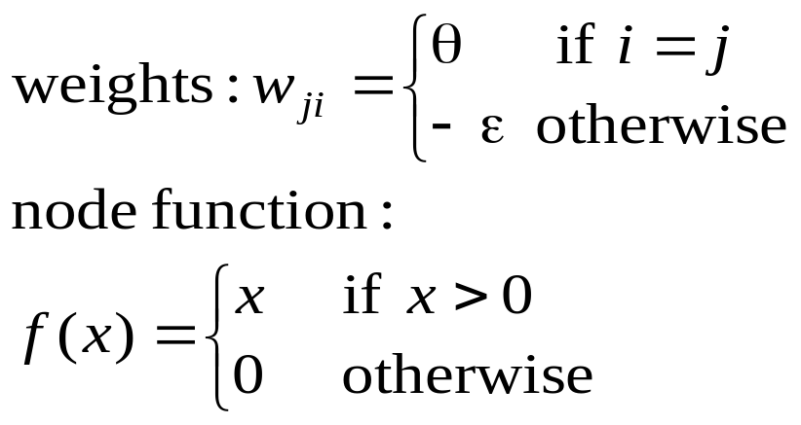


Fixed-weight Competitive Nets
Maxnet
  Lateral inhibition between competitors
  Notes:
    Competition: iterative process until the net stabilizes (at most one node with positive activation)
    where m is the # of competitors
    too small: takes too long to converge
    too big: may suppress the entire network (no winner)

Slide 8
Fixed-weight Competitive Nets
Example
θ = 1, ε = 1/5 = 0.2
x(0) = (0.5 0.9 1 0.9 0.9 ) initial input
x(1) = (0 0.24 0.36 0.24 0.24 )
x(2) = (0 0.072 0.216 0.072 0.072)
x(3) = (0 0 0.1728 0 0 )
x(4) = (0 0 0.1728 0 0 ) = x(3)
stabilized

Slide 9
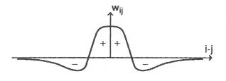
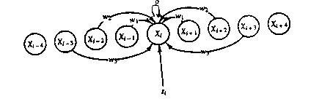
Mexican Hat
Architecture: For a given node,
  close neighbors: cooperative (mutually excitatory , w > 0)
  farther away neighbors: competitive (mutually inhibitory,w < 0)
  too far away neighbors: irrelevant (w = 0)
Need a definition of distance (neighborhood):
  one dimensional: ordering by index (1,2,…n)
  two dimensional: lattice

Slide 10
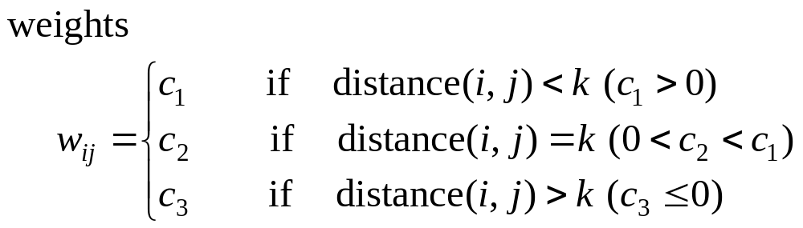
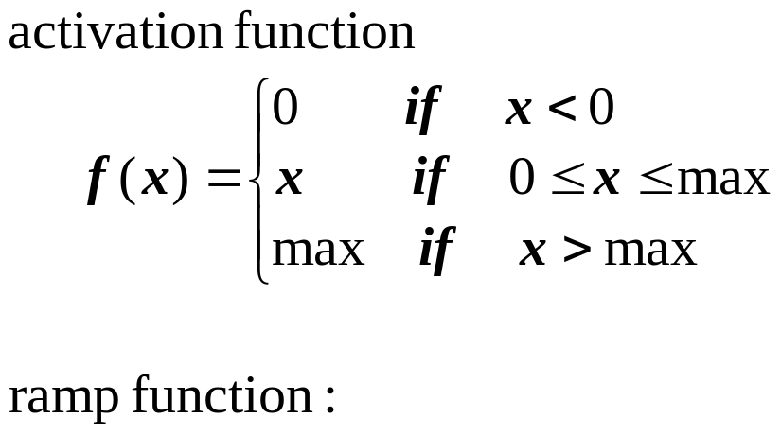

Slide 11
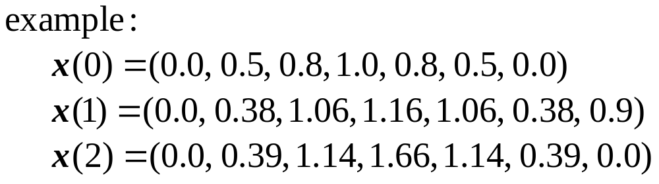
Equilibrium:
  negative input = positive input for all nodes
  winner has the highest activation;
  its cooperative neighbors also have positive activation;
  its competitive neighbors have negative (or zero) activations.

Slide 12

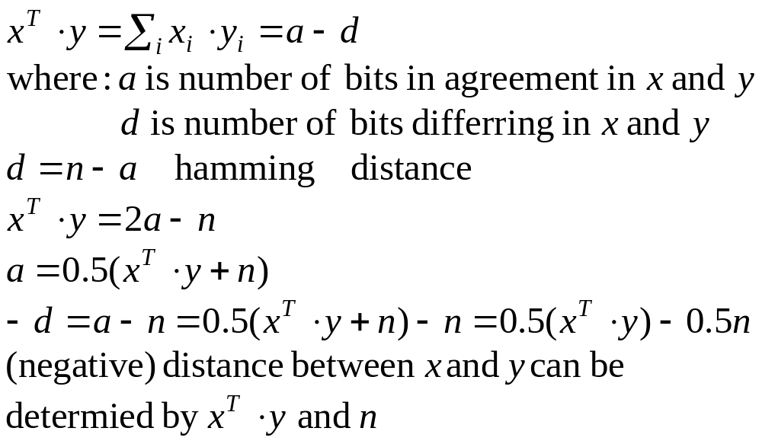
Hamming Network
Hamming distance of two vectors, of dimension n,
  Number of bits in disagreement.
  In bipolar:

Slide 13
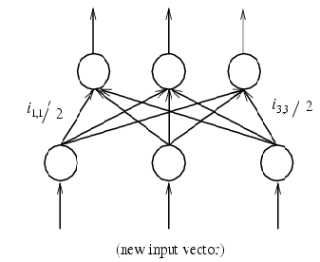
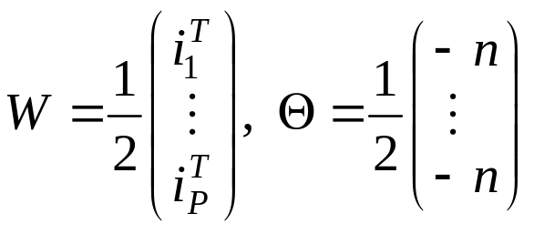
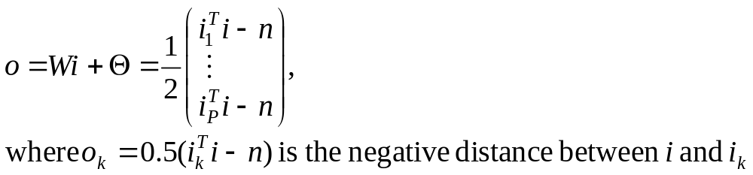
Hamming Network
Hamming network: net computes – d between an input i and each of the P vectors i₁,…, i_{P} of dimension n
  n input nodes, P output nodes, one for each of P stored vector i_{p} whose output = – d(i, i_{p})
  Weights and bias:
  Output of the net:

Slide 14
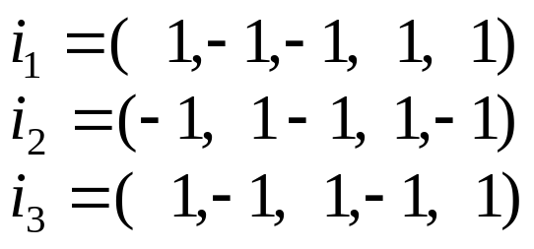

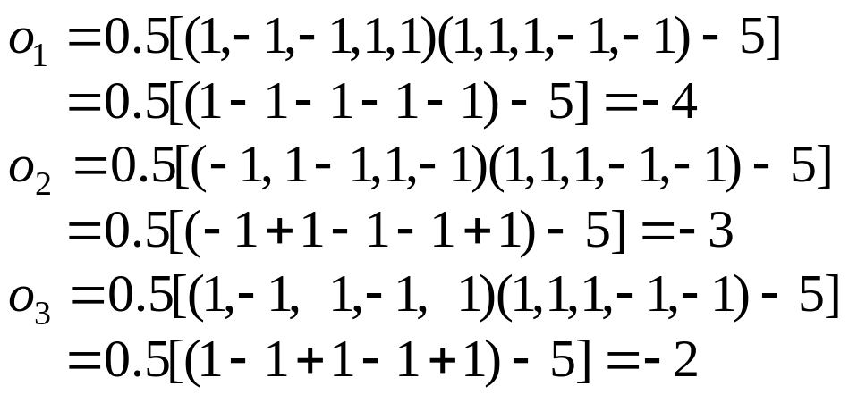
Example:
  Three stored vectors:
  Input vector:
  Distance: (4, 3, 2)
  Output vector
  If we what the vector with smallest distance to I to win, put a Maxnet on top of the Hamming net (for WTA)
    We have a associate memory: input pattern recalls the stored vector that is closest to it (more on AM later)

Slide 15
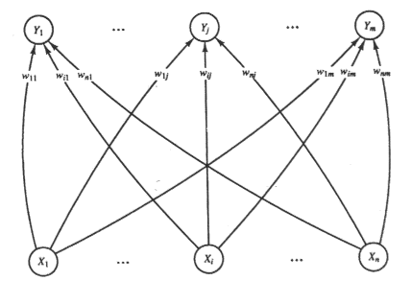
Simple Competitive Learning
Unsupervised learning
Goal:
  Learn to form classes/clusters of examplers/sample patterns according to similarities of these exampers.
  Patterns in a cluster would have similar features
  No prior knowledge as what features are important for classification, and how many classes are there.
Architecture:
  Output nodes:
  Y_1,…….Y_m,
  representing the m classes
  They are competitors
  (WTA realized either by
  an external procedure or
  by lateral inhibition as in Maxnet)

Slide 16



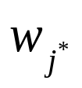
Training:
  Train the network such that the weight vector w_{j} associated with jth output node becomes the representative vector of a class of similar input patterns.
  Initially all weights are randomly assigned
  Two phase unsupervised learning
competing phase:
  apply an input vector randomly chosen from sample set.
  compute output for all output nodes:
  determine the winner among all output nodes (winner is not given in training samples so this is unsupervised)
rewarding phase:
  the winner is reworded by updating its weights to be closer to (weights associated with all other output nodes are not updated: kind of WTA)
repeat the two phases many times (and gradually reduce the learning rate) until all weights are stabilized.

Slide 17
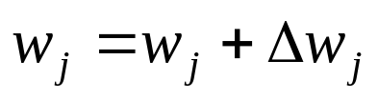
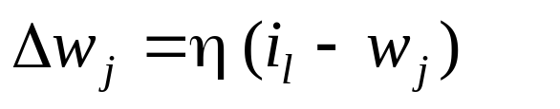


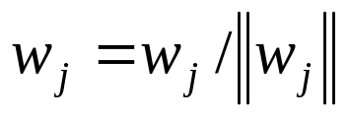
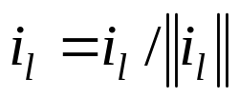
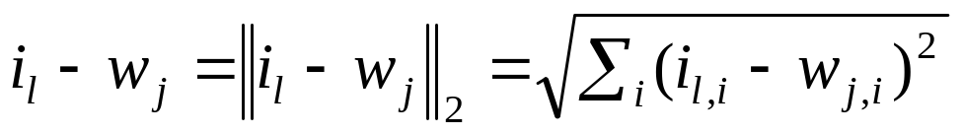
Weight update:
  Method 1: Method 2
  In each method, is moved closer to i_{l}
  Normalize the weight vector to unit length after it is updated
  Sample input vectors are also normalized
  Distance
i_{l} – w_{j}
η (i_{l} - w_{j})
i_{l} + w_{j}
i_{l}
i_{l}
ηi_{l}
w_{j}
w_{j} + η(i_{l} - w_{j})
w_{j}
w_{j} + ηi_{l}

Slide 18
is moving to the center of a cluster of sample vectors after repeated weight updates
  Node j wins for three training
  samples: i₁ , i₂ and i₃
  Initial weight vector w_{j}(0)
  After successively trained
  by i₁ , i₂ and i₃ ,
  the weight vector
  changes to w_{j}(1),
  w_{j}(2), and w_{j}(3),
w_{j}(0)
w_{j}(3)
i₃
w_{j}(1)
i₁
w_{j}(2)
i₂

Slide 19






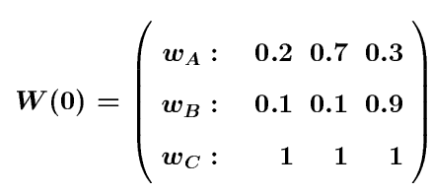
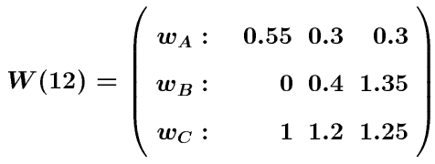
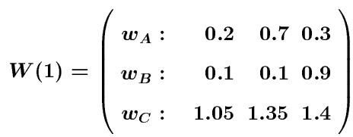
Examples
A simple example of competitive learning (pp. 168-170)
  6 vectors of dimension 3 in 3 classes (6 input nodes, 3 output nodes)
  Weight matrices:
Node A: for class {i₂, i₄, i₅}
Node B: for class {i₃}
Node C: for class {i₁, i₆}

Slide 20


Comments
Ideally, when learning stops, each is close to the centroid of a group/cluster of sample input vectors.
To stabilize , the learning rate may be reduced slowly toward zero during learning, e.g.,
# of output nodes:
  too few: several clusters may be combined into one class
  too many: over classification
  ART model (later) allows dynamic add/remove output nodes
Initial :
  learning results depend on initial weights (node positions)
  training samples known to be in distinct classes, provided such info is available
  random (bad choices may cause anomaly)
Results also depend on sequence of sample presentation

Slide 21


Example
will always win no matter
the sample is from which class
is stuck and will not participate
in learning
unstuck:
let output nodes have some conscience
temporarily shot off nodes which have had very high
winning rate (hard to determine what rate should be
considered as “very high”)
w₂
w₁

Slide 22
Example
Results depend on the sequence
of sample presentation
w₂
w₁
w₂
Solution:
Initialize w_{j} to randomly selected input vectors that are far away from each other
w₁

Slide 23
Self-Organizing Maps (SOM) (§ 5.5)
Competitive learning (Kohonen 1982) is a special case of SOM (Kohonen 1989)
In competitive learning,
  the network is trained to organize input vector space into subspaces/classes/clusters
  each output node corresponds to one class
  the output nodes are not ordered: random map
cluster_1
The topological order of the three clusters is 1, 2, 3
The order of their maps at output nodes are 2, 3, 1
The map does not preserve the topological order of the training vectors
cluster_2
w_2
w_3
cluster_3
w_1

Slide 24



Topographic map
  a mapping that preserves neighborhood relations between input vectors, (topology preserving or feature preserving).
  if are two neighboring input vectors ( by some distance metrics),
    their corresponding winning output nodes (classes), i and j must also be close to each other in some fashion
  one dimensional: line or ring, node i has neighbors or
  two dimensional: grid.
  rectangular: node(i, j) has neighbors:
  hexagonal: 6 neighbors

Slide 25
Biological motivation
  Mapping two dimensional continuous inputs from sensory organ (eyes, ears, skin, etc) to two dimensional discrete outputs in the nerve system.
    Retinotopic map: from eye (retina) to the visual cortex.
    Tonotopic map: from the ear to the auditory cortex
  These maps preserve topographic orders of input.
  Biological evidence shows that the connections in these maps are not entirely “pre-programmed” or “pre-wired” at birth. Learning must occur after the birth to create the necessary connections for appropriate topographic mapping.

Slide 26
SOM Architecture
Two layer network:
  Output layer:
    Each node represents a class (of inputs)
    Neighborhood relation is defined over these nodes
      N_{j}(t): set of nodes within distance D(t) to node j.
    Each node cooperates with all its neighbors and competes with all other output nodes.
    Cooperation and competition of these nodes can be realized by Mexican Hat model
D = 0: all nodes are competitors (no cooperative) → random map
D > 0: → topology preserving map

Slide 27
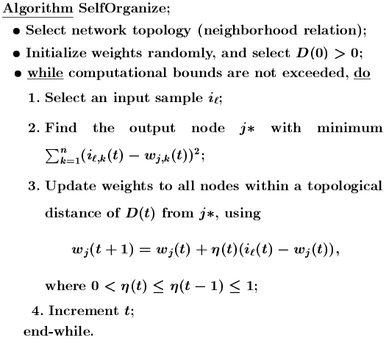

Slide 28


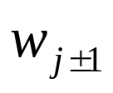
Notes
Initial weights: small random value from (-e, e)
Reduction of :
  Linear:
  Geometric:
Reduction of D:
  should be much slower than reduction.
  D can be a constant through out the learning.
Effect of learning
  For each input i, not only the weight vector of winner
  is pulled closer to i, but also the weights of ’s close neighbors (within the radius of D).
Eventually, becomes close (similar) to . The classes they represent are also similar.
May need large initial D in order to establish topological order of all nodes

Slide 29
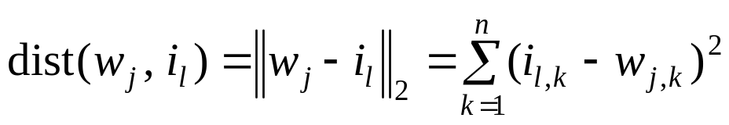
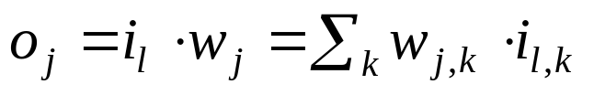
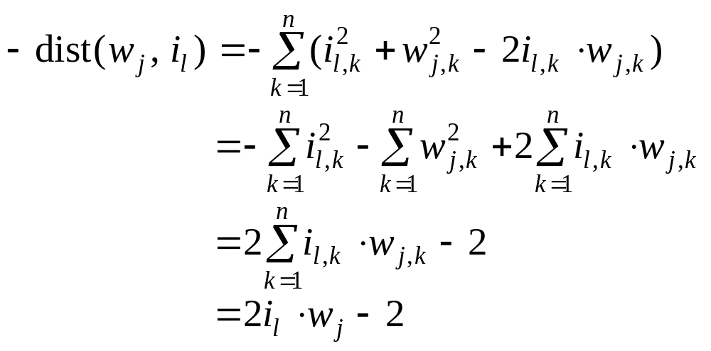
Notes
Find j* for a given input i_{l}:
  With minimum distance between w_{j} and i_{l}.
  Distance:
  Minimizing dist(w_{j}, i_{l}) can be realized by maximizing

Slide 30
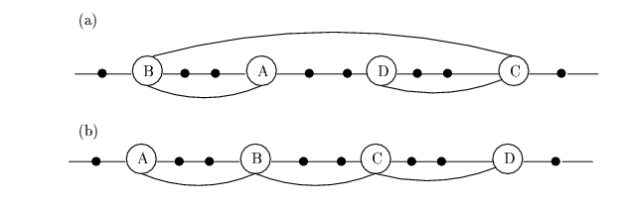
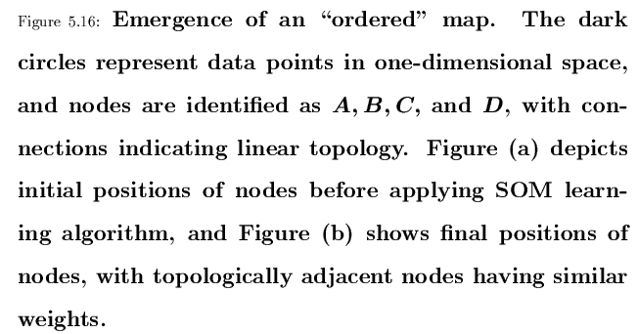

Slide 31
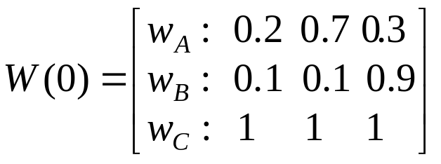




Examples
A simple example of competitive learning (pp. 172-175)
  6 vectors of dimension 3 in 3 classes, node ordering: B – A – C
  Initialization: , weight matrix:
  D(t) = 1 for the first epoch, = 0 afterwards
  Training with
  determine winner: squared Euclidean distance between
  C wins, since D(t) = 1, weights of node C and its neighbor A are updated, bit not w_{B}

Slide 32
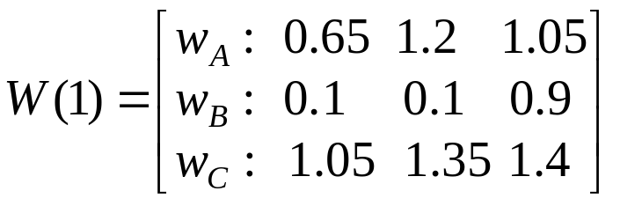
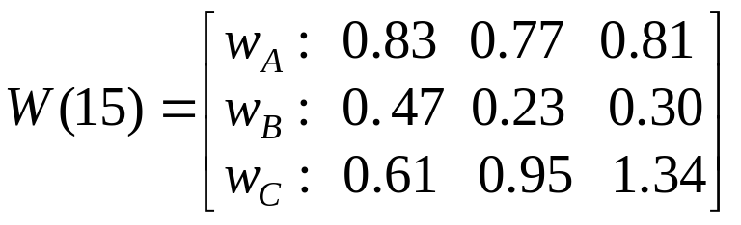
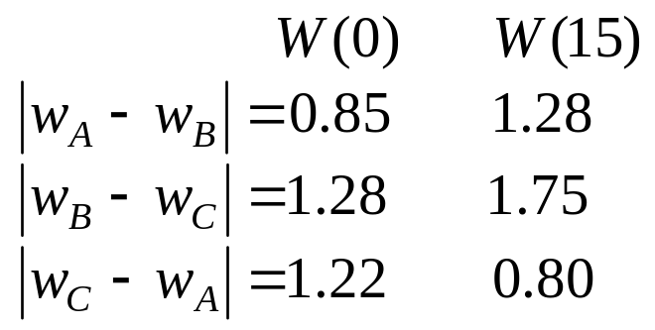
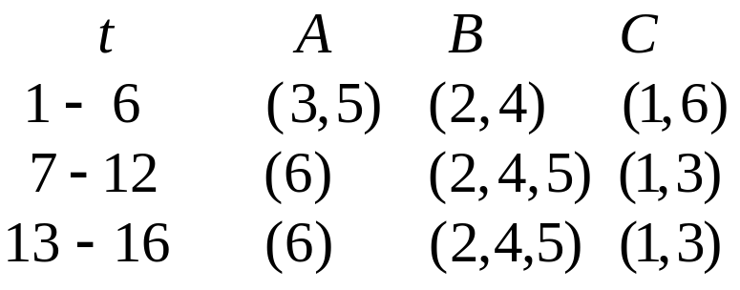
Examples
  Observations:
    Distance between weights of non-neighboring nodes (B, C) increase
    Input vectors switch allegiance between nodes, especially in the early stage of training

Slide 33
How to illustrate Kohonen map (for 2 dimensional patterns)
  Input vector: 2 dimensional
  Output vector: 1 dimensional line/ring or 2 dimensional grid.
  Weight vector is also 2 dimensional
  Represent the topology of output nodes by points on a 2 dimensional plane. Plotting each output node on the plane with its weight vector as its coordinates.
  Connecting neighboring output nodes by a line
  output nodes: (1, 1) (2, 1) (1, 2)
  weight vectors: (0.5, 0.5) (0.7, 0.2) (0.9, 0.9)
C(1, 2)
C(1, 1)
C(2, 1)

Slide 34
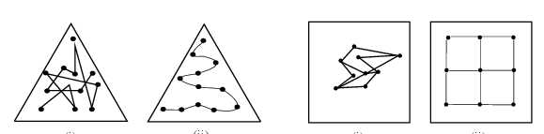
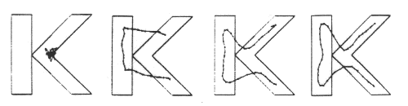
Illustration examples
Input vectors are uniformly distributed in the region, and randomly drawn from the region
Weight vectors are initially drawn from the same region randomly (not necessarily uniformly)
Weight vectors become ordered according to the given topology (neighborhood), at the end of training

Slide 35
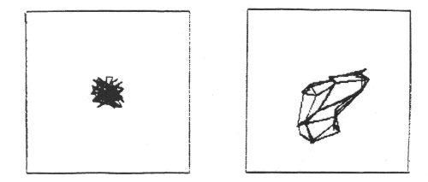
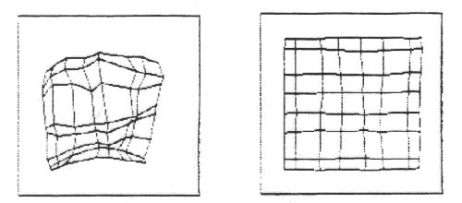

Slide 36
Traveling Salesman Problem (TSP)
Given a road map of n cities, find the shortest tour which visits every city on the map exactly once and then return to the original city (Hamiltonian circuit)
(Geometric version):
  A complete graph of n vertices on a unit square.
  Each city is represented by its coordinates (x_i, y_i)
  n!/2n legal tours
  Find one legal tour that is shortest

Slide 37
Approximating TSP by SOM
Each city is represented as a 2 dimensional input vector (its coordinates (x, y)),
Output nodes C_j, form a SOM of one dimensional ring, (C_1, C_2, …, C_n, C_1).
Initially, C_1, ... , C_n have random weight vectors, so we don’t know how these nodes correspond to individual cities.
During learning, a winner C_j on an input (x_I, y_I) of city i, not only moves its w_j toward (x_I, y_I), but also that of of its neighbors (w_(j+1), w_(j-1)).
As the result, C_(j-1) and C_(j+1) will later be more likely to win with input vectors similar to (x_I, y_I), i.e, those cities closer to I
At the end, if a node j represents city I, it would end up to have its neighbors j+1 or j-1 to represent cities similar to city I (i,e., cities close to city I).
This can be viewed as a concurrent greedy algorithm

Slide 38
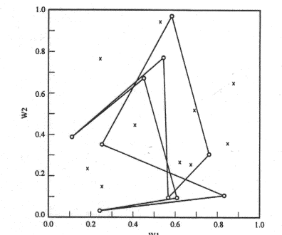
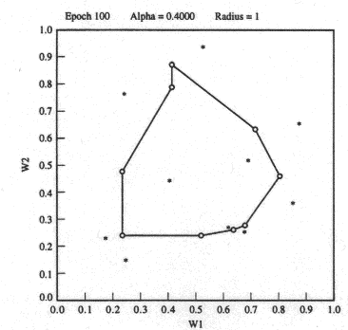
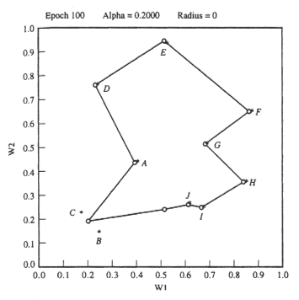
Initial position
Two candidate solutions:
  ADFGHIJBC
  ADFGHIJCB

Slide 39
Convergence of SOM Learning
Objective of SOM: converge to an ordered map
  Nodes are ordered if for all nodes r, s, q
One-dimensional SOP
  If neighborhood relation satisfies certain properties, then there exists a sequence of input patterns that will lead the learn to converge to an ordered map
  When other sequence is used, it may converge, but not necessarily to an ordered map
SOM learning can be viewed as of two phases
  Volatile phase: search for niches to move into
  Sober phase: nodes converge to centroids of its class of inputs
  Whether a “right” order can be established depends on “volatile phase,

Slide 40
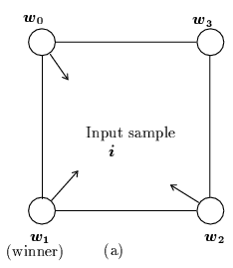
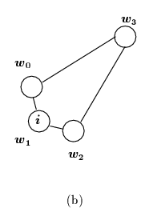
Convergence of SOM Learning
For multi-dimensional SOM
  More complicated
  No theoretical results
Example
  4 nodes located at 4 corners
  Inputs are drawn from the region that is near the center of the square but slightly closer to w₁
  Node 1 will always win, w₁, w₀, and w₂ will be pulled toward inputs, but w₃ will remain at the far corner
  Nodes 0 and 2 are adjacent to node 3, but not to each other. However, this is not reflected in the distances of the weight vectors:
  |w₀ – w₂| < |w₃ – w₂|

Slide 41
Extensions to SOM
Hierarchical maps:
  Hierarchical clustering algorithm
    Tree of clusters:
    Each node corresponds to a cluster
    Children of a node correspond to subclusters
    Bottom-up: smaller clusters merged to higher level clusters
  Simple SOM not adequate
    When clusters have arbitrary shapes
    It treats every dimension equally (spherical shape clusters)
  Hierarchical maps
    First layer clusters similar training inputs
    Second level combine these clusters into arbitrary shape

Slide 42
Growing Cell Structure (GCS):
  Dynamically changing the size of the network
    Insert/delete nodes according to the “signal count” τ (# of inputs associated with a node)
  Node insertion
    Let l be the node with the largest τ.
    Add new node l_{new} when τ_{l} > upper bound
    Place l_{new} in between l and l_{far}, where l_{far} is the farthest neighbor of l,
    Neighbors of l_{new} include both l and l_{far} (and possibly other existing neighbors of l and l_{far} ).
  Node deletion
    Delete a node (and its incident edges) if its τ < lower bound
    Node with no other neighbors are also deleted.

Slide 43
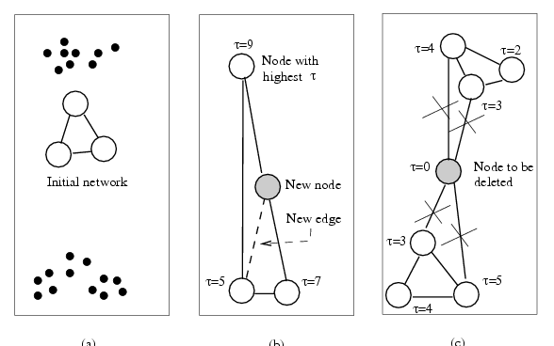
  Example

Slide 44
Distance-Based Learning (§ 5.6)
Which nodes will have the weights updated when an input i is applied
  Simple competitive learning: winner node only
  SOM: winner and its neighbors
  Distance-based learning: all nodes within a given distance to i
Maximum entropy procedure
  Depending on Euclidean distance |i – w_{j}|
Neural gas algorithm
  Depending on distance rank

Slide 45





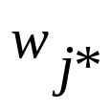
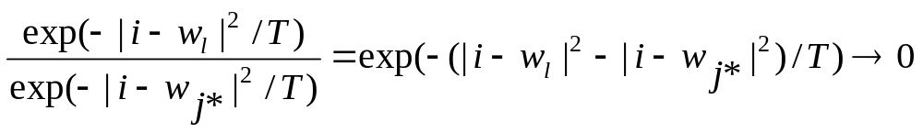
Maximum entropy procedure
T: artificial temperature, monotonically decreasing
Every node may have its weight vector updated
Learning rate for each depends on the distance
where is normalization factor
When , only the winner’s weight vectored is updated, because, for any other node l

Slide 46


Neural gas algorithm
Rank k_{j}(i, W): # of nodes have their weight vectors closer to input vector i than
Weight update depends on rank
where h(x) is a monotonically decreasing function
  for the highest ranking node: k_{j*}(i, W) = 0: h(0) = 1.
  for others: k_{j}(i, W) > 0: h < 1
  e.g: decay function
  when λ ≈ 0, winner takes all!!!
Better clustering results than many others (e.g., SOM, k-mean, max entropy)

Slide 47
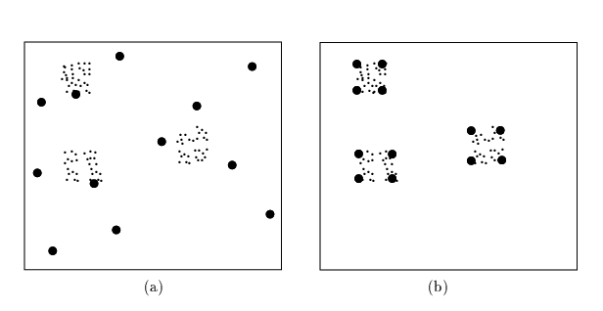
  Example

Slide 48


Counter propagation network (CPN) (§ 5.3)
Basic idea of CPN
  Purpose: fast and coarse approximation of vector mapping
    not to map any given x to its with given precision,
    input vectors x are divided into clusters/classes.
    each cluster of x has one output y, which is (hopefully) the average of for all x in that class.
  Architecture: Simple case: FORWARD ONLY CPN,
x
z
y
1
1
1
x
w
z
v
y
i
k,i
k
j,k
j
x
z
y
n
p
m
from input to hidden (class)
from hidden (class) to output

Slide 49





Learning in two phases:
  training sample (x, d ) where is the desired precise mapping
  Phase1: weights coming into hidden nodes are trained by competitive learning to become the representative vector of a cluster of input vectors x: (use only x, the input part of (x, d ))
  1. For a chosen x, feedforward to determined the winning
  2.
  3. Reduce , then repeat steps 1 and 2 until stop condition is met
  Phase 2: weights going out of hidden nodes are trained by delta rule to be an average output of where x is an input vector that causes to win (use both x and d).
  1. For a chosen x, feedforward to determined the winning
  2. (optional)
  3.
  4. Repeat steps 1 – 3 until stop condition is met

Slide 50

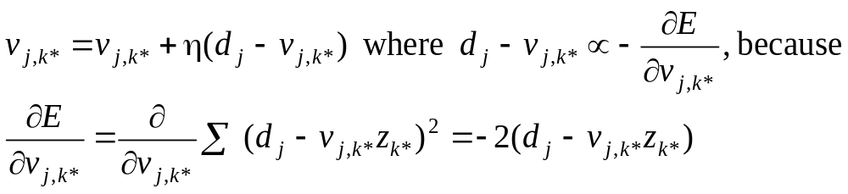
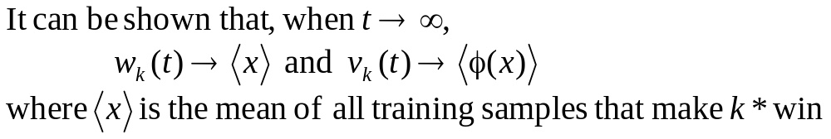
Notes
A combination of both unsupervised learning (for in phase 1) and supervised learning (for in phase 2).
After phase 1, clusters are formed among sample input x , each is a representative of a cluster (average).
After phase 2, each cluster k maps to an output vector y, which is the average of
View phase 2 learning as following delta rule

Slide 51




Slide 52
After training, the network works like a look-up of math table.
  For any input x, find a region where x falls (represented by the wining z node);
  use the region as the index to look-up the table for the function value.
  CPN works in multi-dimensional input space
  More cluster nodes (z), more accurate mapping.
  Training is much faster than BP
  May have linear separability problem

Slide 53



Full CPN
If both
we can establish bi-directional approximation
Two pairs of weights matrices:
W(x to z) and V(z to y) for approx. map x to
U(y to z) and T(z to x) for approx. map y to
When training sample (x, y) is applied ( ), they can jointly determine the winner z_{k*} or separately for

Slide 54
Adaptive Resonance Theory (ART) (§ 5.4)
ART1: for binary patterns; ART2: for continuous patterns
Motivations: Previous methods have the following problems:
  Number of class nodes is pre-determined and fixed.
    Under- and over- classification may result from training
    Some nodes may have empty classes.
    no control of the degree of similarity of inputs grouped in one class.
  Training is non-incremental:
    with a fixed set of samples,
    adding new samples often requires re-train the network with the enlarged training set until a new stable state is reached.

Slide 55


Ideas of ART model:
  suppose the input samples have been appropriately classified into k clusters (say by some fashion of competitive learning).
  each weight vector is a representative (average) of all samples in that cluster.
  when a new input vector x arrives
    Find the winner j* among all k cluster nodes
    Compare with x
if they are sufficiently similar (x resonates with class j*),
then update based on
else, find/create a free class node and make x as its
first member.

Slide 56
To achieve these, we need:
  a mechanism for testing and determining (dis)similarity between x and .
  a control for finding/creating new class nodes.
  need to have all operations implemented by units of local computation.
Only the basic ideas are presented
  Simplified from the original ART model
  Some of the control mechanisms realized by various specialized neurons are done by logic statements of the algorithm

Slide 57


ART1 Architecture

Slide 58
Working of ART1
3 phases after each input vector x is applied
Recognition phase: determine the winner cluster for x
  Using bottom-up weights b
  Winner j* with max y_{j*} = b_{j*} ּx
  x is tentatively classified to cluster j*
  the winner may be far away from x (e.g., |t_{j*} - x| is unacceptably large)

Slide 59


Working of ART1 (3 phases)
Comparison phase:
  Compute similarity using top-down weights t:
  vector:
  If (# of 1’s in s)|/(# of 1’s in x) > ρ, accept the classification, update b_{j*} and t_{j*}
  else: remove j* from further consideration, look for other potential winner or create a new node with x as its first patter.

Slide 60







Weight update/adaptive phase
  Initial weight: (no bias)
  bottom up: top down:
  When a resonance occurs with
  If k sample patterns are clustered to node j then
= pattern whose 1’s are common to all these k samples

Slide 61







Slide 62







Example
for input x(1)
Node 1 wins

Slide 63


Slide 64
Notes
Classification as a search process
No two classes have the same b and t
Outliers that do not belong to any cluster will be assigned separate nodes
Different ordering of sample input presentations may result in different classification.
Increase of ρ increases # of classes learned, and decreases the average class size.
Classification may shift during search, will reach stability eventually.
There are different versions of ART1 with minor variations
ART2 is the same in spirit but different in details.

Slide 65











ART1 Architecture
+
+
R
-
G2
-
+
G1
+
+
+

Slide 66



cluster units: competitive, receive input vector x through weights b: to determine winner j.
input units: placeholder or external inputs
interface units:
  pass s to x as input vector for classification by
  compare x and
  controlled by gain control unit G1
Needs to sequence the three phases (by control units G1, G2, and R)

Slide 67





R = 0: resonance occurs, update and
R = 1: fails similarity test, inhibits J from further computation

Slide 68
Principle Component Analysis (PCA) Networks (§ 5.8)
PCA: a statistical procedure
  Reduce dimensionality of input vectors
    Too many features, some of them are dependent of others
    Extract important (new) features of data which are functions of original features
    Minimize information loss in the process
  This is done by forming new interesting features
    As linear combinations of original features (first order of approximation)
    New features are required to be linearly independent (to avoid redundancy)
    New features are desired to be different from each other as much as possible (maximum variability)

Slide 69





Linear Algebra
Two vectors
are said to be orthogonal to each other if
A set of vectors of dimension n are said to be linearly independent of each other if there does not exist a set of real numbers which are not all zero such that
otherwise, these vectors are linearly dependent and each one can be expressed as a linear combination of the others

Slide 70
Vector x is an eigenvector of matrix A if there exists a constant γ != 0 such that Ax = γx
  γ is called a eigenvalue of A (wrt x)
  A matrix A may have more than one eigenvectors, each with its own eigenvalue
  Eigenvectors of a matrix corresponding to distinct eigenvalues are linearly independent of each other
Matrix B is called the inverse matrix of matrix A if AB = 1
  1 is the identity matrix
  Denote B as A⁻¹
  Not every matrix has inverse (e.g., when one of the row/column can be expressed as a linear combination of other rows/columns)
Every matrix A has a unique pseudo-inverse A*, which satisfies the following properties
  AA*A = A; A*AA* = A*; A*A = (A*A)^{T}; AA* = (AA*)^{T}

Slide 71


Example of PCA: 3-dim x is transformed to 2-dem y
2-d feature vector
Transformation matrix W
3-d feature vector
If rows of W have unit length and are ortho-gonal (e.g., w₁ • w₂ = ap + bq + cr = 0), then
W^{T} is a pseudo-inverse of W

Slide 72
Generalization
  Transform n-dim x to m-dem y (m < n) , the pseudo-inverse matrix W is a m x n matrix
  Transformation: y = Wx
  Opposite transformation: x’ = W^{T}y = W^{T}Wx
  If W minimizes “information loss” in the transformation, then
  ||x – x’|| = ||x – W^{T}Wx|| should also be minimized
  If W^{T} is the pseudo-inverse of W, then x’ = x: perfect transformation (no information loss)
How to find such a W for a given set of input vectors
  Let T = {x₁, …, x_{k}} be a set of input vectors
  Making them zero-mean vectors by subtracting the mean vector (∑ x_{i}) / k from each x_{i}.
  Compute the correlation matrix S(T) of these zero-mean vectors, which is a n x n matrix (book calls covariance-variance matrix)

Slide 73
  Find the m eigenvectors of S(T): w₁, …, w_{m} corresponding to m largest eigenvalues γ₁, …, γ_{m}
  w₁, …, w_{m} are the first m principal components of T
  W = (w1, …, w_{m}) is the transformation matrix we are looking for
  m new features extract from transformation with W would be linearly independent and have maximum variability
  This is based on the following mathematical result:

Slide 74








Example

Slide 75






Slide 76



Slide 77

PCA network architecture
Output: vector y of m-dim
W: transformation matrix
y = Wx
x = W^{T}y
Input: vector x of n-dim
  Train W so that it can transform sample input vector x_{l} from n-dim to m-dim output vector y_{l}.
  Transformation should minimize information loss:
  Find W which minimizes
  ∑_{l}||x_{l} – x_{l}’|| = ∑_{l}||x_{l} – W^{T}Wx_{l}|| = ∑_{l}||x_{l} – W^{T}y_{l}||
  where x_{l}’ is the “opposite” transformation of y_{l} = Wx_{l} via W^{T}

Slide 78


Training W for PCA net
  Unsupervised learning:
  only depends on input samples x_{l}
  Error driven: ΔW depends on ||x_{l} – x_{l}’|| = ||x_{l} – W^{T}Wx_{l}||
  Start with randomly selected weight, change W according to
  This is only one of a number of suggestions for K_{l}, (Williams)
  Weight update rule becomes
(
)
column vector
row vector
transf. error

Slide 79






Example (sample sample inputs as in previous example)
-
After x₃
After x₄
After x₅
After second epoch
After second epoch
eventually converging to 1st PC (-0.823 -0.542 -0.169)

Slide 80

Notes
  PCA net approximates principal components (error may exist)
  It obtains PC by learning, without using statistical methods
  Forced stabilization by gradually reducing η
  Some suggestions to improve learning results.
    instead of using identity function for output y = Wx, using non-linear function S, then try to minimize
    If S is differentiable, use gradient descent approach
    For example: S be monotonically increasing odd function
    S(-x) = -S(x) (e.g., S(x) = x³

