Slide 1
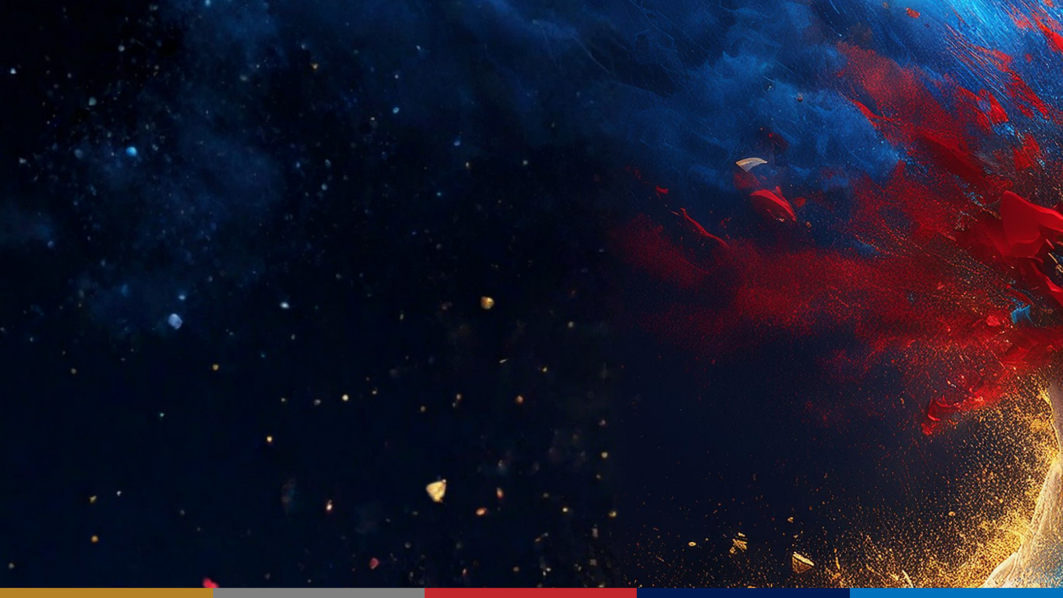
Guided Practice & Team Strategy
CTF Training Series
Dr. Josh Brunty

Slide 2

Solving vs. Competing
You can already solve crypto, web, forensics, and reverse-engineering challenges. Competing well is a different skill layered on top: prioritization (which challenge, in what order, with whom), coordination (a team that doesn't step on itself), and stamina (a CTF is a marathon).
The good news: these meta-skills are learnable, and they compound. Today is practice at competing, not just solving.

Slide 3
How CTFs Are Scored
Most events are jeopardy-style: a board of challenges by category, each worth points. Submit a flag, get the points. Two details change your strategy.
Dynamic scoring — a challenge's value drops as more teams solve it
So solve the soon-to-decay easy ones early
Time tie-breaks — equal scores favor whoever got there first
First-blood bonuses reward sending specialists in fast

Slide 4
Read the Board
Triage smart
Don't
Survey the whole board before you start
Grab cheap, fast flags early for momentum
Send each person at their strongest category first
Start top-left and grind straight down
Tunnel — 45 min stuck means note it and move on
Forget to re-survey as the board changes

Slide 5

Team Roles
By category
By function
A lead per area: Crypto, Web, Forensics, Reverse
Specialists own their category
Add Pwn / OSINT as the team grows
Captain — watches the board, assigns, tracks time
Scribe — keeps the shared notes current
Floaters — strong generalists who jump in

Slide 6
Pair Strong with New
A mixed-experience team is a feature, not a problem — if you use it deliberately.
Pair newer members with a specialist; don't isolate them
Hand newer members the on-ramp flags — real points, real confidence
Explaining a solve out loud sharpens the specialist too
Rotate: this year's beginners are next year's leads

Slide 7
Collaboration
Shared notes
Flag discipline
One doc: challenge, owner, status, flag
Claim a challenge before you start it
Write down where you're stuck before walking away
Confirm the exact CTF{...} format before submitting
Submit the moment you have it
Paste it into the notes so nobody re-solves it

Slide 8
Time & Energy
A CTF is hours — sometimes days. Endurance is strategy.
Timebox how long anyone sinks into one challenge
Take real breaks — tired solvers miss obvious things
Last hour: stop starting hard ones; consolidate and verify
Celebrate every flag — momentum keeps a team finding flags

Slide 9
Failure Modes
Anti-pattern
The fix
Everyone piles onto one shiny challenge
Lone-wolfing — nobody knows who's on what
No notes, so handoffs restart from zero
Spread across categories; one or two per challenge
Claim challenges in the shared notes
A scribe, plus a 'where I'm stuck' line each

Slide 10
The Capstone: Mock CTF
A timed, scored run pulling challenges from every category you've trained. The dress rehearsal — treat it like the real thing.
Form teams with a deliberate mix of skill levels
Assign roles — captain, scribe, leads, floaters
Survey, triage, and divide the board before diving in
Keep shared notes; submit CTF{...} the moment you have it

Slide 11
Team Toolkit
Coordinate
Track
A scoreboard platform — most events run CTFd
One shared, live notes doc everyone edits
A voice or text channel for claims and solves
A simple table: challenge, owner, status, flag
Announce claims so nobody duplicates effort
Announce solves so the win is visible

Slide 12
Before the Final
Recap: competing is prioritization, coordination, and stamina layered on solving. Triage the board, play to strengths, and don't tunnel — clear roles, shared notes, and flag discipline turn a crowd into a team.
Before game day: run a self-organized mini-practice on picoCTF with roles and shared notes, lock in who plays which role, and make sure everyone can grab the easy flags in every category. Next session — The Final CTF: the real thing.

