Slide 1

Digital Forensics for CTFs
CTF Training Series
Dr. Josh Brunty

Slide 2

What Is Forensics?
Forensics is recovering data that someone hid, deleted, or left behind — from files, disks, and memory — carefully enough that you can trust what you find. You're handed an artifact and a flag is concealed inside.
The skill is knowing where data hides and which tool reveals it; the discipline is thoroughness, because these challenges love decoys. (Network captures are their own session. Today is files, disks, and metadata.)

Slide 3
Magic Bytes
A file's extension is just a label — it can lie. What a file really is comes from its first few bytes: the magic number.
FF D8 FF — JPEG ; 89 50 4E 47 — PNG
50 4B 03 04 — ZIP (also docx, apk, jar)
file reads the header; xxd lets you see the bytes
Magic marks the start — so data can hide after a file ends

Slide 4
Metadata
What hides there
How to read it
EXIF: camera, GPS, timestamps, author
Free-text fields: UserComment, ImageDescription
Sometimes plain, sometimes Base64-encoded
exiftool photo.jpg — dump every field
Read all of it — one field may be a decoy
strings works in a pinch if exiftool isn't there

Slide 5
File Systems
A disk stores blocks of data plus bookkeeping that says which blocks belong to which file — a directory entry, inode, or MFT record.
Space is either allocated (in use) or unallocated (free)
Slack space can hold fragments of older data
Deleting only frees the pointer — the data stays on disk
So deleting isn't erasing: deleted files can be recovered

Slide 6

File Carving
What it finds
Tools
Appended data — a ZIP glued onto a JPEG
Embedded files — a PNG inside a PDF
Files with no directory entry, found by signature
binwalk file — scan for embedded signatures
binwalk -e — extract what it finds
foremost, or unzip directly on the carrier

Slide 7
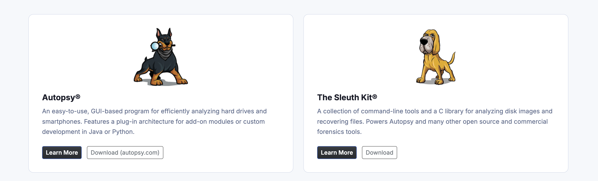
Sleuth Kit & Autopsy
Autopsy (GUI)
The Sleuth Kit (CLI)
Add the disk image as a data source
Browse the file tree; deleted files are flagged
Recover, keyword-search, and build a timeline
fls image — list files; deleted marked with *
icat image inode — dump a file by its number
fsstat / istat — file-system and file details

Slide 8
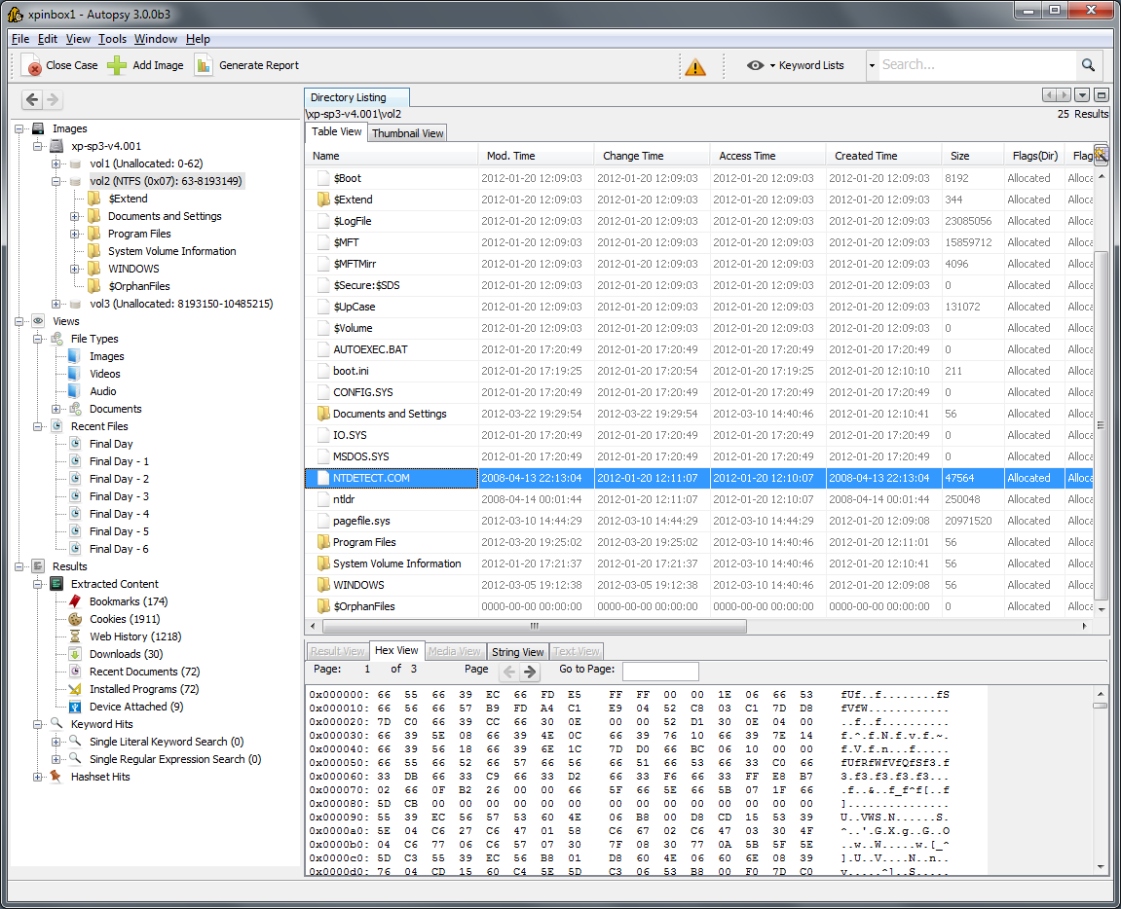
Autopsy (GUI)

Slide 9
The Forensics Workflow
Same loop as every session — the artifact changes, the method doesn't.
Identify — file and xxd: what is this, really?
Inspect — strings, exiftool, fls, Autopsy: read everything
Extract — carve files, recover deleted ones, pull artifacts
Decode — Base64/hex, then recover the CTF{...}

Slide 10
Your Forensics Toolkit
Identify & carve
Disk & memory
file, xxd, strings — identify and read
exiftool — image and document metadata
binwalk, foremost — carve embedded files
Volatility
Sleuth Kit — fls, icat, fsstat on a disk image
Autopsy — the GUI over the Sleuth Kit
strings + base64 — memory artifacts

Slide 11
Hands-On: Four Artifacts
A seized workstation: four files, four flags, increasing difficulty. The artifacts are in your handout — enumerate first, decode last.
briefing.jpg — the flag's in the metadata (one field is a decoy)
evidence.jpg — a second file is appended; carve it out
case001.dd — recover the file the suspect deleted (Autopsy / Sleuth Kit)
memory.raw — bonus: the obvious flag is bait; the real one is encoded

Slide 12
Common Pitfalls
Don't
Do
Trust the file extension
Grab the first flag-shaped string — decoys abound
Assume a deleted file is gone
Identify by magic bytes with file and xxd
Run fls; recover deleted files with icat or Autopsy
Cut the noise, then finish by decoding

Slide 13
Before the Next Session
Recap: identify by magic bytes, not the extension; data hides in metadata, past a file's end, in unallocated space, and in RAM; and remember — deleting isn't erasing, so Autopsy and the Sleuth Kit bring deleted files back.
Homework: work the Forensics track on picoCTF, and install Autopsy to re-open case001.dd and recover the deleted file in the GUI. Next session — Reverse Engineering: taking apart a compiled binary to find what's hidden inside.

