Slide 1

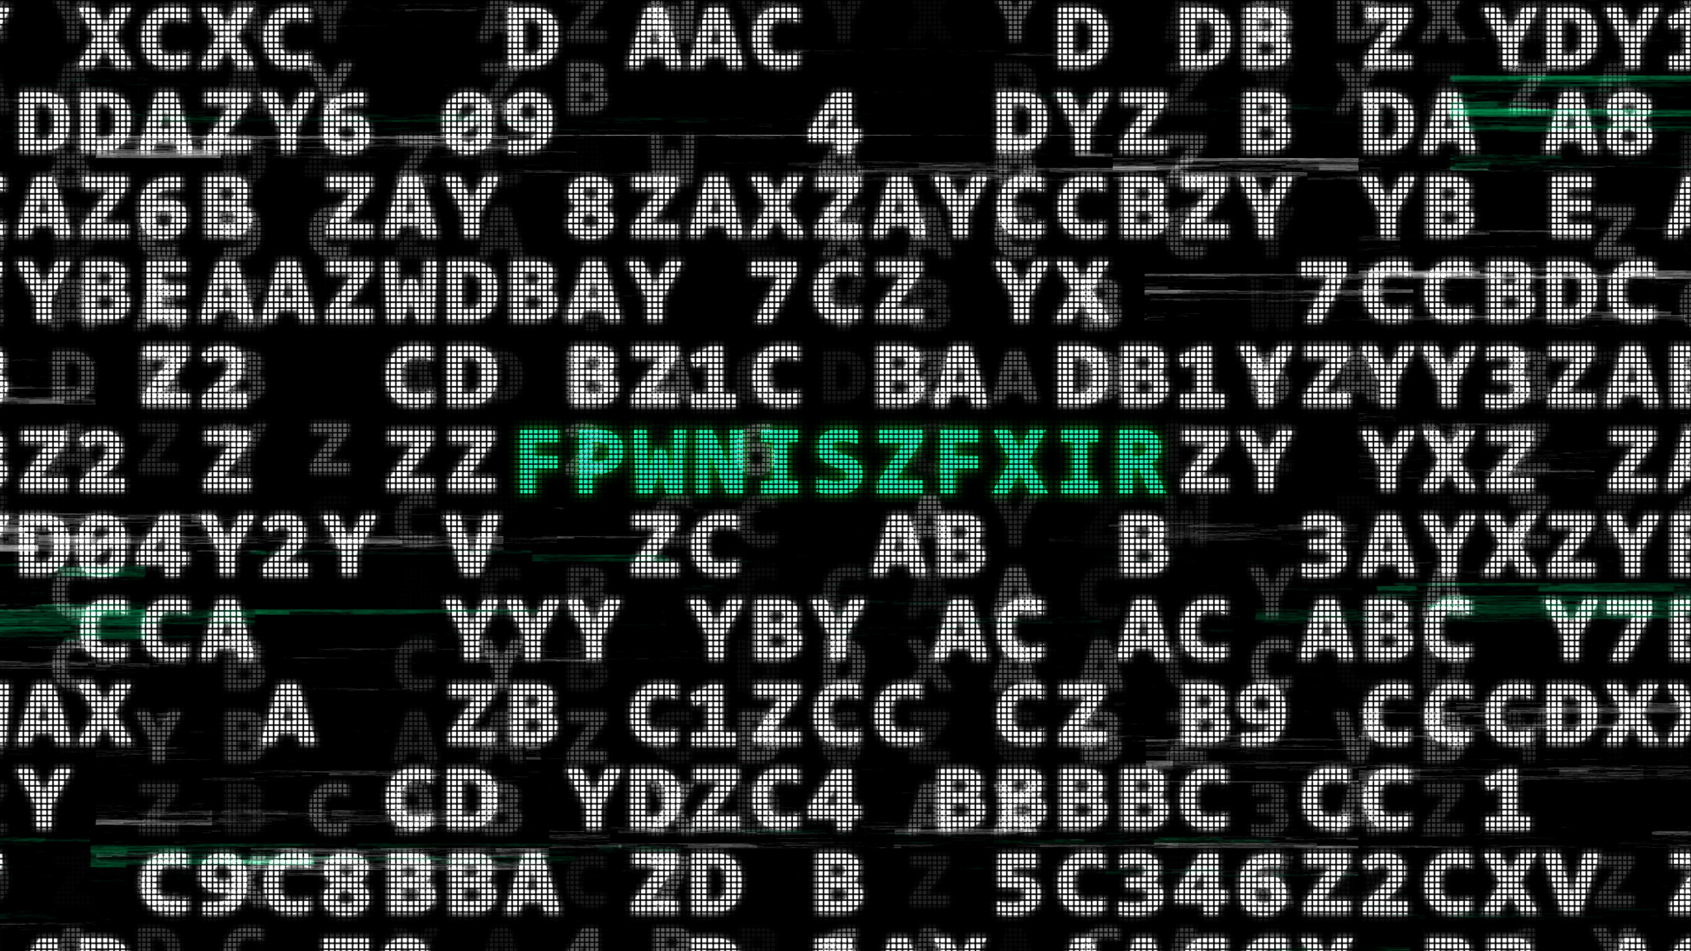
Cryptography Essentials
CTF Training Series
Dr. Josh Brunty

Slide 2

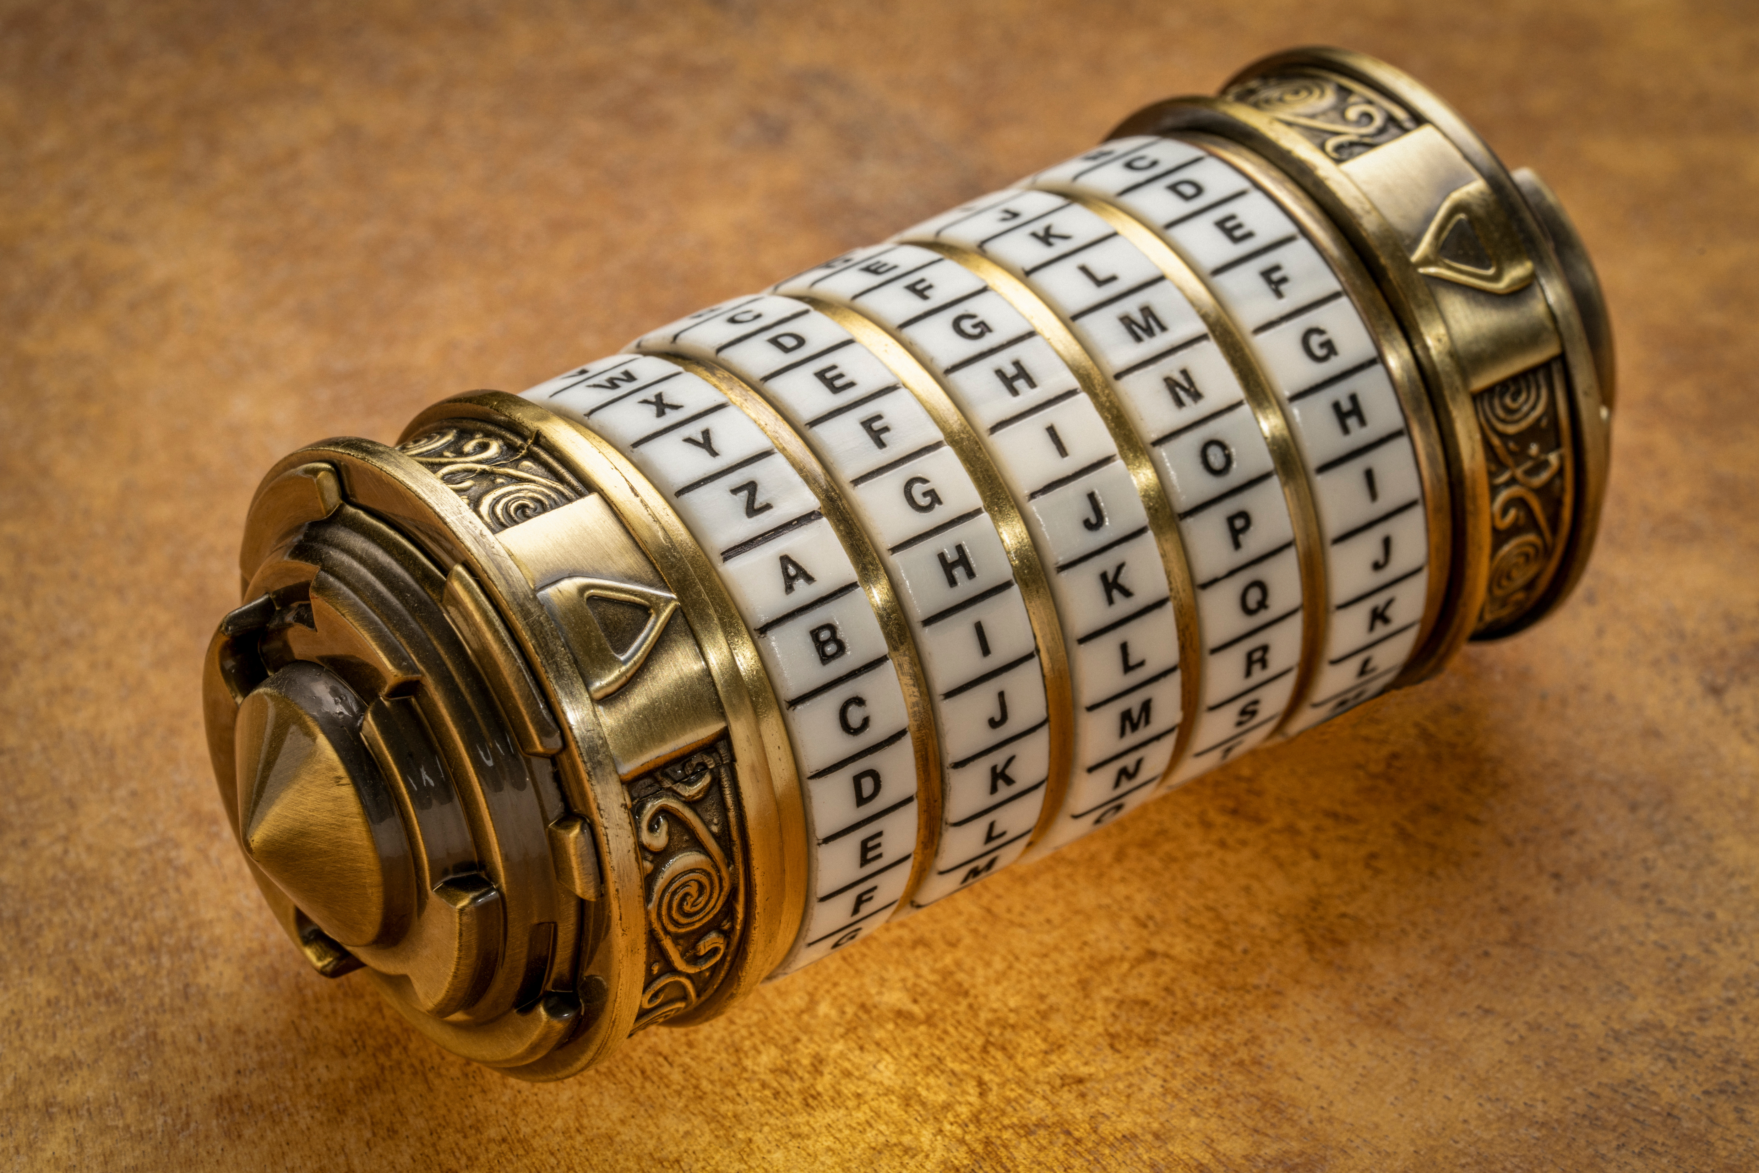
What Crypto Means
CTF crypto is almost never about breaking modern encryption — that's math research, not a two-hour challenge. It rewards three things: recognizing the scheme, pointing the right tool at it, and finding the key.
The key is usually given to you, hiding nearby, or small enough to brute-force. Your job is pattern recognition, not cryptanalysis.

Slide 3
Three Different Things
Encoding, hashing, and encryption get mixed up constantly. Identify which one you're looking at before you reach for a tool.
Encoding — reversible, no key (Base64, hex, ROT13)
Hashing — one-way, no key; you crack it, you don't reverse it
Encryption — reversible only with the key (AES, XOR, Vigenère)

Slide 4
Encoding — No Key Needed
Spot it
Reverse it
Base64 — A–Z a–z 0–9 + /, '=' padding
Base32 — uppercase letters and digits 2–7
Hex — only 0–9 a–f, even length
CyberChef: From Base64 / Base32 / Hex
Terminal: base64 -d, base32 -d, xxd -r -p
Layers are normal — decode, look, decode again

Slide 5
One-Way Fingerprints
You can't reverse a hash — but you can guess inputs, hash them, and compare. That's cracking: fast guess-and-check.
Identify by length: 32 = MD5, 40 = SHA-1, 64 = SHA-256
Crack common ones with John or hashcat + the rockyou wordlist
Look up very common hashes on CrackStation
Salts block lookups — then you must crack, not look up

Slide 6

Classic Ciphers
Shift & reverse
Keyword & swap
Caesar / ROT-n — a fixed shift; only 25 to try
ROT13 is just shift 13; Atbash reverses the alphabet
Brute every shift until words appear
Vigenère — a shifting Caesar driven by a keyword
Substitution — break it with letter-frequency analysis
dcode.fr auto-solves most of these

Slide 7
XOR — The CTF Workhorse
XOR is reversible: data XOR key XOR key gives back the data. Single-byte XOR uses one byte over the whole message — just 256 possible keys, so brute-force them all and watch for CTF{.
Repeating-key XOR uses a short key on repeat: recover the key length, then solve each position like its own single-byte puzzle. In reverse-engineering challenges, the key is often sitting right in the disassembly.

Slide 8
The Crypto Workflow
Every challenge is the same loop — the scheme changes, the method doesn't.
Identify the scheme from its tells (charset, length, padding)
Find the key — given, hidden nearby, or brute-forceable?
Decode or crack with the right tool
Recover the flag and submit it exactly as CTF{...}

Slide 9
Your Toolkit
Point & click
Command line
CyberChef — stack operations into a recipe
CyberChef Magic — auto-detects encodings and layers
dcode.fr — classic-cipher identifiers and solvers
base64 -d, base32 -d, xxd -r -p, tr
hashid, then john or hashcat with rockyou
Python — five lines beats clicking for XOR brute force

Slide 10
Hands-On: Crack These
Four challenges, four schemes — the strings are in your handout. Identify the scheme first; that's the whole game. Each recovers a CTF{...} flag (the hash recovers a word).
Encoding — uppercase letters and digits 2–7; which base?
Hash — 32 hex characters; identify it, then crack it
Classic cipher — the wrapper is shifted; try every rotation
XOR — a hex blob, single-byte key; brute all 256

Slide 11
Recognize It on Sight
If you see...
...it's probably
A–Za–z0–9+/ with = padding → Base64
Uppercase + 2–7 → Base32
0–9a–f, even length → hex
32 / 40 / 64 hex chars → MD5 / SHA-1 / SHA-256
All letters, English-looking → substitution / Vigenère
A hex blob with a 'key' hint → XOR

Slide 12
Before the Next Session
Recap: encoding, hashing, and encryption are three different things — identify which before you act. Recognition plus the right tool solves most challenges, and small keys are meant to be brute-forced.
Homework: practice the Cryptography track on CyLab/picoCTF or CryptoHack, and rebuild today's challenges as CyberChef recipes. Next session — Web Exploitation: SQL injection, XSS, and broken auth.

