Slide 2
Just Enough Admin
PowerShell role-based administration to secure a
post-Snowden world
Jeffrey Snover

Slide 3
In case you aren’t up on current events
There is a tsunami of bad heading our way

Slide 4
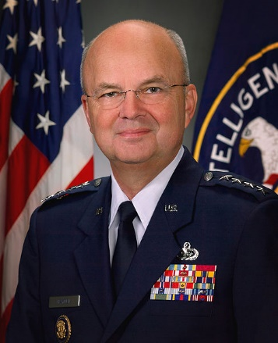
Michael Hayden
Four star general
Director of the NSA
Director of the CIA
Director of National Intelligence

Slide 5

Edward Snowden
Age 30
College dropout

Slide 6

Admins have the keys to the kingdom
You’re an Admin
PWNED!!!

Slide 7
Hunting and Hacking System Administrators
‘Yet the document makes clear that the admins are not suspected of any criminal activity – they are targeted only because they control access to networks the agency wants to infiltrate. “Who better to target than the person that already has the ‘keys to the kingdom’?” one of the posts says.’

Slide 8
Admins are an attack surface!

Slide 9
Admins
Of course, we need admins
But
People make mistakes
Are sometimes bad actors
Are always part of your attack surface

Slide 10
JEA is about reducing the risk of admins

Slide 11
Wouldn’t it be great if?
People didn’t have to have admin privs to do their job
If a machine got cracked, it wouldn’t leak high value creds
People could only do what they needed to do
All admin actions got logged

Slide 12



PS> Enter-PSSession Server1 FAIL! – Talk to your supervisor for assistance
Server1
“Jeffrey I need to be admin on Server1 to restart SQL”
PS> Enter-JeaSession Server1 –Name Maintenance
Server1> Restart-Service MSSQLSERVER
☺
Server1> Steal-Secrets Error: You are not authorized to Steal-Secrets
“No Eddie.
Just use Jea and connect to the ‘Maintenance EndPoint”

Slide 13
Approach
Incrementally reduce admin exposure
Reduce the number of people with administrator privs
Reduce the impact of admin privs
Reduce what can be done when using those admin privs

Slide 14
JEA: Just Enough Admin
Based on the PowerShell security features used by online services
Enabled remote administration of Exchange Online
Simple concepts
JeaToolkit
Well defined set of commands to support a set of activities
JeaEndPoint
Management connection point where authorized users are provided JeaToolkits which run as a JeaEndPointAccount
JeaEndPointAccount
Managed local account with Admin privs
Deployed using PowerShell Desired State Configuration (DSC)

Slide 15
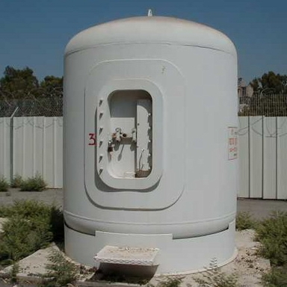

JeaEndpointAccounts puts the server in a blast container
Avoid domain accounts and Group Managed Service Accounts [GMSA] because they extend any breach to all servers that these accounts have access to

Slide 16
Desired State Configuration
Configuration FileServers
{ foreach ($node in Get-FileServers)
{
Node $node
{
JeaToolkit StorageTools
{ CommandSpecs = @'
Module
Storage
SMBShare
'@
}
JeaEndpoint StorageAdmin
{ ToolKit = 'StorageTools‘
SecurityDescriptorSddl = 'O:NSG:BAD:P(A;;GA;;;BA)(A;;GA;;;RM)S:P(AU;FA;GA;;;WD)(AU;SA;GXGW;;;WD)'
}
}
}
}
FileServers -OutputPath .
Start-DscConfiguration .\FileServers -ComputerName (Get-StorageServers)

Slide 17
Fine Grain Proxy Control
JeaToolkit SQLMaintenace
{ Name = ‘SQLMaintenance’
CommandSpecs = @'
Module,Name,Parameter,ValidateSet,ValidatePattern
SQL,GET-*
,Get-Process
,Get-Service
,Stop-Process,Name,calc;notepad
,Restart-Service,Name,,^SQL
'@
}

Slide 18
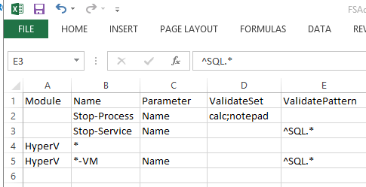
JeaToolkit Authoring
JeaToolkit SQLMaintenace
{ Name = "SQLMaintenace"
CommandSpecs = cat .\SQL.csv -raw
}

Slide 19
DEMO: JEA

Slide 20
Under the Covers
The 400 level stuff

Slide 21
Why PowerShell?
JEA is about controlling admin actions
Like all shells, PowerShell dispatches commands
You can control what gets dispatched by traditional things like path, loading policy, etc
PowerShell adds command visibility
Unlike many shells, PowerShell does command parsing!
Parsing is driven off data structures
Which you can program
Which you can program to create proxies
Command visibility and proxies allow us to secure our environment

Slide 22
Creating a Proxy Command
PowerShell owns the Parser $cmd = Get-Command Stop-Process $MetaData = New-Object System.Management.Automation.CommandMetaData $cmd
You can program a cmdlets’s parameters $MetaData.Parameters.Remove("ID") $metaData.Parameters.Name.Attributes.Add((New-Object ` System.Management.Automation.ValidateSetAttribute ("notepad","calc"))) $MetaData.DefaultParameterSetName="Name“
And then publish a proxy ${Function:Stop-Process} = [System.Management.Automation.ProxyCommand]::create($MetaData)
Now hide the original $cmd.Visibility = "private"

Slide 23
Constrained PowerShell Configurations
Server1
PowerShell Remoting connects to Configurations
Name
ACL
StartupScript
RunAsCredentials
Get-Command *PSSessionConfiguration

Slide 24
Creating a Constrained RunAs PowerShell Configuration
$cred = Get-Credential #Provide account w/local admin privs
Register-PSSessionConfiguration ` -Name Maintenance` -ShowSecurityDescriptorUI ` -StartupScript c:\Jea\Initialize-Maintenance.ps1 ` -RunAsCredential $Cred
Enter-PSSession -ComputerName Server1 ` -ConfigurationName Maintenance
User can perform admin tasks but doesn’t have admin privs
Constrain the environment with the StartupScript

Slide 25
Startup scripts can do anything

Slide 26
Set the LanguageMode
$ExecutionContext.SessionState.LanguageMode =
NoLanguage for maximal security
ConstrainedLanguage for trusted admins
FullLanguage if you need full backwards compatibility
Consider only making this available for when 2 admins are required

Slide 27
Control what can get loaded and seen
$ss = $ExecutionContext.SessionState
$ss.Scripts.Clear()
$ss.Applications.clear()
$s.Applications.add("C:\windows\system32\calc.exe")
(Get-Command restart-computer).visibility=“private”
Always hide
Invoke-Expression
New-Object

Slide 28
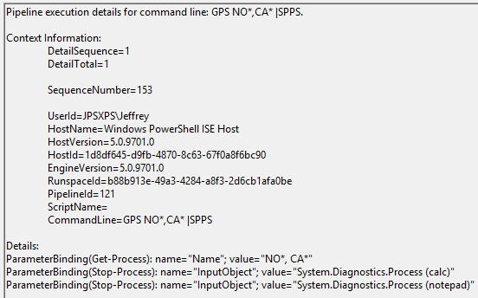
Set up Logging
Get-Module $Module |
% {$_.LogPipelineExecutionDetails = $true}

Slide 29
Anything else
$user = $PSSenderInfo. ConnectedUser
Send-MailMessage –Message “$user on machine $(hostname)”
$today = [DateTime]::NOW.DayofWeek
If ($today –in “Saturday”,”Sunday”)
{ throw “GO HOME”}

Slide 30
More On Logging
$myid = $ExecutionContext.host.Runspace.InstanceId
Get-WinEvent -LogName Microsoft-Windows-PowerShell/Operational | where {$_.properties.Value -match "Runspace ID = $myid"} |
foreach {
New-Object PSObject –Property @{ Command = $_.Properties[2].Value
Time = $_.TimeCreated }
}

Slide 31
Admins are an attack surface!

Slide 32
Incrementally reduce admin exposure
Reduce the number of people with administrator privs
Reduce the impact of admin privs
Reduce what can be done when using those admin privs

Slide 33
Simple concepts
JeaToolkit
Well defined set of commands to support a set of activities
JeaEndPoint
Management connection point where authorized users are provided JeaToolkits which run as a JeaEndPointAccount
JeaEndPointAccount
Managed local account with Admin privs

Slide 34
BlackHat 2010
Q: What do we do about all
these attacks?
A: “Man up and defend yourselves!”

Slide 35
Jea – Just Enough Admin PowerShell role-based administration to secure a post-Snowden world

Slide 36
Questions/Comments

