Slide 1
Wrapping up: hosting and best practices
Lyndsie Wszola

Slide 2
Before we begin
More shiny content:
https://lsw5077.github.io/shiny_workshop/
Libraries:
library(shiny)
library(tidyverse)

Slide 3
Agenda
Best practices: general R
Best practices: shiny
Hosting: set your app free!

Slide 4
Best practices: general R
Any fool can write code that a computer can understand. Good programmers write code that humans can understand.
– Martin Fowler, 2008.

Slide 5
Best practices: general R
Best practice

Slide 6
Best practices: general R
Best practice
Less-than-best practice

Slide 7

Best practices: Names and comments

Slide 8
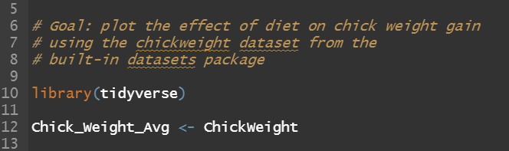
Best practices: Names and comments

Slide 9
Best practices: Formatting

Slide 10
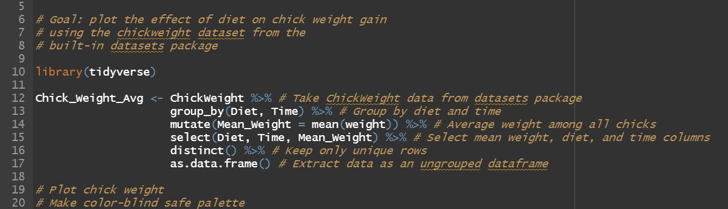
Best practices: Formatting

Slide 11
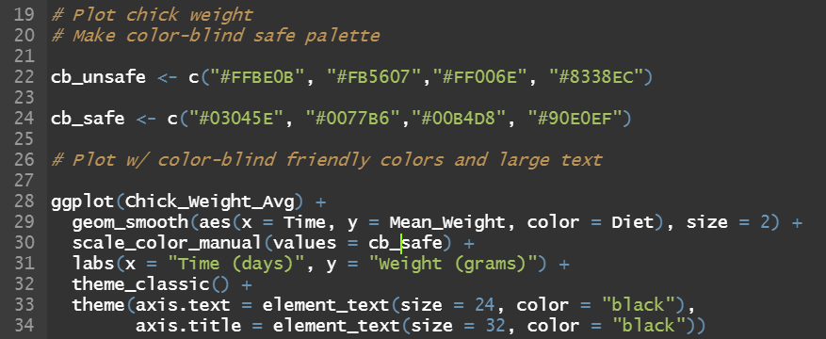
Best practices: Accessibility

Slide 12
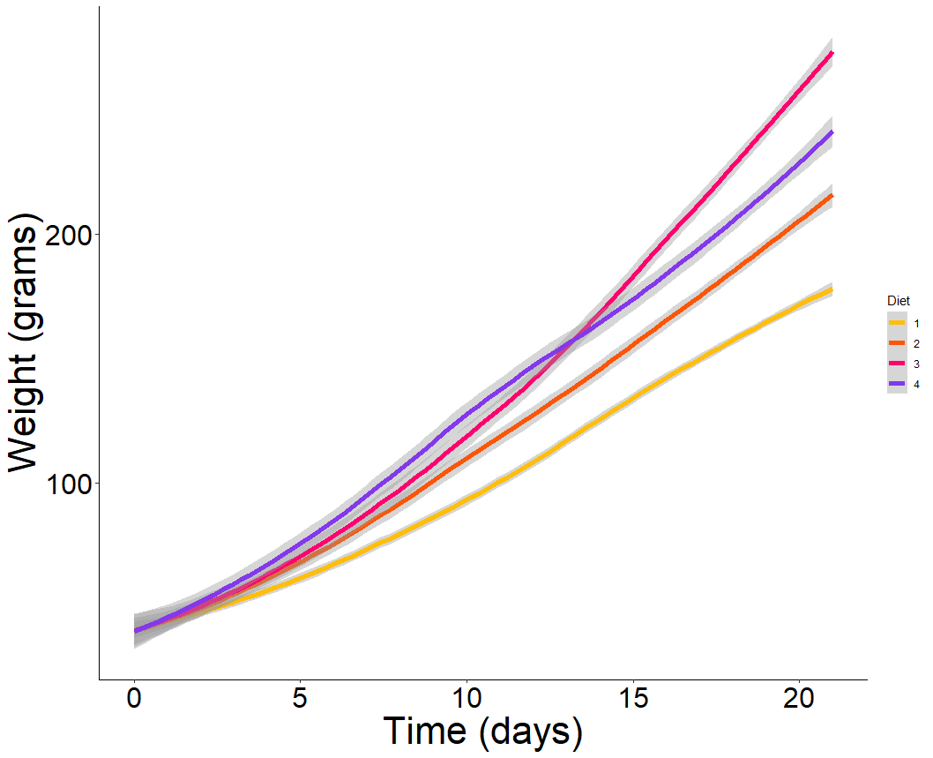
Best practices: Accessibility

Slide 13
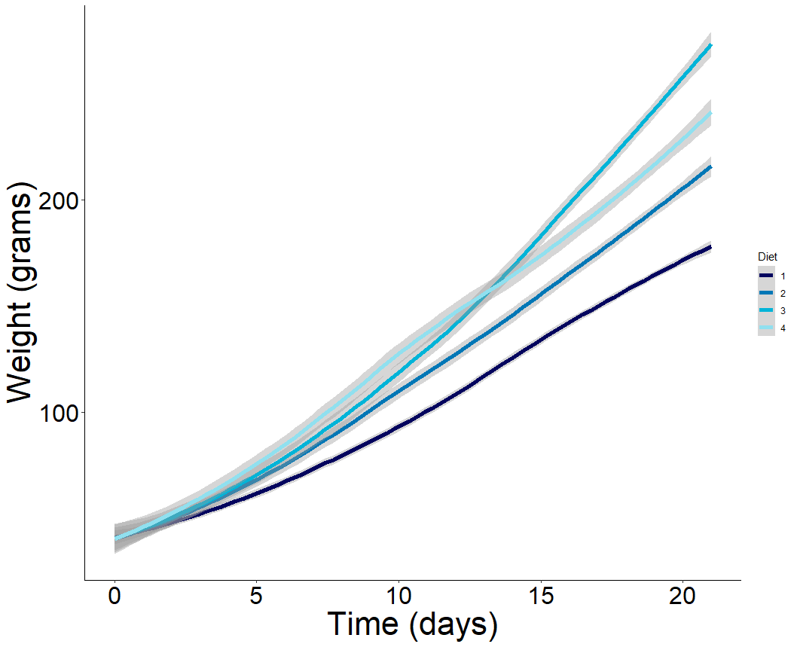
Best practices: Accessibility

Slide 14
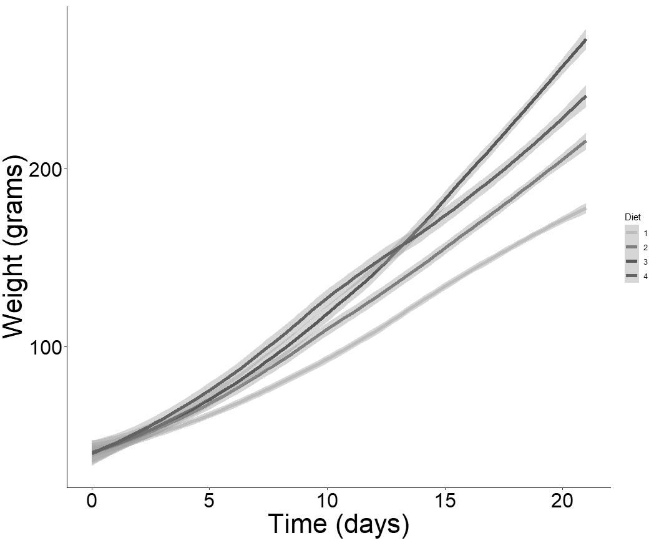
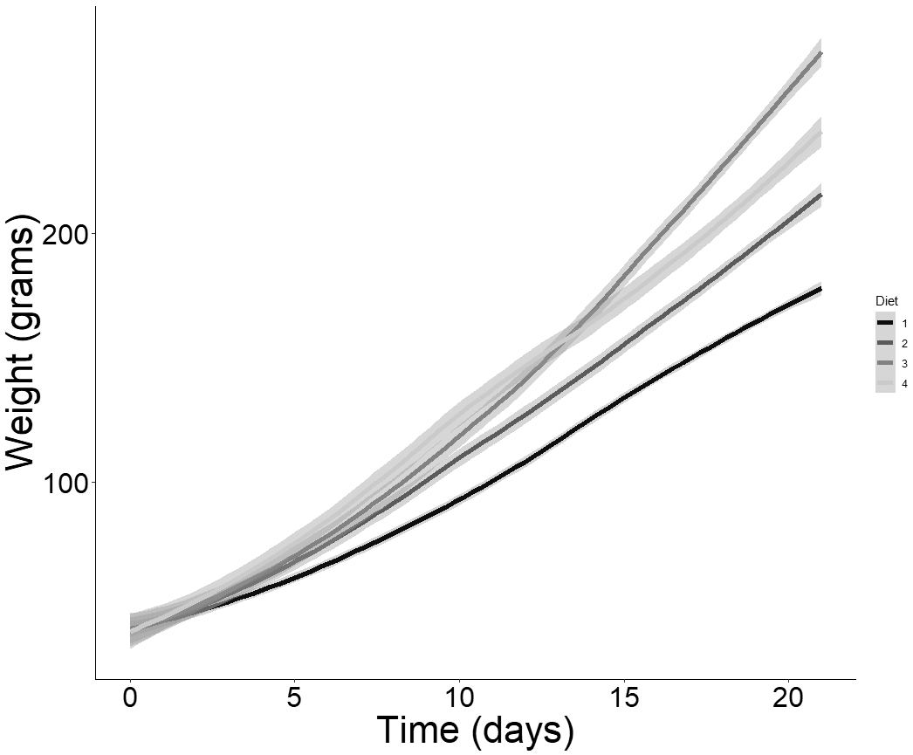
Best practices: Accessibility

Slide 15
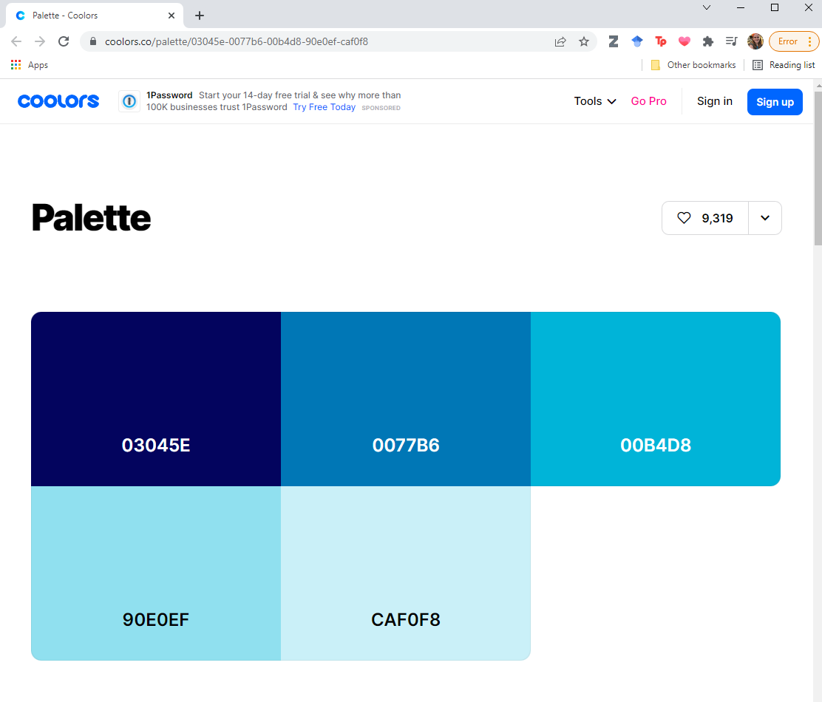
Best practices: Accessibility

Slide 16
Best practices: R
Human-readable names
Extensive comments
Breathable formatting
Accessible figures

Slide 17
Best practices: Shiny
Image accessibility
Citations

Slide 18
Do. Things. Once.

Slide 19
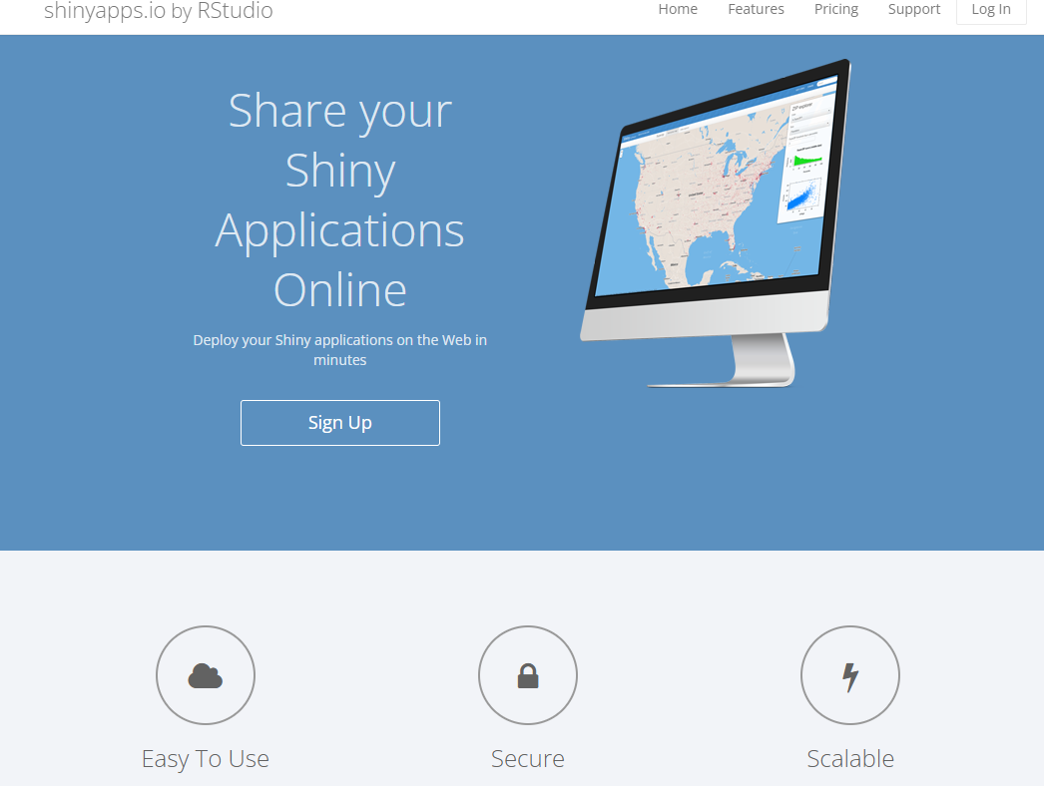


Hosting: options

Slide 20
Hosting: shinyapps.io
Pros:
Easy!
Error logging
Usage stats
Cons:
Limited apps/server time
Potentially expensive

Slide 21
Hosting: your own server
Pros:
Cheap
Full control
Cons:
Needs IT expertise
Requires Linux servers

Slide 22
Hosting: Internal deployment
Pros:
Secure
Can share apps offline
Cons:
Only works on internal systems

Slide 23
Hosting: shinyapps.io

