Slide 1





Demystifying Azure Messaging with Azure Functions
With real world examples from the Imperial Computing Division
Josh Carlisle
@joshcarlisle
#AzureFunctions #Serverless
#Azure #Messaging #EventGrid
#EventHub #ServiceBus

Slide 2

Who Am I
Raleigh North Carolina
Developer x 20 years
Twitter: @joshcarlisle
Web: www.joshcarlisle.io
Email: joshc@viewfusion.com

Slide 3





Benefits of Messaging \ Eventing
Increased Reliability & Resilience Improved fault tolerance. Reduce impact of outages or performance issues with various components. Provides for load leveling to back ends sensitive to scale.
Improved Performance Asynchronous operations increase the performance of the system without requests having to wait for processing.
Improved Scaling Characteristics Decouple components can scale independently of each other and can more easily scale horizontally to process increasing numbers of messages.
Easier to Decouple & Easier to Maintain With messaging the sender and receiver can be easily separated and when separated are easier to both less complex to develop and easer to maintain.
Destroy the Rebel Fleet Slightly more obscure use case but none the less a valid one

Slide 4

Azure Messaging Platforms
Service Bus
Event Grid
Azure Storage
Queues
Event Hub

Slide 5

Which is the best messaging platform?
The wrong question that is!

Slide 6
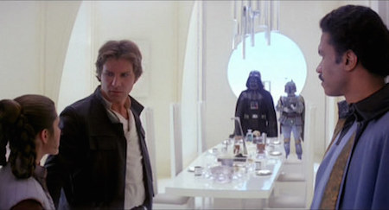
You should first ask…
What’s for dinner!

Slide 7
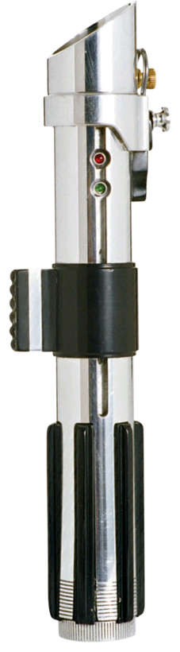
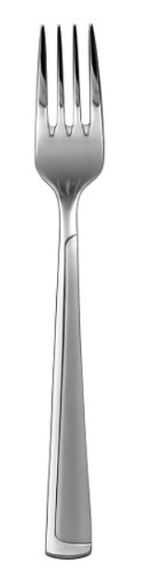


You need the right tool for the right job!

Slide 8






Azure Messaging
Azure Storage
Queues
Service Bus
Event Hub
Event Grid
Cloud City

Slide 9

Important Questions To Help Decide
Is your message expecting a task to be completed?
Queue
Does your message have no expectation of an outcome?
Eventing
Are you trying to reason about the data?
Event Streaming

Slide 10
Where do Azure Functions fit in?
Serverless is a Natural Fit for Message Processing
Azure Functions have native bindings for easy integration with Azure Messaging.
Many Platforms have direct integration with Azure Functions
Can scale to meet high volume message processing needs

Slide 11

Storage Queues – Simple Task Scheduling
When to use?
You just need simple task scheduling
Your primary goal is to decouple your sender from your receiver
You don’t need more advanced queue features.
Advantages
Very easy to work with
Great for competing consumer scenario (Azure Functions!)
Supports very large queues ( > 5000TB/month)
Inexpensive
Disadvantages
FIFO not guaranteed
Polls for queues

Slide 12

Storage Queue Demo – Scheduled Maintenance
Pilot or Crew Chief wants to schedule maintenance check
The maintenance system is often down or inundated with requests after a battle
Message request to be processed by the Imperial Maintenance division even if the system is down at the time of request

Slide 13
Service Bus – Enterprise Messaging
Advantages
Advanced Queue Functionality
Pub\Sub Model (Topics)
Supports High Levels of Availability
Premium Supports Dedicated Instances and Predictable Performance (avoids noisy neighbor)
Topics eliminate need for message dispatcher/router
Role based access
When to use?
You have an important task that needs completed.
Advanced Features such as Transactions, Duplicate Checking, Sessions, Strict Ordering
You require a pub\sub model (Topics) with multiple subscribers with their own copy of queue data.
You need to work with Advanced Messaging Queuing Protocol (AMQP)
You require high availability & predictable performance.
Disadvantages
Can be more expensive especially w/ premium
< 80 GB Queues

Slide 14

Service Bus Demo – Repair Request w/ Topics
An imperial maintenance chief has identified ships that need to go in for repairs
Repairs are done at the repair depot for the fleet but there are two separate depots for the repair. One for fighters and the other for shuttles and other non-combat aircraft
Sometimes however when they get backed up they will help each other out so they should be able to see both queues.
The repair yard wants a single point where all requests are sent to but each depot has a subscription they can listen to that is only for their particular ship class and a combined queue to monitor both.

Slide 15
Event Hubs – Big Data Streaming
When to use?
Work with Large Data Streams & Big Data
Ideal for telemetry type scenario
Fan In Scenario (common w/ telemetry/iot)
You don’t care about individual events as much as the big picture and “reason about your data”
You have IOT devices sending telemetry & data (consider IOT Event Hubs)
Advantages
Handles very large amounts of data
Fast-forward \ reverse \ replay stream
Inexpensive (relative) 1 Througput Unit = 1mb/1k seconds – 86 Billion Events = $2.42 /day
Integrates closely w/ Stream Analytics & Azure Functions
Disadvantages
Server Side Cursor & No Server Side Filtering of Events
Pre-provision resources and throughput
NOT intended for business transactions

Slide 16

Event Hubs – Streams
NOT a special queue
Records in one direct
You can fast forward\rewind\replay over and over
You can generate events from streams
You can use Stream Analytics to get an understanding as your data is streaming in (and trigger events)

Slide 17

Event Hub Demo – Ship Telemetry
The Imperial fleet is concerned about their rate of ship loss and defects.
They want to start collecting ship telemetry to be analyzed later
They want to be especially notified of the average of accuracy on their targeting computers over a given period of time.
They want to process those results separately on a regular basis.

Slide 18
Event Grid – Cross Cloud Reactive Eventing
When to use?
Your message has no expectation of an outcome.
You want to automate Azure operations (e.g. when something happens in Azure)
Trigger a function to execute (Azure Function App)
You want to avoid polling for changes
You want your event to be received anywhere (including outside of Azure)
Important but infrequently raised event
Advantages
Handles VERY large volume of events
Serverless & Inexpensive
Saves having dedicated
Events Pushed (Webhooks)
Dead Letter to storage queue
Disadvantages
No storage of events – must be a subscriber
Failed notifications will retry for only 24 hours – dead letter to storage queue
Cross Cloud Eventing Service
React on the data
Service Bus Raise Raise Grid Event (save having to pay computer for listener). Great for infrequently used . Premium only right now
High Volume Fan Out – something happens on a service and you want to tell the whole world

Slide 19











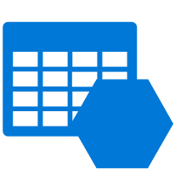


Azure Event Grid
IoT Hub
Azure Functions
Blob Storage
Logic Apps
Azure Subscriptions
Azure Automation
Resource Groups
WebHooks
Event Hubs
Event Hubs
Custom Topics
Storage Queues
Storage (GPv2)
Datalake Store
Container Registry

Slide 20

Event Grid Demo – Ship Destruction Events
When a ship is lost the empire has has quite a few things that need to happen
The fleet doesn’t have to be concerned with all of those details but does need to let everyone know.
The fleet headquarters would like an event raised that the Shipyard can then know to start building a replacement.

Slide 21
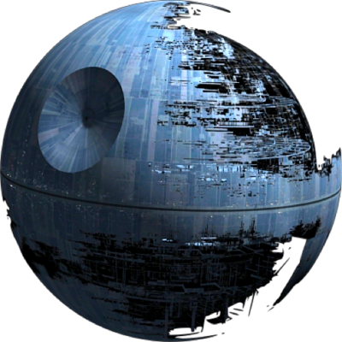
Thank you! Questions?
The Imperial Computing Center is currently closed for renovations but will be back for tours soon!

Slide 22
Additional Resources
Source Code: https://github.com/joshdcar
Twitter: @joshcarlisle
Blog : http://www.joshcarlisle.io
People to follow:
Dan Rosanova – Microsoft @DanRosanova
Clemens Vasters – Microsoft @clemensv
@joshcarlisle

