Slide 1



How would the EPL standings differ if the entire season had been only 75 minute matches?
75’ Matches Table
Actual Table
Standing | Club
 | Club | Standing | Change
1 | LIV
2 | MC
3 | LC
4 | CHE
5 | MU
6 | WOL
7 | SHU
8 | TOT
9 | ARS
10 | BUR
11 | CP
12 | EVE
13 | NEW
14 | SOU
15 | BHA
16 | WHU
17 | WAT
18 | BOU
19 | AVL
20 | NOR
 | LIV | 1 | -
 | MC | 2 | -
 | LC | 3 | -
 | CHE | 4 | -
 | MU | 5 | -
 | ARS | 6 | +3
 | SHU | 7 | -
 | EVE | 8 | +4
 | BUR | 9 | +1
 | TOT | 10 | -2
 | CP | 11 | -
 | WAT | 12 | +5
 | SOU | 13 | +1
 | WOL | 14 | -8
 | WHU | 15 | +1
 | BOU | 16 | +2
 | AVL | 17 | +2
 | NOR | 18 | +2
 | BHA | 19 | -4
 | NEW | 20 | -7

Slide 2
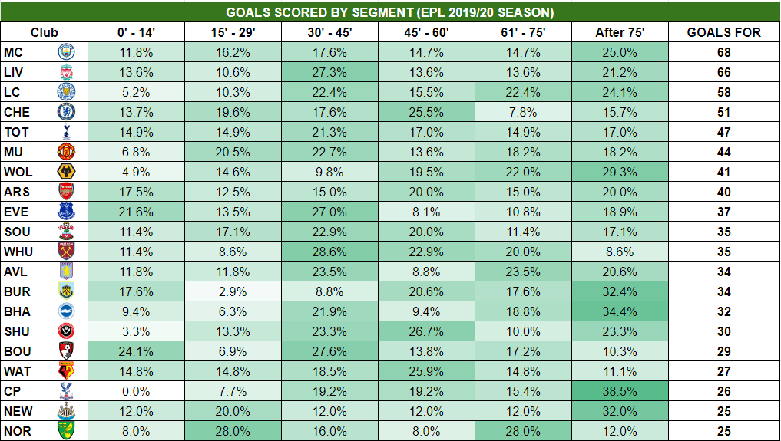
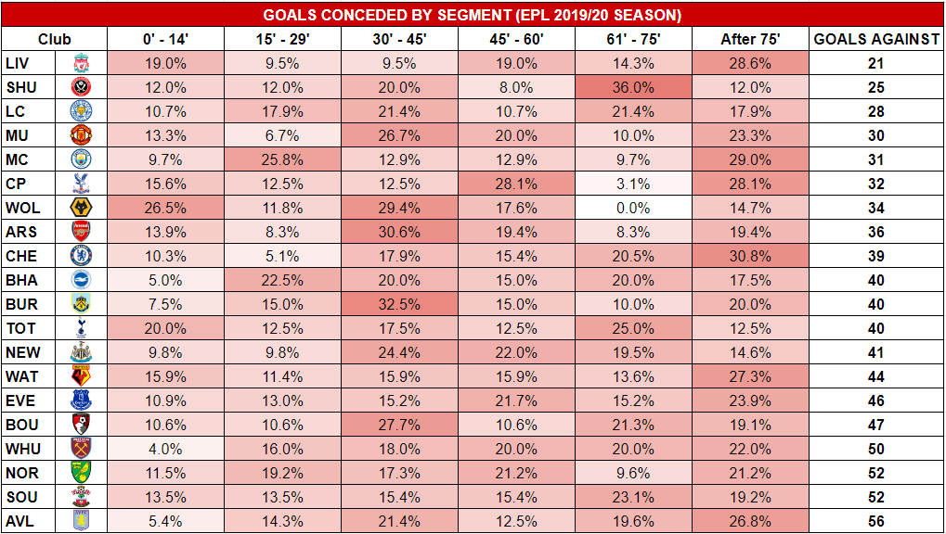
Goals For & Against Analysis

Slide 3
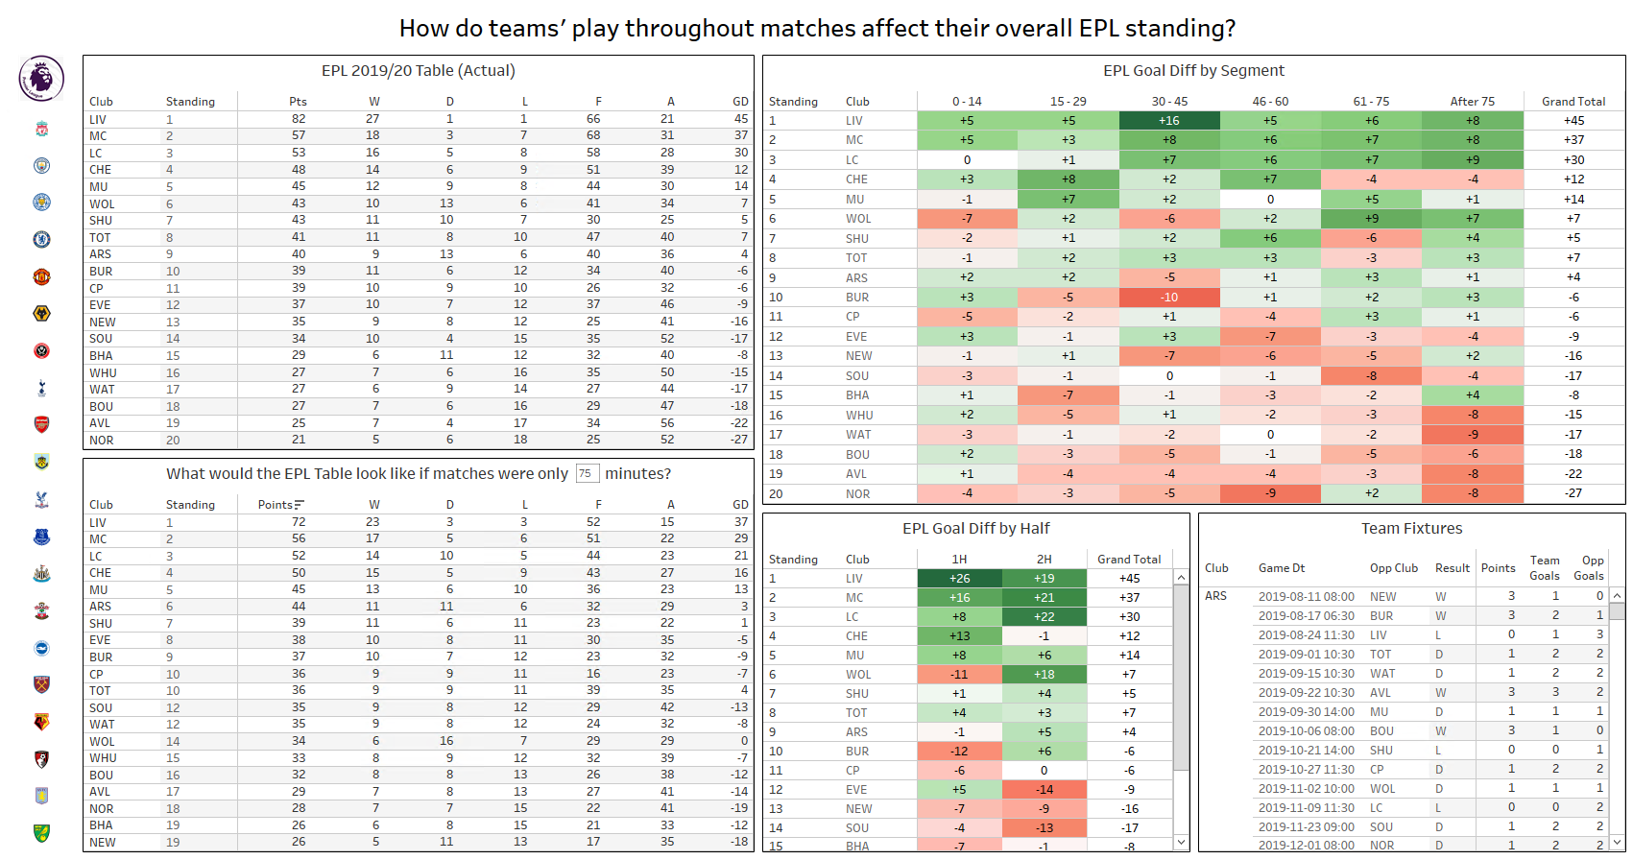

Visualization & Interactive Dashboard
Download Workbook

Slide 5
Actual Table
75’ Matches Table
Standing | Club
 | Club | Standing | Change
1 | LIV
2 | MC
3 | LC
4 | CHE
5 | MU
6 | WOL
7 | SHU
8 | TOT
9 | ARS
10 | BUR
11 | CP
12 | EVE
13 | NEW
14 | SOU
15 | BHA
16 | WHU
17 | WAT
18 | BOU
19 | AVL
20 | NOR
 | LIV | 1 | -
 | MC | 2 | -
 | LC | 3 | -
 | CHE | 4 | -
 | MU | 5 | -
 | ARS | 6 | +3
 | SHU | 7 | -
 | EVE | 8 | +4
 | BUR | 9 | +1
 | CP | 10 | +1
 | TOT | 11 | -3
 | SOU | 12 | +2
 | WAT | 13 | +4
 | WOL | 14 | -8
 | WHU | 15 | +1
 | BOU | 16 | +2
 | AVL | 17 | +2
 | NOR | 18 | +2
 | BHA | 19 | -4
 | NEW | 20 | -7

Slide 6
Actual Table
75’ Matches Table
Standing | Club
 | Club | Standing | Change
1 | LIV
2 | MC
3 | LC
4 | CHE
5 | MU
6 | WOL
7 | SHU
8 | TOT
9 | ARS
10 | BUR
11 | CP
12 | EVE
13 | NEW
14 | SOU
15 | BHA
16 | WHU
17 | WAT
18 | BOU
19 | AVL
20 | NOR
 | LIV | 1 | -
 | MC | 2 | -
 | LC | 3 | -
 | CHE | 4 | -
 | MU | 5 | -
 | ARS | 6 | +3
 | SHU | 7 | -
 | EVE | 8 | +4
 | BUR | 9 | +1
 | CP | 10 | +1
 | TOT | 11 | -3
 | SOU | 12 | +2
 | WAT | 13 | +4
 | WOL | 14 | -8
 | WHU | 15 | +1
 | BOU | 16 | +2
 | AVL | 17 | +2
 | NOR | 18 | +2
 | BHA | 19 | -4
 | NEW | 20 | -7

