Slide 1


Joint Commission Center for Transforming Healthcare
Introduction: Hand Hygiene Targeted Solutions Tool ® (TST)

Slide 2
Time Frame | Agenda | Presenters /Facilitators
3 mins | Check in: Introduction (Name/Title & Role for this Project/ Organization) Ground Rules and Objectives | Jane/Emily Ziad
30 mins | Introduction: Hand Hygiene Targeted Solutions Tool (TST)® Overview of definitions, steps and processes | Ziad
10 mins | Question: What is the ultimate goal you want to achieve going through this project? | Teams All
10 mins | TST Best Practice With: Selecting/building your team Leadership support Selecting your units Training data collectors Collecting data Implementing solutions | Phase 1 Project Teams
3 mins | Closing Remarks Next deliverables Action steps: WWW | Emily
4 mins | Optional: Individual questions & comments
2

Slide 3
Review of Ground Rules
Full participation by project team.
Start on time. End on time.
All ideas welcome.
One conversation at a time. Please announce your name before speaking.
Don’t leave the call with unanswered question(s).
3

Slide 4
Objectives
MUST ACCOMPLISH:
Primary: To establish clear understanding of the project milestone’s expectations and deliverables.
Secondary: To provide individual’s project progress, updates and learning.
Others: To collaborate with other participating organizations in learning and achieving the same goal of improving Hand Hygiene compliance and reducing healthcare-associated infections.
4

Slide 5

TST- Home Page

Slide 6
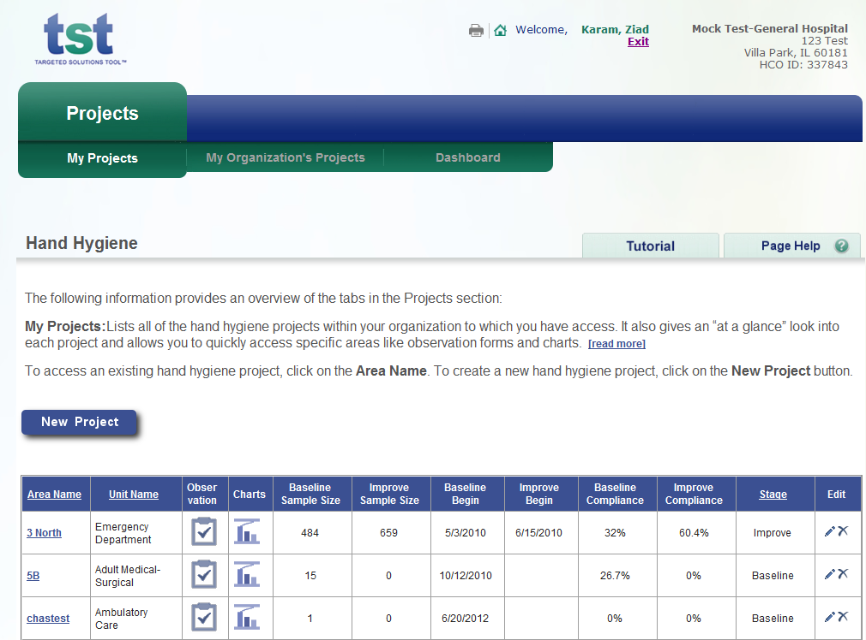
TST – Setting Up Projects

Slide 7
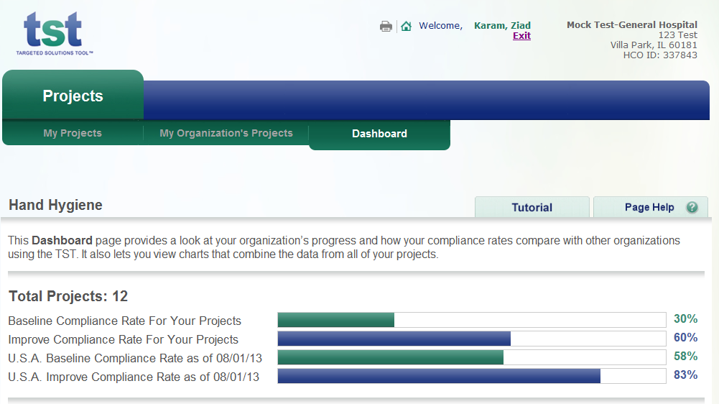
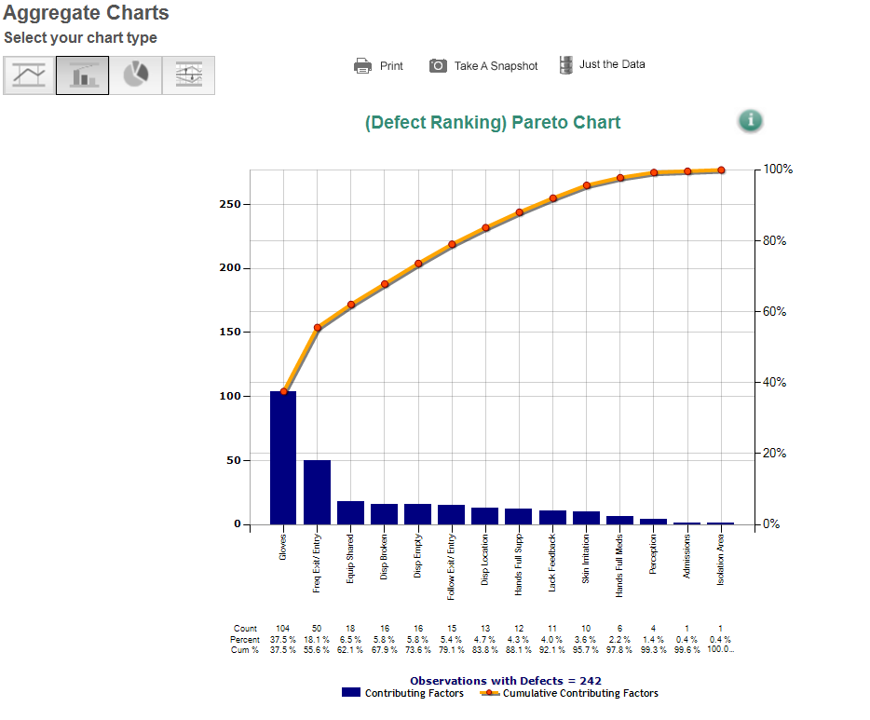
Viewing your Dashboard
Look at your organization’s progress and compare to national TST users
View charts which combine data from all of your projects

Slide 8
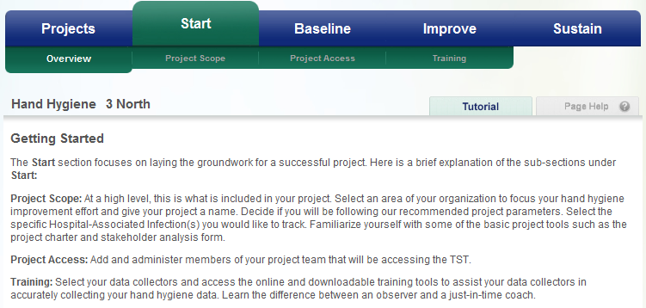
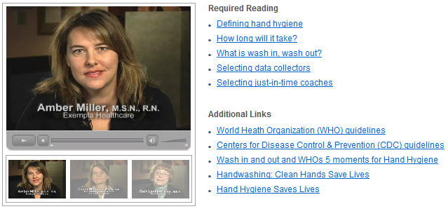
Getting Started
Videos
display tips
from experts
Links to CDC & WHO
guidelines

Slide 9
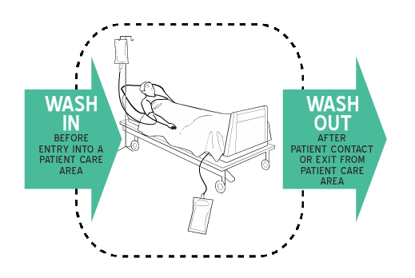
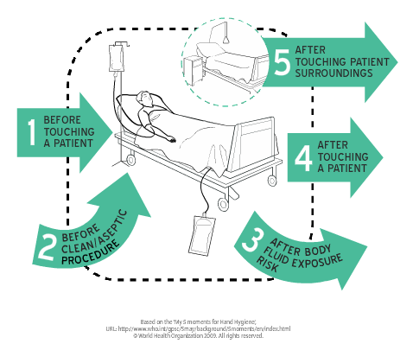
Defining Hand Hygiene
Two Moments
Hand hygiene at room entry
Hand hygiene at room exit
In the TST, hand hygiene is limited to the two moments of wash in and wash out so that your organization can better measure, or count, instances of compliance

Slide 10
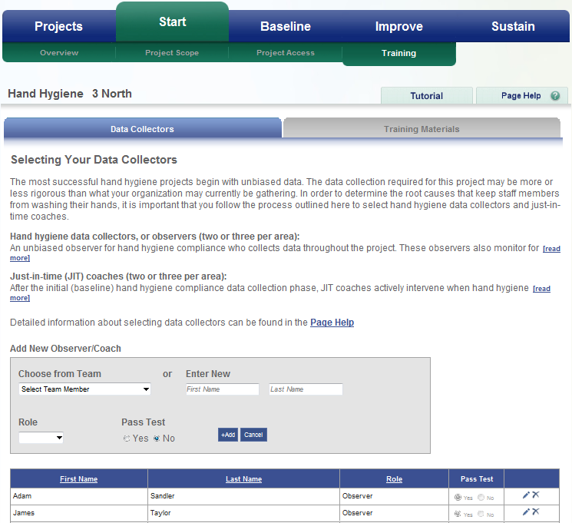
Training Observers
Provides detailed information on selecting data collectors

Slide 11
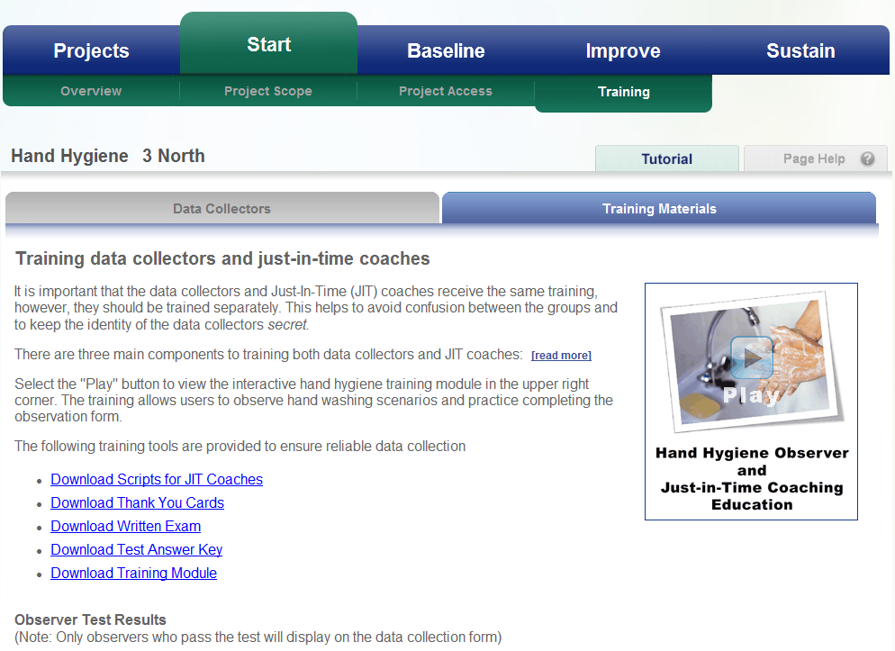
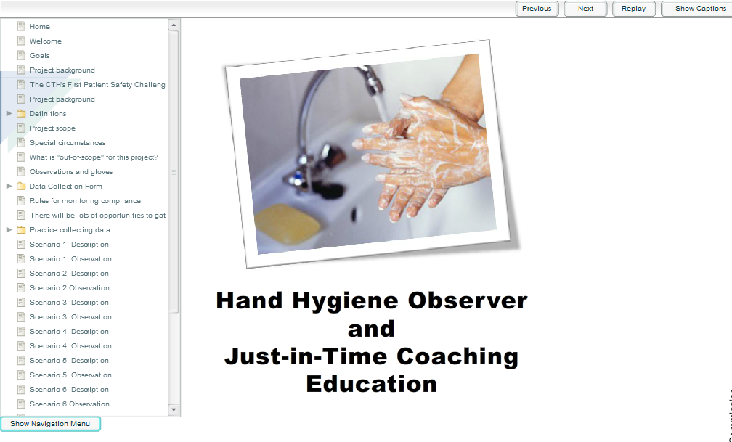
Downloadable Training Materials
Data collection form practice and scenario videos provided for training
Training tools provided to ensure reliable data collection

Slide 12
Data Collection Method
 | HH data collector (observer) | Just-in-time coach
Purpose | To be an unbiased observer for hand hygiene compliance | To collect data, intervene, and coach staff when hand hygiene non-compliance is observed
Data Collected | Hand hygiene compliance data is used for establishing the baseline Hand Hygiene performance | Data collection will begin after the baseline data has been collected and the compliance data shared with staff
 | “Secret shoppers”: anonymous observers collected data on physical barriers of non-compliance without influencing the observed behaviors | JIT coaches capture non-observable cultural barriers by interviewing health care providers after an observed instance of non-compliance
Who | Examples include: housekeeping, lab staff, chaplains, volunteers | Examples include: unit managers, charge nurses, infection control practitioners, executives/leadership, and quality coaches or unit-based educators

Slide 13
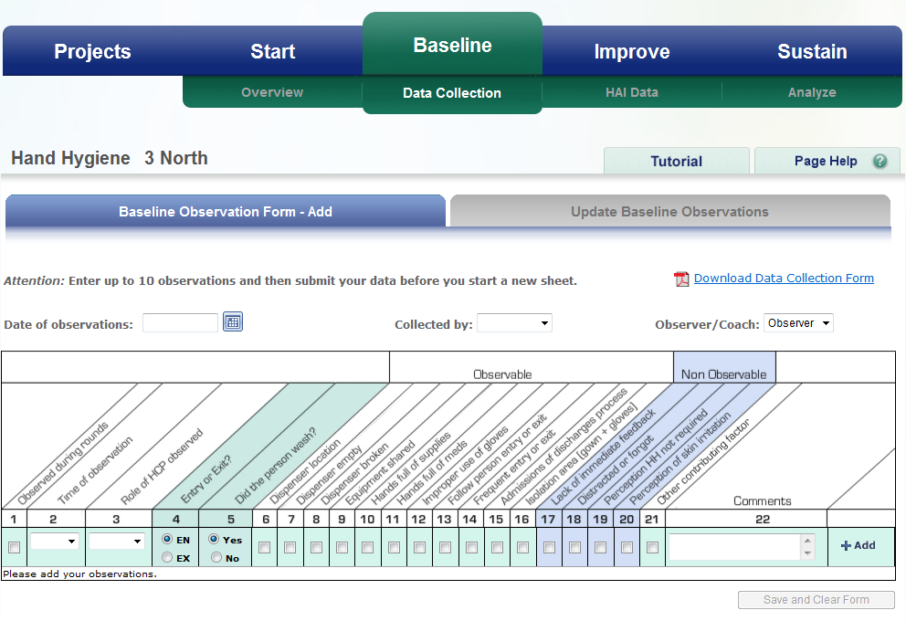
Baseline-Measuring Compliance
Observable Versus Non Observable Contributing Factors

Slide 14
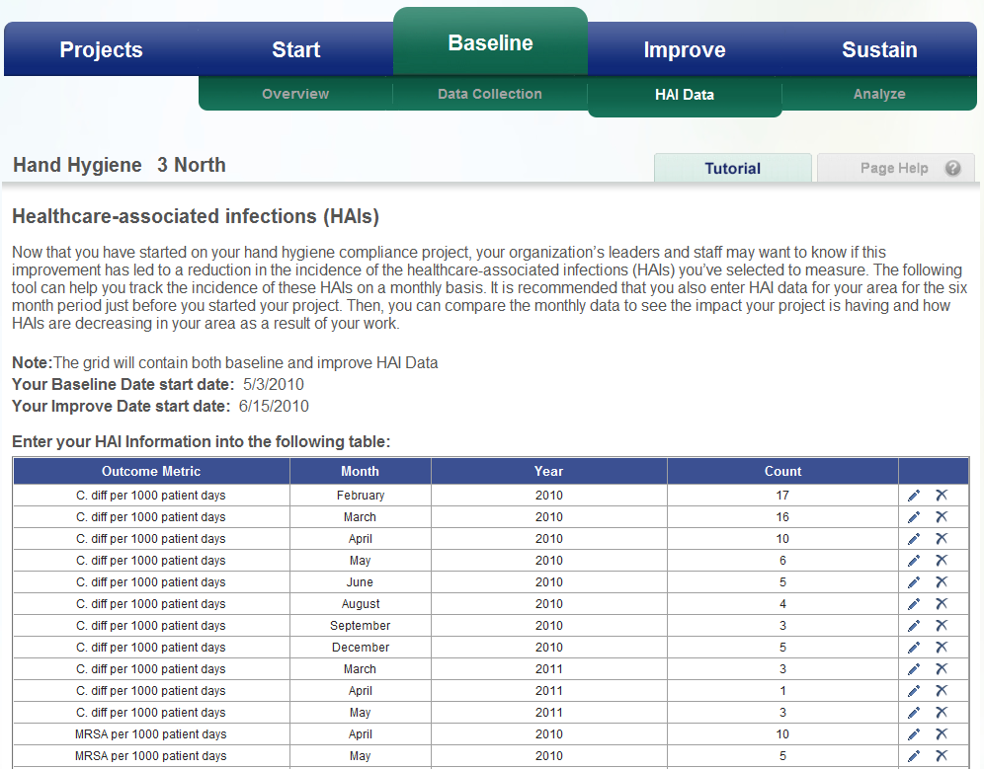
Healthcare-associated infections (HAIs)
Select the types of HAIs that your organization wants to monitor
TST tool helps track incidences of these HAIs

Slide 15
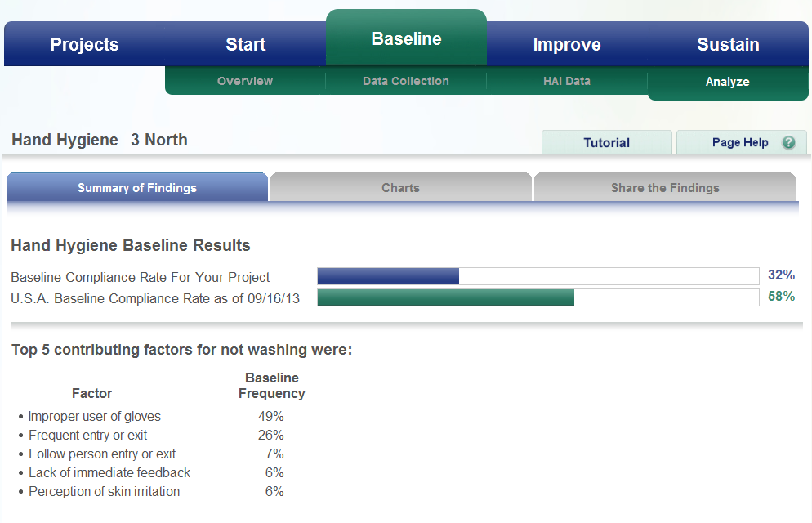
Baseline Results
Provides real-time feedback
Rank your contributing factors from highest to lowest frequency

Slide 16
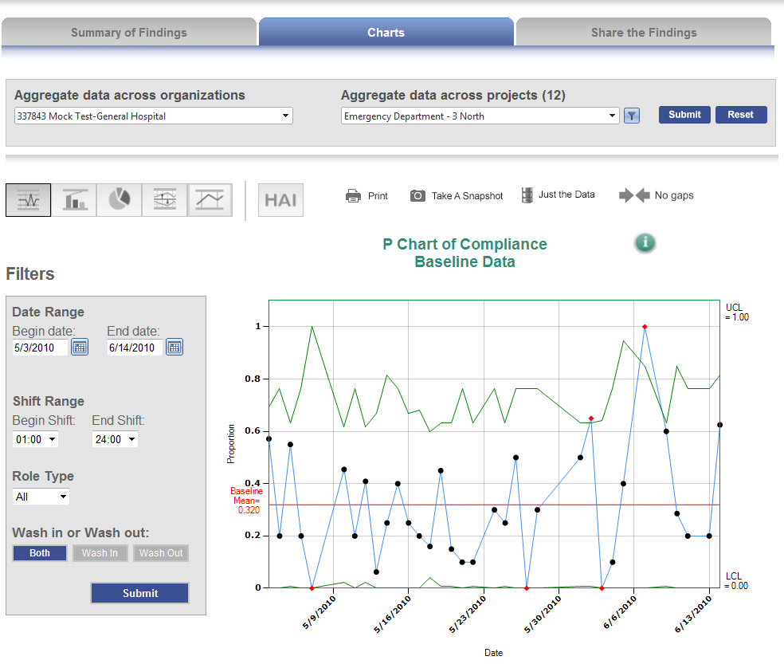
Analyze- Baseline Data
Filtering capability to analyze by shift and role type
Real-time analysis & data feedback

Slide 17

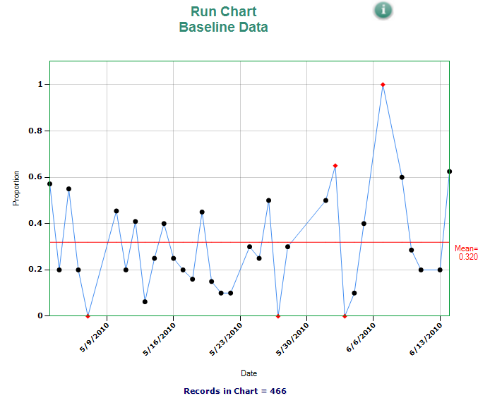
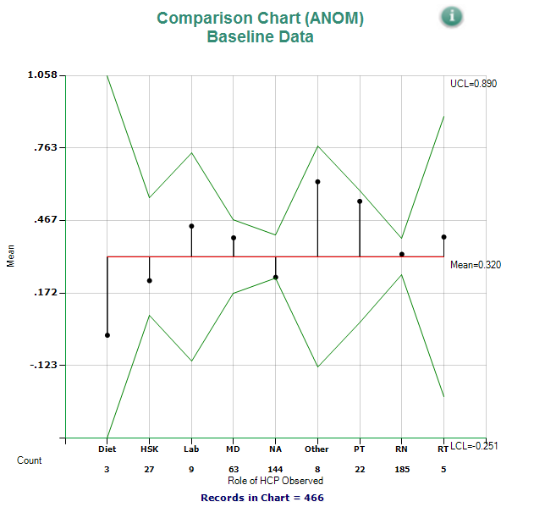
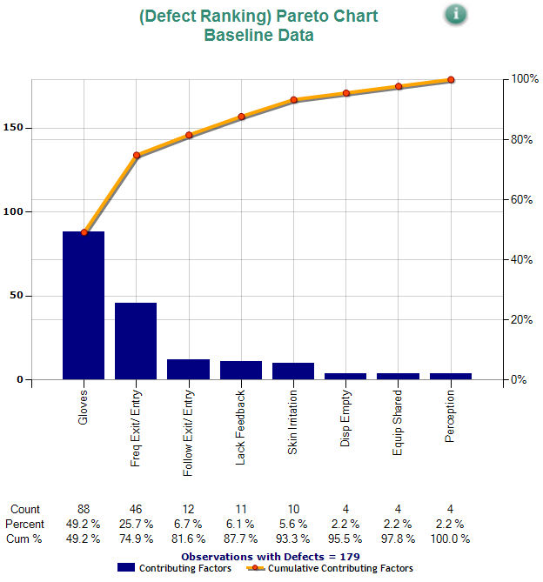
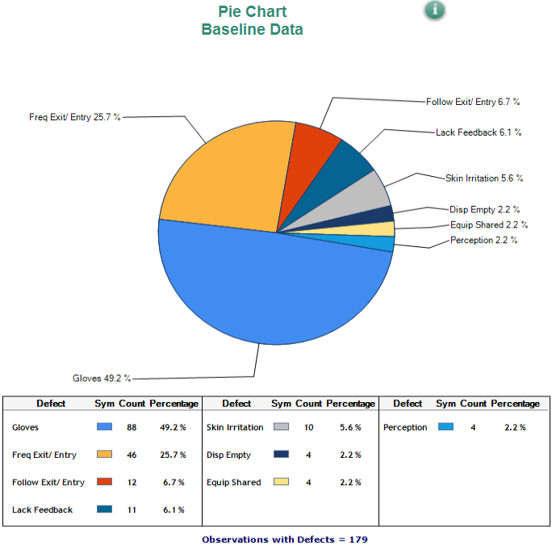






Different Chart Options
Drills down to the contributing factors
Driving acceptance and accountability

Slide 18
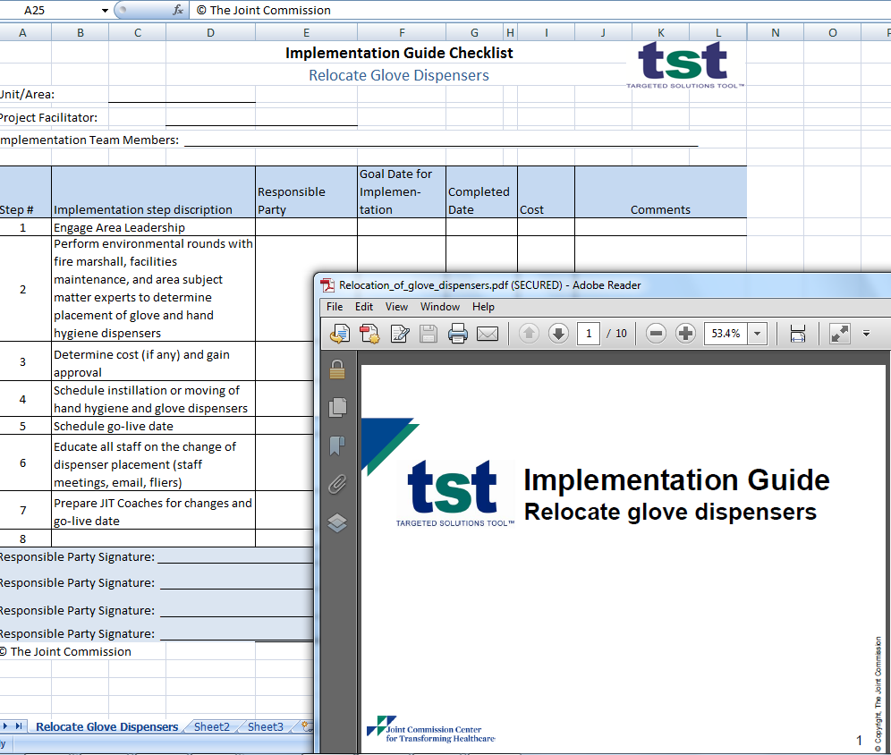

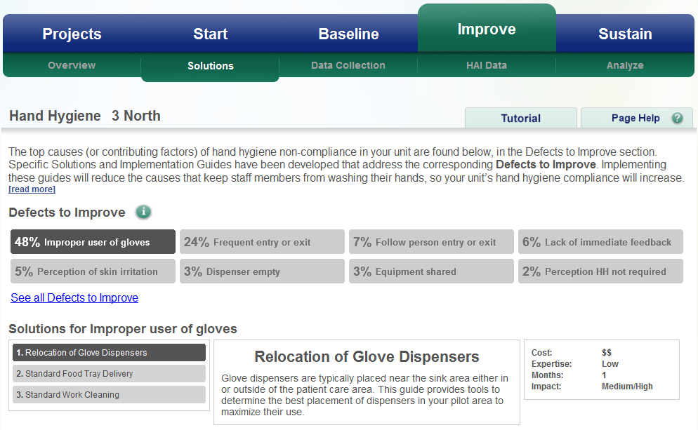
Targeted Solutions
Provides targeted solutions to each specific cause
Downloadable implementation guides and checklists

Slide 19
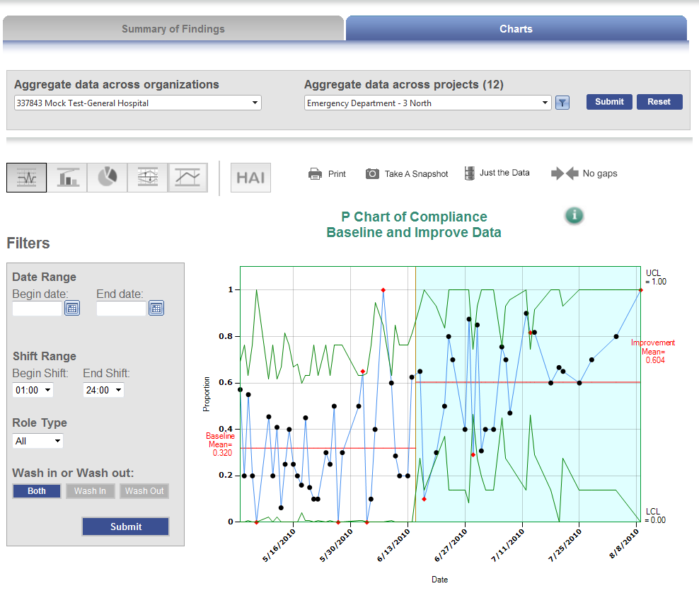
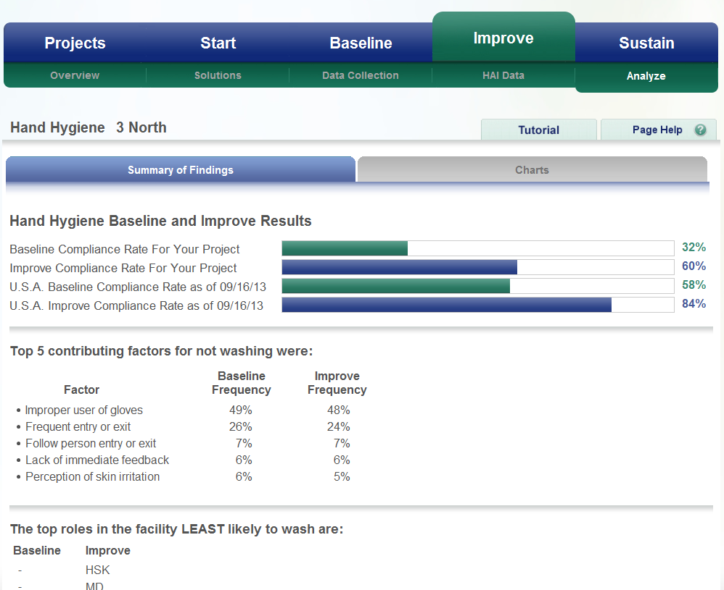
Analyze Baseline and Improve Data

Slide 20
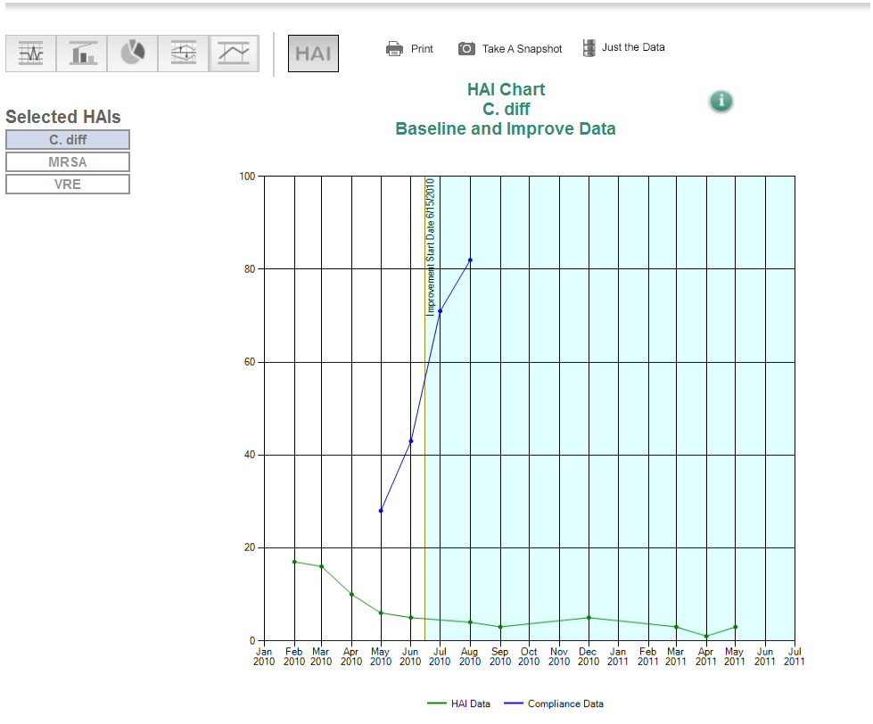
HAI Data Chart
Select HAI type you want to observe in correlation to hand hygiene compliance rates

Slide 21
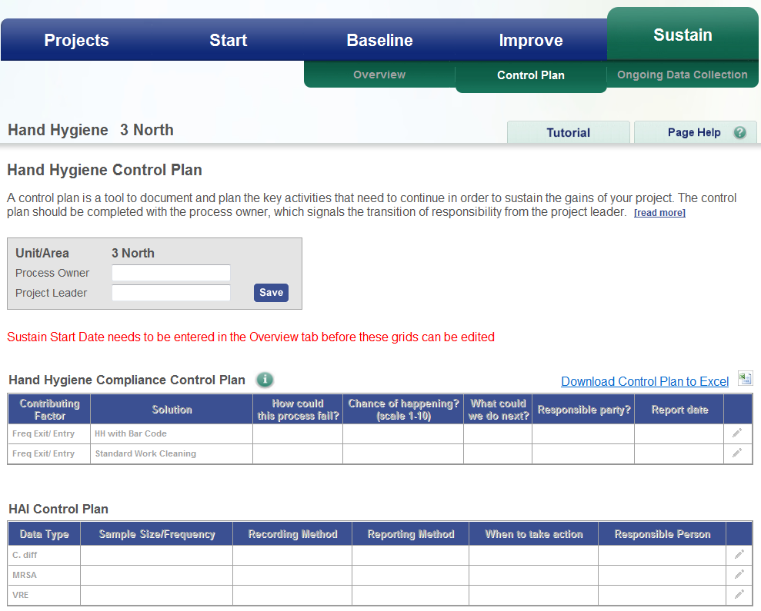
Sustaining the Gain
Provides control plan to sustain the gains of your project

Slide 22
Question:
What is the ultimate goal you want to achieve going through this project?
22

Slide 23
TST Best Practices
Selecting/building your team
Leadership support
Selecting your units
Training data collectors
Collecting data
Implementing solutions
23

Slide 24
Next call: February 5, 2014
2 pm EST
Next Call Schedule
24

Slide 25
Next steps
What | Who | When | Status
25

