Slide 1
Leadership for Safety Web Workshop: Reality Rounding
Essential Hospitals Engagement Network
July 17, 2013

Slide 2
Our new Name
We’ve rebranded! The National Association of Public Hospitals and Health Systems is now America’s Essential Hospitals.
Although we’ve changed our name, our mission is the same: to champion hospitals and health systems that provide the highest quality of service to all by achieving the best health outcomes for every patient, especially those in greatest need. The new name underscores our members’ continuing public commitment and the essential nature of our work to care for the most vulnerable and provide vital community services, such as trauma care and disaster response.
This is an exciting time for us and our members, as we lean forward into new care models, opportunities and challenges of reform, and quality and safety innovations that often take root in our member systems.
Our new website address: www.EssentialHospitals.org

Slide 3
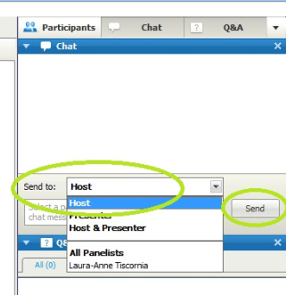
“Q&A” and Chat
Please use the Chat Box on the webinar screen to type your question or comment at any time.
NOW: Use the Chat Box to sign in. Enter your organization and names of all people in the room.

Slide 4
Remember This? Action Planning Checklist
Leadership Behaviors and Tools | Actions Planned
Take personal ownership of safety in your organization
Eliminate the denominator: How many patients did we harm last year?
Be transparent: wall displays, open discussion of serious safety events…
Start every meeting with a patient story
Frame safety aims in reference to the theoretical ideal
Do “reality rounding” on key safety practices
Executive visits to safety teams
Daily safety huddle
Make hard decisions that change the culture—on both values and technical performance!

Slide 5
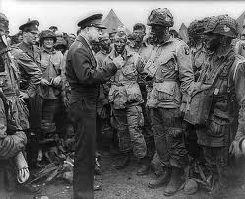
Let’s start with the easier assignment. Do you really know what’s happening on the front lines?

Slide 6
Reality Rounds:
Pick a major safety practice critical to your aims for this year
Develop a scripted set of questions designed to expose operational barriers to implementation of that practice, and to drive positive feedback to staff who know and implement the practice
Commit the leadership team to round
CEO 1 hour per month
VP 1 hour per week
Unit manager 1 hour per day
Fix the operational problems you learn about
Pick another safety practice, and repeat

Slide 7
An example script:
Hi, I’m ____, the VP for surgical services. Do you have a minute to chat about the hospital’s work in infection control?
I see this patient has a urinary catheter. Could you tell me the elements of the “bundle” for preventing infections in this patient?
Great job! So here’s a question. Which of the elements of the bundle is hardest for you and the other nurses to implement?
Thanks. Are there any people around you who go “over and above” to implement this bundle?
Let’s move beyond bundles: are there any other things that worry you about patients getting infections in our hospital?
As long as we’re chatting, do you have any other concerns about safety, either of the patients, or of the staff?
Thanks!

Slide 8
Stories from the field.
“We took care of that.”
“Yes sir, we’ve fully implemented those bundles.”
Let’s hear your field reports.

Slide 9
A More Difficult Assignment
Think of a recent harm event in your system, in which a patient was killed or seriously injured.
Call the staff member(s) who were at the sharp end of this event (e.g. the nurse who gave the overdose of the drug, or the team in the OR when the wrong site surgery was performed) and ask to speak with them about their experience. Listen to each of them, individually, for as long as it takes to understand their view of this event.
Call the patient or family member involved, and ask to speak to them personally. Listen to them describe the experience.
Reflect on what you’ve learned, and be prepared to share your insights with the rest of your leadership team.

Slide 10
Next Webinar: Thursday August 15 @ 9am PT/10am MT/11am CT/ noon ET
Assignment
Tell a patient harm story at the board or board quality committee meeting: Be prepared to tell us what you tried and how it went
Display harm measurements to the board using best practices such as eliminating the denominator, displaying names and dates of events, etc.

Slide 11
Save the date…
Leadership for Safety: Yes, It’s Personal A Workshop for CEOs, Board Members and C-Suite Leaders October 7, 2013 9:30am – 4:30pm San Mateo Marriott | San Mateo, CA The deadline to register is September 13, 2013 For more information, visit: http://tc.nphhi.org/Archive/EHEN-Events/Leadership-for-Safety-Yes-Its-Personal-A-Workshop-for-CEOs-Board-Members-and-C-Suite-Leaders

Slide 12
Thank you for JOINING US!
Feedback survey can be accessed in chat box.
Essential Hospitals Engagement Network website: http://tc.nphhi.org/Collaborate/NAPH-Safety-Network.aspx

