Slide 1

Welcome to the Leadership for Safety Webinar
Engaging Physicians in Safety Initiatives
The webinar will be starting momentarily…
If you are having technical difficulties please contact 202-495-3356 or ltiscornia@naph.org

Slide 2
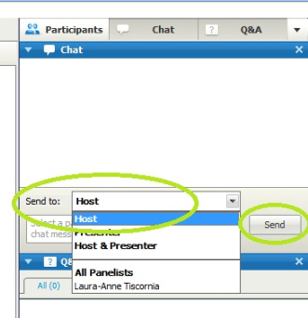
Chat Box
Please use the Chat Box on the webinar screen to type your question or comment at any time.
NOW: Use the Chat Box to sign in.
1) Enter your organization and names of all people in the room.
2) Send to “HOST”
3) Click “SEND”

Slide 3
Agenda for Today’s Webinar
Who is your most engaged physician, what continues to drive their engagement, and what would work to engage other physicians?
Next month’s focus: What leaders need to know about how to make processes more reliable

Slide 4
How did the most engaged physician in your safety collaborative become engaged?
She understood the work to be done on reducing readmissions would also benefit her process...but most of all, it would benefit her patients.
He is the Medical Director for Quality Management and is very interested in Quality Improvement and has a strong relationship with our Chief Quality Officer.
Appointment to the role.
There was a request made and they responded. We have great physician engagement.

Slide 5
What continues to drive this physician’s engagement?
Progress and our commitment to improve patient outcomes. She sees the team is not only talking about improving the process, but also is taking the steps to make it happen.
He is a large part of the Quality and Leadership academy that is an annual training program on the Model for Improvement and leadership development.
Desire to improve patient outcomes and experience.
They are tremendously invested in the success of the organization and more importantly the quality of patient care. They are great partners.

Slide 6
What does this physician think would work to engage other physicians?
The physician needs to see a clear benefit to their practice or themselves.
Physicians generally listen to other physicians when discussing and deciding on practice changes and evidence-based practices; he recognized that he had to be the one to have the difficult conversation with those MD's who were lagging.
Constant feedback related to personal outcomes.
Increased collaboration and communication.

Slide 7
Engaging Physicians in Quality and Safety
Ask them what they want to improve
Ask them to lead the improvement, and expect them to get results
Make it easy to lead improvement
Show courage: support them in making difficult changes
Recognize them when they succeed
Good Tactics
Segment your approach—not all physicians need to be engaged in the same way!
Use QI methodology in ways that don’t turn doctors away
Do your improvement work in clinics and units, not in conference rooms
Use stories, data, and displays in ways that engage the heart

Slide 8
Polling Question
Which of the following is the most common intervention used by your NSN improvement teams to achieve its safety goals? (check one)
Educating staff
Using high reliability principles to achieve 99% reliability
Exhorting staff to pay attention
Increasing surveillance/using “secret shopper” audits
Inputting safety processes into electronic order systems

Slide 9
Next Month: Tuesday, April 16 8am PT/9am MT/10am CT/11am ET
How to make processes more reliable: What leaders need to know
Achieving 99% reliability means adopting principles such as
Make the desired action the default
Integrate new process steps into existing workflow
Use redundancy wisely

Slide 10
SAVE THE DATE!
Leadership for Safety: Yes, It’s Personal A Workshop for Boards, C-Suite, and Senior Leaders June 19, 2013 8:30am – 5:00pm Westin Diplomat Resort in Hollywood, FL
Notes:
Thursdays 9am seems best

Slide 11
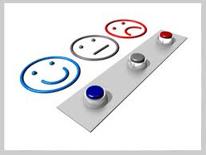
THANK YOU FOR JOINING US
Feedback survey can be accessed in chat box.

