Slide 1

Welcome to the Leadership for Safety Webinar
When Things Go Really Wrong:
Responding to Patient Safety Disasters
The webinar will be starting momentarily…
If you are having technical difficulties please contact 202-495-3356 or ltiscornia@naph.org

Slide 2
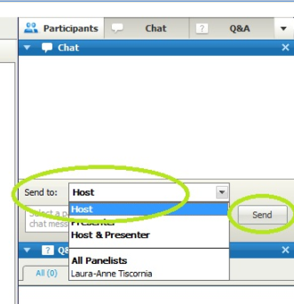
Chat Box
Please use the Chat Box on the webinar screen to type your question or comment at any time.
NOW: Use the Chat Box to sign in.
1) Enter your organization and names of all people in the room.
2) Send to “HOST”
3) Click “SEND”

Slide 3
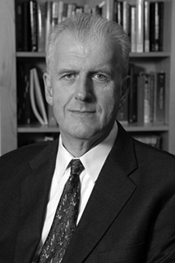
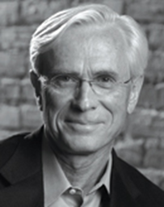
Today’s Speakers
Jim Conway, MS
Adjunct Faculty, HSPH
Principal, Pascal Metrics Inc.
Jim Reinertsen, MD
Principal
The Reinertsen Group

Slide 4
Agenda:
Discussion: What is your organization’s plan for dealing with patient safety disasters?
Upcoming leadership for safety webinars and workshops

Slide 5
We Were Treated
With Respect
National Association of Public Hospitals and Health Systems
Jim Conway
Adjunct Faculty, Harvard School of Public Health
jconway@hsph.harvard.edu

Slide 6
Outline
My Personal Journey
An Opening Reflection
Core Content
Role of the CEO and executive leadership in the moment and over time
Dealing with the Media & Social Media
Resources

Slide 7

For your service to your patients, families, staff, and communities.

Slide 8
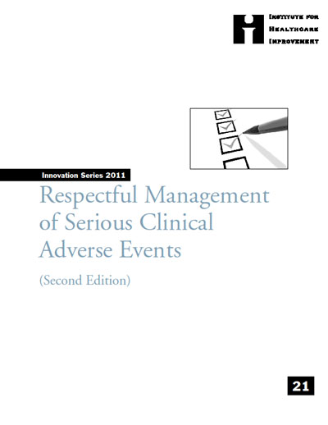
The Journey: Personal to Community
1995 - 2013
DANA-FARBER ADMITS DRUG OVERDOSE CAUSED DEATH OF GLOBE COLUMNIST, DAMAGE TO SECOND WOMAN
When 39-year-old Betsy A. Lehman died suddenly last Dec. 3 at Boston's Dana-Farber Cancer Institute, near the end of a grueling three-month treatment for breast cancer, it seemed a tragic reminder of the risks and limits of high-stakes cancer care. In fact, it was something very different
“We’ve just had a terrible error in the ICU. A patient died who shouldn’t have. What should we do?”

Slide 9
An Opening Reflection
Recent Serious Case
Think about a recent serious event
How did it go?
  Patient and family
  Staff,
  Organization
  You
Did you have a plan?
Were there surprises?
What’s been the real learning & improvement?

Slide 10
Realities of Large Complex Imperfect Healthcare Organizations
Preventable serious harm
Fatal rare complication
Violent crime
Fire
Drug diversion
Identity theft
Other breaches, etc.

Slide 11
Breaking A No-Win Cycle
Serious clinical adverse event occurs.
Organization is not transparent.
People close to the incident contact media.
Media contacts the organization, gets “no comment,” or incorrect or superficial information.
Media go looking everywhere for any information.
Information is supplied by people who really don’t know.
All parties are further traumatized by the strident, inaccurate media attention.
The organization’s response becomes as big a story.

Slide 12
Serious Clinical Event Defined
Serious harm, potential serious harm, death, or a clear or present danger to one or more patients and/or to a community (psychological and physical)
Possible definitions include but not limited to:
  Harm categories G, H, and I, as measured by the NCC MERP harm index.
  Sentinel events as defined by Joint Commission
  The National Quality Forum Serious Reportable Events as a baseline list of serious clinical events.
  HPI Safety Event Classification .
Harm is usually, but not exclusively, preventable.

Slide 13
How To Respond?
What should we do?
  First hour, day, week, month
  Moving forward
Who should do it?
What should we say, and to whom?
Whose problem is this?

Slide 14
The Burden of the “Call”
Devastation of the person calling
Similarities of the stories
Working with a blank sheet of paper
Highly reactive, unbalanced response, and
Underestimating the potential harm to all.

Slide 15
In Summary,
Crisis Management Steps
Avoid the crisis
Prepare to manage the crisis
Recognize the crisis
Contain the crisis
Resolve the crisis
Profit (by learning) from the crisis
Augustine N. Managing the Crisis You Tried To Prevent

Slide 16
Avoid the Crisis
Leadership and a Culture of Quality and Safety

Slide 17
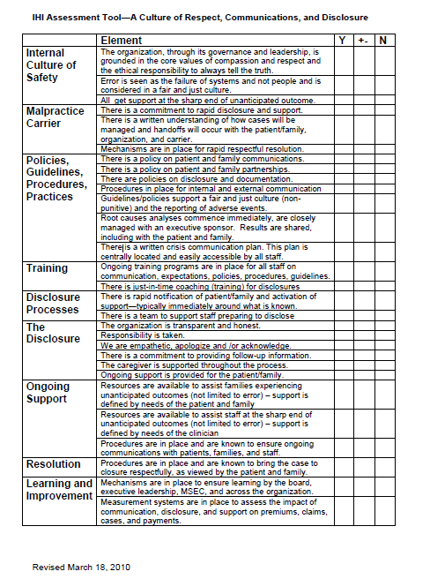
Assessing Your Policies, Procedures, Practices, Culture
Internal Culture of Safety
Malpractice Carrier
Policies, Guidelines, Procedures, Practices
Training
Disclosure Processes
The Disclosure
Ongoing Support
Resolution
Learning and Improvement

Slide 18
Manage the Crisis
The Team, The Plan, the Priorities

Slide 19
The Best Way To Manage a Crisis is to Have a Plan
Create a team for planning
Determine each potential problem’s likelihood
Create a plan
Simulate the plan
Update the plan
Crisis Management: Master the Skills to Prevent Disasters
by Harvard Business Essentials

Slide 20
Model Crisis Management Team
CEO/COO
CMO
CNO
Communications Officer
General Counsel
Patient Representative
Representatives from: Risk Management / Quality Improvement / Patient Safety, Ethics, Pastoral Care
Relevant service chief
Others as appropriate for incident
  Expert in Hospital Incident Command System

Slide 21
Crisis Management Team:
Moving Forward
Routine check-in daily to multiple times a day
Maintain highly disciplined documentation and log
Engage outside help through colleagues and consultants
Listen and be prepared to hear things you don’t want to
Embrace speed and flexibility
Stay close to internal and external voices
Consider implications for hospital/professional billing
Imagine the worst; mitigate as possible
Be prepared for inquiry from or the arrival of external accrediting and regulatory agencies
Ensure knowledge management / improvement

Slide 22
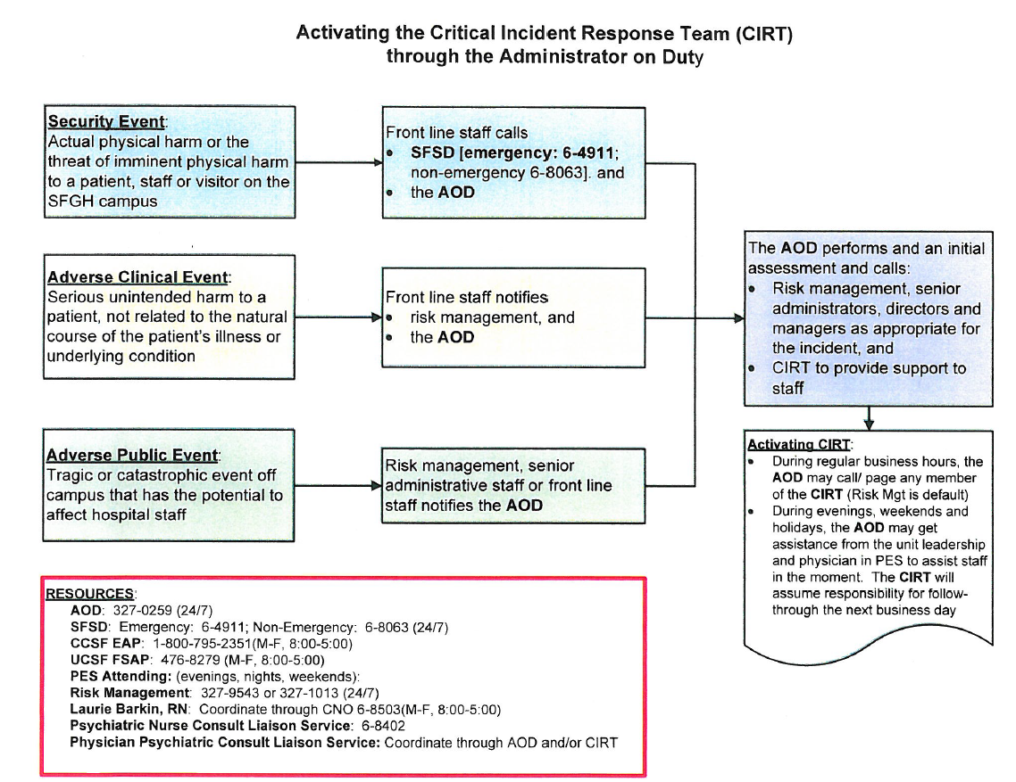
San Francisco General Hospital

Slide 23
Crisis Management Plan
Internal notifications
Crisis Management Team
Priorities
  Patient and family
  Staff
  Organization
    External and Internal Communications
External notifications and unannounced visits

Slide 24
Areas Requiring Focus
(In this order)
Patient and family
Staff, particularly those at the sharp end of the error
Organization

Slide 25
Seeking To Achieve for All
Patient, Family, Staff, Organization
Empathy
Disclosure
Support (including reimbursement)
Assessment
Apology
Resolution (including compensation)
Learning
Improvement

Slide 26
Patient and Family
Team disclosure
Statement of empathy/sorrow
Apology
RCA participation
Safety and support
Reimbursement
Compensation
Resolution
Learning
Never lose sight of the patient and family

Slide 27
Staff
Coaching around disclosure
Safety and support
Engage in RCA
Inclusion of all patient’s team
Bring to resolution
Assure learning
Never lose sight of the staff at the sharp end of the error

Slide 28
Organization
Governance and executive team notifications
Visible CEO & C-Suite
Activated crisis team and leader
Engaged Board of Trustees
RCA underway
Internal and external communications
External notifications and unannounced visits
Ongoing RCA, learning and improvement

Slide 29
Whose Problem Is This?
Board of Trustees (Governing Body)
  Ultimately responsible and accountable for quality and safety
  Engaged immediately and ongoing in system learning and improvement
  Must fulfill their responsibility to the patient, family, and community
CEO

Slide 30
DHHS: OIG Interest Continues and Intensifies
“CMS rarely directed State agencies to assess governance during their complaint surveys at accredited hospitals. Only 12 of the 78 complaint surveys in our sample included State surveyors’ examining the CoP regarding hospitals’ governing bodies. This CoP states that a hospital’s governing body is legally responsible for the conduct of the hospital as an institution, including its quality improvement system. Hospital leadership and medical staff are accountable to the governing body.”
“If surveyors find that the hospitals have not adequately addressed the problems or that ongoing noncompliance might exist, they should broaden their complaint surveys to evaluate compliance with the governing-body CoP and other relevant CoPs.”
http://oig.hhs.gov/oei/reports/oei-01-08-00590.pdf

Slide 31
What is your organization’s plan for notifying the board of safety disasters?
UMC El Paso: The whole board is notified of patient safety disasters by the CNO during the Board meetings under executive session.
San Francisco General: A sentinel event review policy outlines the steps to review/report critical incidents. The Medical Director of Risk Management reviews incidents with the Medical Executive Committee and the Joint Conference Committee, our governing body. These meetings occur monthly. If the media is involved or it is a high profile case, CEO calls the President of the San Francisco Health Commission and Chair of the Joint Conference Committee, who in turn notifies the Director of the Department of Public Health.
Maricopa: Our CEO notifies the board of any safety disaster issues. At times with the assistance of CMO or Director of Risk.
St. Luke’s: Chief Quality Officer or Leader for Quality at individual sites notifies the CEO who notifies the Board Chair. Timing is based on the event and could be immediate or within 24 hours.
UT Northeast: Our Board is the CEO/President as delegated by the Board of Regents. In the event of a safety disaster, the CEO/President is notified as well as senior leaders.

Slide 32
“I am accountable for those unnecessary deaths in our NICU”
Paul Wiles
CEO, Novant Health
Retired

Slide 33
Risk Assessment and Root Causes Analysis
Commence immediately
  Nothing more important on the schedule
Include executive leadership
  Comprehensive, fair and balanced process
  Remove barriers
  Learning
Include staff close to the sharp-end
Include patient / family as possible
Fully integrate into governance and executive processes
Assure follow-through on plan of correction
Note: Study conducting effective RCAs now.

Slide 34
Internal and External Communications
What can we say?
How can we say it?
Who are we communicating to?
  External
  Internal

Slide 35
What Can We Say
Essential Messages
Hospital apology, outrage, anger, regret that incident happened
Disclosed to the patient/family--- informing and supporting them is priority
Involvement of Board and leadership
  understanding why systems failed patient and family
  steps to prevent a similar occurrence
Working with appropriate authorities
  NOT a time to fight with authorities or Accreditors
Understand this as a breach of trust and a failure to our community

Slide 36
How Can We Say It?
Define your essential messages as clearly and concisely as possible
Centralize and narrow the flow of information
  Determine who will speak for the institution
  All spokespersons must be briefed and prepared
  Remind all staff to direct outside inquiries to Comm.
  Communications Dept. should review communications to all core audiences
Mobilize your allies

Slide 37
Internal Communications Critical
All staff devastated when these events happen
Need to understand what’s going on as staff, consumers, and sources of information
The “drop a dime” phenomenon
  Action not visible around immediate incident
  Frustration over historical issue resolution
  Organization not “telling the truth”
Note: Routine communication of errors facilitates communication of serious incidents.

Slide 38
Who speaks for the organization? Who speaks to family members?
UMC El Paso: The Quality Director provides the information to the CNO who in turn speaks for the organization about safety disasters. The Risk Manager speaks to the family members in conjunction with the physician.
San Francisco General: Communications Director works with CEO, Risk Management and Pt Safety to handle media calls. We started a “storytelling” process - critical events are shared with the unit where the event occurred and other units to promote organization-wide learning. The attending physician is ultimately responsible for disclosing the event to patients and families and at the very least is present to ensure that the disclosure is complete and that all questions are addressed.
Maricopa: Generally, a team interacts with family members e.g., Attending, Social Worker, Nursing Director of the area, CNO or CMO, and Director of Risk.
St. Luke’s: CQO/CMO at sites or the CEO. Family interactions include members of the Department of Safety and highest level quality/safety leader for the organization.
UT Northeast: Senior clinicians and manager of area speak to family members. Legal Counsel and Director of Marketing (as well as pertinent senior leader or senior clinician) address the media.

Slide 39
What training is in place to improve crisis management for safety disasters?
UMC El Paso: Risk Management receives training through multiple avenues, e.g. legal seminars, literature reviews. Process participants are then provided information/training by the Risk Manager.
San Francisco General: SFGH understands that staff sometimes have to cope with challenging events that are emotionally and physically taxing and cognitively distracting. The Critical Incident Response Team (CIRT) is an interdisciplinary team of SFGH staff with representatives from the San Francisco City & County Employee Assistance Program, the UCSF Faculty, Chaplain Service, Psychiatric Consult Service and Employee Assistance Program. The CIRT is activated at the time of an incident and coordinates interventions to provide support to staff in crisis.
St. Luke’s: Some experience with IHI Patient Safety Officer, but not formal throughout.
UT Northeast: We have conducted crisis management training and have designated "coaches" that assist with staff and family during and after a crisis. We have a policy/procedure for disclosure.

Slide 40
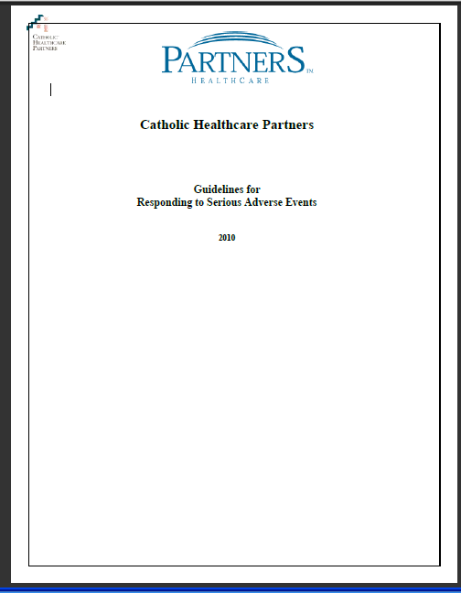
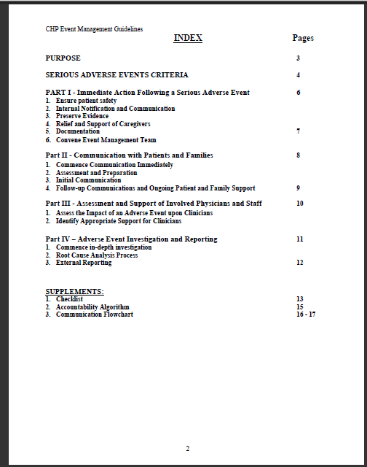
The Final Plan

Slide 41
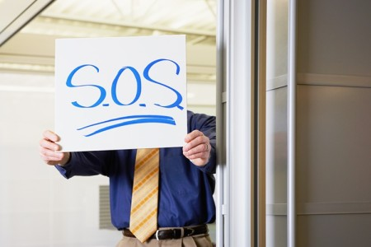
What to Do When a Crisis Occurs, Without a Plan

Slide 42
No Plan
Notify executive leadership and the Board.
Establish a sense of urgency.
Assemble an ad-hoc Crisis Management Team led by the CEO or other C-suite
Utilize this White Paper (Appendix A&B)
Review the White Paper.
Consider outside crisis management help.
Contact other executive leaders (Appendix D)
Never lose sight of the patient and family, staff, and organization.

Slide 43
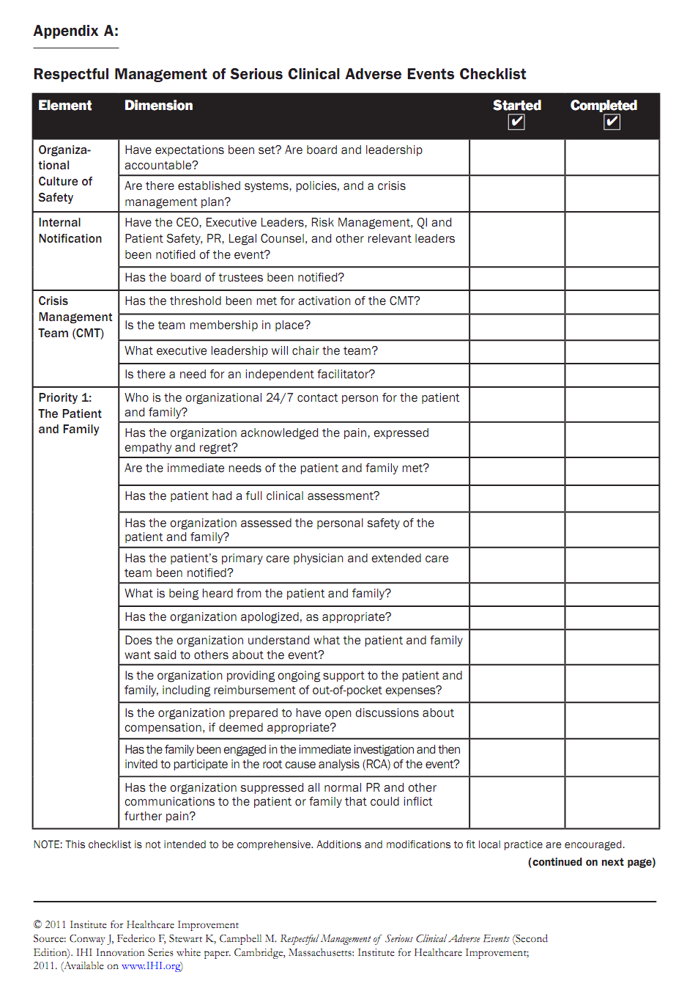
Checklist: Respectful Management of a Serious Clinical Event
PROBING ALL STEPS
COMPLETING ALL STEPS
Prepared Plans & Systems
Internal Notification
Crisis Team Activation
Priority 1: Patient / Family
Priority 2: Staff
Priority 3: Organization
Adverse Event Management
Communications
Reimbursement/Compensation
External Notification / Visits

Slide 44
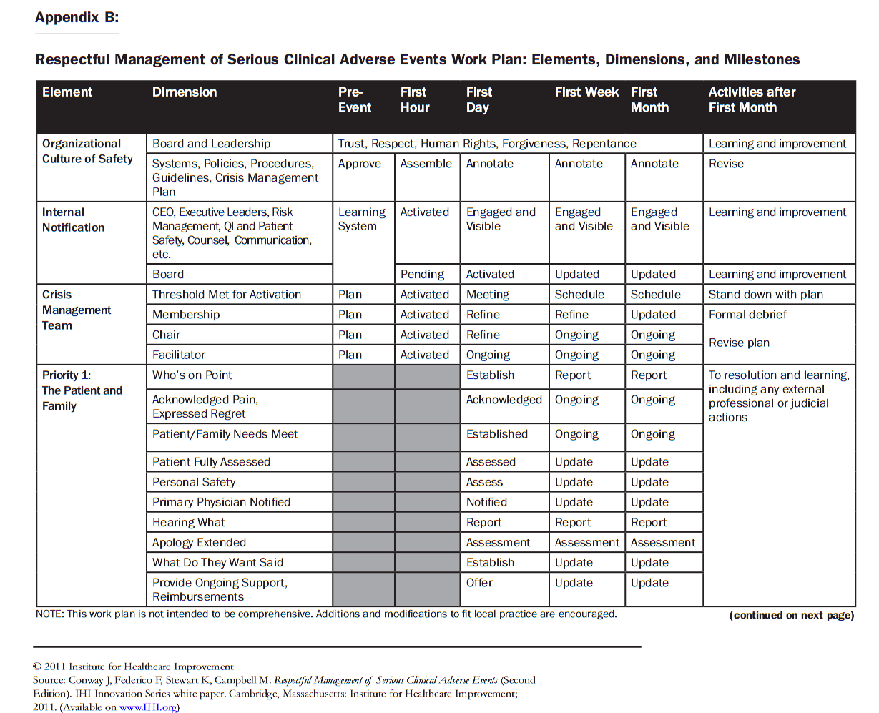
Work Plan: Respectful Management of a Serious Clinical Event

Slide 45
Supporting Organizations Dealing with Serious Clinical Events
Offer support, a helping hand, counsel to others dealing with tragic events and crises.

Slide 46
Learning From Events In Other Organizations: Could It Happen Here?
http://www.ihi.org/knowledge/Pages/Publications/CouldItHappenHereLearningfromSafetyEfforts.aspx

Slide 47
In Review: The Role of the CEO and Senior Leadership
Set expectation
Inform and approve plan
Be “in the know” & engage governance
Lead the crisis management team
Be prepared
Be visible (patient, family, staff, community)
Be informed
Assure resolution, learning, and improvement
Listen to these two CEOs and their teams on WIHI http://www.ihi.org/knowledge/Pages/AudioandVideo/WIHIReportsfromFrontlinesofEffectiveCrisisManagement.aspx

Slide 48
In Review: Dealing with the Media
In advance:
  Up-to-date, tested media plan / crisis plan
  Informed internal PR/Communications staff
  Cultivated media
  Media training for organization leaders
On the heels of an adverse event
  Rapid response
  Honest; don’t stonewall
  What happened, why, what’s being done?
  Empathetic
  Provide updates

Slide 49
“If you take my pen and say you are sorry, but don't give me the pen back, nothing has happened.”
Bishop Desmond Tutu

Slide 50
Response Since October 2010 Release
Affirmed and interested:
  ~80,000 visits to content & ~20,000 downloads
  Presentations, endorsement, and use
Challenges in implementation
  Legal considerations, “trump card”
  Dealing with “someone else's” error
  Lack of organizational attention
  Money, money, money
Updates
  2011: Major update
  2013: Add “Through the Eyes of Patients and Families Members”

Slide 51
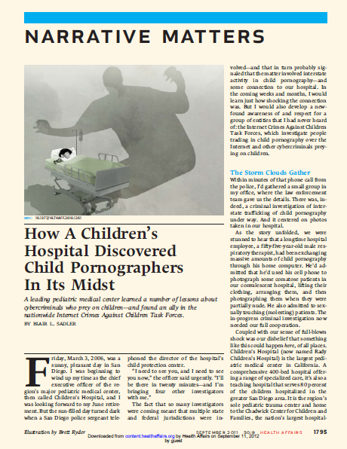
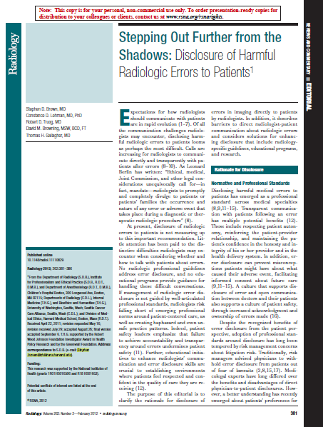
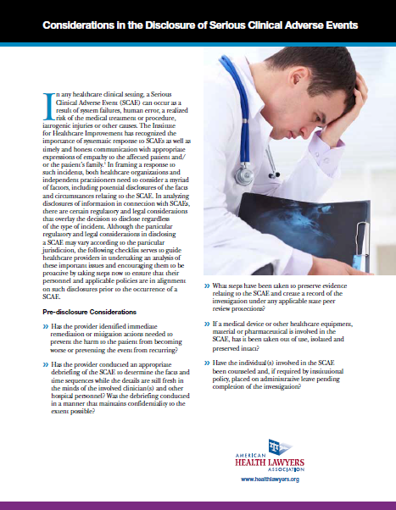
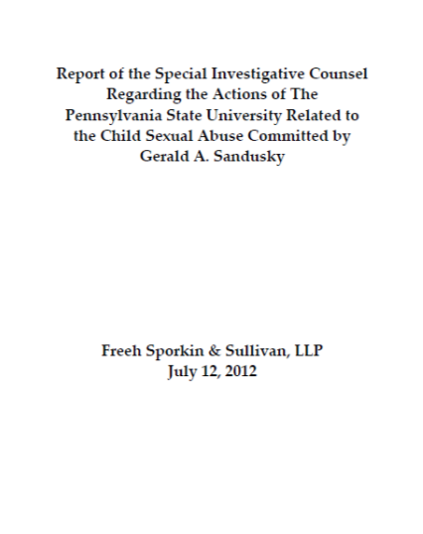
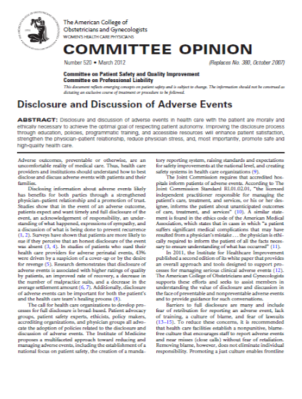
http://www.healthlawyers.org/hlresources/PI/InfoSeries/Documents/For%20the%20Healthcare%20Executive/Adverse%20Events.pdf
http://www.thefreehreportonpsu.com/REPORT_FINAL_071212.pdf
http://www.ncbi.nlm.nih.gov/pubmed/21900671
http://www.acog.org/~/media/Committee%20Opinions/Committee%20on%20Patient%20Safety%20and%20Quality%20Improvement/co520.pdf?dmc=1&ts=20120912T1449395922
http://www.ncbi.nlm.nih.gov/pubmed/22282177

Slide 52
“When something goes wrong it is how the organization acts that redefines and reshapes the culture.”
J. Clough, Mt. Auburn Hospital

Slide 53
An IHI Resource Center
Leadership Response to a Sentinel Event: Respectful, Effective Crisis Management
http://tinyurl.com/IHIEffectiveCrisisMgmt
“In the aftermath of a serious adverse event the patient/family, staff, and community would all say, ‘We were treated with respect.’”

Slide 54

Comments, Questions, Answers

Slide 55
Next Month…
Leadership for Safety: Yes, It’s Personal A Workshop for CEOs, Board Members and C-Suite Leaders June 19, 2013 8:00am – 5:00pm Westin Diplomat in Hollywood, FL The deadline is approaching! The special NAPH hotel reservation rate expires this Friday, May 24, 2013.
Notes:
Thursdays 9am seems best

Slide 56
Our Leadership for Safety Program will continue!
July 18, 2013 9am PT/ 10am MT/ 11am CT/ 12pm ET | Webinar: Reality Rounding & Leadership Reviews of Progress of Safety Improvement Teams
August 15, 2013 9am PT/ 10am MT/ 11am CT/ 12pm ET | Webinar: Getting the Board on Board
September 19, 2013 9am PT/ 10am MT/ 11am CT/ 12pm ET | Webinar: Will and Transparency
October 7, 2013 San Francisco Area (exact location TBD) | In-Person Leadership for Safety Workshop

Slide 57

THANK YOU FOR JOINING US
Feedback survey can be accessed in chat box.

