Slide 1

Welcome to the Leadership for Safety Webinar
Just Culture: What Happens When Individuals are Responsible for Safety Mishaps?
The webinar will be starting momentarily…
If you are having technical difficulties please contact 202-495-3356 or ltiscornia@naph.org

Slide 2
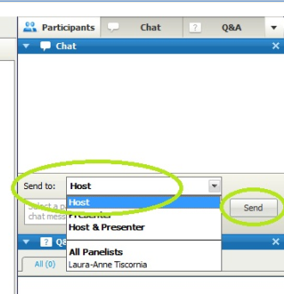
Chat Box
Please use the Chat Box on the webinar screen to type your question or comment at any time.
NOW: Use the Chat Box to sign in. Enter your organization and names of all people in the room.

Slide 3
Agenda for Today’s Webinar
Recent disciplinary actions against individual staff members: Accounts from your peers
Methods for determining individual culpability: Examples of Just Culture algorithms and HR protocols
Next month’s focus: Engaging doctors in safety initiatives

Slide 4
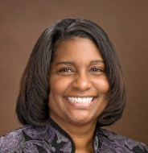

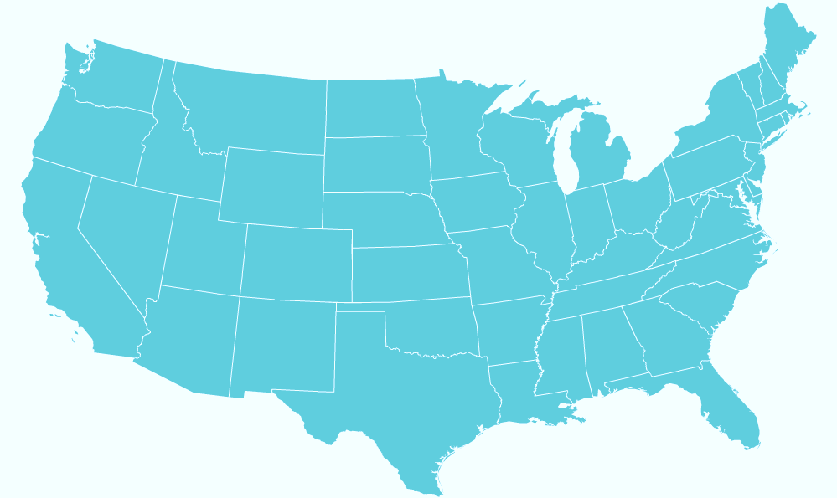
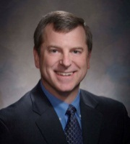
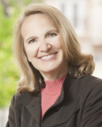

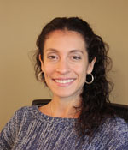

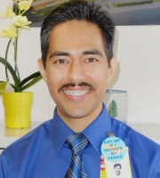
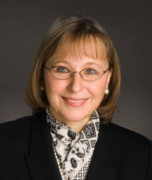
Who is on Today’s Call?
Kimberly Horton, DHA, MSN, FNP, RN, FACHE
Jim Reinertsen, MD
Bart Hill, MD, MPA
St. Luke’s Treasure Valley
Jill Steinbruegge, MD, PhD
St. Luke’s Regional Medical Center
Kerin Bashaw, MPH
St. Luke’s Meridian Medical Center
Cook County Health & Hospitals System
MetroHealth
San Francisco General Hospital and Trauma Center
John H. Stroger, Jr. Hospital
Provident Hospital
Contra Costa Regional Med. Center
Alameda County Medical Center
Santa Clara Valley Health and Hospital System
Truman Medical Centers
San Mateo Medical Center
TMC- Hospital Hill
TMC- Lakewood
Bianca Perez, PhD
Regional Medical Center at Memphis
Kimberly Horton, DHA, MSN, FNP, RN, FACHE
Los Angeles County Department
of Health Services
Harbor-UCLA Med Center
LAC+USC Healthcare Network
Rancho Los Amigos National
Rehab. Center
Maricopa Medical Center
UT-Health Science Center at Tyler
Univ. Medical Center of El Paso
LSU-HCSD
Arielle Gorstein
Harris County Health System
Interim
Bogalusa
Ben Taub General
LBJ Hospital
Quentin Mease
Leadership Summit staff
Javier Gonzalez, MBA/HCM,BSN,CCM,CPHQ
Guest speakers on today’s call
Joan Spicer, RN, PhD, CCM

Slide 5
A Fair and Just Culture:
Why Is it Important?
In-Patient Care Unit | M/S 1 | M/S 2 | ICU
Number of Responses | 24 | 65 | 31
Nonpunitive response to error | 37% | 46% | 61%
Staff feel like their mistakes are held against them. (A8R) | 43% | 43% | 58%
When an event is reported, it feels like the person is being written up, not the problem. (A12R) | 46% | 46% | 74%
Staff worry that mistakes they make are kept in their personnel file. (A16R) | 22% | 49% | 52%

Slide 6
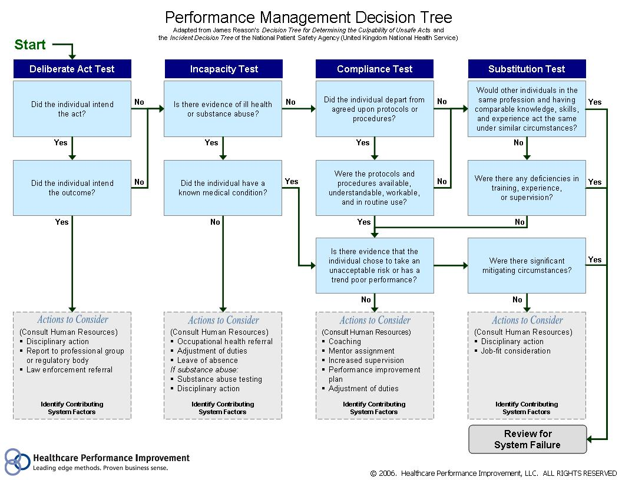

Yes
© 2006. Healthcare Performance Improvement, LLC. ALL RIGHTS RESERVED

Slide 7
University Medical Center of El Paso

Slide 8
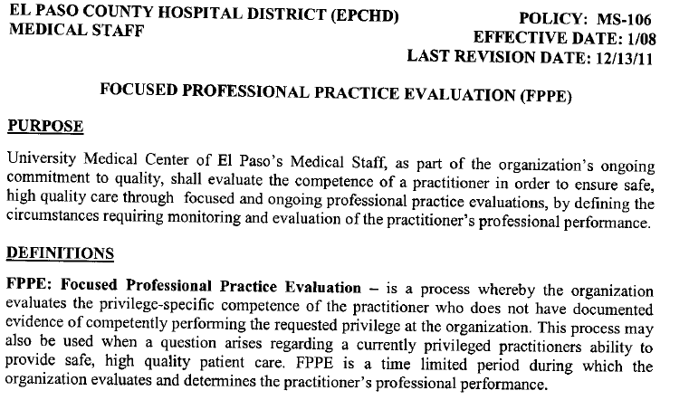

Slide 9
Alameda Health System

Slide 10
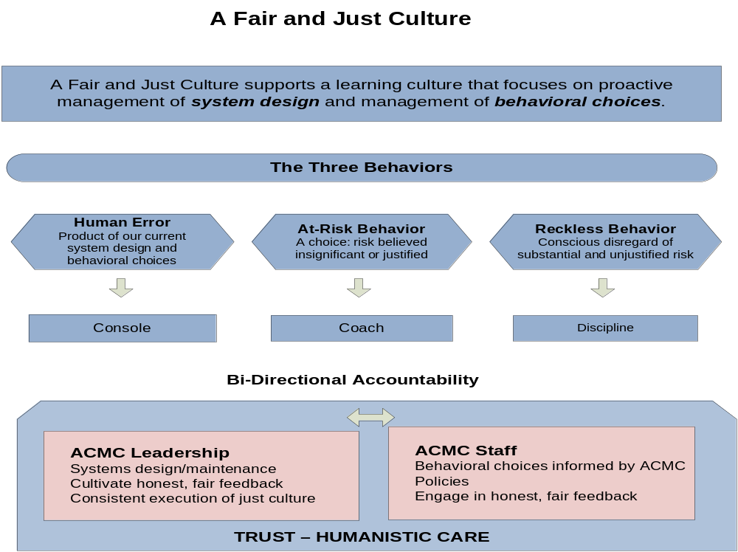

Slide 11
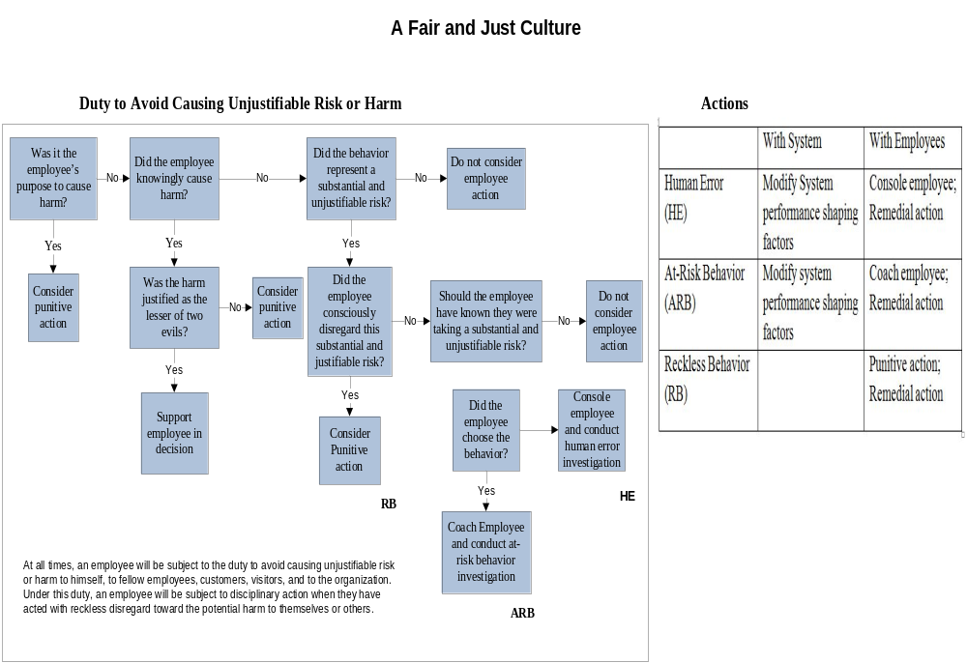

Slide 12
Next Month:
Tuesday March 12th 8am PT/9am MT/10am CT/ 11am ET
Engaging Doctors in Safety Initiatives
Ask your staff: Who is the most engaged physician in your collaborative?
Talk to him or her and be prepared to tell the rest of the group
  How s/he became engaged
  What continues to drive engagement
  What s/he thinks would work to engage other physicians

Slide 13
SAVE THE DATES!
Monthly webinars extended to September 2013
June 19, 2013 Leadership for Safety: Yes, It’s Personal A Workshop for Boards, C-Suite, and Senior Leaders
Notes:
Thursdays 9am seems best

Slide 14
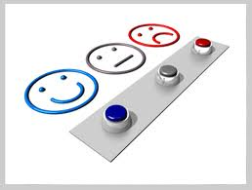
THANK YOU FOR JOINING US
Feedback survey can be accessed in chat box.

