Slide 1
Leadership for Safety: Safety Briefing (Part I)
Essential Hospitals Engagement Network
November 14, 2013

Slide 2
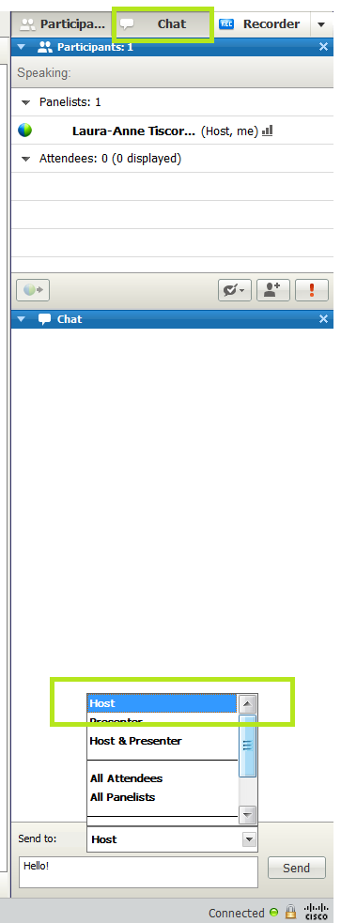
Before we start…
Mute your phone lines while you’re not speaking
Don’t put us on hold!
The chat tool is available to ask questions or comment at any time

Slide 3

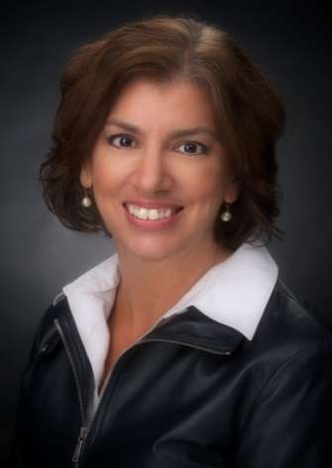
Speaker information
Jim Reinertsen, MD
The Reinertsen Group
Jennifer A. Graves, RN, MS
Chief Executive
Nurse Executive Swedish Medical Center, Ballard

Slide 4
Leadership for Safety: Action Planning Checklist
Leadership Behaviors and Tools | Actions Planned
Take personal ownership of safety in your organization
Eliminate the denominator: How many patients did we harm last year?
Be transparent: wall displays, open discussion of serious safety events…
Start every meeting with a patient story
Frame safety aims in reference to the theoretical ideal
Do “reality rounding” on key safety practices
Executive visits to safety teams
Daily safety huddle
Make hard decisions that change the culture—on both values and technical performance!

Slide 5
EHEN Leadership Webinar
Jennifer Graves, RN, MS
Chief Executive & Nurse Executive
Swedish Medical Center / Ballard

Slide 6
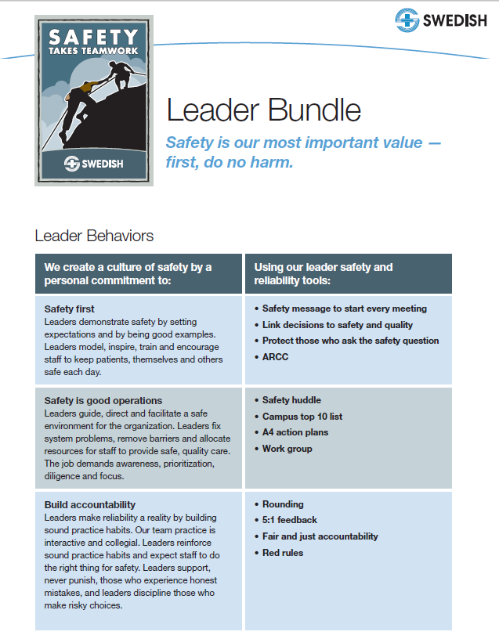

Slide 7
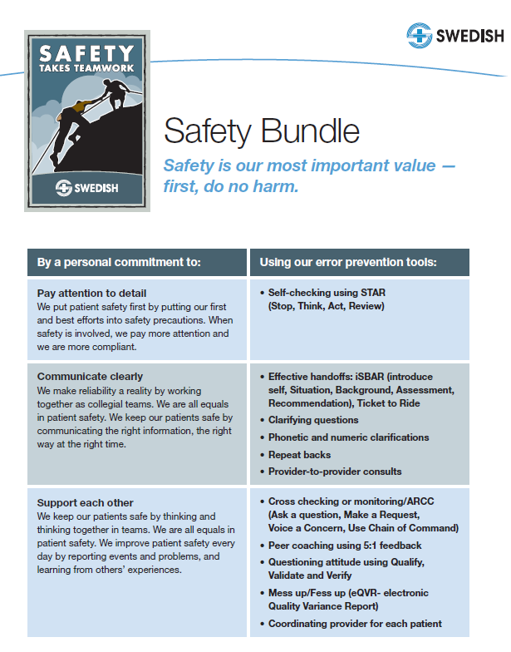

Slide 8
Safety Huddle at Swedish / Ballard
Began in September 2009
Conducted as a stand-up gathering
Occurs twice per day at 0945-1000 and 2145-2200, seven days per week
Includes representatives from each and every department throughout the campus, including ambulatory clinics and support departments
Purpose is to provide a state of the union report, provide an opportunity for clarifying questions, and discuss / troubleshoot actual and potential safety concerns from the perspective of each individual in the room

Slide 9
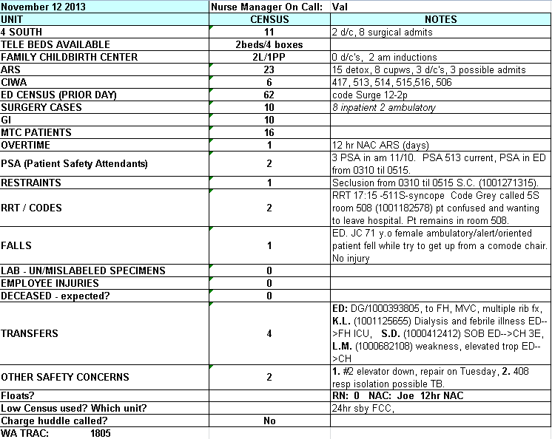
Daily Status Report Example

Slide 10
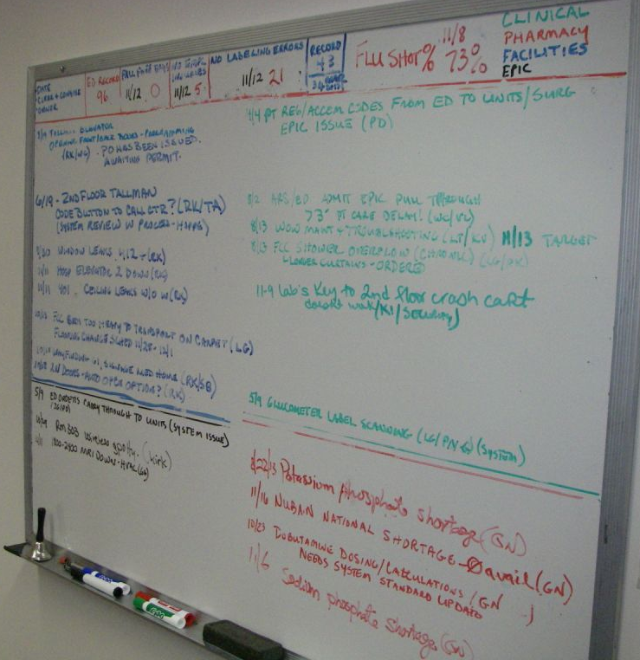
Safety Huddle Whiteboard

Slide 11
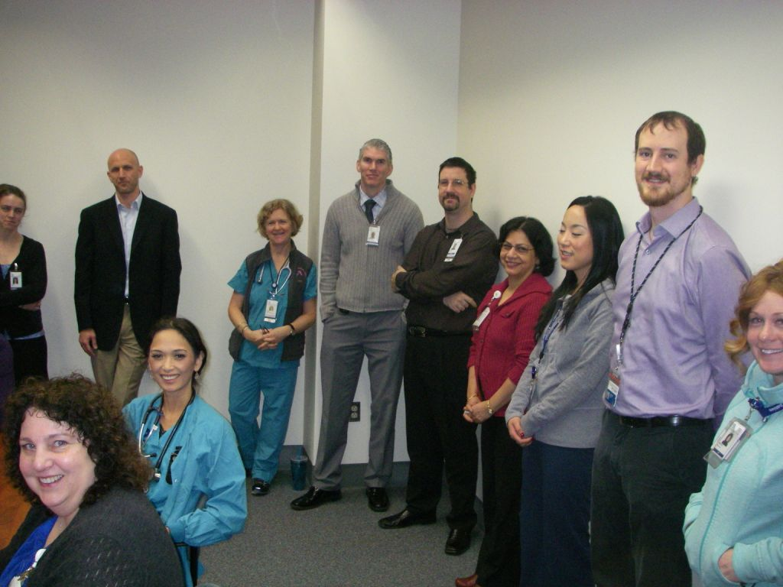
Safety Huddle Participants

Slide 12
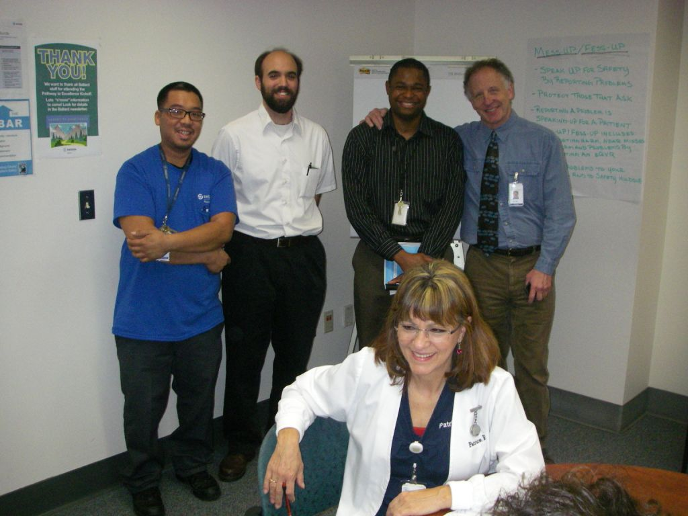
Safety Huddle Participants

Slide 13
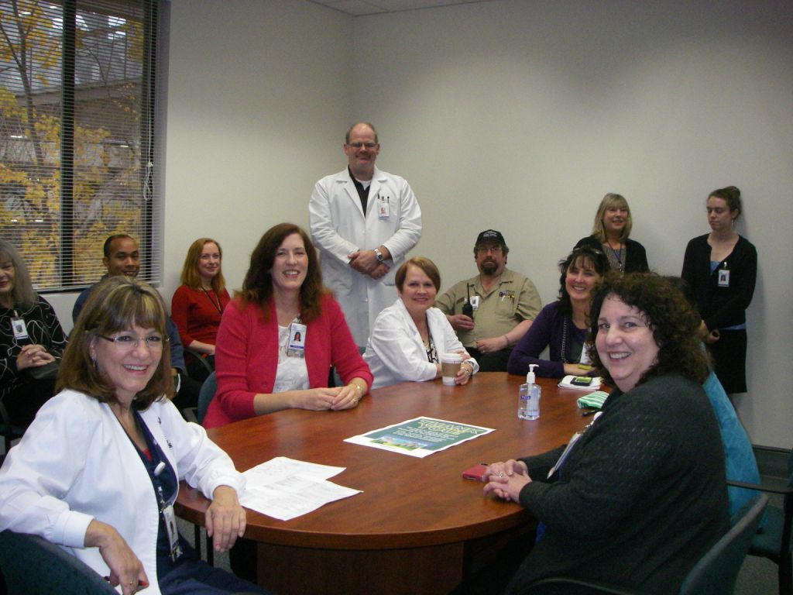
Safety Huddle Participants

Slide 14
Questions and Field Reports
What would you like to ask Jennifer Graves about her experience with daily safety huddles?
Are any of you doing this? How is it working? What could we learn from you?

Slide 15
Daily Safety Huddle: Summary
15 minute daily meeting of key operational leaders, led by CEO or equivalent
Agenda:
Quick safety status: “It’s been X days since our last Serious Safety Event and Y Days since last employee lost work day event.”
Brief report on any safety issues from each manager, including security, facilities, bio-med…
Brief follow-up on any previously identified urgent safety issues
Note: Generally works best around 830 or 9 am, allows managers to have their own “pre-huddles” with their teams.

Slide 16
Assignment for Next Webinar February 20, 2014
Put “try daily safety huddle” on your personal to-do list!
Be prepared to report on your experience at a future webinar!
Bonus points: send us a video of your best huddle!

Slide 17
Thank you for attending
Coming soon! 2014 Leadership for Safety webinar series information and registration. For registration assistance, please contact ltiscornia@essentialhospitals.org
Evaluation survey can be accessed by clicking link in chat box. We greatly appreciate your feedback!
Essential Hospitals Engagement Network website: http://tc.nphhi.org/Collaborate

