Slide 1

Who’s at risk: Identifying patients in danger of rehospitalization
The webinar will be starting momentarily…
If you are having technical difficulties please contact 202-495-3356 or ltiscornia@naph.org

Slide 2
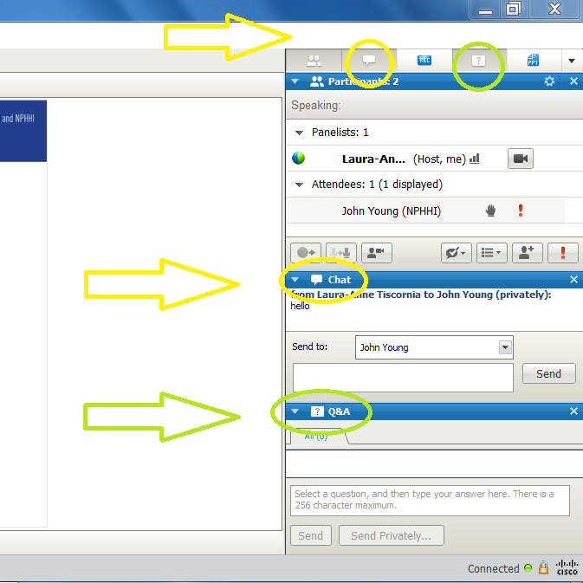
“Q&A” and Chat
Please use the “Q&A” or Chat tools on the webinar screen to type your question or comment at any time during this event.

Slide 3
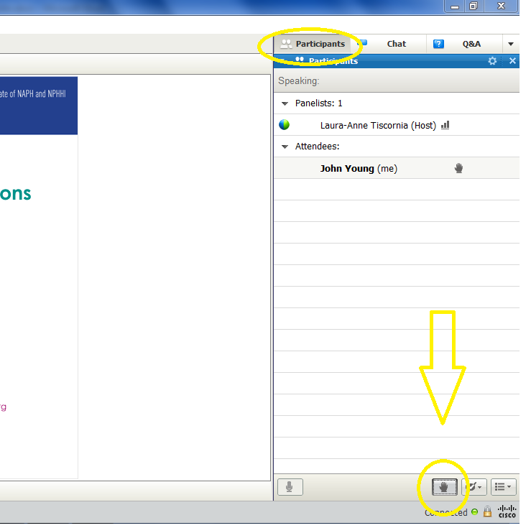
Raise Your Hand
To raise your hand, you must be in the “Participants” pane.
Your line will be un-muted to ask your question. Once your question has been answered, please un-raise your hand.

Slide 4
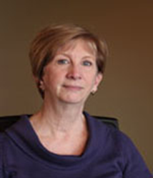
Agenda
Welcome and introductions
Key driver review
Presentation by Dr. George Oliver
Question and answer session
Wrap-up
Vickie Sears MS, RN, CPHQ
NSN Improvement Coach
vsears@naph.org
Notes:
Laura-Anne, please put Dr. Oliver’s picture on top
Once we get his slides, we can add the title of his presentation

Slide 5
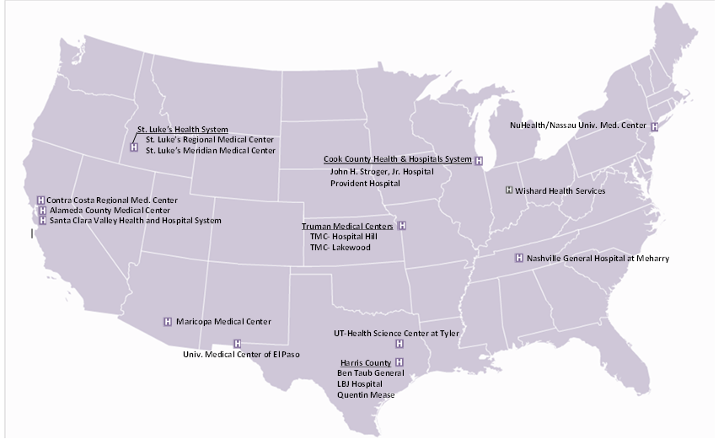
NSN Readmissions Collaborative

Slide 6
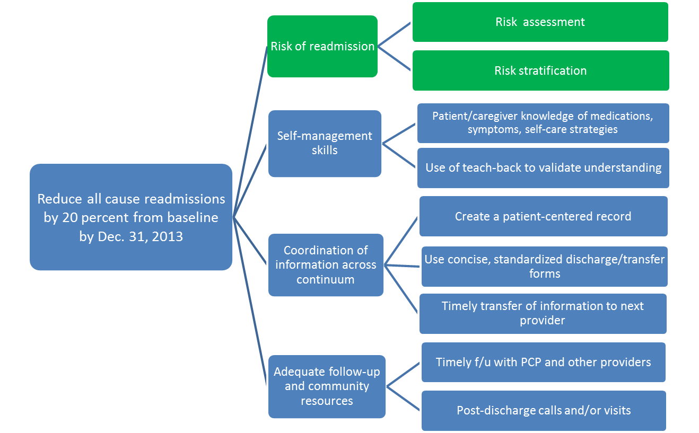
Goal and Key Drivers
Notes:
Laura-Anne & Cassandra, the green color is to highlight these are the drivers we will be addressing on the webinar

Slide 7
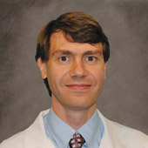
Speaker Information
George “Holt” Oliver, MD, PhD
Vice President of Clinical Informatics
Parkland Center for Clinical Innovation

Slide 8

Who’s At Risk? Identifying Patients in Danger of Re-hospitalization
10/24/2012
George Oliver, MD, PhD
Privileged and Confidential,
© Parkland Center for Clinical Innovation

Slide 9
Goals of this Presentation
Electronic risk model based assessment
Key risk factors for CHF readmission
Hospital implementation of readmission reduction program
Privileged and Confidential,
© Parkland Center for Clinical Innovation

Slide 10
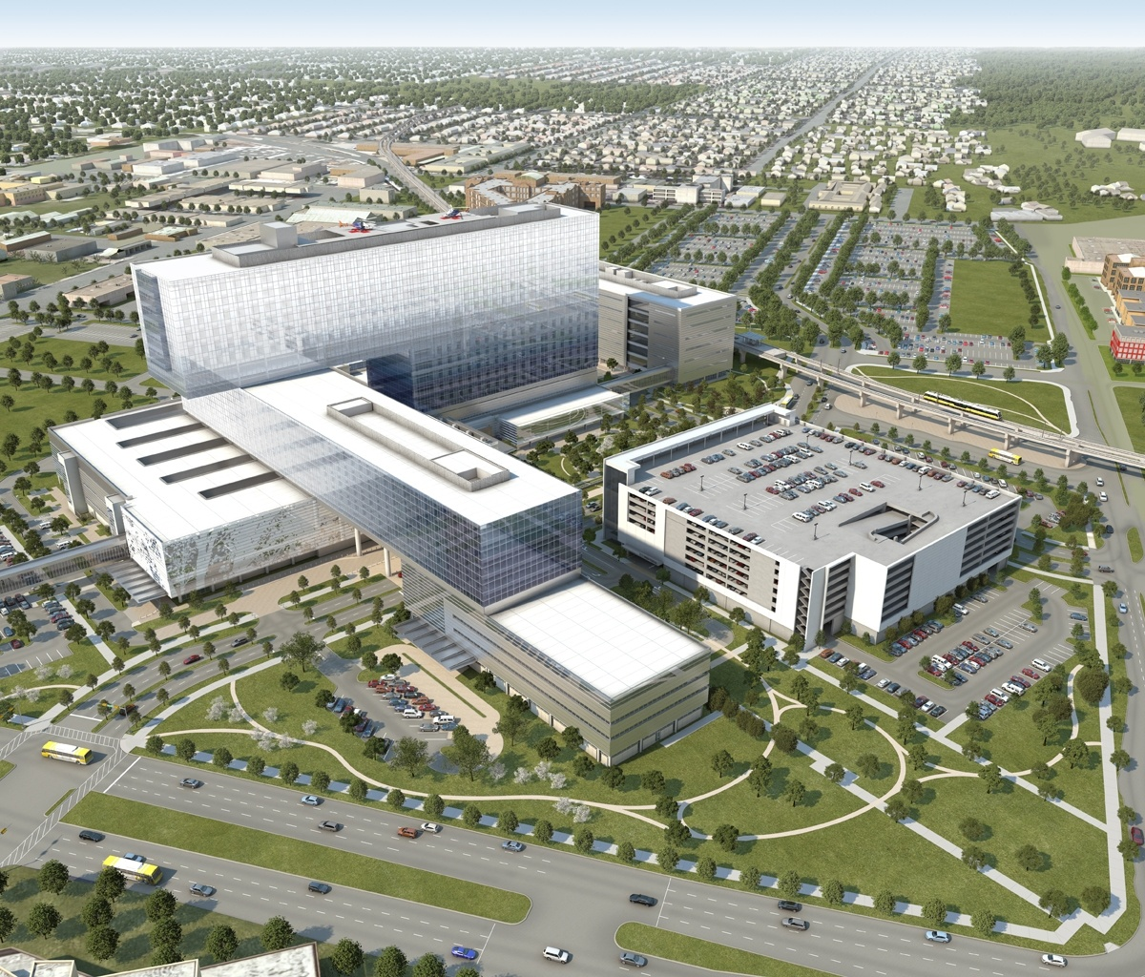
Parkland Health & Hospital System
Past, Present, and Future
Public, safety net, county-owned health system founded in 1898
12 COPC clinic facilities
>1 million patient encounters per year
1.2 billion operating budget
Fully implemented EMR in all inpatient and outpatient facilities in 2008
Privileged and Confidential,
© Parkland Center for Clinical Innovation

Slide 11
What We Do in Medicine:
Prediction & Monitoring
What does this patient have?
What will this patient develop?
What is required?
Are we on course?
Privileged and Confidential,
© Parkland Center for Clinical Innovation

Slide 12
Glimmers of a New Age in Medicine
Massive data capture
Real-time precision monitoring
Vast computational power
Natural Language Processing
Machine Learning
Robotics
Exquisite Predictive Modeling
Privileged and Confidential,
© Parkland Center for Clinical Innovation

Slide 13
Key Risk Factors for Readmission
[Electronic variables available in the first 24 hours]
Clinical Risk +
Social Risk
= Combined Risk Score
  Albumin
  Total Bilirubin
  CPK
  Creatinine
  Sodium
  Arterial pCO2
  WBC
  Troponin
  BUN
  Glucose
  PT INR
  BNP
  Arterial pH
  Temperature
  Pulse
  Blood pressure
  Age
  Single
  Male
  High risk census tract
  Number of address changes
  Positive for Cocaine
  History of mental illness
  Prior heart failure
  Prior admission
  Appointment no-shows
  Admission time
Copyright PCCI 2012

Slide 14
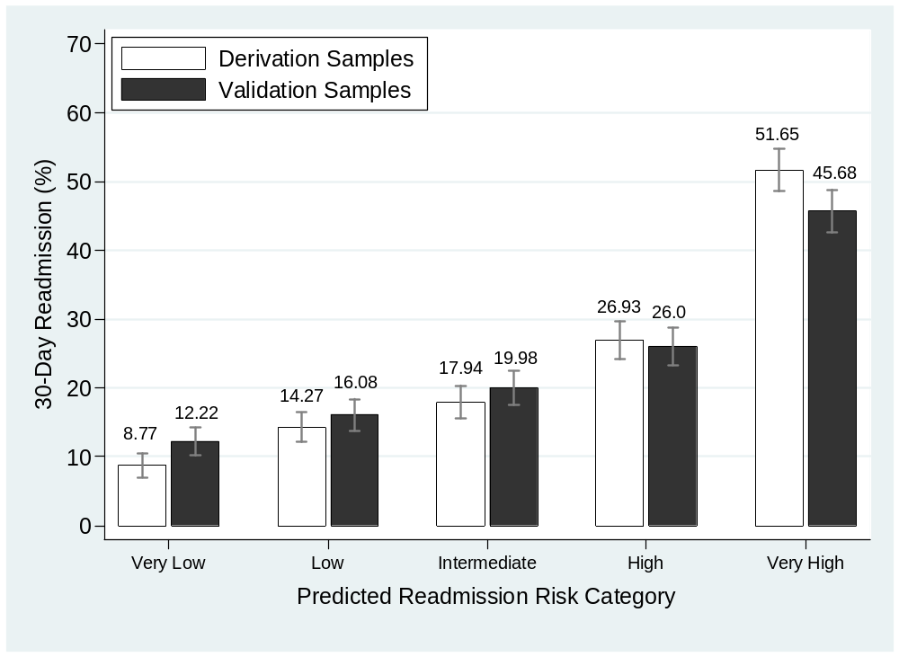
Identifying High-Risk Patients in Real-Time
*
Privileged and Confidential,
© Parkland Center for Clinical Innovation
Amarasingham et al, Medical Care, 2010

Slide 15
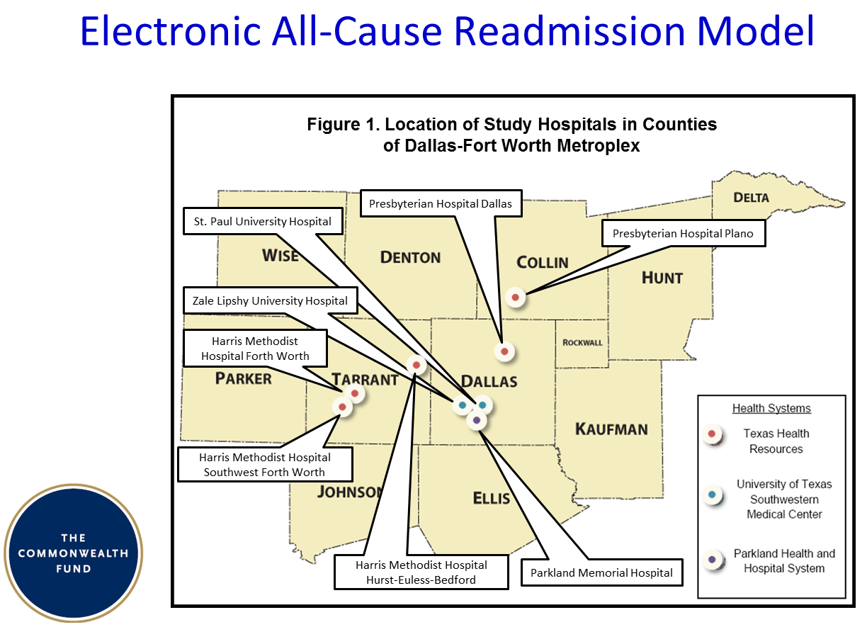

Slide 16
JAMA Systematic Review: Oct 19, 2011
“ Readmission risk models intended for clinical use have requirements and limitations. [They must] provide data prior to discharge, discriminate high- from low-risk patients, and be adapted to the settings and populations in which they are to be used. [Out of 7,785 approaches reviewed], few models met all these criteria, and only 1 of these had acceptable discriminative ability. (Amarasingham et al.)”
- page 1696
Privileged and Confidential,
© Parkland Center for Clinical Innovation

Slide 17
Decision Support System and Intervention Processes
Admission
Discharge
30 Days
90 Days
24
7
hours
days
ID
Risk
List
Orders
1
2
3
4
Inpatient Intervention
Outpatient Intervention
5
5
6
Monitoring
1
System helps clinicians identify CHF patients
2
System calculates potential risk for readmission
3
System provides list of targeted potential high risk patients to intervention coordination teams
4
Intervention teams order inpatient and outpatient interventions in EMR
5
Intervention teams conduct interventions
6
System monitors inpatient and outpatient interventions and other activities
Privileged and Confidential,
© Parkland Center for Clinical Innovation

Slide 18
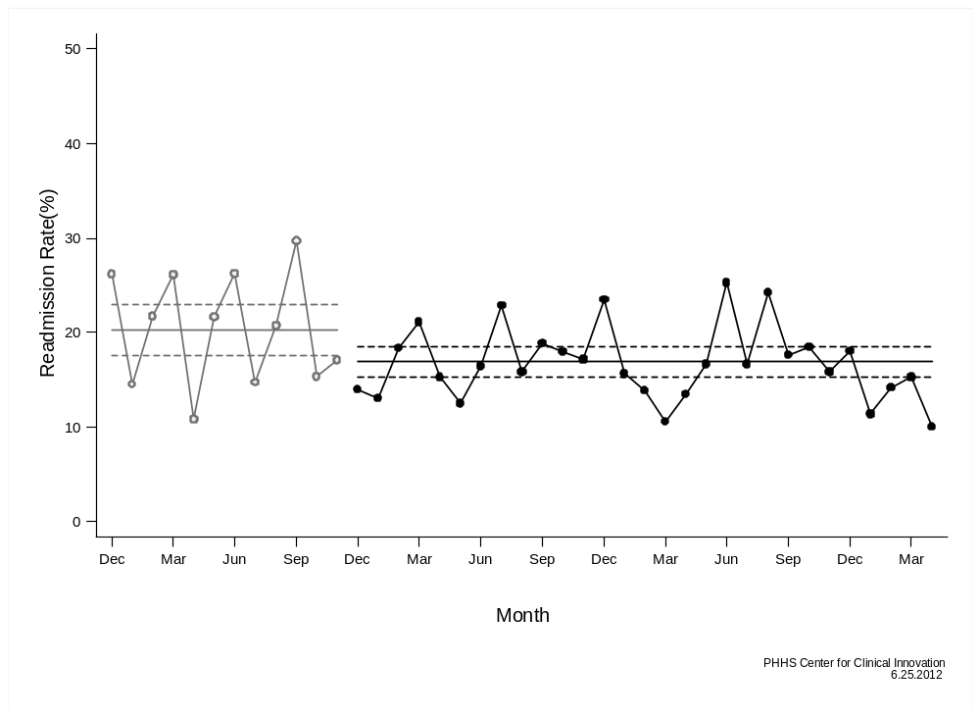
Figure 5. Heart Failure 30-Day Readmission Rate by Month
20.3% (17.5%, 23.0%)
16.9% (15.3%, 18.5%)
2008
2009
2010
2011
Privileged and Confidential,
© Parkland Center for Clinical Innovation

Slide 19
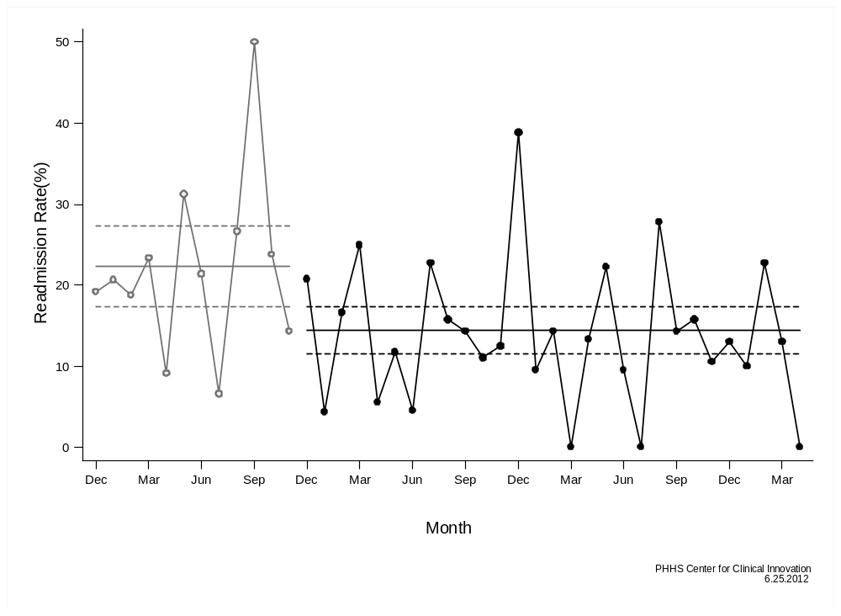
Figure 6. Heart Failure 30-Day Readmission Rate by Month – Medicare Patients
22.3% (17.3%, 27.4%)
14.4% (11.5%, 17.3%)
2008
2009
2010
2011
Privileged and Confidential,
© Parkland Center for Clinical Innovation

Slide 20

System Monitoring and Prediction over Multiple Time Scales
Hours
30 days
90 days
5 years
Cardio-Pulmonary Arrest
Readmission to the hospital
Chronic Kidney Disease
Cancer
Privileged and Confidential,
© Parkland Center for Clinical Innovation

Slide 21

The Parkland Center for Clinical Innovation is a non-profit research and development corporation in Dallas, Texas that specializes in real-time predictive and surveillance analytics for health care.
Copyright PCCI 2012

Slide 22
For more information about the PCCI and ways to collaborate with us, visit us at www.pccipiecs.org
Notes:
Add logo as a watermark?

Slide 23
“Q&A” and Chat
Please use the “Q&A” or Chat tools on the webinar screen to type your question or comment at any time during this event.

Slide 24
Raise Your Hand
To raise your hand, you must be in the “Participants” pane.
Your line will be un-muted to ask your question. Once your question has been answered, please un-raise your hand.

Slide 25
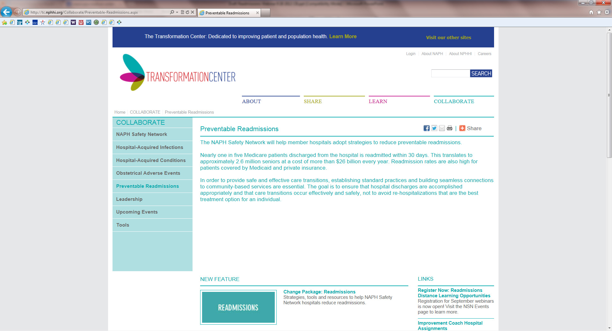
Resources

Slide 26
Thank you for attending!
Next Readmissions webinar: Nov. 28 from 2 to 3 pm Eastern
Register on the NSN events page: http://tc.nphhi.org/Collaborate/Events
Evaluation: Following the webinar, when you close out of WebEx, an evaluation of the webinar will appear on your screen. We greatly appreciate your feedback!
NSN’s website: http://tc.nphhi.org/Collaborate
Comments or questions about today’s webinar?
Contact Laura-Anne Tiscornia at 202-495-3356 or ltiscornia@naph.org

