Slide 1
Communication Counts Janiece Gray, Founding Partner DTA Associates
Communication Counts – Strategies for Improving Physician Communication & Patient Experience

Slide 2




Start with a Story…
Empathy doesn’t have to be huge
Exhibit A: Smashed Goldfish snacks remnants
Total elapsed time in an exam room with 2 year old boy waiting to see a provider:
63 minutes!

Slide 3
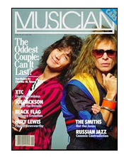

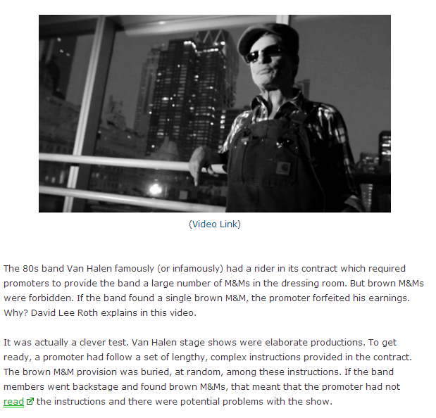
M & M’s – What do you notice?
Pay Attention to the Basics!

Slide 4
A Hierarchy of Communication
Explain Things
Listen Carefully
Courtesy & Respect

Slide 5
Spectrum of Strategies
 | Less | More | Most
Projecting the Patient Voice | Sharing comments, awards | Patient & Family Advisory Council | Patients serving on committees
Data & Reporting | Clinic/site/unit level | Physician level | Enterprise Data Warehouse
Goal Setting & Compensation | Identify areas of focus | Internal scorecard | Tied to physician compensation
Service Strategy & Training | Discuss at provider meetings | Develop/adopt a service mnemonic, Video vignettes | Service training, CMEs
Other | Newsletters, Cards, Care boards | Care team coaching, mystery shopping | SWAT Teams, Patient Centered Medical Home
Resource Investment ($/Time)

Slide 6

North Memorial Medical Center
North Memorial Medical Center improved 10x the national rate of improvement!
Level I trauma
care facility in
Minneapolis
Average daily
Census = 240
70,000 annual
ED visits
Large Medicare
Population
Full spectrum
of care excluding
transplants
Notes:
NMMC is well known for Trauma, Stroke, Cardiac, Orthopedic and community care.
North Memorial Medical Center engaged DTA Associates to provide an initial assessment and roadmap for Patient Experience in the fall of 2012. As part of that work, DTA noted the need to focus on Physician Communication and recommended a spectrum of strategies for the organization to adopt.
North Memorial Medical Center engaged DTA Associates to provide an initial assessment and roadmap for Patient Experience in the fall of 2012. As part of that work, DTA noted the need to focus on Physician Communication and recommended a spectrum of strategies for the organization to adopt.

