Slide 1


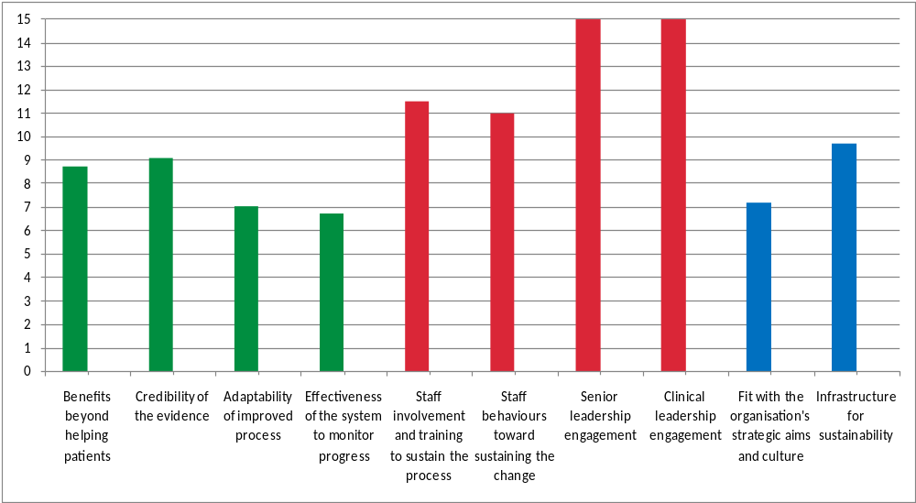
NHS Sustainability Model
A graph to show the potential for improvement
Draw your scores on the chart below

