Slide 1
Audits for the Medicare and Medicaid EHR Incentive Programs
Vidya Sellappan
HIT Initiatives Group, CMS

Slide 2
Audit Basics
Any provider that receives an EHR incentive payment for either EHR Incentive Program may be subject to an audit.
CMS, and its contractor, Figliozzi and Company, will perform audits on Medicare and dually-eligible (Medicare and Medicaid) providers who are participating in the EHR Incentive Programs.
States, and their contractor, will perform audits on Medicaid providers participating in the Medicaid EHR Incentive Program.

Slide 3
Medicare Audits
Medicare EPs and Dual-Eligible Hospitals
Pre- and post-payment audits are performed
5-10% of providers subject to pre/post-payment audits
Random audits and risk profile of suspicious/anomalous data
If a provider continues to exhibit suspicious/anomalous data, could be subject to successive audits
In order to ensure robust oversight, CMS will not be making the risk profile public

Slide 4
Medicare Documentation
It is the provider’s responsibility to maintain documentation.
Documentation to support attestation data for meaningful use objectives and clinical quality measures should be retained for six years post-attestation.
Save any electronic or paper documentation that supports attestation, including documentation that supports values the provider entered in the Attestation Module for CQMs.
Hospitals should also maintain documentation that supports their payment calculations.
Medicaid providers can contact their State Medicaid Agency for more information about audits for Medicaid EHR Incentive Program payments.

Slide 5
Primary Source Documentation
Primary source document is usually the report generated by the provider’s certified EHR technology
Report should contain the following elements:
Numerators and denominators for the measures
Time period the report covers
Evidence to support that it was generated for that provider (e.g., identified by National Provider Identifier (NPI), CMS Certification Number (CCN), provider name, practice name, etc.)
Snapshot vs. rolling reports

Slide 6
Audits and the 2014 CEHRT Flex Rule
CMS released a final rule in September allowing CEHRT flexibility for an EHR Reporting Period in 2014.
CMS will continue to follow standard guidelines used for CMS programs with audit provisions, including:
Auditing providers based on a random selection process
Selection also based on key identifiers such as prior audit failure or known incidence of fraud
Providers will not be targeted by provider type, location, stage of meaningful use, or participation year.
CMS will provide guidance to auditors relating to the final rule.
Auditors will be instructed to work closely with providers on the supporting documentation needed.

Slide 7
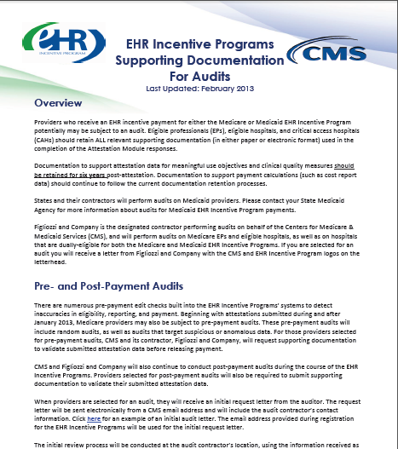
Documentation Guidance: Stage 1
http://www.cms.gov/Regulations-and-Guidance/Legislation/EHRIncentivePrograms/Downloads/EHR_SupportingDocumentation_Audits.pdf

Slide 8
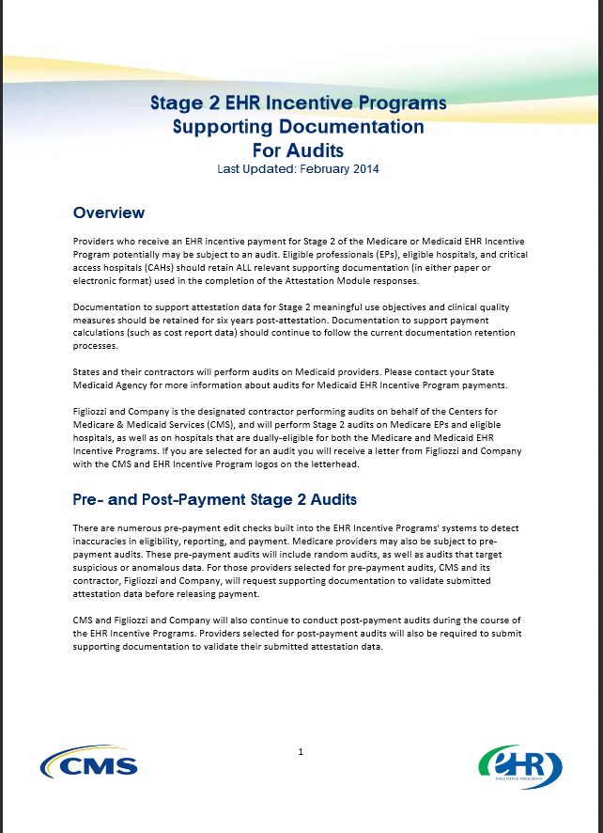
Documentation Guidance: Stage 2
http://www.cms.gov/Regulations-and-Guidance/Legislation/EHRIncentivePrograms/Downloads/Stage2_AuditGuidance.pdf

Slide 9
Audit Resources
Audit resources found on CMS EHR Incentive Programs Educational Resources webpage:
Supporting Documentation for Audits
Sample Audit Letter for EPs
Sample Audit Letter for Eligible Hospitals & CAHs
Audit Overview Fact Sheet

