Slide 1
HEN Results Appendix
May 6, 2015
Notes:
The purpose of this appendix is to provide more in-depth, technical information about progress in quality measures. You may use as is on the America’s Essential Hospitals template or you may put on your own organization’s template. We do ask you note this presentation framework was provided by EHEN. You may choose whichever slides are applicable to your presentation.
Note to Presenter: Slides 4, 5, and 6 contain information not publicly released. Please utilize information on these slides in an internal manner only.
If you have questions regarding use of this template, please direct them to Allison Cater, Project Analyst at America’s Essential Hospitals at acater@essentialhospitals.org.

Slide 2
Comparison of National Perspectives
 | AHRQ National Scorecard | HEN Evaluation (Contracted to HSAG and Mathematica)
Scope | All federal quality improvement initiatives (e.g. HENs, QIOs) | Only the 27 HENs
Data Sources | MPSMS for 7 PfP conditions NHSN for SSI HCUP for Adverse OB | Medicare claims NHSN NDNQI & CALNOC HEN-reported
Baseline | 2010 | Varies by measure; 2011 for most
Performance Period | 2011-2013, except NHSN is preliminary 2013 data and HCUP is 2012 data | Varies by measure; Q1 or Q2 2014 for most
Abbreviations: AHRQ- Agency for Healthcare Research and Quality; CALNOC- Collaborative Alliance for Nursing Outcomes; HCUP- Healthcare Cost and Utilization Project; HEN- Hospital Engagement Network; HSAG- Health Services Advisory Group; MPSMS- Medicare Patient Safety Monitoring System; NDNQI- National Database of Nursing Quality Indicators; NHSN- National Healthcare Safety Network; PfP- Partnership for Patients;
QIO- Quality Improvement Organization; SSI-Surgical Site Infection
Notes:
Talking Points:
The AHRQ National Scorecard is a measurement strategy of the national hospital-acquired conditions rate. A vast majority of the data comes from an annual review of approximately 18,000 to 33,000 Medicare medical records. All of the hospital-acquired conditions in the scope of the Partnership for Patients, except readmissions, are included in the National Scorecard.
A report released by the Agency for Healthcare Research and Quality shows preliminary estimates of 1.3 million fewer harms from 2011 to 2013, 50,000 fewer patients died in hospitals and approximately $12 billion in health care costs avoided as a result of a reduction in hospital-acquired conditions from 2010 to 2013.
The report was released in December 2014. A finalized report is expected in third quarter 2015.
It is important to note the differences in these evaluations because their findings can conflict due to different data sources, measure definitions and baseline periods.
Main differences include:
Different sources of data- AHRQ primarily uses medical records; HEN evaluation uses Medicare claims, NHSN, NDNQI, and HEN-reported data
Measure definitions- Because the data sources differ, measure definitions differ in ways like rate versus standardized infection ratio (SIR) or hospital-wide versus intensive care units (ICU) only
Different baseline and performance periods

Slide 3
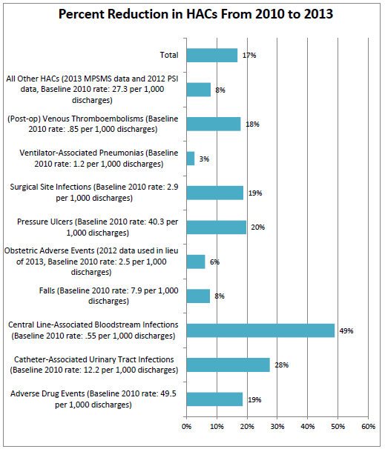
AHRQ National scorecard
Source: Agency for Healthcare Research and Quality (AHRQ) National Scorecard. December 2014. http://www.ahrq.gov/professionals/quality-patient-safety/pfp/interimhacrate2013.html
Notes:
Highlights:
From the AHRQ National Scorecard findings in December 2014, this graph breaks down, by condition, the overall 17 percent decline in hospital-acquired conditions from 2010 to 2013.
Significant improvement in CLABSI
Source:
Efforts To Improve Patient Safety Result in 1.3 Million Fewer Patient Harms: Interim Update on 2013 Annual Hospital-Acquired Condition Rate and Estimates of Cost Savings and Deaths Averted From 2010 to 2013. December 2014. Agency for Healthcare Research and Quality, Rockville, MD. http://www.ahrq.gov/professionals/quality-patient-safety/pfp/interimhacrate2013.html

Slide 4
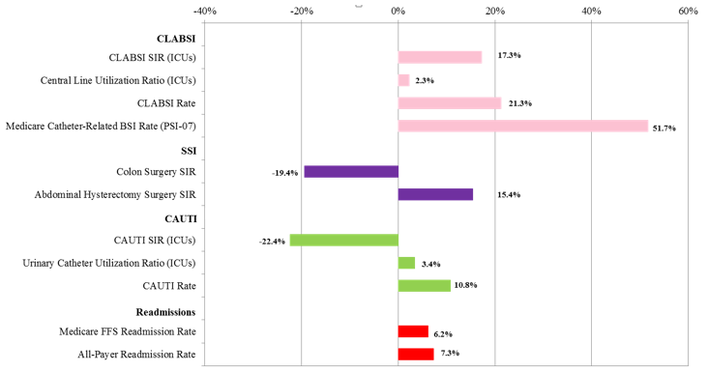
HEN Evaluation - HAIs And Readmissions
Improvement
Source: HSAG and Mathematica. PfP Leading Indicators Dashboard. November 2014.
Notes:
*For internal use only*
Talking Points:
Similar to the AHRQ National Scorecard, the HEN evaluation found large improvements in CLABSI.
The story is less straightforward when looking at SSI and CAUTI. While SSIs for abdominal hysterectomies improved, they worsened for colon surgeries.
For CAUTI, the standardized infection ratios among intensive care units (ICUs) worsened. This data comes from NHSN. The CAUTI rate, on the other hand, improved but this is from a smaller sample using NDNQI data.
Source: PfP Leading Indicators Dashboard, HSAG and Mathematica, November 2014.
NHSN data received August 2014. NDNQI and CALNOC data received September 2014. CMS PSI/readmissions and HEN-reported data received November 2014.
Note: NHSN data presented for PfP-aligned hospitals only. This affects the following measures: CLABSI SIR (ICUs only), Central Line Utilization Ratio (ICUs), Colon Surgery SIR, Abdominal Hysterectomy SIR, CAUTI SIR (ICUs) and Urinary Catheter Utilization Ratio (ICUs).

Slide 5
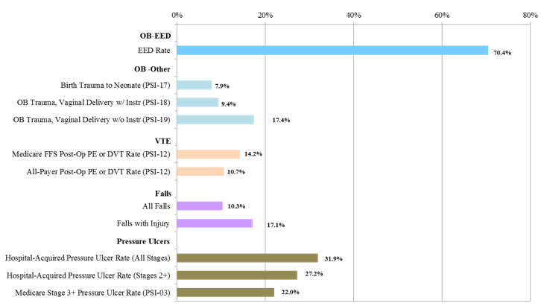
HEN Evaluation - Other Adverse Event Areas
Improvement
Improvement
Improvement
Source: HSAG and Mathematica. PfP Leading Indicators Dashboard. November 2014.
Notes:
*For internal use only*
Talking Points:
The Partnership for Patients (PfP) put a special focus on reducing early elective deliveries (EEDs), HENs and their hospitals met the challenge by reducing EEDs by approximately 70 percent.
Nationally, PfP-aligned hospitals performed better on reducing hospital-acquired conditions than infections.
Source: PfP Leading Indicators Dashboard, HSAG and Mathematica, November 2014.
NDNQI and CALNOC data received September 2014. CMS PSI/readmissions and HEN-submitted data received November 2014.

Slide 6
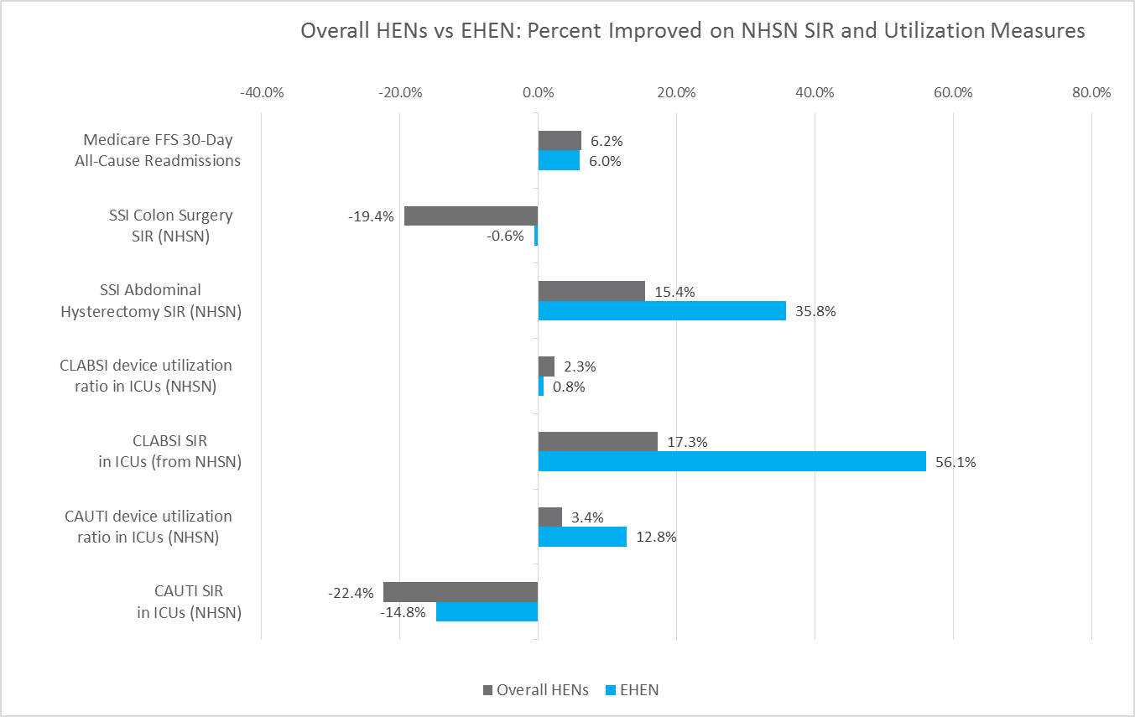
EHEN vs National Hen Performance
Improvement
Source: HSAG and Mathematica. PfP Leading Indicators Dashboard. November 2014.
Notes:
*For internal use only*
Talking Points:
When comparing EHEN to the collective HENs, EHEN performed as well, if not better, on several measures.
For example, EHEN’s improvement in CLABSI and SSIs for abdominal hysterectomies far exceeded that of the combined HENs.
EHEN mirrored the overall HEN worsening in CAUTI and SSIs for colon surgeries, but to a lesser degree. In SSIs for colon surgeries, EHEN worsened by 0.6%, while the overall HENs worsened by 19.4%. Similarly for CAUTI SIR, EHEN worsened by 14.8%, while the overall HENs worsened by 22.4%.
Regarding this data, please keep in mind:
The readmissions data only covers Medicare fee for service patients, which does not represent a large portion of those served by essential hospitals including those with Medicaid or uninsured.
The NHSN measures are reflective of ICUs only. Many hospitals report additional units to NHSN.
Source of Data: PfP Leading Indicators Dashboard, HSAG and Mathematica, November 2014.
NHSN data - Received August 2014; Baseline: Q1 2012 (CAUTI & SSI), 2011 (CLABSI); Performance Period: Q1 2014
Medicare claims readmissions data- Received November 2014; Baseline: 2010; Performance Period: March-May 2014

Slide 7
EHEN 2.0
Proposal submitted March 2015
Outcome and Process Measures
Includes original HEN 1.0 conditions, plus two elective:
Sepsis
C.difficile
Continuing focus on Patient and Family Engagement and Health Equity
Notes:
Talking points:
CMS issued a call for proposals regarding a 12 month contract for EHEN 2.0.
The EHEN 2.0 proposal includes process and outcome measures for:
30-day readmissions
Hospital-acquired conditions:
Central line-associated blood stream infections (CLABSI)
Catheter-associated urinary tract infections (CAUTI)
Surgical site infections (SSI)
Adverse drug events
Falls
Pressure ulcers
Ventilator-associated events (VAE)
Venous thromboembolisms (VTE)
Adverse obstetrical events (includes early elective delivery)
Sepsis
C.difficile
Proposed new measures to be discussed with Steering Council:
Sepsis
Outcome
Postoperative sepsis rate (AHRQ PSI-13)-UHC CDB/CDB-lite
C.difficile
Outcome
SIR for adult C. difficile -NHSN
C. difficile due to antibiotic exposure (UHC-defined)-UHC CDB/CDB-lite

