Slide 1
HEN Results Sample Presentation
May 6, 2015
Notes:
Note to Presenter: EHEN is providing this template presentation to hospitals to showcase EHEN 1.0 work and results. You may use as is on the America’s Essential Hospitals template or you may put on your own organization’s template. We do ask you note this presentation framework was provided by EHEN. Talking points are provided for each slide.
If you have questions regarding use of this template, please direct them to Allison Cater, Project Analyst at America’s Essential Hospitals at acater@essentialhospitals.org.

Slide 2
Partnership for Patients
Partnership for Patients (PfP)
CMS-funded
Hospital Engagement Networks
(HENs)
27 contracted organizations
Essential Hospitals Engagement Network (EHEN)
23 hospitals nationwide
3,700 U.S. hospitals
Only essential hospital- focused HEN
Reduce nine hospital-acquired conditions by 40 percent
Reduce readmissions by 20 percent
Special focus on health equity
Notes:
Talking points:
The initial Partnership for Patients HEN initiative started in 2012 and was a two-year project with an optional third year. Due to the overall success of the first two years, the optional third year was picked up for every HEN. These three years can collectively be considered HEN 1.0.
PFP is a public-private partnership funded by CMS through the Affordable Care Act to help improve the quality and safety of health care.
27 organizations called Hospital Engagement Networks were selected by CMS to bring hospitals together to find strategies and solutions through collaboration.
Altogether, the 27 HENs are working with over 3,700 hospitals to make care safer through education and training, providing technical assistance and creating systems to track and monitor progress through data analysis.
EHEN was the only HEN that worked exclusively with essential hospitals. These hospitals are members of America’s Essential Hospitals and share five fundamental characteristics: 1) Care for the most vulnerable, 2) Train future health care leaders, 3) Provide comprehensive coordinated care, 4) Provide specialized lifesaving services (e.g. Trauma, Burn, NICU), 5) Advance population health.

Slide 3
HEN 1.0 Conditions
30-day readmissions
Nine hospital-acquired conditions:
Central line-associated blood stream infections (CLABSI)
Catheter-associated urinary tract infections (CAUTI)
Surgical site infections (SSI)
Adverse drug events
Falls
Pressure ulcers
Ventilator-associated events (VAE)
Venous thromboembolisms (VTE)
Adverse obstetrical events (includes early elective delivery)
Notes:
Talking points:
These conditions were identified by Partnership for Patients as national priorities.
Partnership for Patients set ambitious goals of 40 percent reduction in nine hospital-acquired conditions and 20 percent reduction in 30-day readmissions by 2014 (from 2010 baselines).

Slide 4
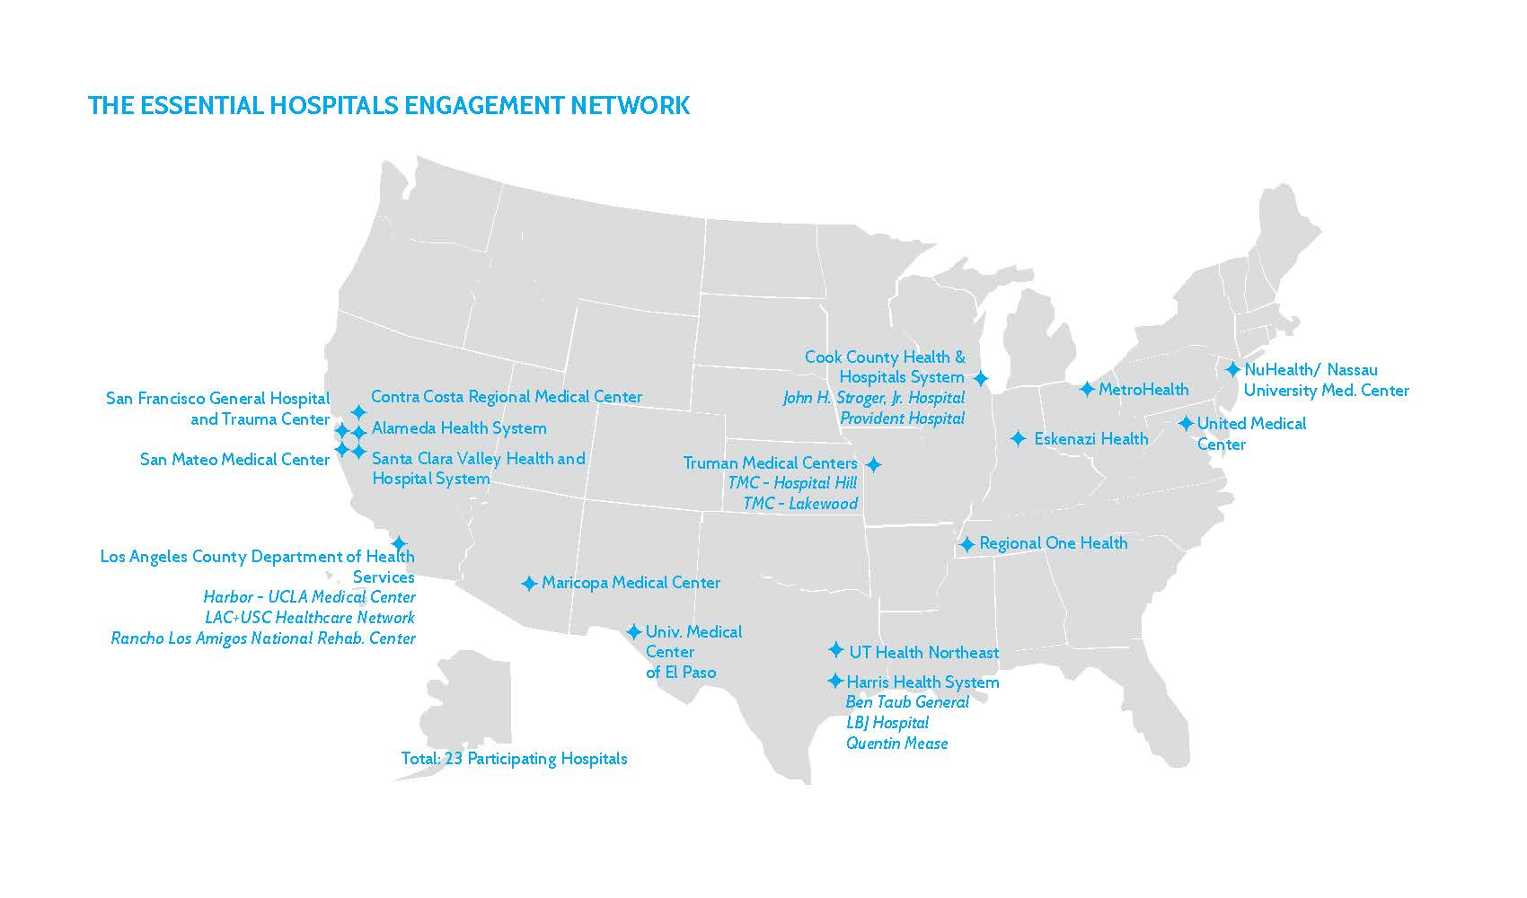
EHEN
Notes:
EHEN is comprised of 23 hospitals across 10 states and District of Columbia.

Slide 5
Essential Hospitals Engagement Network (EHEN)
Reduce Harm
Engage Patients and Families
Promote Equity of Care
Notes:
Talking points:
EHEN worked to reduce harm through in-person and virtual events that were collaborative, as well as individualized. Examples include coaching calls with improvement teams, webinars on innovative and successful practices, hospital site visits that raised awareness among frontline staff and senior leaders, and an in-person harm reduction summit in Chicago last November. This is done in conjunction with data to support and affirm that improvement is happening.
EHEN supports the national movement towards patient and family-centered care. Several hospitals are moving to an open hours visitation policy, and EHEN members have been recognized as leaders in this field.
EHEN has a special interest in promoting health equity due to the unique populations served. EHEN members helped develop an online training module for registration staff to more accurately capture race, ethnicity and language data (REAL). This module is now available to all members of America’s Essential Hospitals.

Slide 6
National Progress
HARMS
AVOIDED
17 percent decline from 2010 baseline;
1.3 million fewer hospital-acquired conditions (HACs) from 2011-2013
COSTS
AVOIDED
Approximately $12 billion saved
DEATHS
AVOIDED
50,000 fewer deaths as a result of reduction of HACs
Source: Agency for Healthcare Research and Quality (AHRQ) National Scorecard. December 2014. http://www.ahrq.gov/professionals/quality-patient-safety/pfp/interimhacrate2013.html
Notes:
Talking points:
A report released by the Agency for Healthcare Research and Quality shows preliminary estimates of 1.3 million fewer harms from 2011 to 2013, 50,000 fewer patients died in hospitals and approximately $12 billion in health care costs avoided as a result of a reduction in hospital-acquired conditions from 2010 to 2013.
This progress toward a safer health care system is attributed to many factors including Centers for Medicare and Medicaid Services payment reform incentives, the Partnership for Patients initiative, and other state and regional programs such as Delivery System Reform Incentive Payment Program (DSRIP).
Full Source:
Efforts To Improve Patient Safety Result in 1.3 Million Fewer Patient Harms: Interim Update on 2013 Annual Hospital-Acquired Condition Rate and Estimates of Cost Savings and Deaths Averted From 2010 to 2013. December 2014. Agency for Healthcare Research and Quality, Rockville, MD. http://www.ahrq.gov/professionals/quality-patient-safety/pfp/interimhacrate2013.html

Slide 7
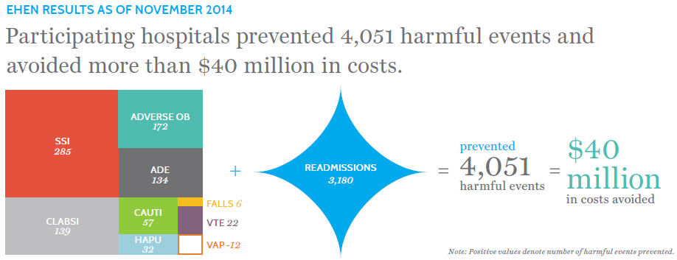
EHEN Progress (July’12-July’14)
Harms Avoided
Cost Avoided
Source: UHC Claims Data
Notes:
Talking points:
EHEN has made a sizable contribution to this national improvement in safer care. EHEN prevented over 4,000 harmful events with an estimated $40 million in cost avoided.
EHEN’s calculation uses a 2010 baseline and EHEN’s performance period represents July 2012 to July 2014.
The source is claims data from UHC.
Note to Presenter: Positive numbers indicate less harm events than expected when using the 2010 baseline rate as a reference. Negative numbers indicate more harm events than expected.

Slide 8
[sample Hospital Name] Progress
HARMS
AVOIDED
COSTS
AVOIDED
More than
$4.6 million
481
harm events avoided
Notes:
**Sample results**
Note to Presenter: Please insert the December 2014 Harm and Cost Avoided information sent with your hospital’s December 2014 quarterly report. Figures will need adjustment.

Slide 9
Reflection and Looking to the Future
Areas of Recognition
condition
condition
Areas of Opportunity
condition
condition
Notes:
Note to Presenter: Please choose two areas to highlight improvement and two areas of opportunity with participation. You may alter the graphic to add or remove condition boxes. Additionally, you may want to add a subtitle by Areas of Recognition such as “EHEN 1.0” and a subtitle by Areas of Opportunity such as “EHEN 2.0.”

