Slide 2
ROADMAP: *WHY SOCIAL *WHO IS ON IT & WHAT DO THEY DO? *YOUR CAMPAIGN *BACK TO BASICS

Slide 3
WHY SOCIAL MEDIA?
Quick way to share information
Amplify your voice
Free
Built-in audience
Targeting
Notes:
If that isnt reason enough, consider this: social media are just additional communications tools.

Slide 4
WHY SOCIAL MEDIA? (cont.)
Conversations happen with or w/out you
“It should be abundantly clear by now
that conversation, not facts, is what
drives digital media usage”
--- Rich Gordon,
Northwestern University Readership Institute
Notes:
Everyone asks why – it seems vapid, pointless. Well, the point is that people are talking about your work all the time. And if you do not participate, you run the risk of allowing misinformation to spread. If you engage, you now have the opportunity to spread accurate, helpful information. So for instance, if someone online gets a conversation going about the flu vaccine, you can jump in with your msg.

Slide 5
Just Another Tool
Snail Mail
E-mail
Telephone
Social
If Mom will get something out of it, other moms will, too. And dads. And policymakers…
Notes:
We share information every day … call mom to tell her a bit we saw on the news, email a colleague a link to a news article, clip a newspaper column for grandma.
SM just makes this sharing easier. Stop thinking about social media as “Technology” … Start thinking of it as just another way to tell people something.
If you think your mom would get something out of that news bit, you can bet that every other mom would get something. Or grandma, or dad, or son or daughter.

Slide 6
What Social Media Can DO
Builds community
Encourages loyalty, compliance
Gives your organization a voice
Train health professionals (video, simulations)
Real-time emergency updates
Correct misinformation
Mobilize the public
Encourage discussion
Promote healthy behaviors
Notes:
So you get online and you start sharing news stories, facts, or other info. Now what? What does all this sharing do?
Builds community – the world is a smaller place than it was 20 years ago, 5 years ago, even 1 year ago. But that means nothing if we arent connecting and sharing and learning from one another.
That learning and sharing can lead to changed behavior. You are building the trust of others, and if they trust you, they will listen when you tell them to act on something.
Without it, you are silent to the majority of this new small world.
WE can bridge gaps – if you are an expert at something, why don’t you teach someone else to be an expert in it somewhere else?
Information is power, cliché but true. Real-time updates can make responders more effective and help individuals take action or stay safe
The biggy – correct misinformation. Autism and vaccines is the most common example
Mobilize the public – same example. Your information can make individuals come together and encourage change at the policy level.
More discussion = more learning

Slide 7
What are some of the tools?
Facebook: strengthen existing relationships, re-establish former relationships
Twitter: connect w/others who have common interests; for making new relationships
Blogs: greater opportunity for thoughtful reflection, fleshing out ideas
YouTube/Flickr/Instagram: share media, reinforce messages

Slide 8
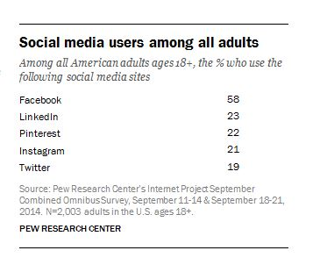
What is the scope on twitter?
Notes:
Will focus on Twitter mostly throughout because most relevant for the efforts of this group but also probably least intuitive so warrants more discussion.
Source: http://www.fiercehealthcare.com/story/healthcare-professionals-flock-twitter/2014-04-22
http://www.creationpinpoint.com/how-we-differ/big-hcp-data/

Slide 9
u.s. government officials on twitter
As of Nov. 3, 2014
SENATE: 100%
HOUSE: 99%
CABINET: 100% OF ALL 15 AGENCIES + 9 OF 15 CABINET SECRETARIES
GOVERNORS: 100%
MAYORS: 96% OF MAYORS FROM THE 25 MOST POPULOUS U.S. CITIES
Notes:
Source: https://blog.twitter.com/2014/election2014-keeping-you-informed-on-the-midterms

Slide 10
What we Do as @ourhospitals
Listen, help shape important conversations
#essential
Issue pros/cons
Connect with the press
Correct misinformation
Encourage discussion

Slide 11
What Our Members Do
Encourage loyalty
Consumer-focus: promote healthy behaviors, customer service
Train health professionals (video, simulations)
Real-time emergency updates

Slide 12
What Our Members SHOULD Do More
Engage in discussion with key influencers
Correct misinformation
Mobilize the public
Drive support for niche issues
Crowdsource legislative priorities (do people care?)
ID unlikely partnerships
Reframe policy narrative in real time (live tweet what testimony really means, what is missing, what is perceived as inaccurate)
Demonstrate role in community (pictures)
Notes:
Because there is that brand awareness and brand loyalty, hospital accounts have an opportunity to impact more than the customer base.
Key Influencers – these are people online who have large followings, who post information that others willingly and actively share with their own networks, and who drive conversation. An influencer might be a well-educated person who is active in his or her areas of interest professionally, or it might be a mom who has an aging parent with lymphoma on Medicare or a child with diabetes.
Key uses – drives mass support around niche issues, crowdsourcing legislative priorities (do people care?), determining unlikely partnerships (cross-sector orgs may realize share same position), reframe policy narrative in real time (live tweet what testimony really means, what is missing, what is perceived as inaccurate).

Slide 13
What You Can Do
Engage in discussion with key influencers
BECOME an influencer
Correct misinformation
Share successes
Mobilize the public
Notes:
You as individuals can enhance that effort exponentially, given you are a person people can put a face to.

Slide 14
What Members of Congress Do
Listen – check pulse on positions
Engage constituents (online town halls)
Engage with press
Notes:
Congressional Chiefs of Staff have told the National Journal –
They listen to what interest groups and leadership are saying, helps them form a narrative around their viewpoint, or even augment their view.
They have rethought a vote or taken a different angle on a bill based on what’s happening online. And definitely at the provision level.
They gauge whether or not a position they’d like to take will be popular – helps determine if and how hard to push for something.
From Edelman 2011 report:
While the majority of Congressional tweets – between half and two-thirds – dealt with legislation, official events, or political issues of the day, a significant portion of Congressional tweets touched upon other subjects. Members devoted roughly one in six tweets to human interest stories, such as remembering 9/11, saluting the troops, and acknowledging birthdays and holidays. Personality.
Members of Congress are not afraid to tweet while in session. In the Senate, this behavior split neatly along party lines: Senate Democrats sent slightly more tweets while the Senate was in session, while Senate Republicans were more likely to tweet while adjourned. This disparity did not carry over to the House, where representatives from both parties posted the bulk of their tweets while adjourned. Thanks to the fact that smartphones and tablets are now allowed on the floor of the House of Representatives, Twitter could potentially give constituents real-time access to their elected officials in the heat of political debate.

Slide 15
few social can beat 1000+ emails
75% of senior staff: 1-30 SM comments were enough to grab their attention on an issue
35% said <10 comments were enough
CONTEXT:
seeing an issue pop up just once - generally not enough
“thunderclaps” not authentic [much like bulk emails]
BUT if tweets/comments on an issue appear across many days, staffers notice
Interactions must have HUMAN element
tweeting or posting the exact same language over and over again will not convince staff of a real constituent concern
Source: Congressional Management Foundation poll 2014
Notes:
poll of House and Senate offices by the Congressional Management Foundation -The study polled Capitol Hill communications directors, legislative directors and legislative assistants in July and August 2014
although social media’s influence is rising among Congressional offices, seeing an issue pop up in tweets or comments in just one instance is generally not enough to get their attention. At the same time, so-called “thunderclaps,” when advocates tweet a prearranged message at an account all at once, are not seen as authentic communication. But if tweets and comments on an issue appear over the course of many days on social media accounts, staffers will notice. These repeated interactions have to have a human element: simply tweeting or posting the exact same language over and over again will not convince staff that a real constituent concern is being expressed.

Slide 16
Pulse on public opinion
Lawmakers don’t care whether comments from in or out of district
See SM more as barometer of public opinion, organic
Someone leaving a comment or tweeting is ostensibly a real person taking a more significant action than simply clicking on a “send” button attached to an online petition or call to action.
“FACEBOOK IS KING, TWITTER IS CROWN PRINCE”
Lawmakers particularly like when constituents interact w/content their staff posts on Facebook.
They want you to have a conversation, not change the subject.
Notes:
http://connectivity.cqrollcall.com/just-a-handful-of-social-media-comments-can-grab-attention-of-congress-study-shows/
My impression: Facebook is less anonymous than Twitter and also easier to follow/quantify. All comments on one post versus all tweets on one subject – may or may not relate to the Member specifically.

Slide 17
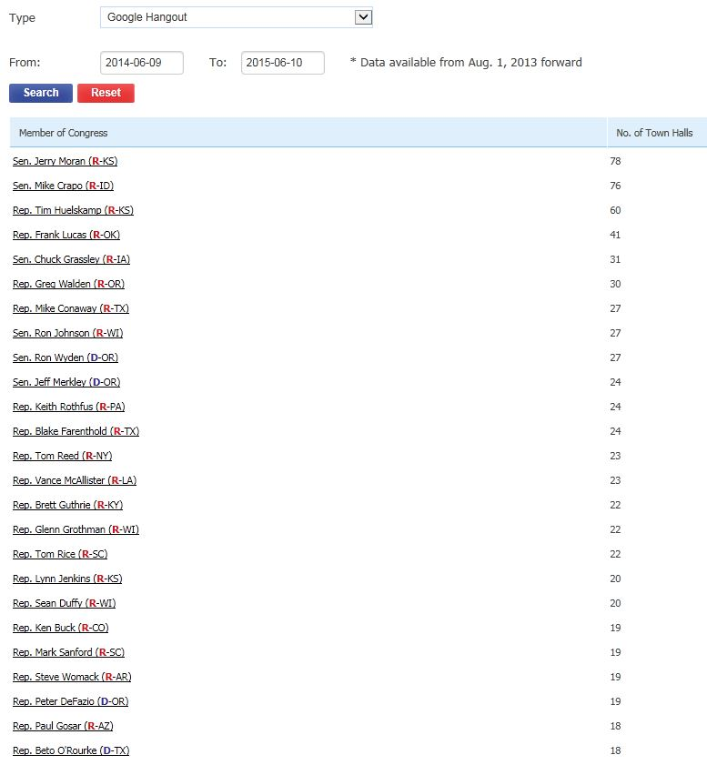
Open dialogue
In the last year, Members of Congress held 1,000+ town halls via Google Hangouts
Notes:
Moving more toward online engagement; prereading shows Vines used by administration and others as another mouthpiece.
Source: https://www.legistorm.com/townhall/top_members.html?search%5Bchamber%5D=&search%5Bparty%5D=&search%5Bstate_id%5D=&search%5Bregion%5D=&search%5Btype%5D=1&search%5Bfrom%5D=2014-06-09&search%5Bto%5D=2015-06-10&commit=Search

Slide 18
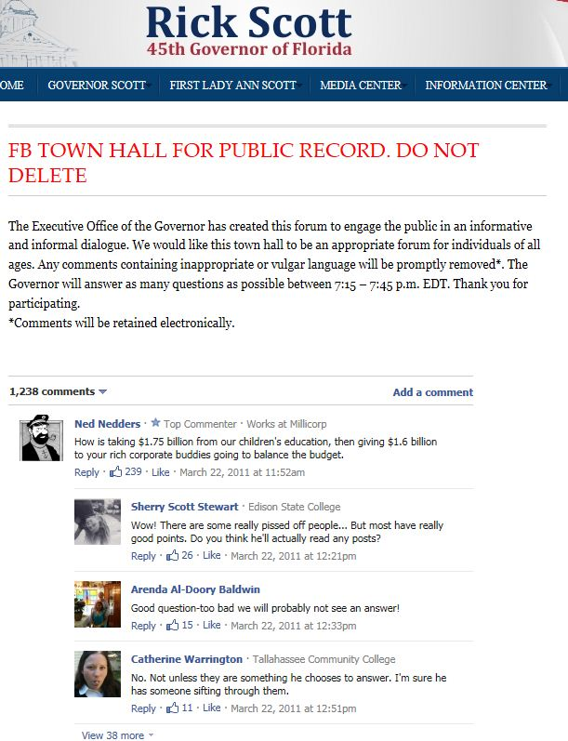

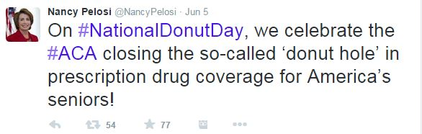
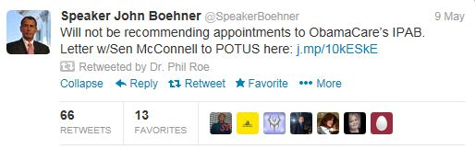
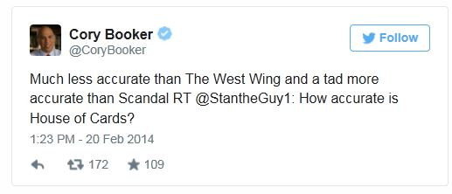
Notes:
Sample pages – Left is an example of a town hall hosted via Facebook that will exist in perpetuity. Note – Rick Scott, smart to open this up, many negative comments. Stupid to not respond – couldn’t find many instances of replies or feedback. If people go ignored, that is pointless.
On the right, demonstrates they are people and they are authentic. Engaging about entertainment on one day means another day when they ask for support, they are more of a friend.

Slide 19
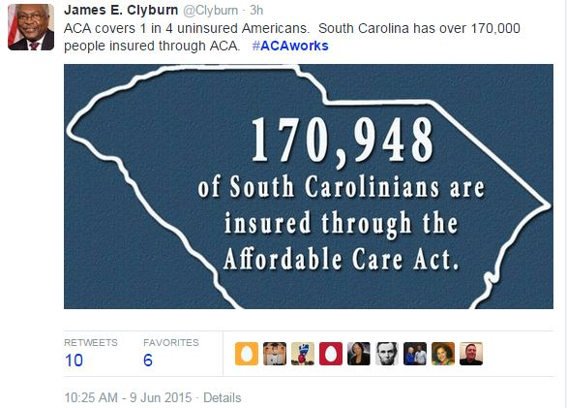
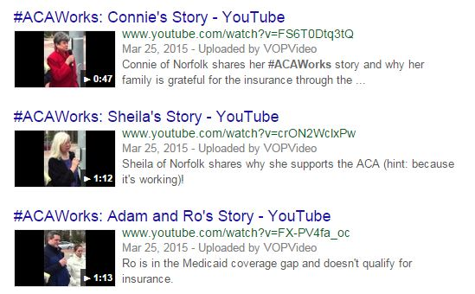
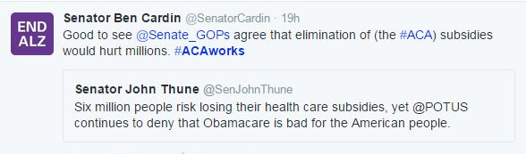
#ACAWORKS
Notes:
CT congressman launched this campaign to promote himself for reelection, but it caught on. Co-opted by social media users and government officials to promote positive conversation. Monitored to track what people consider successes, what stories are viewed the most, endless possibilities for applying learnings from the data.
Feb 2014

Slide 20
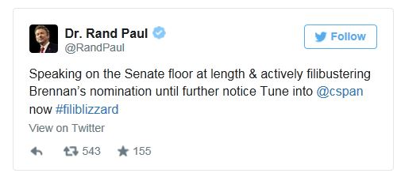
Twitter enhances rand paul’s 2013 filibuster
OBJECTIVE: build awareness/buzz
STRATEGY: involve Twitter in first person from @RandPaul; colleague Sen. Ted Cruz read tweets of support as part of filibuster in Senate chamber
RESULTS: 1M+ tweets sent about the filibuster that day
Public supported the effort, generated creative hashtags
Activity on Twitter alerted and informed
Debate continued outside Senate chamber during and after
#standwithrand
#paulnighter
Notes:
Another example that is more straightforward
https://media.twitter.com/success/twitter-enhances-rand-pauls-filibuster

Slide 21
Key Take Aways
“Influencers” share content
Online discussion = broader reach
To be successful, simply: listen, share, be yourself
Notes:
So as you can see, these tools can spark change. You get major influencers to share your content – or become an influencer! – that content then reaches far more people than traditional media and thus encourages behavioral and policy changes.

Slide 22
APPLYING THE TAKEAWAYS – SPECIFIC TIPS

Slide 23
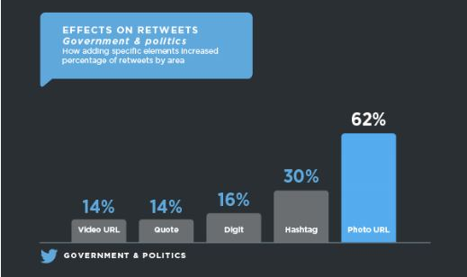
Campaign Advice
Photos shared most, hashtags helpful
Notes:
https://media.twitter.com/best-practice/government-politics-what-works-best

Slide 24
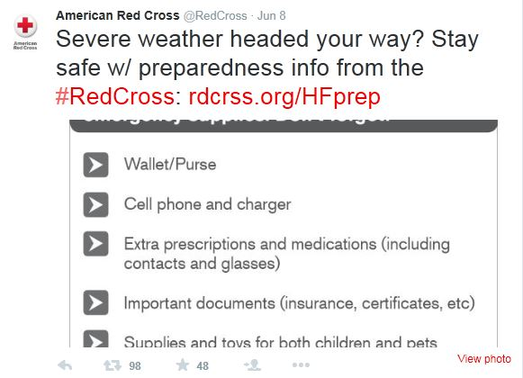
Campaign Advice
Photos shared most, hashtags helpful
Prime your audience – use great content to engage before asking people to act
Notes:
Always asking for money or blood donations. But between those times of need, they also are a value-add for important info

Slide 25
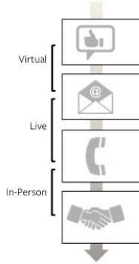
Campaign Advice
Photos shared most, hashtags helpful
Prime your audience – use great content to engage before asking people to act
Combine with offline engagement

Slide 26
Campaign Advice
Photos shared most, hashtags helpful
Prime your audience – use great content to engage before asking people to act
Combine with offline engagement
Listening summary
TWITTER
ADVOCATE A
MOTIVATED BY CHRISTIAN ISSUES
FACEBOOK
INFLUENCER 1
MOTIVATED BY CUTE PICTURES
ENGAGED IN #SCOTUS, #BABIES
ENGAGED IN HYPERLOCAL CONVERSATIONS
Notes:
Additional tips:
Listening summary – list top 5 users by platform who are active advocates, influencers, what motivates them, what conversations they engage in, etc. Reference it during campaign.

Slide 27
BACK TO THE BASICS

Slide 28

Where to start? Twitter.
“Brevity is the soul of wit”
“Username” = someone’s handle (@mlinson)
“Tweet” = an update; 140 characters max
“Follower” = a user who has subscribed to another user’s updates
“RT” or “Retweet” = resending a user’s update verbatim to your followers
@Reply =
#Hashtag = placing a # in front of a word categorizes updates
Notes:
Hamlet Act 2 – Polonius says it …
You can say a lot in just a few words – 140 characters to be exact (little known fact: the # of characters comes from that of a text message – 140 8-bit characters make up an SMS)
People w/common interests can still span many audiences. You are interested in boosting child vaccinations. Well, parents care about vaccines, policy folks, journalists, teachers, academics, researchers, etc. so not just looking for other people in your field. Just others interested in your field.
Hashtag - This is when a simple phrase is proceeded by the pound sign (#). The purpose of a hashtag is to bring a sense of organization to conversations that often span many different twitter users. Hashtags are often used during the planning (and attendance) of an event or around a major news event (#Haiti), but can also be around a topic (#HCR) or for specific audiences/conversations (#journchat)

Slide 29
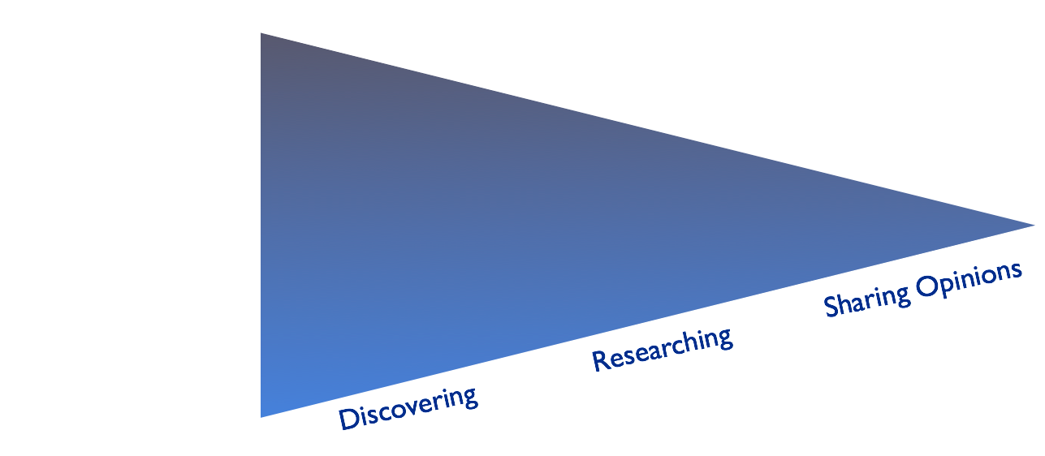


Continuum of “I Don’t Care”

Slide 30
Basic Guidelines
Act with integrity
Be real and transparent
Give credit where credit is due (RT)
Engage – respond to people, thank people, start conversations
Worried about work/position affiliation?
Simple profile disclaimer: “Tweets are my own.”
Simple tweet disclaimer: “Now reading: xxx”
Notes:
People will connect with you the same way they would in person – they want personality, they want credibility. Admit when you make a mistake, give other users credit when you repost their content,

Slide 31
Great Resources
SMUG – Social Media University Global: http://social-media-university-global.org/
Twitter for Government: https://media.twitter.com/government
Great slidedeck to introduce you to all that social media has to offer: http://www.slideshare.net/LeeAase/helping-auxilians-tell-their-stories
Twitter Registration Quick Guide: https://support.twitter.com/articles/100990-signing-up-with-twitter
Notes:
Look into the “Curriculum” – twitter and facebook 101+
Read up on real life examples of how social media is enhancing communities
The cheat sheet even has a quick reference guide for some of the common shortcuts

Slide 32
NEXT STEPS FOR SUCCESS BEGINNER

Slide 33
Now you’re on Twitter…
Find people with similar interests (and they will find you!)
Listen…scan the site by searching for keywords, looking at “trending topics,” etc.
Save a list or take note of specific hashtags (#ACA, #SCOTUS)
Follow back
Notes:
People w/common interests can still span many audiences. You are interested in boosting child vaccinations. Well, parents care about vaccines, policy folks, journalists, teachers, academics, researchers, etc. so not just looking for other people in your field. Just others interested in your field.

Slide 34
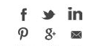
Dip your toe in
Re-tweet (e.g., @ourhospital tweets)
Recognize your peers (Congrats to @The_BMC on getting great #HCAHPS scores!)
Thank Members of Congress with their username (Thanks @FLOTUS for the Let’s Move campaign!)
Use the “share” link for interesting reads
Answer others’ questions or pose to others
Participate in established conversations (#340B, #FollowFriday)

Slide 35
NEXT STEPS FOR SUCCESS INTERMEDIATE

Slide 36
Monitoring tools
LISTS – via Twitter
HOOTSUITE – dashboard
ALERTS – Twitter service
GOOGLE – search for Twitter activity
GENERAL – add a few outside the box (local businesses, celebrities, charities, universities, etc.)
Notes:
Adapted from National Journal

Slide 37
key stakeholders - lists
POLICYMAKERS – pick a few local, state, national
PEER ORGANIZATIONS – pick a few (competitors, sponsors, partners)
RELEVANT EXPERTS – pick a few (@OurHospitals, for instance); be sure to follow a few you agree with and a few you disagree with
NEWS – pick a few reporters/news outlets you like and don’t like
GENERAL – add a few outside the box (local businesses, celebrities, charities, universities, etc.)
Notes:
Adapted from National Journal

Slide 38
Planning an online initiative
Gather information (who are the key voices, what are the key opinions on the issue)
Build your reputation/add value (ongoing)
Prep for action (talk to others offline about engaging online)
Join existing conversations discovered in the gathering phase, then co-opt the dialogue (frame the issue for others directly)
Call out key influencers with facts, questions
Broadcast calls to action (encourage individuals to comment directly to stakeholders)
Notes:
Adapted from National Journal.

Slide 39
QUESTIONS? STAY IN TOUCH mlinson@essentialhospitals.org @mlinson on Twitter

Slide 40
Extra presentation links
https://media.twitter.com/success/givingtuesday-encouraging-and-telling-stories-of-charity-on-twitter
https://media.twitter.com/success/charity-water
https://media.twitter.com/best-practice/twitter-alerts
http://www.edelman.com/insights/intellectual-property/exploring-consumer-attitudes-actions-key-tech-policy-issues-2014/

