Slide 1
Understanding Your Network:
Engaging Stakeholders & Leveraging Assets
Liz Schrayer, Schrayer & Associates, Inc.
June 24, 2015

Slide 2
Agenda: Life of Policymaker Power of Hospitals Winning Strategies: Breaking Through the Noise

Slide 3
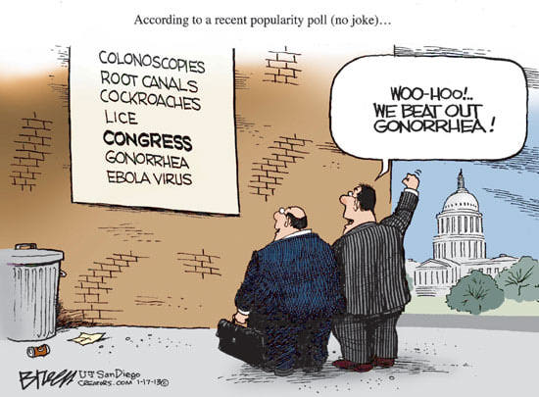
Congress Today

Slide 4
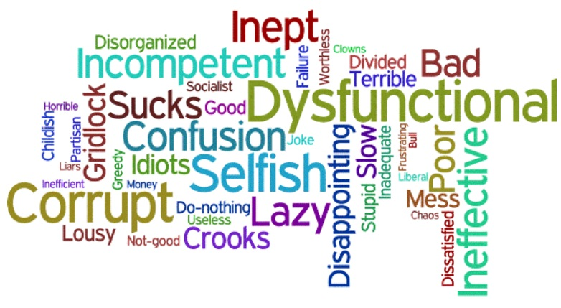
Public View of Congress

Slide 5
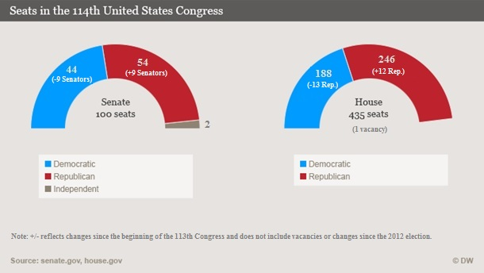
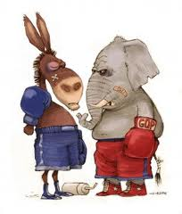
The 114th Congress
Notes:
More than 200 new in last four years – 40% of Senate new since 2006

Slide 6
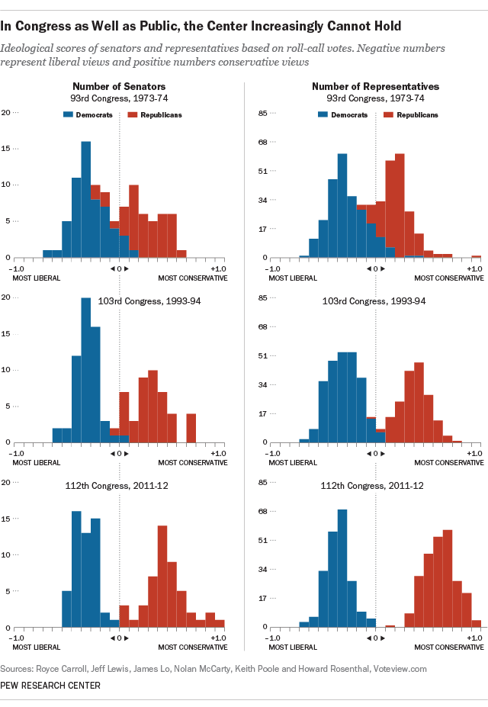
The Growing Polarization in Congress

Slide 7
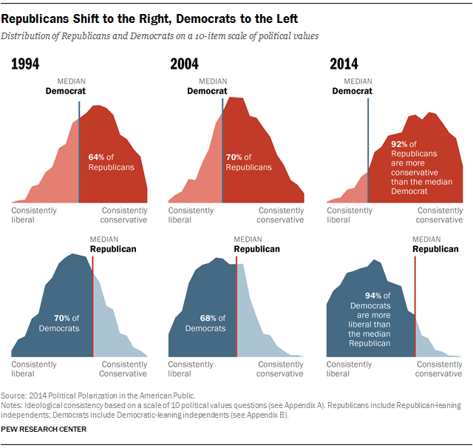
The Growing Polarization Among Americans

Slide 8

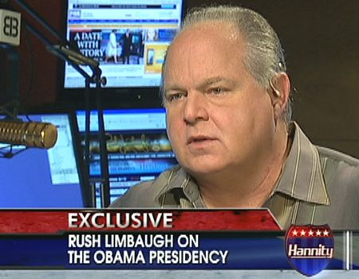



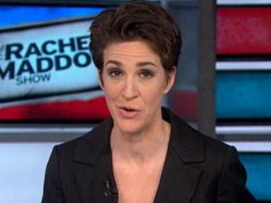



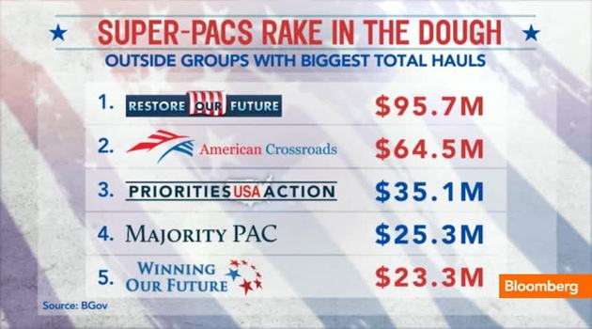
The Challenges
24 Hr News Cycle
1,440 Minutes Per Day
$ 6 Billion Election

Slide 9











The Competition
Over 100,000 Professional and Trade Associations

Slide 10
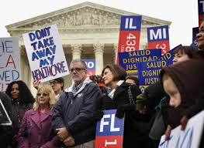


Can We Break Through the Noise?

Slide 11

Tools of Engagement
Citizen
Advocacy
Direct
Lobbying
Effective
Communications
Notes:
11

Slide 12


The Most Powerful Interest Groups
The Fortune Magazine “Power 25 Survey”

Slide 13
The Power of the Public Hospital Network

Slide 14
Hospital Stakeholders
CEO
Physicians/
Nurses
Staff
Community
Leaders
Trustees
Hospital/
System
Families
Donors
Business
Leaders
Volunteers
Notes:
14

Slide 15

Your Hurdles
Spread Thin:
Local, State, Federal
Limited Staff
Avalanche of Issues
Notes:
15

Slide 16
Getting Started
Your Resources

Slide 17
Step I: Prioritize Your Delegation

Slide 18
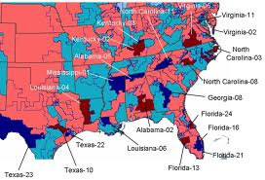
Your Delegation
Senators
Representatives
Challengers
Open Seat Candidates
Champions
Unmovables
Opportunities
Notes:
18

Slide 19
Step II: Fine-Tuning Your Lobbying

Slide 20
Direct Lobbying: Best Practices
Become Trusted Resource
Send Articles/Information
Serve as Reliable Responder
Quick turn around on requests
Face-to-Face Meetings
1-2 x in DC
1-2 x in Home
Create Opportunities for Engagement
Organize Hospital Tours
Invite as Speaker
Profile on Website
Attend Town Hall meetings
Engage on Social Media
Don’t Be Afraid to “Ask”
Notes:
20

Slide 21
Step III: Engaging Your Grasstops

Slide 22
Identify Powerful Audiences
Senior hospital management
Board members
Foundation Board members
Donors
Physicians
Business Community
Faith- Based Leaders
Nurses
Former elected officials
Notes:
22

Slide 23


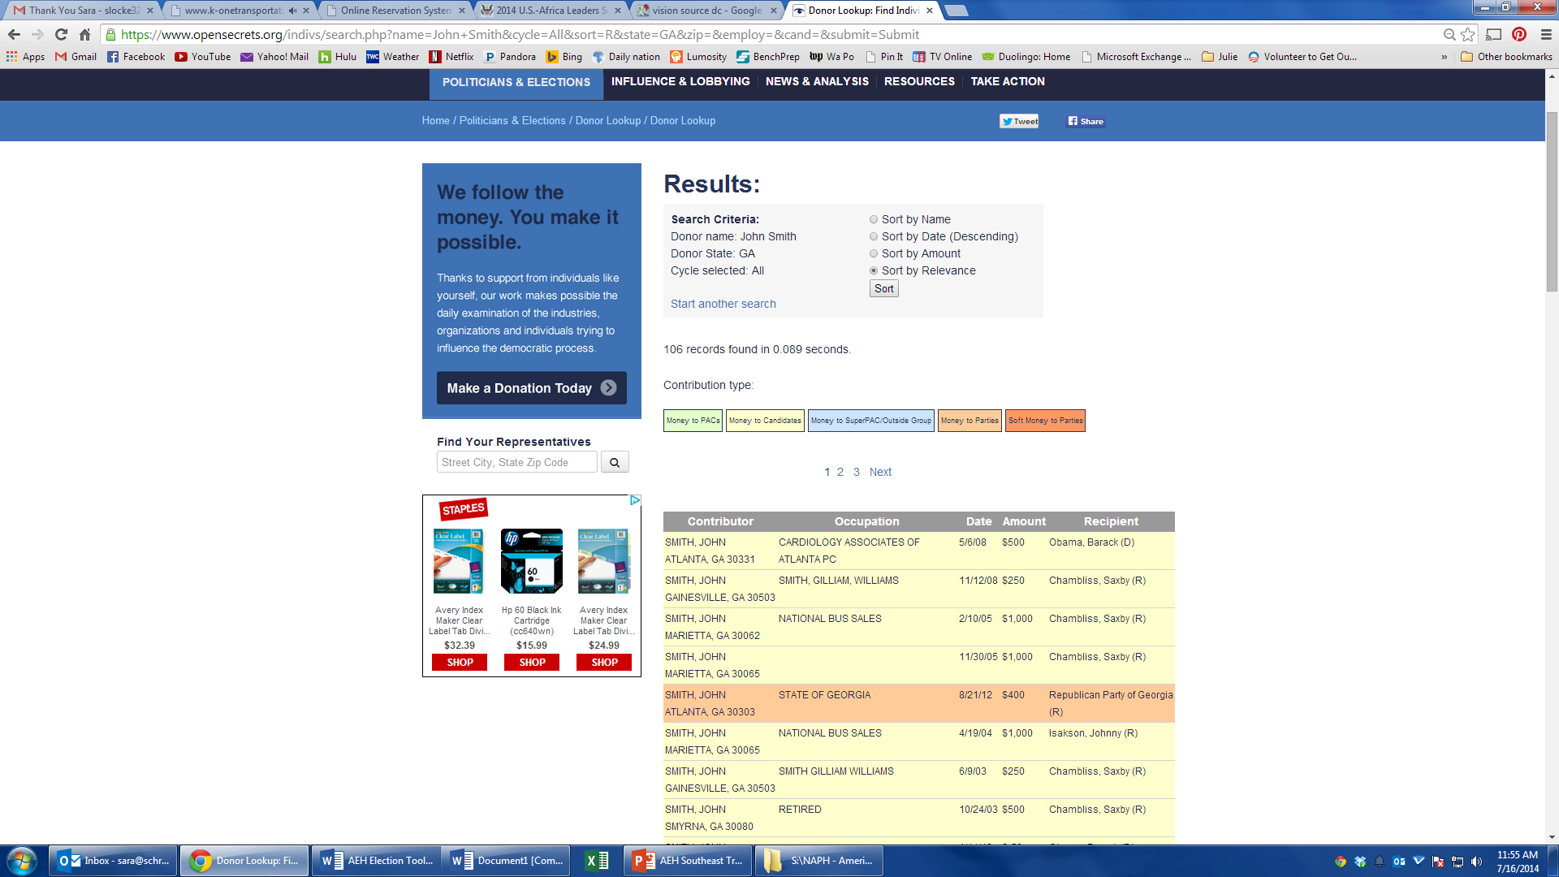
Identify Key Contacts
Notes:
23

Slide 24
Winning recruitment strategies
Organizing Strategy:
Public Policy Committee for Board
Kitchen Cabinet for CEO
Hand – Select Committee
Recruitment:
One-on-One Outreach
Speaker Outreach
Ongoing Engagement:
Smart Communications Strategy calls & emails
Notes:
24

Slide 25
Step IV: Mobilizing Your Stakeholders

Slide 26
Winning Strategies
Secure In-Person Meetings
Use stakeholders to help
Bring stakeholders/”script”
Invite policymaker to “tour”
Hospital Visits/Tours
Involve stakeholders
Showcase success & needs
Use social media
Notes:
26

Slide 27
Key Strategy
Simple Message
“ I am a supporter of ----- hospital, one of several hundred of America’s essential hospitals around the country that provides high quality care for all, including the most vulnerable people, and I hope we can count on your support.”
Notes:
27

Slide 28

Winning Strategies
Trips to DC
Public Policy Committee
Respond to Action Alerts
Use Election Season
Candidate Forums/Town Hall Meetings
Notes:
28

Slide 29
Communications: Best Practices
For Stakeholders:
Review basic packet
On-going communications
Leverage social media
Twitter, online chats
For Policymakers:
Review message and material
On-going communications
Leverage social media
Twitter, Facebook, Blog
Notes:
29
Seek out opportunities to meet with members of Congress and their staff.
Meetings can be in Washington or in their districts when they are home for recesses.
Town Hall meetings also present opportunities to meet members and raise issues; take advantage of Town Halls taking place in your district.
(NOTE: We will delve into tips for successful meetings later in the session.)

Slide 30
Grassroots: Best Practices
Potential Audiences:
Senior management
Physicians
Nurses
Employees
Volunteers
Religious leaders
Community health professionals
Engagement
Simple “sign up” form
Public policy briefing at meetings
Interested parties to a brown bag
Information table near the cafeteria
Communications
Monthly email
Twitter follower
Brown bag/grand round updates
Quarterly conference calls
Notes:
30
Seek out opportunities to meet with members of Congress and their staff.
Meetings can be in Washington or in their districts when they are home for recesses.
Town Hall meetings also present opportunities to meet members and raise issues; take advantage of Town Halls taking place in your district.
(NOTE: We will delve into tips for successful meetings later in the session.)

Slide 31
Coalitions: Best Practices
Potential Audiences:
Business (e.g., Chamber)
Health Care Groups
Faith-based Organizations
Hispanic Leadership
Civic Organizations
Universities/Academic Institutions
Engagement
Speak at one group per month
Invite coalition leaders to strategy meeting/ VIP breakfast
Find interlockers to make introduction
Appoint Board member as coalition point person
Communications
Quarterly VIP Breakfast
Monthly email letter from CEO
Notes:
31
Seek out opportunities to meet with members of Congress and their staff.
Meetings can be in Washington or in their districts when they are home for recesses.
Town Hall meetings also present opportunities to meet members and raise issues; take advantage of Town Halls taking place in your district.
(NOTE: We will delve into tips for successful meetings later in the session.)

Slide 32
Key Take Away
To Break Through the Noise:
Engage Grasstop Stakeholders
8-10 Influential Stakeholders
Public Policy Kitchen Cabinet
Join Meetings/Tours/DC Trips
Contact Members of Congress
Notes:
32
Seek out opportunities to meet with members of Congress and their staff.
Meetings can be in Washington or in their districts when they are home for recesses.
Town Hall meetings also present opportunities to meet members and raise issues; take advantage of Town Halls taking place in your district.
(NOTE: We will delve into tips for successful meetings later in the session.)

