Slide 1
Latest Challenges in Medicaid Payments and Financing Sarah Mutinsky Eyman Associates
June 23, 2015

Slide 2
Overview
Challenges to Non-DSH Supplemental Payments
New (Renewed) Scrutiny of UPL Payments
Managed Care Proposed Rule
CMS’ Evolving Position on Waiver-Based Payments
CMS Scrutiny of Provider-Related Donations

Slide 3
Medicaid Non-DSH Supplemental Payments

Slide 4
Refresher: Rules Governing “UPL” Payments
Upper Payment Limits
Hospital/NF/Clinic UPLs: Aggregate rates must be no greater than Medicare
1. State-owned and operated providers
2. Non-state government providers
3. Private providers
Professional services: No regulatory UPL
CMS policy limits payments to Average Commercial Rate (ACR) or Medicare
Direct pay prohibition for services under managed care contract

Slide 5
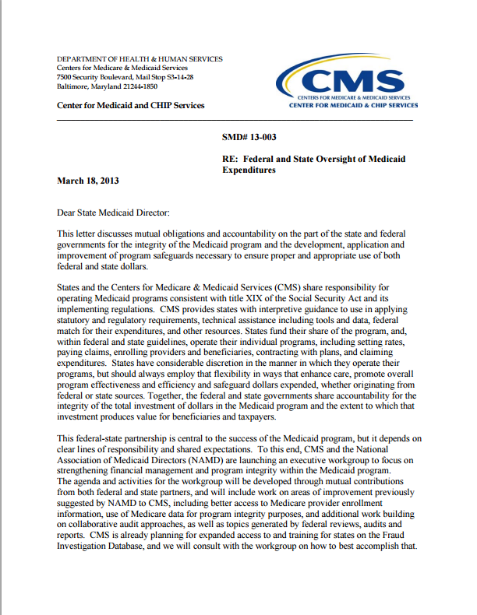
CMS Accountability Initiative (2013)
First time states required to submit annual UPL demonstrations
Inpatient & outpatient hospital, nursing facilities, physician/practitioners, clinics, etc.
Provider-specific reporting
Includes source of non-federal share funding
First time published CMS guidance on how to calculate the UPLs
Contractor engaged to organize and analyze the data

Slide 6
Reminder Interaction of UPL & DSH Payments
UPL
UPL
Cost of Services
UPL or DSH
DSH
Base
Pmt
Self Pay

Slide 7
Medicaid Non-DSH Supplemental Payments
New Agency and Legislative Scrutiny

Slide 8




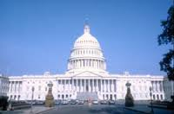

Slide 9
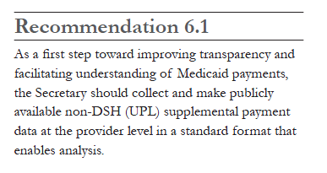

MACPAC Dissatisfied with CMS Accountability
March 2012: “State Approaches for Financing Medicaid”
March 2014: “Examining the Policy Implications of Medicaid Non-Disproportionate Share Hospital Supplemental Payments”

Slide 10

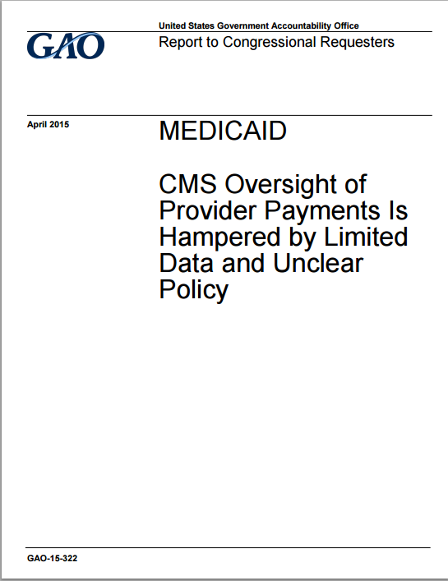
Renewed Government Accountability Office (GAO) Scrutiny
July 2014/March 2015: “States' Increased Reliance on Funds from Health Care Providers and Local Governments Warrants Improved CMS Data Collection” (Reps. Issa, Lankford) (Rep
Lankford)
April 2015: “Medicaid Demonstrations: Approval Criteria and Documentation Need to Show How Spending Furthers Medicaid Objectives” (Sen. Hatch, Rep. Upton) . Hatch; R
ep. Upton)
April 2015: “CMS Oversight of Provider Payments is Hampered by Limited Data and Unclear Policy” ((Reps. Chaffetz, Jordan, Issa, Sen. Lankford)Sen. Lankford)

Slide 11
GAO Findings, April 2015
Analyzed provider payments in 3 states
Findings
Provider-specific data insufficient
Some public hospitals received payments above total (not just Medicaid) operating costs
“a small number of government hospitals were receiving high payments that warrant oversight”
CMS oversight insufficient
Recommendations for CMS:
Ensure states report provider-specific payment data
Develop policy to determine economy and efficiency
Develop process to review payments to individual providers to determine economy and efficiency
Not just aggregate UPL test

Slide 12
CMS Response
HHS is gathering information from states’ annual UPL and DSH audit submissions to better inform individual provider level payment criteria and establish policies and procedures to evaluate whether payments at the provider level are economic and efficient.
CMS Response
GAO Report 15-322 April 2015, Appendix

Slide 13
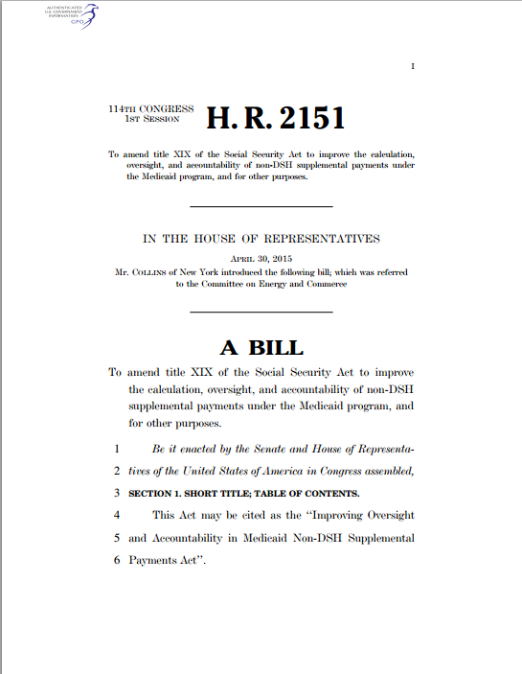
Renewed Congressional Interest
Introduction of the “Improving Oversight and Accountability in Medicaid Non-DSH Supplemental Payments Act” (H.R. 2151, Rep. Collins (R-NY))
Requires DSH-style independent audits of non-DSH supplemental payments
Could lead to repayment obligations
Application to waiver-based UC payments unclear

Slide 14
CMS Working on Supplemental Payments Rule
CMS Regulatory Agenda includes plans to issue “Medicaid State Payment Adjustment” proposed rule
New requirements to ensure supplemental payments are economic and efficient
Would require “all supplemental payments be distributed proportional to the volume or cost of service delivered or be tied to meeting performance benchmarks”
Time limit on supplemental payments
Additional state reporting requirements

Slide 15
Medicaid Non-DSH Supplemental Payments
Implications of Managed Care Proposed Rule

Slide 16
Challenge of Adequate Support Under Managed Care
Direct pay prohibition
CMS regulations say states cannot make supplemental payments directly to providers for services under MCO contract
Past interpretation limited state indirect payments through plans
Exceptions
Statute requires to pay DSH directly to providers
CMS policy allows states to pay graduate medical education directly to providers
FQHC wrap-around

Slide 17
State “Workarounds”
Services carve-outs
Waiver-based UC pools
DSRIPs (in some cases)
GME payments (may be paid directly)
Payments through MCOs

Slide 18
Simplified Model FFS vs. Managed Care
CMS
CMS
FFP
FFP
State
State
Capitated Payment
Provider Payments
MCO
Provider Payments
Providers
Providers

Slide 19
Direct Pay Prohibition
DSH
CMS
UPL
CMS
X
State
State
MCO
X
DSH
DSH
Providers
DSH
DSH
UPL
Providers
UPL
X

Slide 20
Enhanced Payments through MCOs
DSH
CMS
UPL
CMS
FFP for enhanced rate
State
State
Enhanced Capitation Pmt
MCO
Enhanced Payment to Provider?
?
Providers
Providers
How much will CMS let State direct payment to provider?

Slide 21
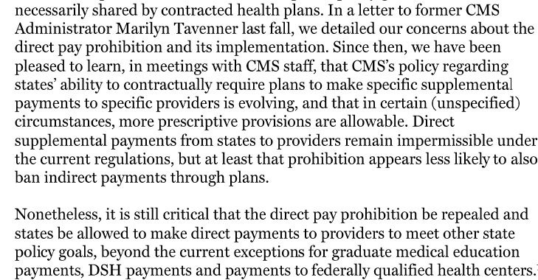
Prior to Managed Care Proposed Rule
America’s Essential Hospitals Letter to CMS, April 2015

Slide 22
Proposed Managed Care Rule
Released May 26, 2015
Comprehensive overhaul of managed care regulations (first since 2002)
Goals include promoting innovation and cost-efficiency, expanding value-based payments, incentivizing use of performance targets
Retains the direct pay prohibition
Adds explicit prohibition on directing payments through MCOs

Slide 23
Proposed Rule on Directing Payments through MCOs
State cannot direct MCO payments under contract with plans except under specified circumstances:
1) requiring implementation of value-based purchasing models,
2) mandating participation in a multi-payer delivery system reform and
3) requiring the plan to adopt
A minimum fee schedule or
uniform rate increase for all providers of a particular service.
Troublesome preamble language characterizes as simply codifying “longstanding CMS policy”
Significant new constraints compared to current practice
(Does not impact ability to negotiate higher payment amounts in contract between plan and provider)

Slide 24
Medicaid Non-DSH Supplemental Payments
CMS’ Evolving Position on Waiver-Based Payments

Slide 25

CMS’ Evolving Position on DSRIPs
CMS is re-evaluating its DSRIP activity
Return on investment
Administrative burden
New York waiver as preferred approach
DSRIP as a means not an end
Sustainability a concern

Slide 26
CMS’ Evolving position on Uncompensated Care Pools
CMS disfavors uncompensated care pools
Will review each state’s circumstances individually, as pools expire
Requiring independent evaluations
Principles announced in April 14 letter to Florida, later sent to 8 other states with UC pools:
“…uncompensated care pool funding should not pay for costs that would be covered in a Medicaid expansion.”
“Medicaid payment should support services provided to Medicaid beneficiaries and low-income uninsured individuals.”
“…provider payment rates must be sufficient to promote provider participation and access…”

Slide 27
Example Waiver Terms
Arizona 1115 Waiver
Special Terms and Conditions
Florida 1115 Waiver
Special Terms and Conditions
“Arizona must conduct an independent evaluation of the use of the SNCP for Phoenix Children’s Hospital…An analysis of factors that contributed to the necessity of SNCP payments to PCH including, but not limited to…Provider and diagnosis payment rates in the state…An analysis of …the factors that contributed to the necessity of SNCP payments overall as well as specifically for Medicaid shortfall.
The state shall submit a transition plan describing movement towards long term payment reforms and solutions for PCH and away from current payments received through the SNCP…”
“Florida will …develop a plan to reform Medicaid provider payments and funding mechanisms, with the goal of developing sustainable, transparent, equitable, appropriate, accountable, and actuarially sound Medicaid payment systems and funding mechanisms that will ensure quality health care services to Florida’s Medicaid beneficiaries throughout the state without the need for LIP funding…
…A report from an independent entity on Medicaid provider payment in the state…

Slide 28
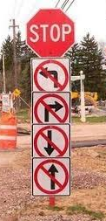
Significant Challenges to Each Avenue of Supplemental Payment
Renewed scrutiny and potential proposals to limit FFS UPL payments
No direct supplemental payments for MC services
No indirect state direction of enhanced payments through MC plans, except limited circumstances
Transition out uncompensated care pools
Uncertain future of DSRIPs
DSH cuts ahead

Slide 29

Where does this leave you?
CMS wants states to pay adequate base rates
But
Armstrong decision forecloses providers’ ability to seek judicial enforcement of adequate rates
CMS not yet finalized proposed Equal Access Rule, pending since 2011
And question efficacy of proposed form

Slide 30
Financing Challenges

Slide 31
Provider-Related Donations
No federal match for expenditures financed with funds from private provider-related entities
CMS regulations define as:
“a donation or other voluntary payment (in cash or in kind) made directly or indirectly to a state or unit of local government by or on behalf of a health care provider, an entity related to such a health care provider, or an entity providing goods or services to the state for administration of the state’s Medicaid plan”

Slide 32
Recall permissible to fund private hospital payments with IGTS
(Assumes 50% FMAP)
State
$100 IGT
$200 Claim
$100 FFP
$50
Payment
$150
Payment
Federal Government
Public Hospital
Private Hospital

Slide 33
But IGT cannot be funds from private provider
(Assumes 50% FMAP)
State
$100 IGT
$200 Claim
$100 FFP
$50
Payment
$150
Payment
Federal Government
Public Hospital
Private Hospital

Slide 34
CMS’ Evolving Policy on Provider Donations
May 9, 2014 State Medicaid Directors Letter
Public-private partnerships
The provision of a service or in-kind transfer of value by a private provider to “further the purposes of the government entity” may constitute an impermissible provider donation
Louisiana SPA disapproval
Texas deferral lifted; must address by end of 2015

Slide 35
Examples of Potential Donations from May 2014 Guidance
Example 1
Private hospital lease space from a government entity at an amount above fair market value
Government entity uses lease payments to fund IGTs for the non-Federal share of Medicaid supplemental payments to the private hospital
Example 2
Government entity and private hospital enter public-private partnership arrangement
government entity terminate an existing contract with a non-profit organization for certain services
private hospital executes the same contract with the same non-profit organization
Government entity sends an IGT to Medicaid agency to fund Medicaid payments to the private hospital
IGT is in an amount approximately equal to the amount that it would have spent on the now terminated contract

Slide 36
No Payment without Permissible Source of Non-Federal Share
Viable alternatives?
General Revenues
Intergovernmental Transfers
Without impermissible public/private arrangement?
Provider Taxes
Non provider-related donations

Slide 37
Conclusion

Slide 38
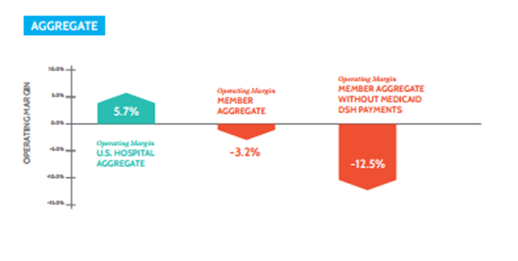
The Stakes are High
National Operating Margins
Members of America’s Essential Hospitals vs. All Hospitals Nationwide FY2013

Slide 39


Slide 40

Questions?
Sarah Mutinsky
smutinsky@eymanlaw.com
(202) 567-6202
Eyman Associates
810 First Street NE
Suite 201
Washington, DC 20002

