Slide 1
Current GIS data
Reliability Nodes Project

Slide 2
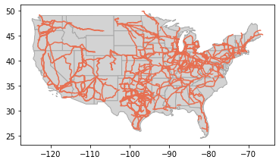
High voltage transmission lines (>=345kVA)

Slide 3
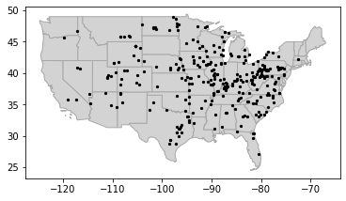
US with coal plants

Slide 4
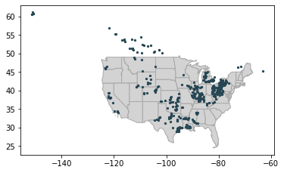
US with natural gas storage facilities

Slide 5
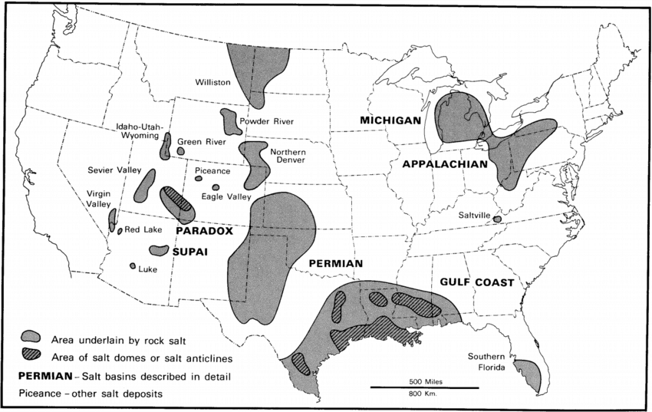
US salt domes
Circa 1978…
???
Haven’t found these data yet, not sure they exist in how we want them…
Only found data from 1978?

Slide 6
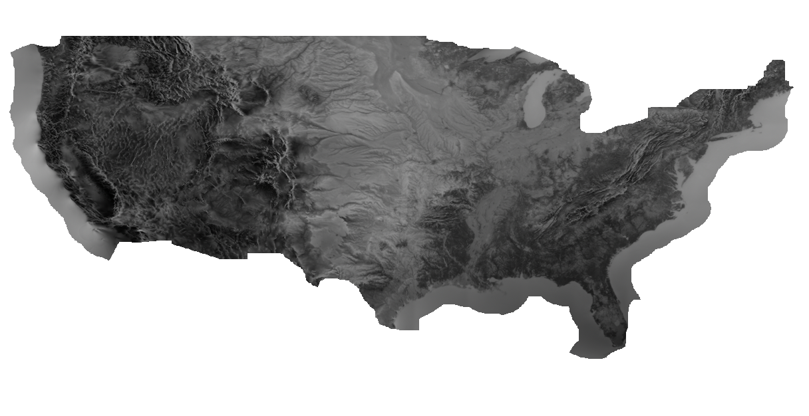
US wind capacity factor (unprocessed image)

Slide 7
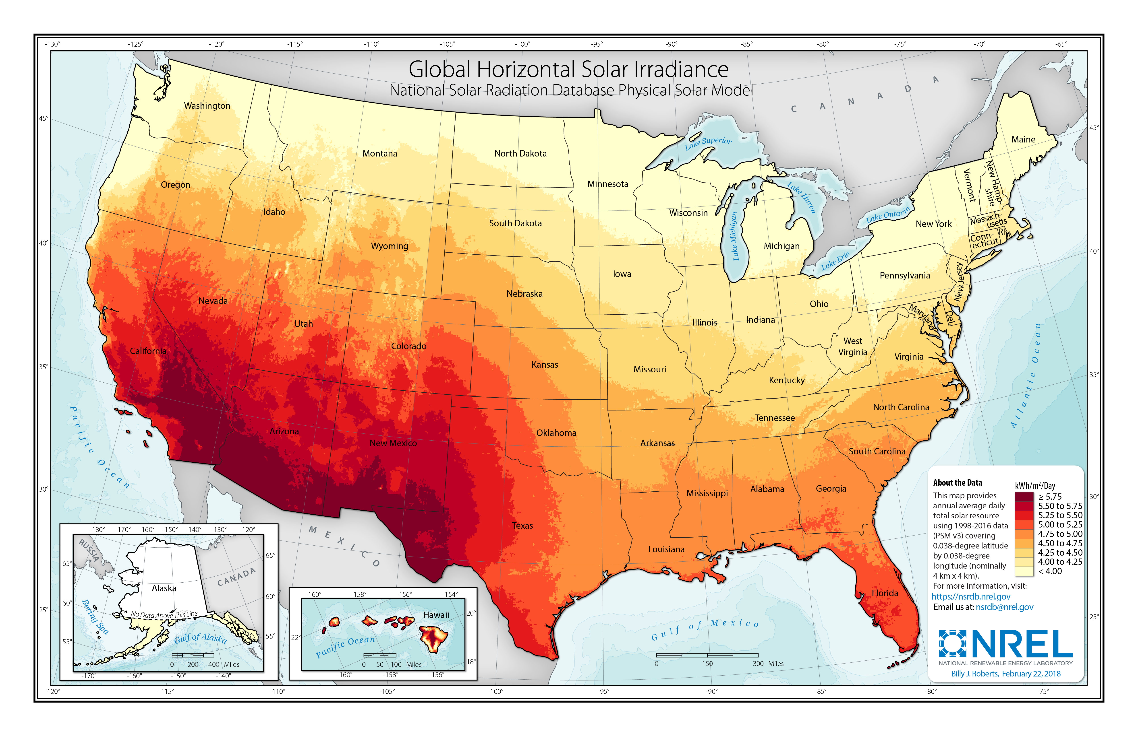
US with solar capacity factor (underlying data need processing)

Slide 8
US load data
US load data
US price data

Slide 9
Ammonia plants and/or fertilizer plants
Other users of H2?
Iron and steel plants???

Slide 10
Next steps
What else do we need?
Consuming all these data and geospatial analysis
Buffer zones
Intersections
Need to develop methodology criteria

