Slide 1
Asteroid Game Capstone Project
Conner Stephens, Josh Duplaa, Megan Beavers

Slide 2
Project Overview & Objectives
For this project we were tasked with designing and implementing a “flappy bird” style game on the ATmega328P. The game needed to use an LCD display, 2 buttons and an EEPROM. The game should also have a “start” scene, “game” scene and a “game over” scene. The difficulty of the game should increase, and a high score should be saved to the EEPROM.

Slide 3
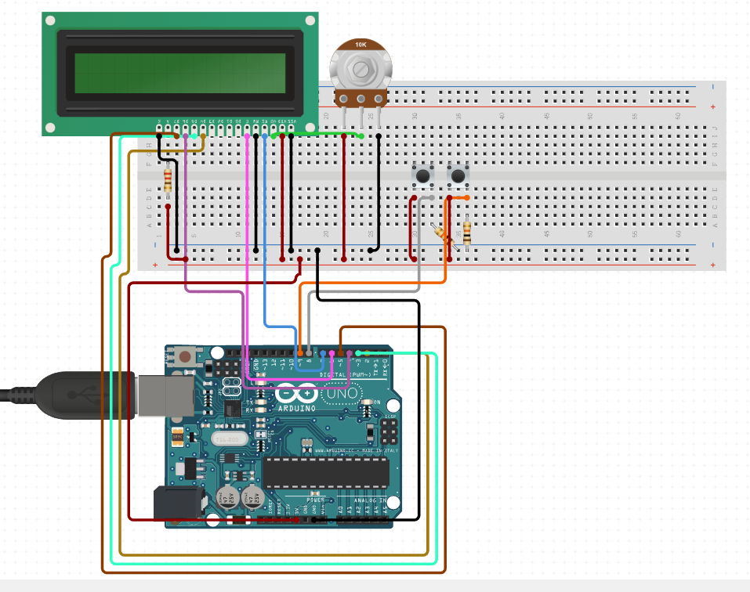
Hardware Schematic
We connected the LCD with the potentiometer to VO
Then as we go down the LCD VSS, VDD, RW, and K are directly connected to the breadboard. RS is connected to portD 7 and enable pin is connected to portD 6. Next, we have D4-D7 for data transfer between module and the Arduino. The buttons are connected to portD 8 and portD 9 to trigger external interrupts, so the Arduino responds to the button press. We used resistors to ensure that when the button is pressed the input is connected to 0 or 1.

Slide 4
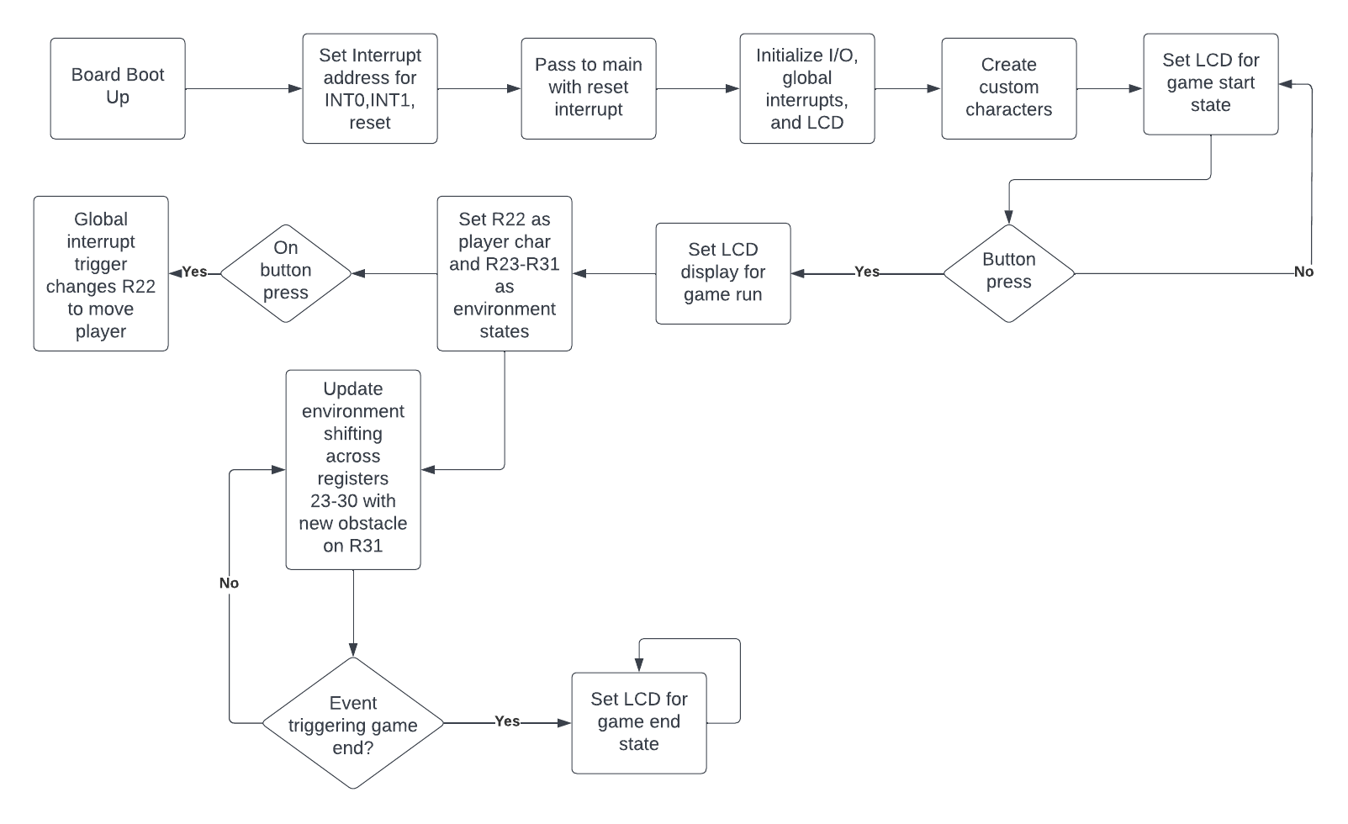
Software Flowchart

Slide 5
Technical Game Design
The game being designed is a type of asteroids game.
The objective is to navigate your ship through holes in walls or “asteroids”.
The LCD initializes with a clear screen command, along with setting selection for 2 lined mode, 4 digit select mode as well as creation of our custom characters in slots 0-7.
The game begins on the start screen waiting for a any button push at all to begin the game.
Upon the game beginning the bottom-line rewrites with the ship and the first obstacle on the far right. The LCD continually rewrites with new obstacles on the far right with the shifting of all previous obstacles across the screen to the left.
One button is made for the ship to go up and another for the ship to go down, pushing the button to go up or down at the edge of the screen causes a game over, not being lined up with the hole in the wall prior to a rewrite results in a game over
Upon any game over result, the LCD will be looped permanently with its screen until reset to play again.

Slide 6
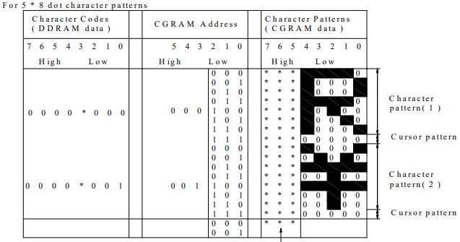
DDRAM Figure

Slide 7
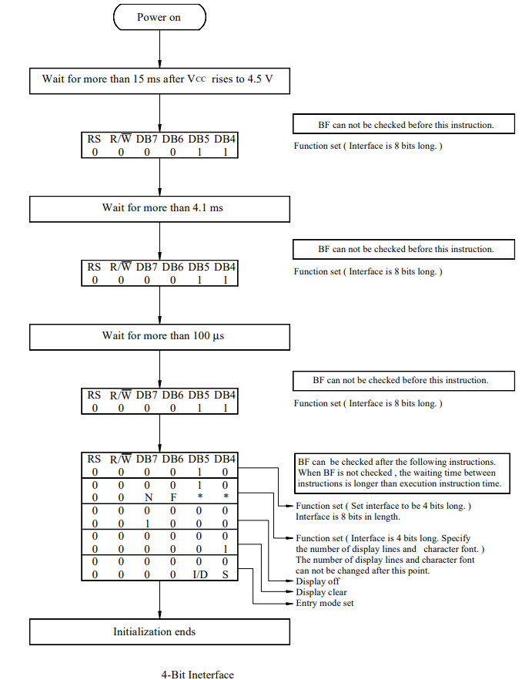
LCD Initialization Figure

Slide 8
Technical Software Implementation
The implementation of the aforementioned game design elements were nearly complete. The missing design specifications were saving a score to the EEPROM and a scaling difficulty of the game, although it starts off fairly difficult as is.
Key points of game design:
With custom character creation. Each character position and obstacle are made so the only passing position for the character is set in the DDRAM before it.
Utilizes a register to track an environment piece on the LCD(one of the 5x8 pads), the LCD game environment is shifted by using MOV across each register(R23-R30) and creating a new obstacle at R31.
R31 is responsible for the obstacle creation, it does pseudo random obstacles as any button push increases R31 to a new value resulting in a new object, R31 is constrained with OR/AND statements to not rise too large and keep things somewhat random.
There are command_wrt and data_wrt subroutines set for easy calling and changing of data within the LCD, R16 is used for all command and data exchanges with the LCD.
There are 3 different timer delays used for delaying and stops for communication with LCD, a micro-second delay, a milli-second delay and a quarter of a second delay. These are used for keeping timing for communication with the LCD.
There are external interrupts that are triggered by the buttons on the breadboard, the interrupts are triggered on the falling edge of the input to try and keep from having multiple inputs. One button raises player position, the other lowers.

Slide 9

Shortcomings of The Project
Unfortunately, some things did not get 100% finished within Project asteroid.
Most notably, the game currently does not output a score to the screen the score, calculated by a point for every half second of survival, is saved in data address $100. This unfortunately never got pushed over to the EEPROM and does not save a high score.
The other shortcoming was the lag the buttons can have with the LCD, the majority of the time the button press reads as a single input but can occasionally read as 2 presses, this can result in some unfortunate game overs.
The obstacle placing system currently is not fully functioning either, ideally, we would’ve wanted the system to alternate between open space and an obstacle, but this could not get fully integrated in time.

Slide 10
Thank you! Any Questions?

