Slide 1

Zeb Fractal 2026
AI Readiness
Decision Intelligence
System
Submit a form. Get a McKinsey-grade
AI roadmap in seconds.
Claude 3.5 Sonnet
Amazon Titan
AWS Bedrock
FastAPI
React
Report Assistant Chat (Claude 3.5 Sonnet)
Notes:
1

Slide 2




02
THE PROBLEM
Why companies fail at AI adoption
85%
No Clarity on AI Fit
Consultants Cost Weeks + $$$
Teams don't know which processes are AI-ready or where to start strategically.
Traditional assessments are slow, expensive, and often produce generic advice.
of AI initiatives
fail or stall before
delivering value
Generic Recommendations
Tech Stack Blind Spots
One-size-fits-all roadmaps miss real organisational complexity and constraints.
AI solutions proposed without considering existing infrastructure and integrations.
McKinsey Global AI Survey
AI Readiness Decision Intelligence System · Zeb Fractal · AVASOFT Hackathon
02 / 12
Notes:
2

Slide 3





03
THE SOLUTION
One Form. One Pipeline. One Report. One Chat.
Not a chatbot. Not a copilot. A Decision Intelligence System with an intelligent post-report assistant built in.
01
02
03
04
Fill the Form
Pipeline Runs
Report Delivered
Chat with Report
Company & industry info
Claude analyzes patterns
AI Opportunity List
Ask questions about results
Process descriptions
Titan validates use cases
Impact / Complexity Matrix
Claude reads full report JSON
Pain points & data types
Python scores complexity
Phased Implementation Roadmap
Multi-turn conversation
Tech stack & constraints
Claude generates report
Executive Summary + PDF
Grounded in YOUR data
Claude 3.5 Sonnet · Amazon Titan Embeddings · AWS Bedrock · FastAPI · React · SQLite
AI Readiness Decision Intelligence System · Zeb Fractal · AVASOFT Hackathon
03 / 12
Notes:
3

Slide 4
04
INPUTS & OUTPUTS
What goes in — what comes out
WHAT USERS PROVIDE
WHAT SYSTEM DELIVERS
Business Process Descriptions
AI Opportunity List
Free-text workflow descriptions
Per-process use case + impact score
Pain Points
Impact / Complexity Matrix
Operational challenges & inefficiencies
Visual scatter plot of all opportunities
Current Tech Stack
Tech Stack Recommendations
Tools, cloud services, integrations
AWS services per opportunity
Data Availability
Phased Implementation Roadmap
Structured / Docs / Logs / Images
3-phase timeline with milestones
Constraints
Executive Summary + Chat
Budget, timeline, compliance requirements
Narrative report + interactive Q&A
AI Readiness Decision Intelligence System · Zeb Fractal · AVASOFT Hackathon
04 / 12
Notes:
4

Slide 5
05
SYSTEM ARCHITECTURE
7-Layer Design including Report Assistant
1
FRONTEND
AssessmentForm · ProcessingScreen · ResultsDashboard · ChatWindow · ZebLogo · api.js
2
API SERVER
main.py · routers/assessment.py · POST /assess · GET /result/:id · POST /chat/:id
3
ORCHESTRATION
analysis_engine.py · embedding_service.py · complexity_scorer.py · report_generator.py
4
AWS BEDROCK
Claude 3.5 Sonnet (Call 1 + Call 2 + Chat calls) · Amazon Titan Embeddings (Call 3)
5
DATABASE
SQLite · assessments table (status tracking) · reports table (full_report_json)
6
OUTPUT LAYER
Opportunity List · Impact Matrix · Phased Roadmap · Tech Stack · Executive Summary
7
REPORT ASSISTANT
ChatWindow.jsx · POST /api/chat/:id · Report JSON as system prompt · Multi-turn history
AI Readiness Decision Intelligence System · Zeb Fractal · AVASOFT Hackathon
05 / 12
Notes:
5

Slide 6
06
ORCHESTRATION PIPELINE
Layer 3 Deep Dive — 4 Sequential Stages
Validated Form Input (JSON)
STAGE 1
STAGE 2
STAGE 3
STAGE 4
Analysis Engine
Embedding Validator
Complexity Scorer
Report Generator
Claude 3.5 Sonnet
Amazon Titan v1
Pure Python — No AI
Claude 3.5 Sonnet
analysis_engine.py
embedding_service.py
complexity_scorer.py
report_generator.py
Identify patterns per process
1536-dim vector embeddings
Data Availability score
Executive summary prose
Map to AI use case category
Cosine similarity vs 8 categories
Integration Dependency score
3-phase implementation plan
Estimate impact + rationale
Validates / corrects Claude's mapping
Real-Time Requirement score
AWS service recommendations
Opportunity List JSON
Validated + Similarity Scores
Complexity + Matrix Data
Final Report JSON
Final Report JSON → SQLite Database → Frontend Dashboard → Report Assistant Chat
AI Readiness Decision Intelligence System · Zeb Fractal · AVASOFT Hackathon
06 / 12
Notes:
6

Slide 7


07
AI MODEL LAYER
AWS Bedrock — 3 models, 3 distinct roles
CLAUDE 3.5 SONNET
AMAZON TITAN EMBEDDINGS
anthropic.claude-3-5-sonnet · Called 2x per assessment + N chat calls
amazon.titan-embed-text-v1 · 1536 dimensions · Called once per assessment
CALL 1 analysis_engine.py
Pre-embeds 8 AI category strings at startup
Input
Full form JSON + system prompt
Embeds process descriptions at runtime
Task
Cosine similarity validates Claude's category
Identify patterns, map use cases, score impact
Acts as semantic double-check, not primary AI
Output
Opportunity List JSON
CALL 2 report_generator.py
COMPLEXITY SCORER · Pure Python — No AI Call
Input
Scored + validated opportunities
Axis
Low
Medium
High
Task
Executive summary + roadmap + tech stack
Data Availability
Structured
Partial
None
Output
Report Narrative JSON
Integration Dep.
API Exists
New Connector
Custom Build
Real-Time Req.
Batch OK
Near RT
True RT
AI Readiness Decision Intelligence System · Zeb Fractal · AVASOFT Hackathon
07 / 12
Notes:
7

Slide 8

08 NEW
REPORT ASSISTANT
Post-Report Chat — Ask Claude About Your Roadmap
What Is It?
Report Assistant
Claude 3.5 Sonnet · Knows your full report
A floating chat window that appears on the Results Dashboard after the report is generated. The user can ask Claude anything about their specific report — and Claude answers grounded in the actual report data, not generic AI knowledge.
Hi! I've read your full AI Readiness Report. Ask me anything about your opportunities, roadmap, or AWS recommendations.
1
User types question in ChatWindow.jsx
What's my easiest quick win?
2
POST /api/chat/{assessment_id} fires
Invoice Processing is your strongest quick win — impact score 8.5 with Medium complexity. Claude identified it as Document Intelligence, validated by Titan at 92.3% similarity. I'd start there — 6-8 weeks, Amazon Bedrock + Textract.
3
Backend fetches full_report_json from SQLite
4
Report JSON injected into Claude's system prompt
5
Full conversation history sent for multi-turn context
6
Claude answers grounded in the actual report data
Why is Customer Support Triage scored Medium?
Ask about your report...
Send
AI Readiness Decision Intelligence System · Zeb Fractal · AVASOFT Hackathon
08 / 12
Notes:
8

Slide 9
09
LLM CALLS BREAKDOWN
3 guaranteed pipeline calls + N chat calls per user
01
Call 1
Claude 3.5 Sonnet
02
Call 2
Amazon Titan Embed
Stage 1 — analysis_engine.py
Stage 2 — embedding_service.py
When:
Immediately after form submission
When:
After Call 1 completes
Why:
Free-form text requires LLM reasoning. Rule-based parsing cannot understand 'we manually match invoices to POs in Excel'.
Why:
Validates Claude's categorisation via cosine similarity. Embeddings outperform LLMs for pure semantic similarity measurement.
Output: Opportunity List JSON
Output: Validated categories + similarity scores
03
Call 3
Claude 3.5 Sonnet
N+
Chat Calls
Claude 3.5 Sonnet
Stage 4 — report_generator.py
POST /api/chat/:id
When:
After complexity scoring
When:
Every user message in the chat window
Why:
Synthesis is a different task from analysis. Roadmap needs complexity scores from Stage 3 which don't exist at Call 1 time.
Why:
Report JSON injected as system prompt. Claude answers grounded in actual scores and process names, not generic AI knowledge.
Output: Executive summary + roadmap + tech stack
Output: Natural language answer about the report
AI Readiness Decision Intelligence System · Zeb Fractal · AVASOFT Hackathon
09 / 12
Notes:
9

Slide 10
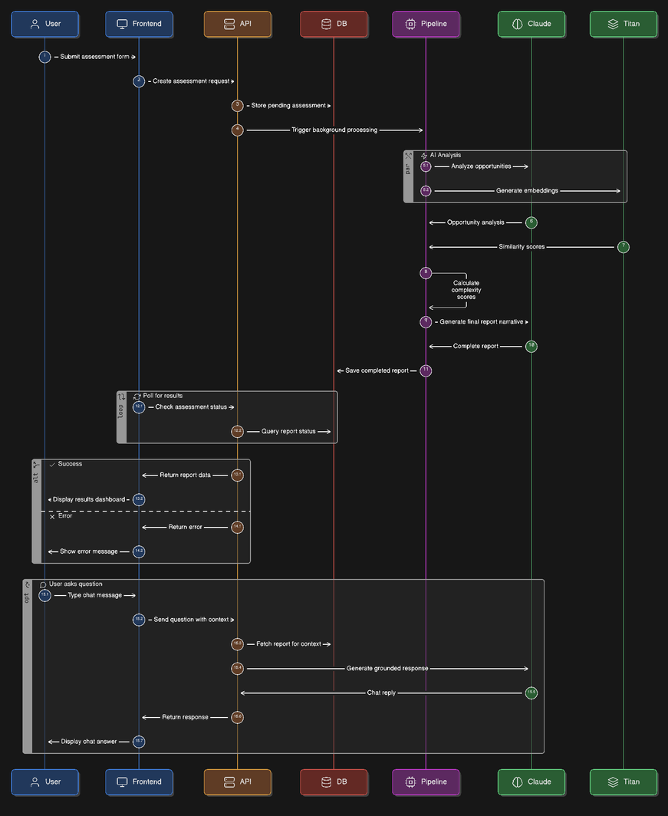
10
END-TO-END DATA FLOW
From blank form to chat reply
AI Readiness Decision Intelligence System · Zeb Fractal · AVASOFT Hackathon
10 / 12
Notes:
10

Slide 11
Thank You
AI Readiness Decision Intelligence System · with Report Assistant Chat
Claude 3.5 Sonnet
Amazon Titan
AWS Bedrock
FastAPI
React
+ Report Assistant Chat
Notes:
12

