Slide 1

#TidyTuesday women’s world cup
Presented by Josh Ganz, Julian Mucha, and Eric Rwabuhihi
Dataset: https://data.world/sportsvizsunday/womens-world-cup-data
Women's World Cup Outcomes
Squads
Codes
October 28, 2019

Slide 2
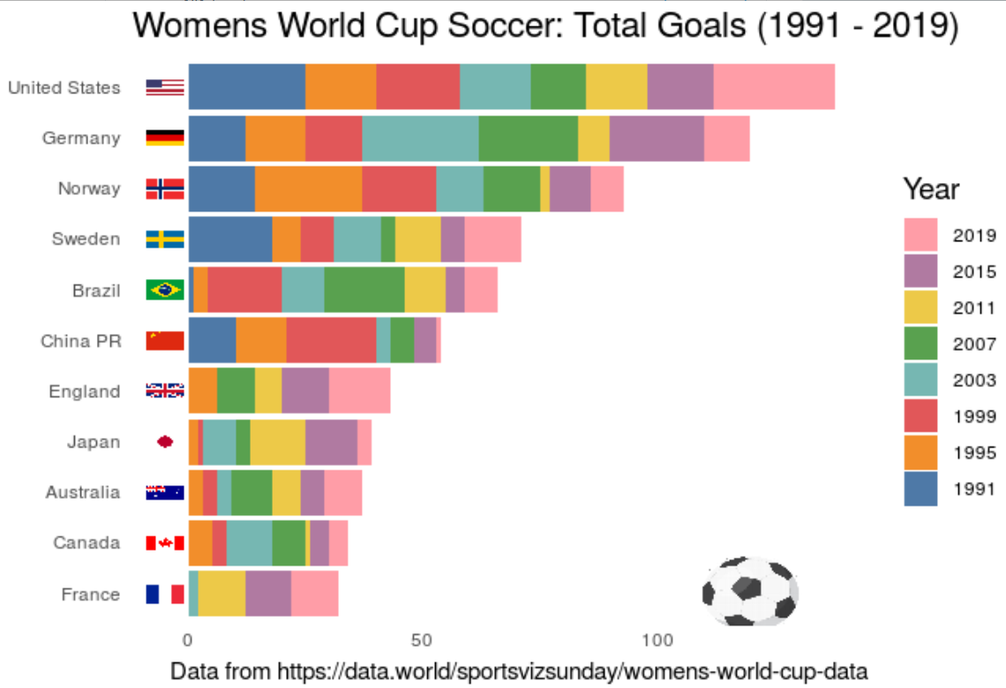
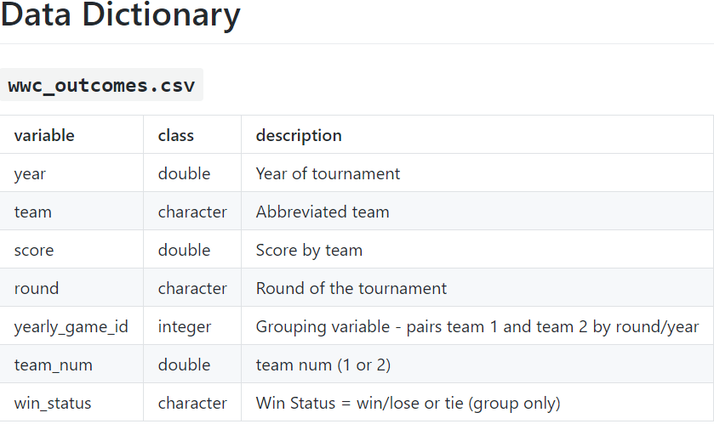
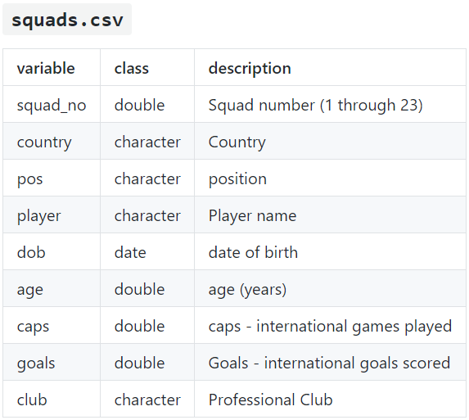
Dataset and Tidytuesday selection
Source: https://twitter.com/DrAmandaRP/status/1150976573421555717

Slide 3
Critique: Pros
Coordinate flip (C6, Wilke)
easy to read country names
Ordering of countries by bar size (C6, Wilke)
easy to visualize and compare which countries scored the most goals across all years combined
listed top/down from greatest to least
Qualitative instead of sequential color scale (C4, Wilke)
Source: https://twitter.com/DrAmandaRP/status/1150976573421555717

Slide 4
Critique: Cons
Color is overly visually stimulating; too many colors
“As a rule of thumb, qualitative color scales work best when there are three to five different categories that need to be colored. Once we reach eight to ten different categories or more, the task of matching colors to categories becomes too burdensome to be useful…” (C19, Wilke)
Difficult to compare goals from year to year between countries
Difficult to identify countries that missed the World Cup during specific years
Scale: the increment of the scale is too vast; makes it challenging to identify goals scored per a specific year and over all years
Flags are not scaled properly/necessary
Legend: should be ascending, not descending (left/right, top/down)
Source: https://twitter.com/DrAmandaRP/status/1150976573421555717

Slide 5
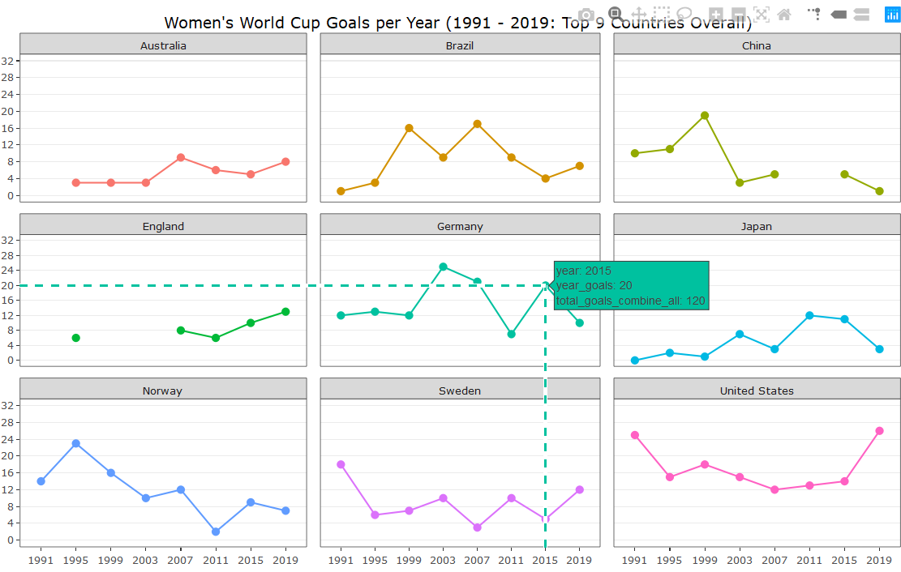
Modified selection
Line graph with points and facet wrap, replaced stacked bar graph (C5, Wilke)
cleaner look; less visually distracting
easier to see consecutive WC appearances and years when teams did not make the WC
Color represents country instead of year since there is no intrinsic order (C4, Wilke)
isolates focus to one country
Adjusted scale
improve visibility of goals scored per year
Gridlines
verticals removed to reduce additional distraction
horizontals remain to match a point to number of goals
Interaction
ggplotly allows for interaction and visual clarity of points using toggle spike lines and hovering information
Notes:
Chapter 4 – no intrinsic order
Chapter 5 Wilke - When the x axis represents time or a strictly increasing quantity such as a treatment dose, we commonly draw line graphs.

Slide 6
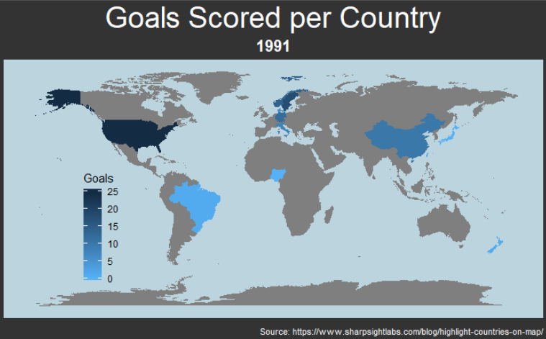
Future Visual
Make an interactive map
Dropdown menu
choose year of WC
choose country
Hovering information (per country)
total goals scored per year chosen
name of country
cumulative scored goals
Adds current year to prior years’ goals

Slide 7
References/sources
#TidyTuesday Selection
https://nsgrantham.shinyapps.io/tidytuesdayrocks/
Selected Women’s World Cup from dropdown menu to find graph to critique (Thank you Amanda Peterson Plunkett)
https://twitter.com/DrAmandaRP/status/1150976573421555717
Modified Selection
https://github.com/AmandaRP/tidytuesday/blob/master/2019/week28/fifa.R
Future Visual (map)
https://www.sharpsightlabs.com/blog/map-oil-production-country-r/
Sharp Sight
https://github.com/AmandaRP/tidytuesday/blob/master/2019/week28/fifa.R
Fundamentals of Data Visualization by Claus O. Wilke
https://serialmentor.com/dataviz/
Links to project
Rstudio.Cloud public link: https://rstudio.cloud/project/658002
GitHub: https://github.com/joshganz13/Womens-World-Cup.git
Twitter post: https://twitter.com/Jganz4/status/1188927316446941184

