Slide 2
Building the Node.js platform through open source partnership
Josh Gavant
Microsoft Program Manager
Node.js Technical Steering Committee Member

Slide 3
Agenda
Node.js – What and Why
History of Node.js (and Microsoft)
An API for SQL in ~10 LOC

Slide 4
What is Node?
A host for a JavaScript VM with an extensible set of builtin system libraries.
npm
node-
inspect
express
buffer
tls
dns
fs
zlib
JavaScript
Modules
child_
process
stream
events
http/
https
net
process
C++ Bindings
JavaScript VM
V8
libuv
cares
http_
parser
zlib
openssl
Native
Modules

Slide 5
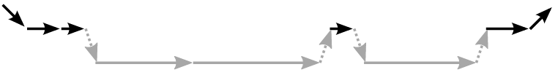
Why Node? Asynchronous, Evented I/O
synchronous
asynchronous
Node.js
from http://synsem.com/SyncNotAsync/
Notes:
From: http://synsem.com/SyncNotAsync/

Slide 6
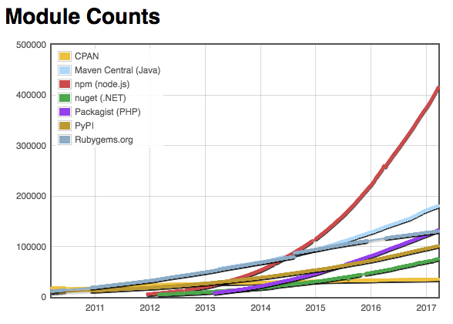
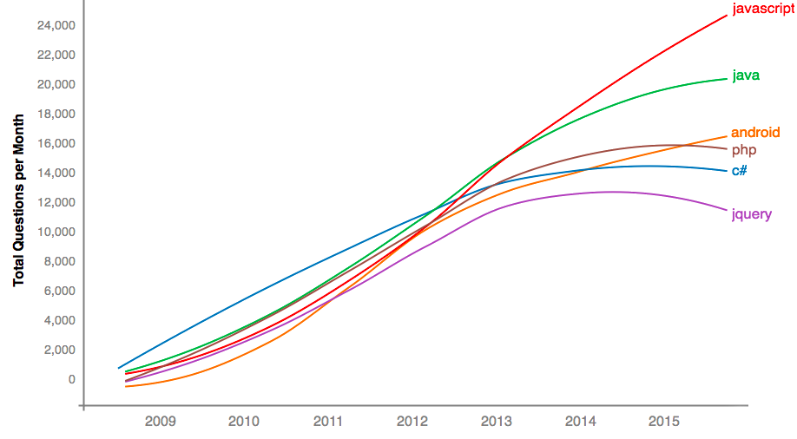


Why Node? JavaScript and npm
Stack Overflow Questions
Module Counts

Slide 7
A bit of history...

Slide 8


2010: npm package manager – sharing components through open source
2011: Node.js supported on Azure Web Apps – PaaS for Node
2009: Node.js introduced at JSConf.EU –async I/O
2011: Node.js ported to libuv & Windows

Slide 9
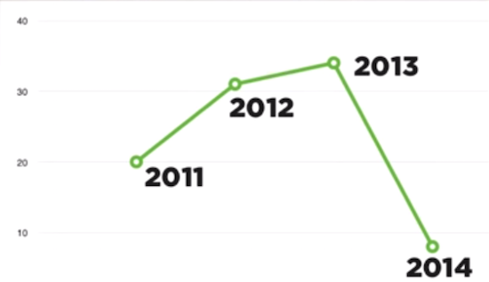






2014: Functions and Serverless – Node.js as a universal scripting language
2015: Node.js Foundation founded & io.js merged
2013: The “MEAN” stack – Node.js and NoSQL
2014: io.js – tension between rapid innovation and long-term stability

Slide 10
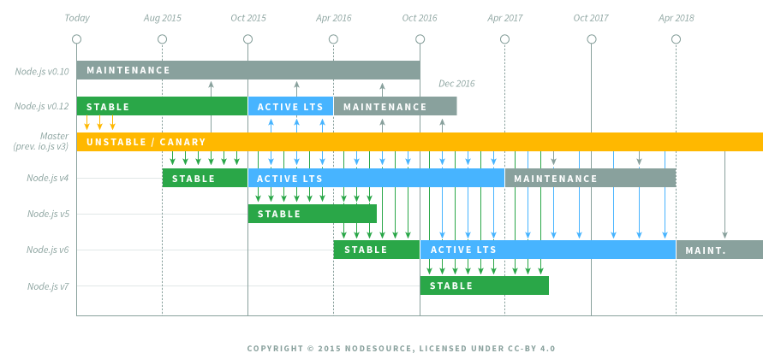


2016: Node-ChakraCore – bringing Node.js everywhere
2016: Diagnostics WG – New diagnostic capabilities
2015: First LTS release – Addressing stability needs
2016: VS Code 1.0 – Debugger for Node.js
Node.js
V8
ChakraCore
ChakraShim

Slide 11

2017 and beyond
Community
Node.js Developer Certification
Code-and-Learn
Diagnostics
Inspector
Trace Controller
Low-level tools
Native Node-API
Standard C and C++ APIs for JavaScript runtimes
HTTP/2
Security
Ecosystem vulnerability management
© Disney

Slide 12
An API for SQL in 10 LOC
Rapid development with Azure, VS Code, and Node.js

Slide 13
Resources
Azure: https://azure.microsoft.com/en-us/develop/nodejs
VS Code: https://code.visualstudio.com/docs/nodejs/nodejs-debugging
Demos
https://github.com/joshgav/node-sql-api
https://github.com/joshgav/demos
SDKs
Azure: https://github.com/Azure/azure-sdk-for-node

Slide 14
Notes:
Dark gray background.

