Slide 1
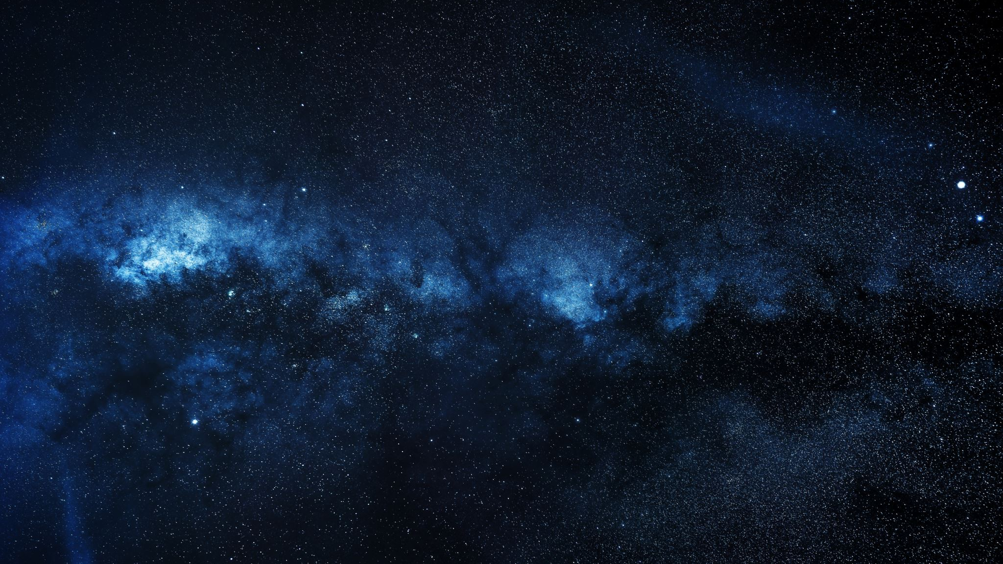


Knowledge Production in the Age of AI Astronomy, Noesis & The AI Co-Scientist
J G Weston, K Gibson
15th January 2026

Slide 2
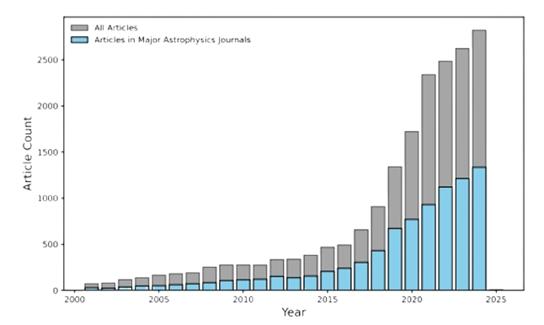
AI & Machine Learning in Astronomy
The new generation of astronomical sky surveys generate Petabyte-scale data that requires AI and ML to effectively analyse.
“The computational revolution continues to transform the conduct and culture of astronomy through the growing roles of large surveys and shared public data sets, big-team research, applications of machine learning, and numerical simulations, among others, and research investments will need to evolve to adapt to this changing landscape” - Pathways to Discovery in Astronomy and Astrophysics for the 2020s [2]
New collaborations and institutes have been formed to incorporate and develop the field of Astroinformatics.
1. Number of astrophysics articles containing the term “machine learning” by year [1].

Slide 3
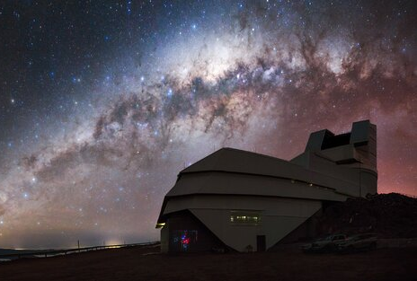
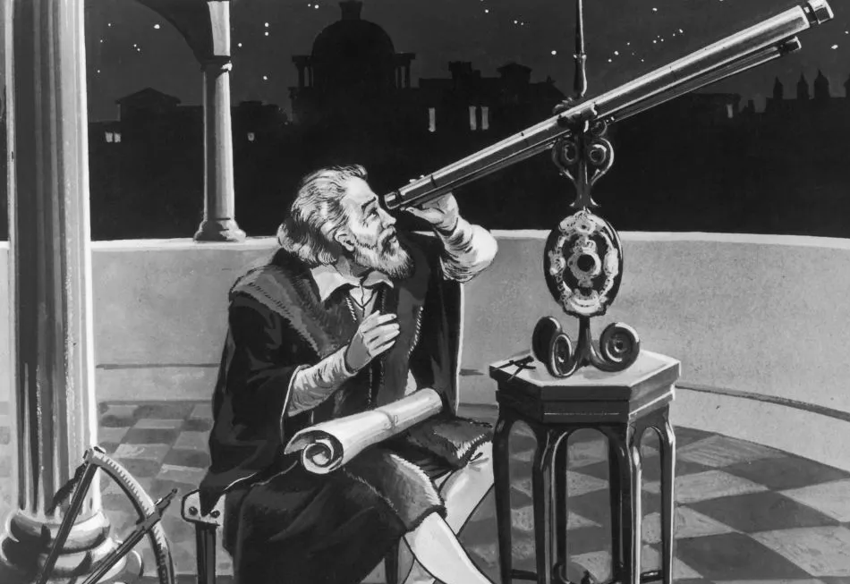
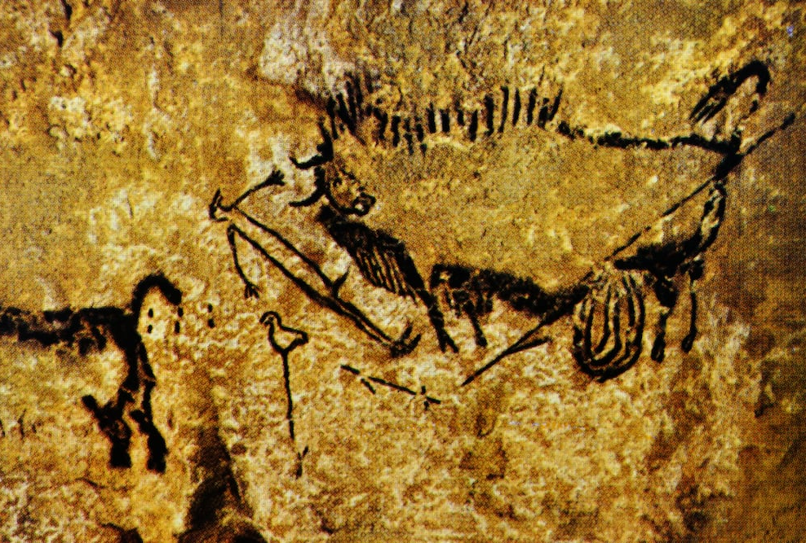
Exosomatization & Noesis
Exosomatization externalises operations of thinking into technics, which in turn creates new opportunities and priorities for evolution [3].
Vision is technically displaced when using survey telescopes: seeing is mediated through instruments that incorporate previous discoveries. In turn, the telescope reorganises human perception and cognition across new wavelengths and timescales.
Exosomatization partly performs noetic acts or noesis; the active process of thinking and understanding. Humanity is defined by this co-evolution with technics.
“Advances in theory and scientific computing directly enable analyses from current experiments and help to guide the design of future ones.” [2]
“The modern observations deprive all former writers of any authority, since if they had seen what we see, they would have judged as we judge.” [4]
“It is ‘Lascaux man’ about whom we can surely say, and for the first time that, making works of art, he evidently resembled us, he was one of us, our fellow man.” [5]
“Advances in theory and scientific computing directly enable analyses from current experiments and help to guide the design of future ones.” [2]
“The modern observations deprive all former writers of any authority, since if they had seen what we see, they would have judged as we judge.” [4]
“It is ‘Lascaux man’ about whom we can surely say, and for the first time that, making works of art, he evidently resembled us, he was one of us, our fellow man.” [5]
“Advances in theory and scientific computing directly enable analyses from current experiments and help to guide the design of future ones.” [2]
“The modern observations deprive all former writers of any authority, since if they had seen what we see, they would have judged as we judge.” [4]
“It is ‘Lascaux man’ about whom we can surely say, and for the first time that, making works of art, he evidently resembled us, he was one of us, our fellow man.” [5]
“Advances in theory and scientific computing directly enable analyses from current experiments and help to guide the design of future ones.” [2]
“The modern observations deprive all former writers of any authority, since if they had seen what we see, they would have judged as we judge.” [4]
“It is ‘Lascaux man’ about whom we can surely say, and for the first time that, making works of art, he evidently resembled us, he was one of us, our fellow man.” [5]

Slide 4
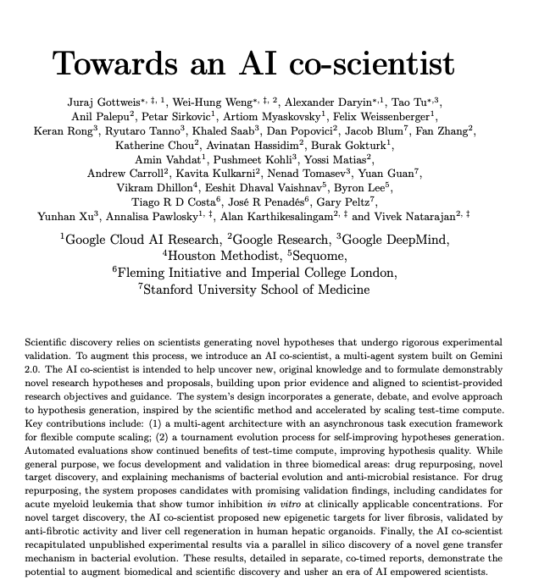
The AI Co-Scientist
AI Co-Scientists (AICS) [6] are a continuation of the exosomatization of noesis itself.
The rate of astronomical survey discovery with AICs outpaces the human ability to interpret and codify results.
AICS can be used to generate hypothesis and formulate logical flows for coding pipelines.
AICS can speed up the literature writing and reviewing process, accelerating the dissemination of information.
In this way AICS continue to reorganise scientific discovery.

Slide 5
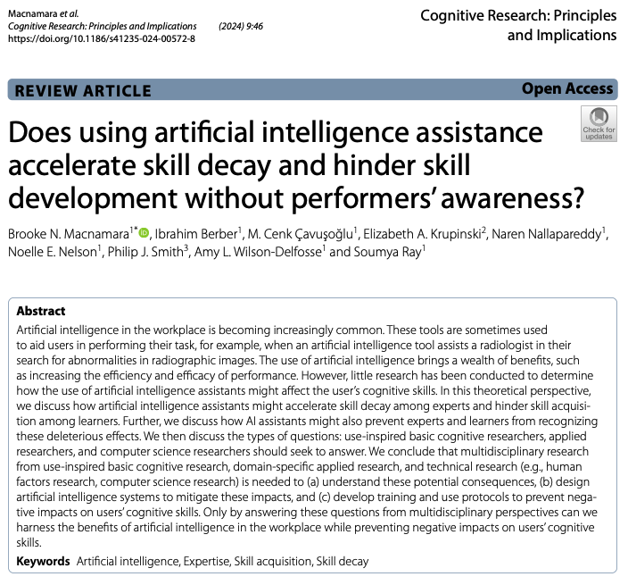
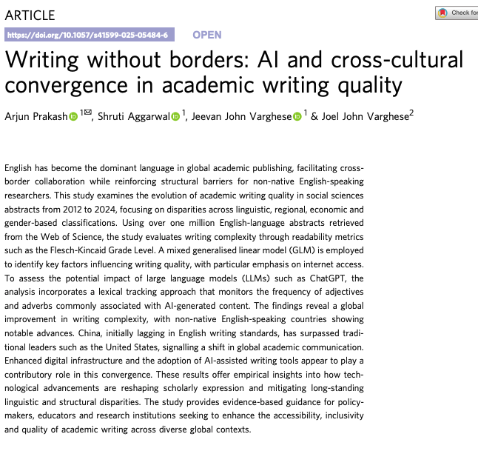
Collective Knowledge & Entropy
Collective knowledge is created when information can be transmitted, interpreted, and contested over a long period of time.
Entropy is used to describe the destruction or loss of the ability to produce collective knowledge; the breakdown of coherent thought, and the acceleration of disorder in systems of cognition, culture or economy.
This can happen when the human production of individual or collective knowledge is replaced by its artificial support - or an artificial intelligence - such that astronomers lose their interpretive agency, and can no longer participate in the production of knowledge themselves [7].

Slide 6
Negentropy in Astronomy
Full automisation isn’t possible in astronomy owing to the need for noesis. Likewise, full disautomisation is not possible – nor necessary.
Astronomers should develop ML technics with a negentropic mindset that seeks to increase the sharing of collective knowledge rather than reducing it [3].
“Ultimately understanding the connected cosmos through that “formalized curiosity” . . . requires more than big new machines. It requires people to translate observations into discoveries, theoretical studies to connect the observational clues, experiments in the laboratory and with the computer to interpret the data and the theory, and digital libraries of these precious data that meet the needs for the 21st century.”

Slide 7

Thank you!
[1] - Rodriguez, J.-V., Rodríguez-Rodríguez, I. & Woo, W.L. (2022) ‘On the application of machine learning in astronomy and astrophysics’, WIREs Data Mining and Knowledge Discovery, 12(5), e1476. doi:10.1002/widm.1476.
[2] - National Academies of Sciences, Engineering, and Medicine, 2021. Pathways to Discovery in Astronomy and Astrophysics for the 2020s. Washington, DC: The National Academies Press
[3] - Stiegler, B. (2018) Artificial stupidity and artificial intelligence in the Anthropocene. Lecture, Instituto de Ereignis, Shanghai.
[4] - Third letter on sunspots (December 1612) to Mark Wesler (1558 - 1614), as quoted in Discoveries and Opinions of Galileo (1957) by Stillman Drake, p. 134 – 135
[5] - Bataille, G. (1980) Prehistoric painting: Lascaux, or, the birth of art. Geneva; London: Skira ; Macmillan.
[6] - Gottweis, J. et al. (2025) Towards an AI co-scientist. arXiv:2502.18864.
[7] - Bishop, R. & Ross, D. (2021) ‘Technics, time and the internotion: Bernard Stiegler’s thought – a dialogue with Daniel Ross’, Theory, Culture & Society, 38(4), pp. 111–133.
LINAS PGR
Conference
Contact:
jweston04@qub.ac.uk

