Slide 1
Test
Driven
Development
Josh Go
@joshgogo

Slide 2
About Me
Studied CS and Math (a long time ago)
Worked in marketing w/ VB.Net/ASP
Currently working in finance:
C#
ASP.Net
JS - jQuery and AngularJS
C++, Java

Slide 3
Reasons for talk
Give back to tech community
Personal experiences
Bad - projects w/ no testing
Young me thought testing was boring
Worked on project that 90% SQL
Worked on web apps w/o proper layering
Good - projects w/ testing
AP system

Slide 4
Overview
What?
Who?
Why?
How? (Go over some code)

Slide 5
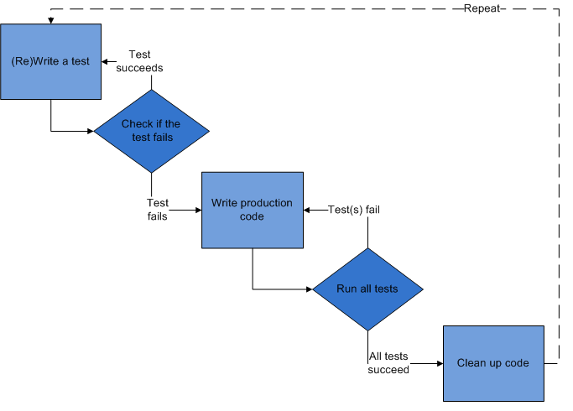
What is TDD?

Slide 6
Really … what is TDD? (cont’d)
Definition - A method of software development in which unit testing is repeatedly done on source code. (techtarget.com)
Unit Testing - Specify and test one point of the contract of single method of a class. (narrow scope)
Pass or Fail

Slide 7

Another way of looking at it …
Is f(x) equal to y, run it every code update
What is f
Could be a simple math function
Calculate temperature
Calculate stock index Ex:
Think of it as a black box
Underneath the system their could be 100s of parts
I.e. Car (Engine, Muffler)

Slide 8
Real life examples
College exams
Periodic testing by professor
Test if-else, class, inheritance
At the end of the semester you Pass or Fail
Hire a repair guy to fix washing machine
Power
Wash cycle
Dry cycle

Slide 9
Why should you use TDD?
Validation / Verification
Test the new feature is correct
Test the bug has been fixed
Clean layered code
Decoupling of classes
Injection (interfaces)
Feel confident
It’s better than writing a console app
Blame tests for bugs!!!

Slide 10
Why isn’t TDD taught in schools?
This is a good discussion for later with your professor!
Or ask me later

Slide 11
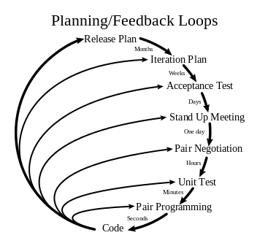
Who “invented” TDD?
Kent Beck
~ 1999 or early 2000s
XP Programming concept

Slide 12
How do you do TDD?
Add a test
Run test
If the test fails, then write some code
Repeat Step 2-3
If no test fails, then refactor (optional)
Lastly, it helps to have tools like NUnit, JUnit, XUnit

Slide 13
Let’s get to the code samples
1. Use Visual Studio 2010
2. HelloWorld, Add, Fib, Temp, Cards, Bank
3. Write a console to test it
4. Write a MSTest, NUnit

Slide 14
MSTest , NUnit, XUnit
MSTest | NUnit | XUnit
[TestClass] | [TestFixture] | n/a
[TestMethod] | [Test] | [Fact]
[TestInitialize] | [SetUp] | Constructor
[TestCleanup] | [TearDown] | IDisposable.Dispose
For more ...
http://xunit.codeplex.com/wikipage?title=Comparisons

Slide 15
Points / Tips
Initial development increase (15-35%)
Decrease bugs 40-90% …. it pays off!!!
Need: MSTest, NUnit, and XUnit
Build systems help enforce
Jenkins
Travis
Testable code (Dependency Inversion)
Bug … write a test immediately
Bug == Feature

Slide 16
More points … next steps
Dive deeper into testing
Test your code
All software projects should have unit tests
Dive deeper into SOLID principles
Code contracts
Learn about agile methodologies
Go to Github and look at some unit test
CSVHelper !!!

Slide 17
Digging deeper into testing ….
Unit test
Specify and test one point of the contract of single method of a class. (narrow scope)
Integration test
Test the correct inter-operation of multiple subsystems.
Regression test
A test that was written when a bug was fixed
Acceptance, Smoke, Performance, etc.

Slide 18
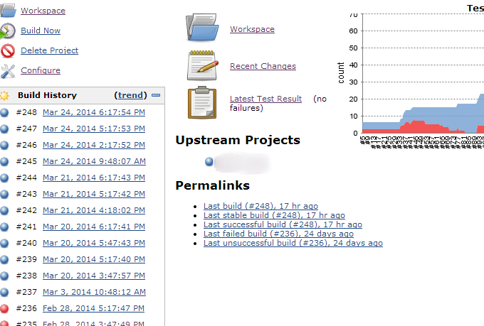

Slide 19
SOLID principle
- Single responsibility
- Open/Closed
- Liskov Substitution
- Interface-segragation
- Dependency inversion

Slide 20
Why isn’t TDD taught in schools?
This is a good discussion for later with your professor!
Ask me later

