Slide 1
Project OASIS

Slide 2
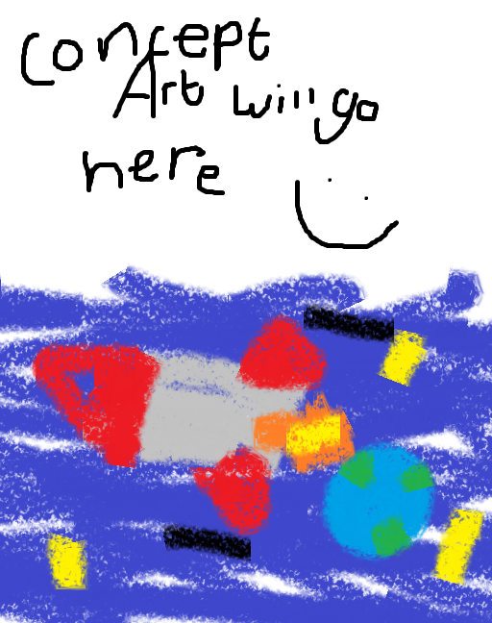
Planet Earth
In a future quite some time from now, Earth has made a lot of advances in technology – however, not all was at peace, as a Great World War broke out on the planet. This resulted in many deaths, and ultimately the planet itself becoming uninhabitable.
In response to this, a plan was formed to scope out a new planet for humanity to live on, and move as many of the survivors to this new world.
As this plan was the last hope for humanity’s survival, it was dubbed Project OASIS – and the gigantic spaceship that humanity would ride into the future would also be named as such.

Slide 3
OASIS
OASIS is the name of the ship used in Project OASIS – it is intended to fit a large quantity of people, and to store a lot of resources used to allow humanity to flourish on their new, arid home.
However, an accident occurred while landing, and the ship made a tragic plummet to the surface of O’siri, the planet they were meant to call home.
In the landing, many parts of the ship were scattered across the land, leaving both resources and people alike missing, or perhaps even lost.

Slide 4
Planet O’siri
Planet O’siri was scoped out as a new home for humanity due to its atmosphere and lifeforms being relatively safe for humanity to inhabit and exist with.
Despite this, it is a planet with very little in the way of variety – it’s deserts all the way down, really. In response to this, OASIS prepared technology to terraform the planet, but a lot of this went missing in the crash, and it is the main priority of the survival effort to reclaim this.
On top of this, O’siri is home to a lot of hostile and territorial creatures, and there are hints that humans are not the first spacefaring species to call this dusty planet their home…

Slide 5
Survival
Now trapped on a new planet, humanity must survive for themselves and try and reclaim what was lost in the crash. A base camp has been formed at the main crash site, with impromptu homes being made out of ship parts or whatever can be found.
The game’s story begins a while after the crash, as you are discovered by a group of people whose job it is to recover that what was lost in the crash.
However, many people are scattered around the planet, and not all of them will be on your side. Not only this, but monsters are a constant threat as well.

Slide 6
The Future?
Moving into the future, the player may face many different obstacles through the story – rogue factions of humanity, remnants of the planet’s previous inhabitants, and more…
You may unlock the secrets of the planet’s former history, which tell of a once flourishing civilization on the planet that left for similar reasons to humanity.
Ultimately, your final goal will be to recover as much as was lost in the crash as possible – all while discovering new possibilities, and potentially new allies, that will help you along the way.

Slide 7
The Past
The great planet of O’siri was inhabited by a brilliant alien race, who lived in underground bunkers that were concealed for many years.
The crash of the Oasis caused many of these bunkers to be unearthed in various places, and may form extra areas to explore.
On top of this, they created many pieces of great technology, and some of these might have been reawakened – things such as ancient computer systems, that could be as helpful as they could be deadly…
It is possible that the desert state of O’siri is because of a war in the past that was much like the one that ravaged the Earth, and before that point it was a luscious planet…

