Slide 1
Team 11
Alireza Bahremand
Cecilia La Place
Joshua Hewlett
Paul Horton

Slide 2
Language: AH-J
This language is modeled after day-to-day communication methods.
Inspired by the in-class communication between Dr. Bansal and Xiangyu
Reformatted to create an epistolary language
Strongly typed to enforce security & maintainability of the language.
This language is best for those with an understanding of:
English grammar
Email/letter writing

Slide 3
Grammar
AH-J follows a pattern-like structure that is representative of the English language.
Commands are portrayed as common English-phrase-directives.
Declarations are conveyed as statements separated by periods.
Structure | AH-J Syntax
Program opening block, Open body code block Declaration Command Command Close body code block Program closing block. | Salutations Xiangyu, Would you mind doing the following: Create the variable n. Assign the integer n to the value of 1. Assign the integer n to the value of n + 3. Thank you. Sincerely, Ajay Bansal

Slide 4
Grammar
AH-J Syntax | Code Comparison
Salutations Xiangyu, Would you mind doing the following: Create the variable soft. Assign the boolean foft to the value of 0. Should it be the case foft EQUALS 0 please Would you mind doing the following: Assign the integer soft to the value of 4 * 3. Thank you. otherwise Would you mind doing the following: Please reply with the value of foft. Thank you. that is all. Thank you. Sincerely, Ajay Bansal | Salutations Xiangyu, { body { var soft; var foft = 0; if (foft == 0) { soft = 4 * 3; } else { print(foft); } } }
The grammar of AH-J is comprised of 2 entities, declarations & commands.
Declarations initialize variables for the runtime environment.
Commands perform logical & arithmetic operations on variables.
Commands include conditional statements, while loops, expressions, and nested blocks of code.

Slide 5
Compiler: Parser
DCG
program(t_prog(K)) --> ["Salutations", "Xiangyu,"], list(K), ["Sincerely,", "Ajay", "Bansal"]. list(t_list(D, C)) --> ["Would", "you", "mind", "doing", "the", "following:"], declaration(D), block_command(C), ["Thank", "you"], ["."]; ["Would", "you", "mind", "doing", "the", "following:"], declaration(D), command(C), ["."], ["Thank", "you"], ["."]. list(t_list(C)) --> ["Would", "you", "mind", "doing", "the", "following:"], block_command(C), ["."], ["Thank", "you"], ["."]; ["Would", "you", "mind", "doing", "the", "following:"], command(C), ["."], ["Thank", "you"], ["."].
Using Prolog, AH-J is first tokenized by checking for
Spaces
Newlines
AH-J is then parsed using Prolog’s DCG functionality in order to ensure
Enforcement of type security
Syntax validation
The parse tree is then generated in the event of successful compilation.
DCG

Slide 6
Intermediate Code: Parse Tree
AH-J Syntax | Parse Tree
Salutations Xiangyu, Would you mind doing the following: Assign the integer c to the value of 7. So long as NOT c EQUALS 5 please Would you mind doing the following: Assign the integer c to the value of c - 1. Thank you. your iterations are appreciated. Thank you. Sincerely, Ajay Bansal | t_prog(t_list( t_command( t_id(c),t_term(t_factor(t_num(7))), t_block_cmnd(t_while(t_exp_not(t_exp_eq(t_term(t_factor(t_id(c))),t_term(t_factor(t_num(5))))), t_list(t_command(t_id(c),t_minus(t_term(t_factor(t_id(c))),t_term(t_factor(t_num(1))))) )) ) ))

Slide 7
Runtime: Interpreter
The interpreter for AH-J is written in Prolog and takes the parse tree as input and uses the parameters of each node of the parse tree to perform the desired functionality in Prolog.
The control structure of the final program is determined by the sequence in the parse tree.
Conditional blocks, such as while and if, are accomplished by evaluating boolean expressions and executing the correct data path.
Environment variables are collected through the execution and are output at the end.

Slide 8
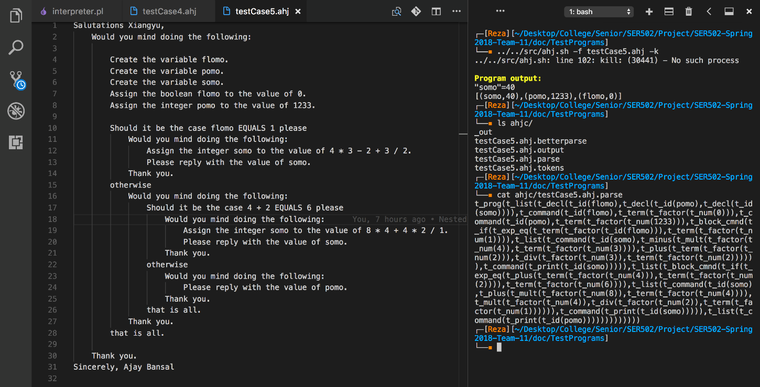
Screenshot
Compiling language for parsing and interpreting

