Slide 1
Basic Autoencoder

Slide 2
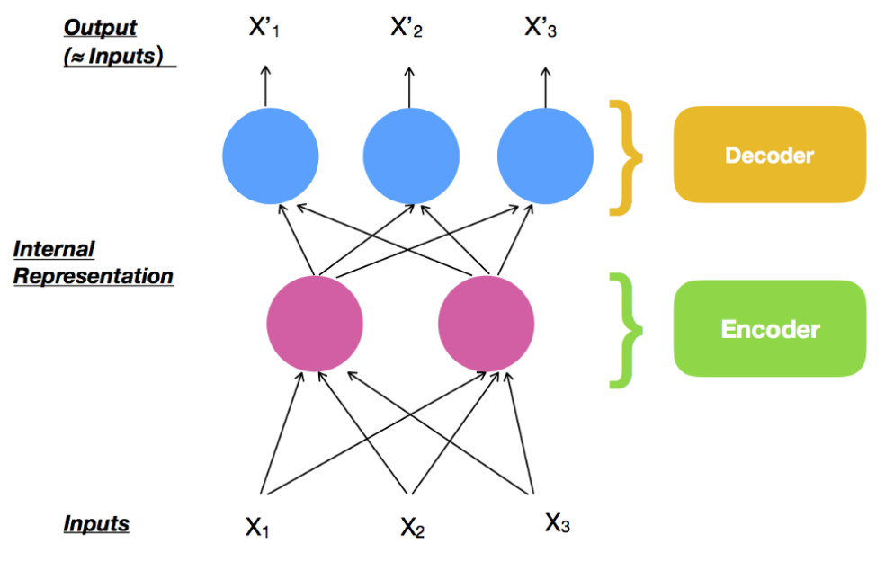
Undercomplete AutoEncoder
Notes:
What is ML?

Slide 3
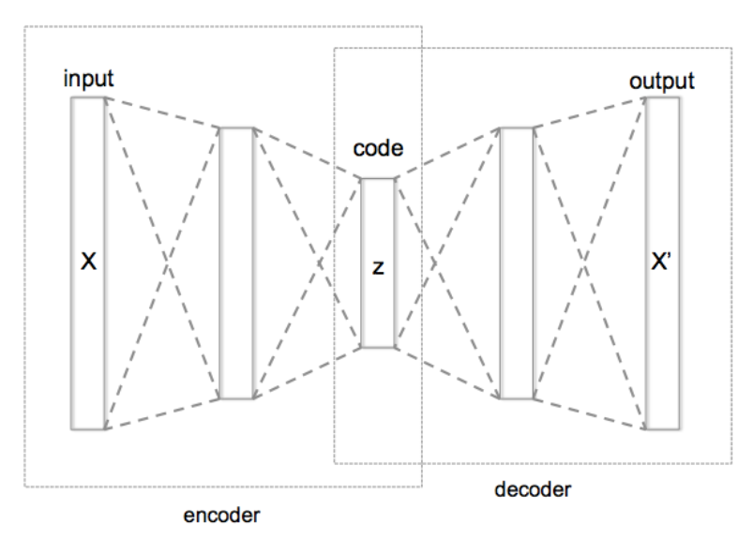
Stacked Autoencoder
Notes:
What is ML?

Slide 4
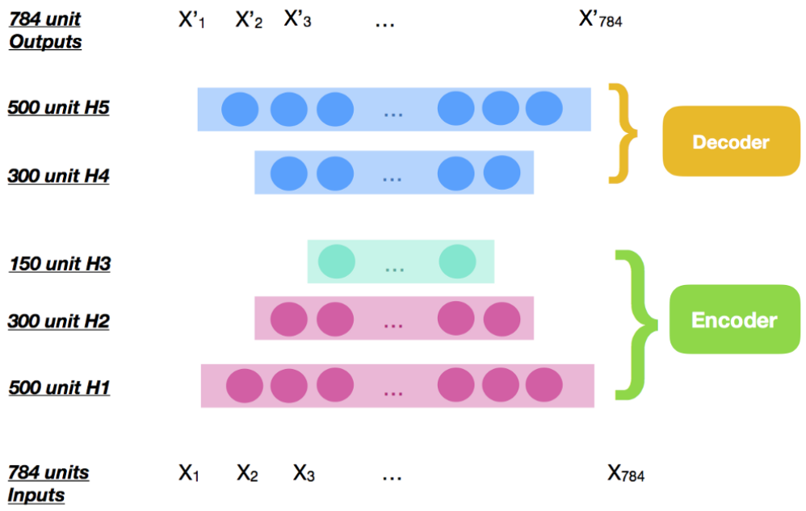
MNIST example
Notes:
What is ML?

Slide 5
Autoencoder
Input layer
Encoder layers
Coding layer(in the middle)
Decoder layers(same number as encoder layers)
Output layer(same number as Input layer)

Slide 6
Input Layer
Like normal neural network layer
No labeled data
Weights and biases
Will be down-sampled
Notes:
What is ML?

Slide 7
Encoder Layers
Dimension reduction
Feature extractor
Input layer data is ‘compressed’
Representing higher level features
Notes:
What is ML?

Slide 8
Code Layer
The very condensed features of the Input.
Can be used to ‘reproduce’ an output
Generative model
Notes:
What is ML?

Slide 9
Decoder Layer
Use features that learned in the encoder layers
Reproduce new features
Create similar results
Notes:
What is ML?

Slide 10
Output Layer
Output from decoder layers
Use the values to compare with the Input
Use loss function to reduce the difference
Unsupervised learning
Notes:
What is ML?

