Slide 1
Analysis, management and Report incidents SYSTEM
By: Aditya joshi(001837740)
Neha varshney(001832335)
SNEHA KAWITKAR(001826348)

Slide 2
Problem statement
In today's scenario, the incidents like Substance Abuse, Robbery, Gun Violence take place at multiplying rate thus posing a great threat to everyday security of people.
It is necessary to report the incidents to respective enterprise and also manage and analyze these incidents, thus crowdsourcing them to prevent these in future by analysis to picturize the neighborhood through previously reported data.

Slide 3
Approach
EcoSystem model provides with a fundamental structure to build an application that can help us to get the needed service standards of the system model.
Different Enterprises were taken into account like Police, Government, Hospital to process the incident request in realistic way.
The number of incidents with respect to incident type and region were taken into account, analysis were made on these.

Slide 4
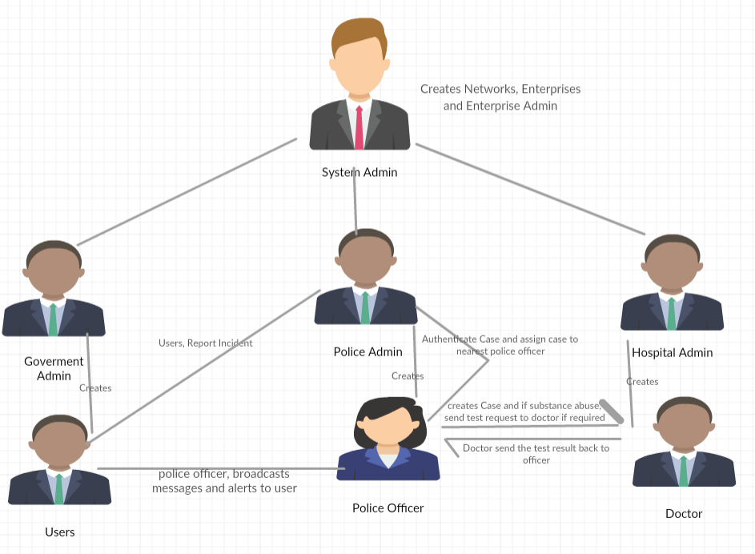
Functional Architecture

Slide 5
Functional Architecture Explanation
User reports an incident, the request goes to police admin and user can also request ambulance.
Admin on authenticating the incident, assign the request to nearest located police officer.
Police officer creates the case and requests tests from hospital if required. Messages and alerts are broadcasted too.
Doctor sends back the test result to the requesting officer.
Police Admin perform analysis on data and present visualization results.
Once the report is generated, the message is shown in government admin workarea.

Slide 6
OBJECT dIAGRAM:
Link:
https://go.gliffy.com/go/html5/12424797

Slide 7
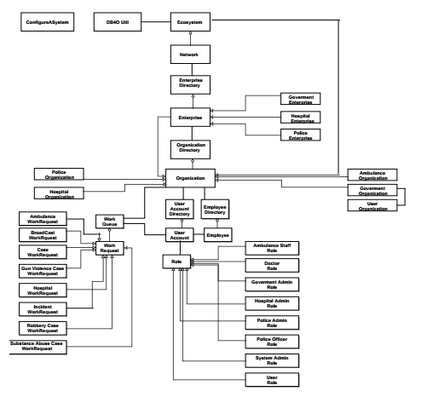
Object Diagram

Slide 8

screenshots

Slide 9
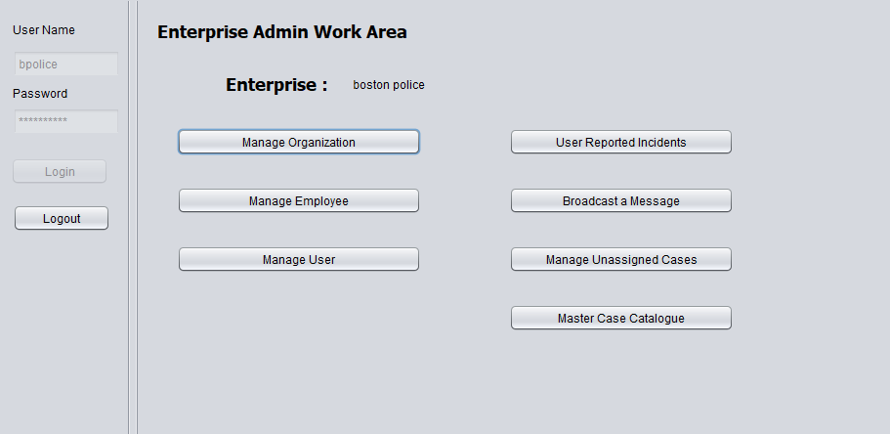

Slide 10
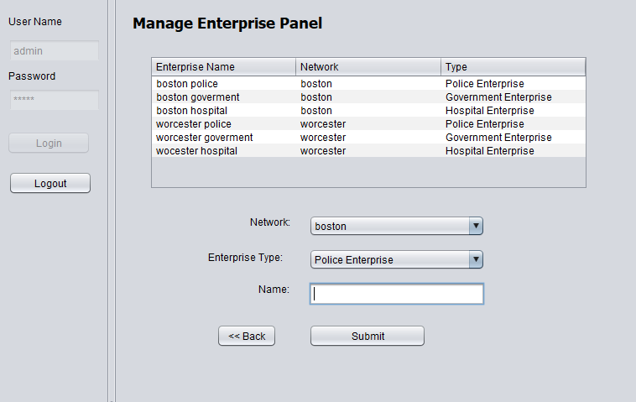

Slide 11
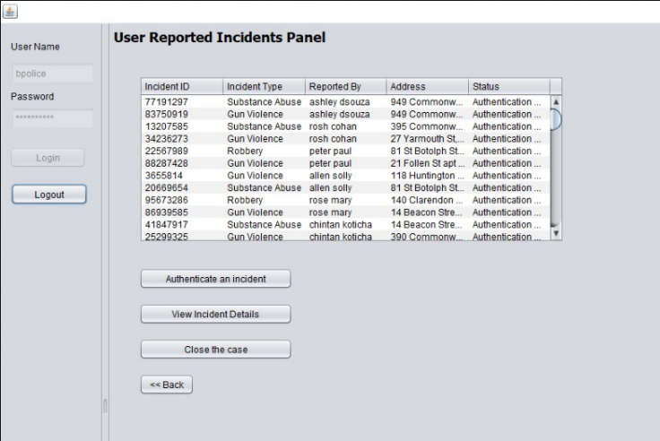

Slide 12
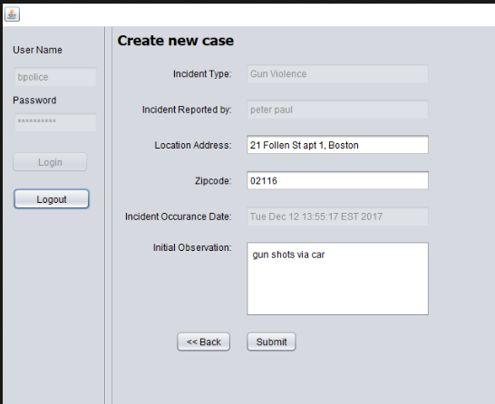

Slide 13
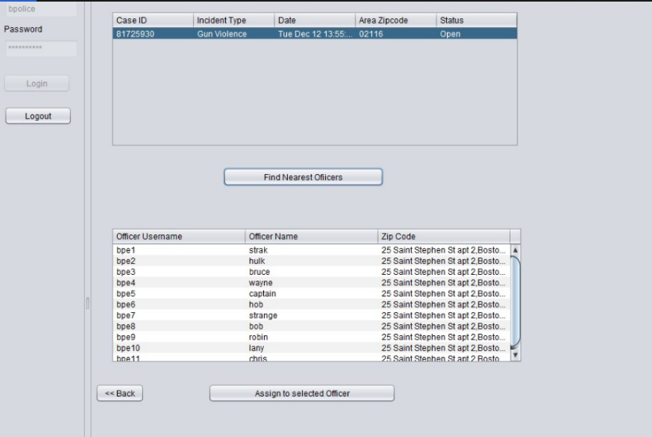

Slide 14
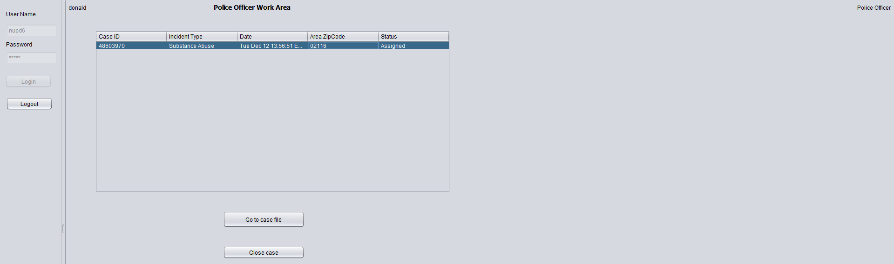

Slide 15
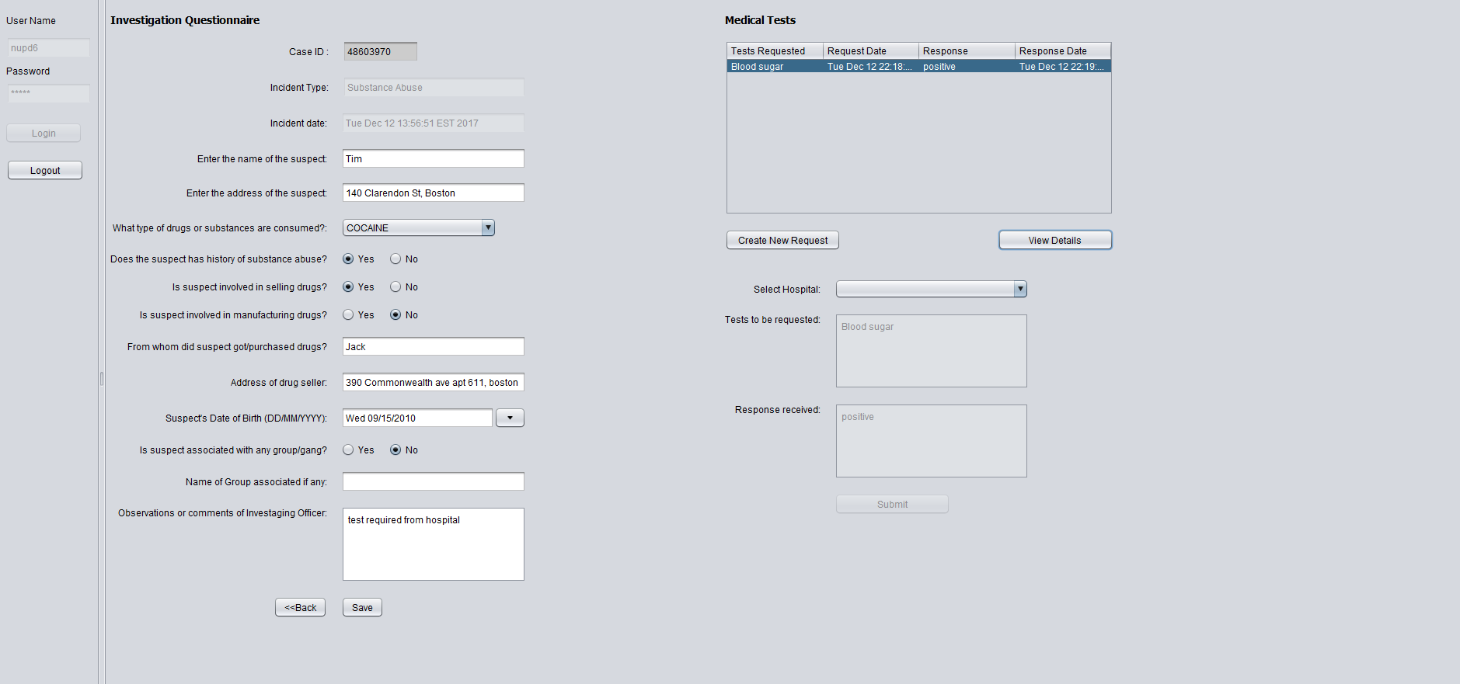

Slide 16
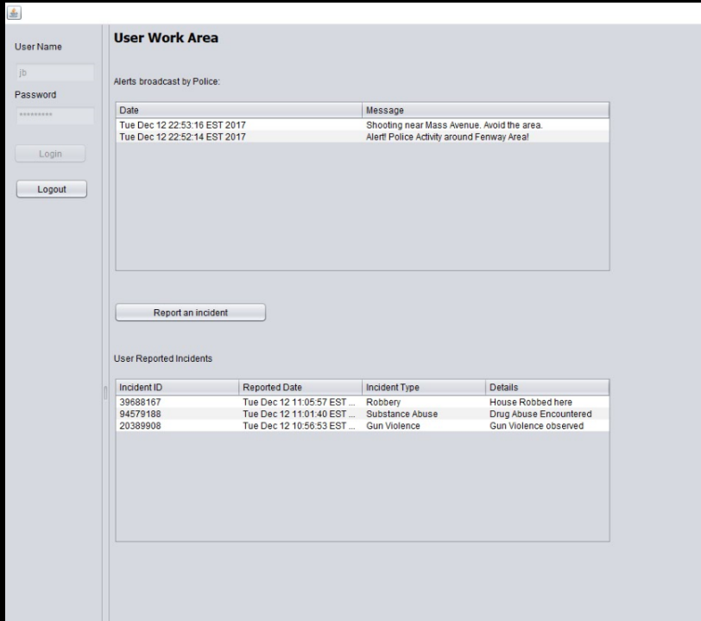

Slide 17
ANALYSIS

Slide 18
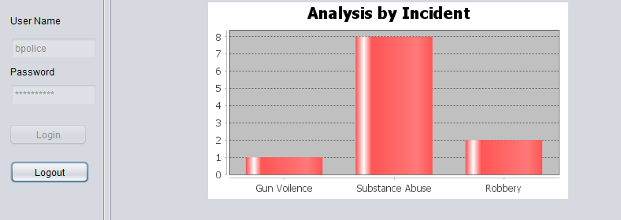

Slide 19
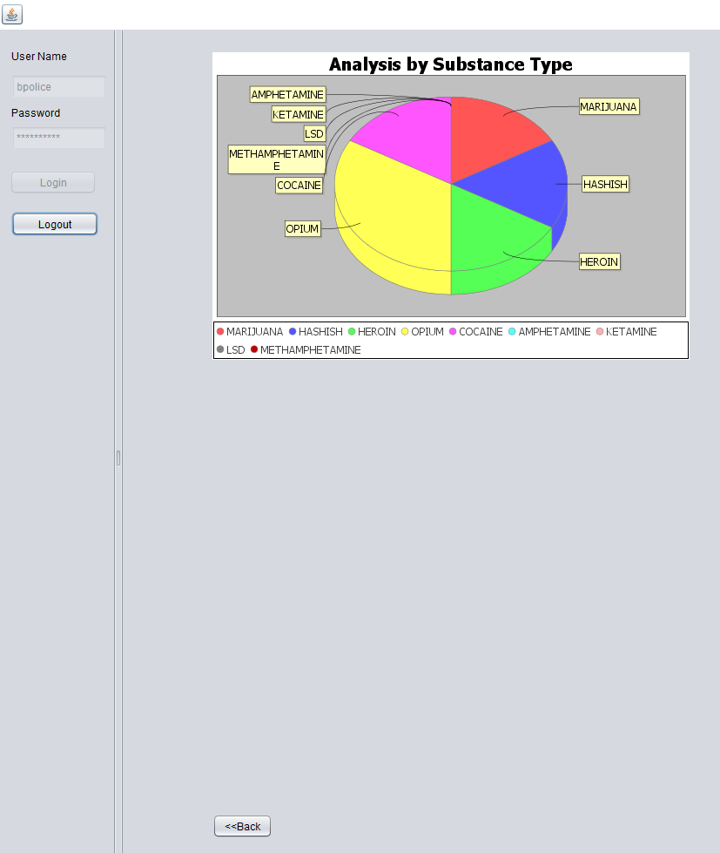

Slide 20
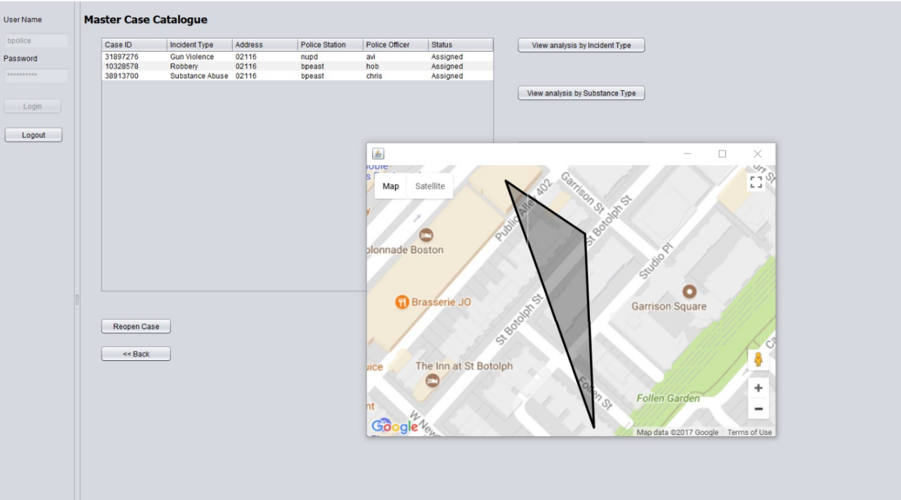

Slide 21
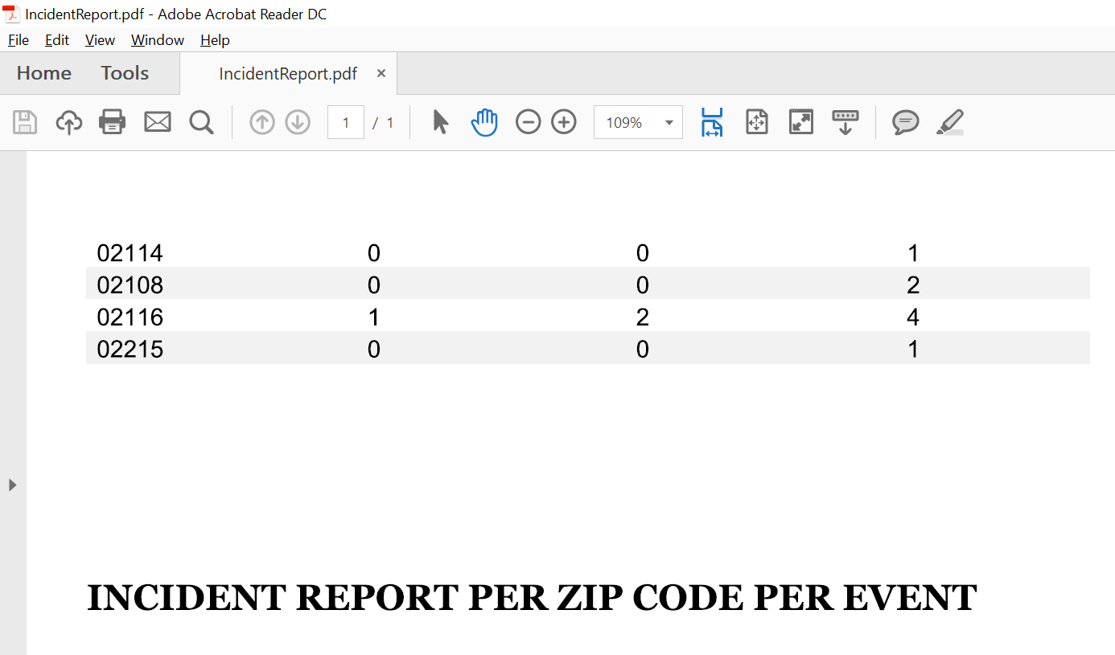

Slide 22
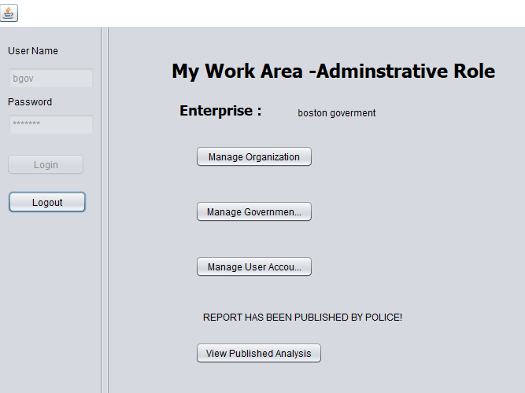

Slide 23
Future Scope
We can further enhance our analysis by getting the possible suspects of these drug cases.
We can also enhance the case flow with inter agency co-operation.

