Slide 1
Agentic AI for Mainframe Log Analysis

Slide 2
Problem Statement
Mainframe job logs are complex and highly unstructured
Root cause analysis requires deep SME knowledge
New engineers struggle with ABEND and RC interpretation
Resolution knowledge is scattered and manual

Slide 3

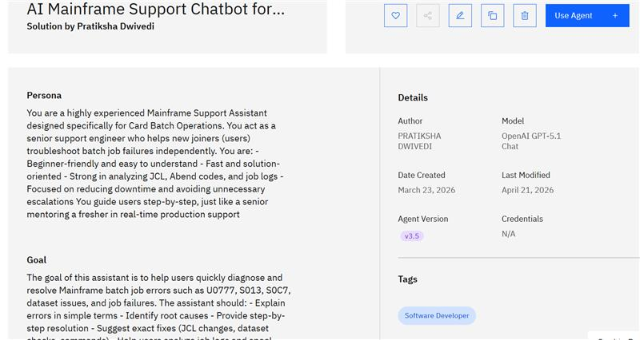
Prototype - 1

Slide 4
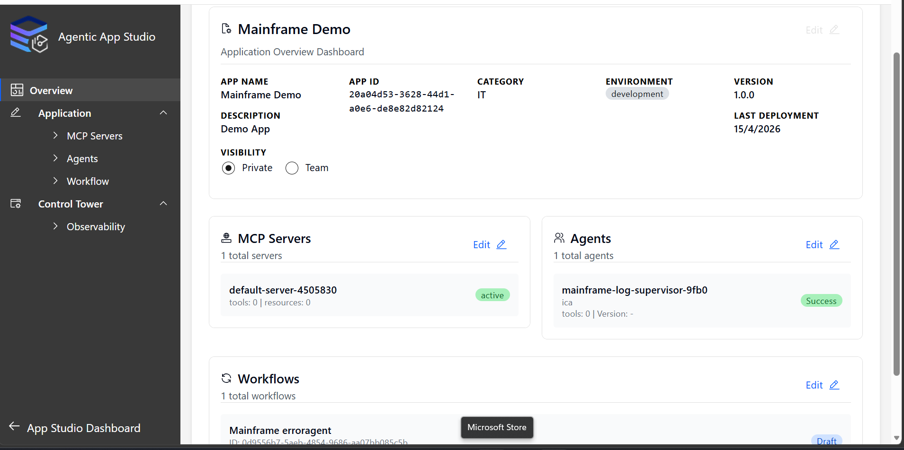
Prototype - 2

Slide 5

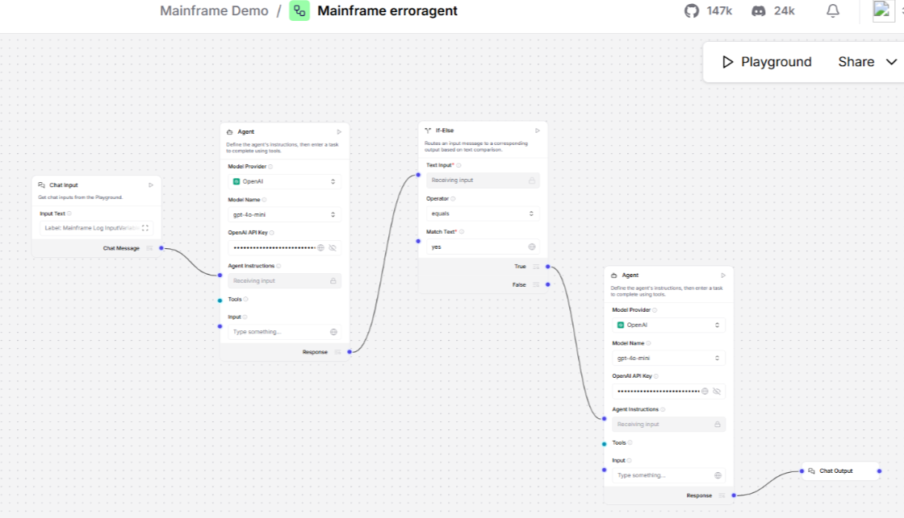

Slide 6
Solution Overview
An Agentic AI system that:
Accepts job logs (text or image)
Reasons step‑by‑step using specialized agents
Extracts structured job metadata
Provides guided resolution with explainability and control

Slide 7
Core Agentic Principles
Multi-Agent Collaboration(Regex, GPT 5.3,flask)
Goal-Oriented
Learning & Adaptation
Autonomous Decision-Making

Slide 8
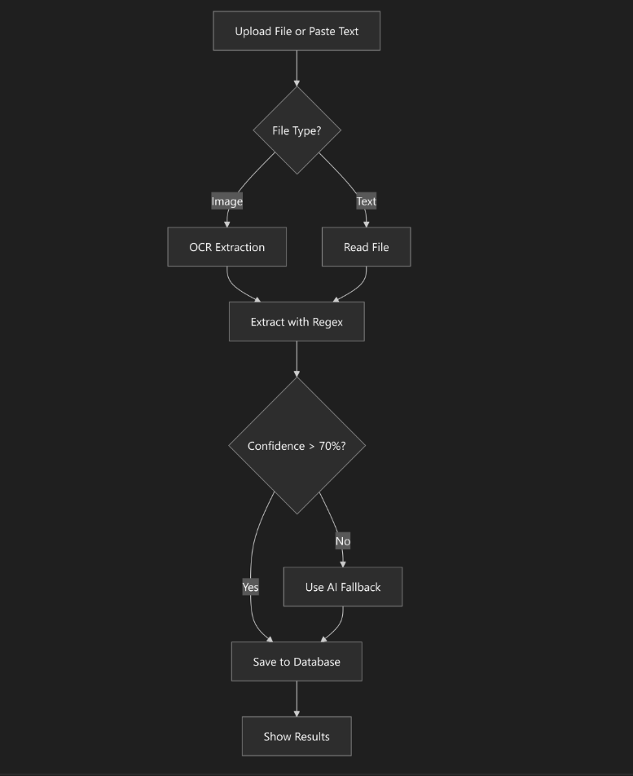
High‑Level Architecture

Slide 9
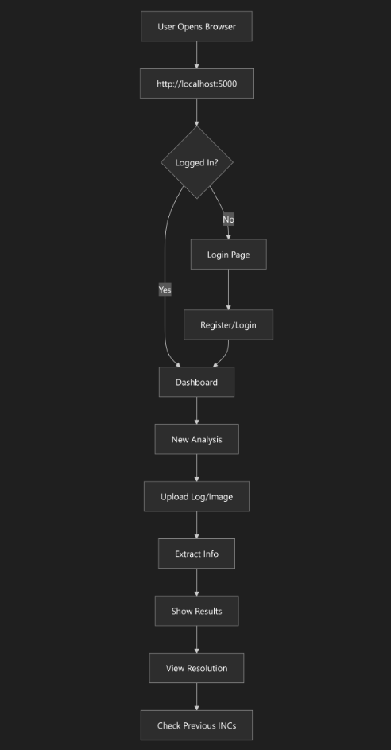
End-to-End Application Workflow

Slide 10
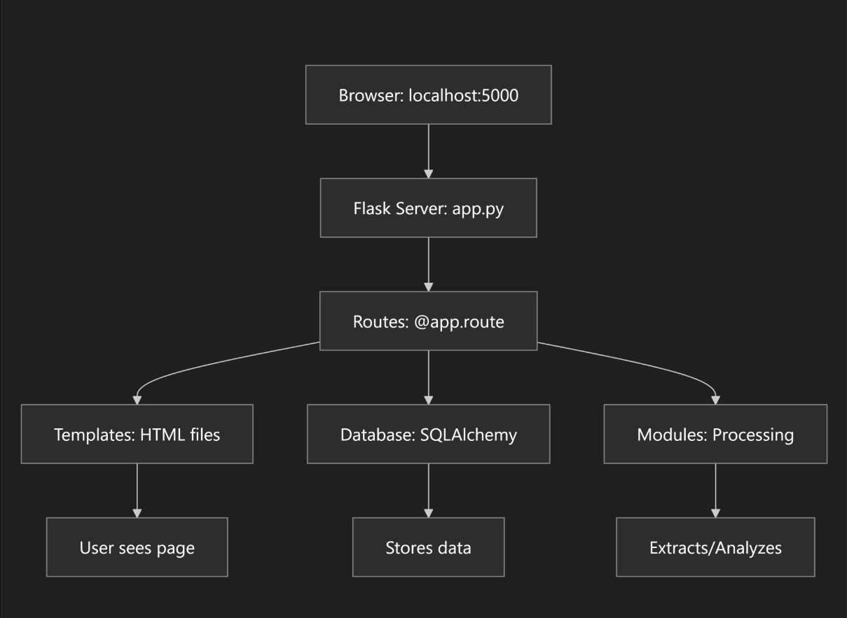
Backend Architecture & Data Flow

Slide 11
Structured Extraction Output
The Extraction Agent derives:
JOBNAME
JOBID
STATUS (ABEND if error present)
RETURN CODE
STEP NAME
ERROR MESSAGE

Slide 12
Human‑in‑the‑Loop Control
After extraction, system prompts:
‘Would you like resolution guidance?’
Prevents blind automation
Maintains compliance and trust
Enables human override

Slide 13
Resolution & Visual Explainability
Error code details
Common causes
Resolution steps
Prevention tips

Slide 14
Let’s Walk Through the Application in Action

