Slide 1
R to Powerpoint
Mark Niemann-Ross

Slide 2
Table of Contents
Here’s a picture
This slide has two columns
Slide with Bullets
Slide with R Output
Slide with data.frame
Slide with Plot

Slide 3
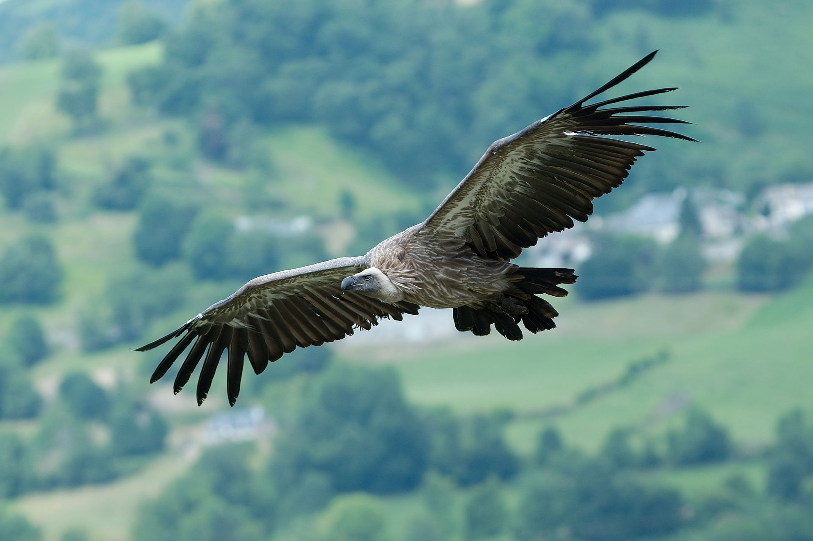
Here’s a picture
Griffon Vulture in France
Notes:
This photo was taken by Luc Viatour
It is a Griffon Vulture
It was taken in France (Pyrénées)

Slide 4
This slide has two columns
This photo was taken by Luc Viatour
It is a Griffon Vulture
It was taken in France (Pyrénées)
Griffon Vulture in France

Slide 5
Slide with Bullets
Bullet 1
Bullet 2
Bullet 3

Slide 6
Slide with R Output
summary(cars)
## speed dist ## Min. : 4.0 Min. : 2.00 ## 1st Qu.:12.0 1st Qu.: 26.00 ## Median :15.0 Median : 36.00 ## Mean :15.4 Mean : 42.98 ## 3rd Qu.:19.0 3rd Qu.: 56.00 ## Max. :25.0 Max. :120.00

Slide 7
Slide with data.frame
weight | Time | Chick | Diet
42 | 0 | 1 | 1
51 | 2 | 1 | 1
59 | 4 | 1 | 1
64 | 6 | 1 | 1
76 | 8 | 1 | 1
93 | 10 | 1 | 1

Slide 8
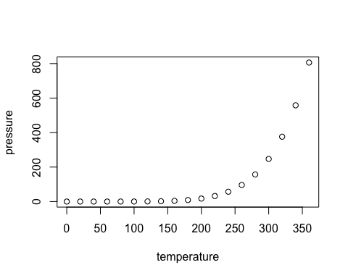
Slide with Plot

